Slide 1
WEEK 5 – Auxiliary Projection
Very Import, Please Pay Close Attention!

Slide 2
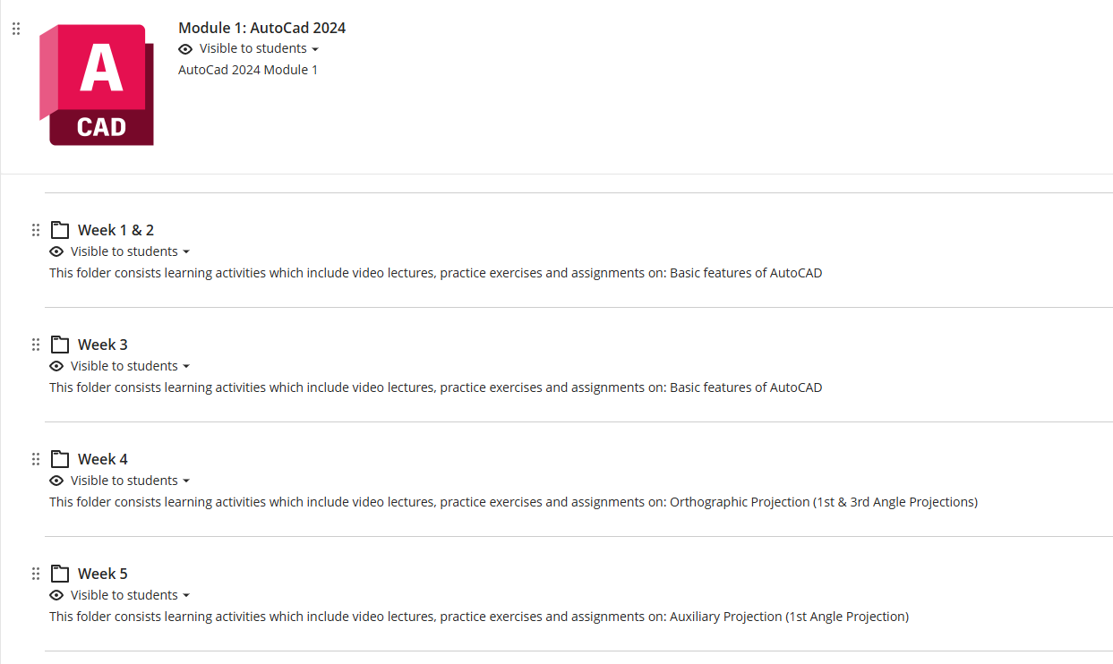
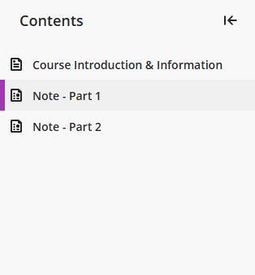
WEEK 5 – Auxiliary Projection – Self-learning

Slide 3
WEEK 5 – Auxiliary Projection – Assignments
Finish – E9, E10, E11
Submit – E10

Slide 4

WEEK 5 – Auxiliary Projection – Recap
First Angle Projection
Third Angle Projection

Slide 5
WEEK 5 – Auxiliary Projection – Terms
First (Primary) Auxiliary Projection: A view projected onto a plane that is perpendicular to one principal view, used to show an inclined surface in its true size and shape.
First / Primary: The projection obtained by rotating once from a principal view (front, top, or side). NOT First Quadrant/First Angle Projection.

Slide 6
WEEK 5 – Auxiliary Projection
First Auxiliary Plan (using 1st Angle Projection)
https://www.youtube.com/watch?v=xPUgz6Pj0ds&list=PLILX3iYME5rHp4AplmfQXYfMYkzTCIVat&index=73
First Auxiliary Elevation (using 1st Angle Projection)
https://www.youtube.com/watch?v=Q8YeCa0tB0I&list=PLILX3iYME5rHp4AplmfQXYfMYkzTCIVat&index=76

Slide 7
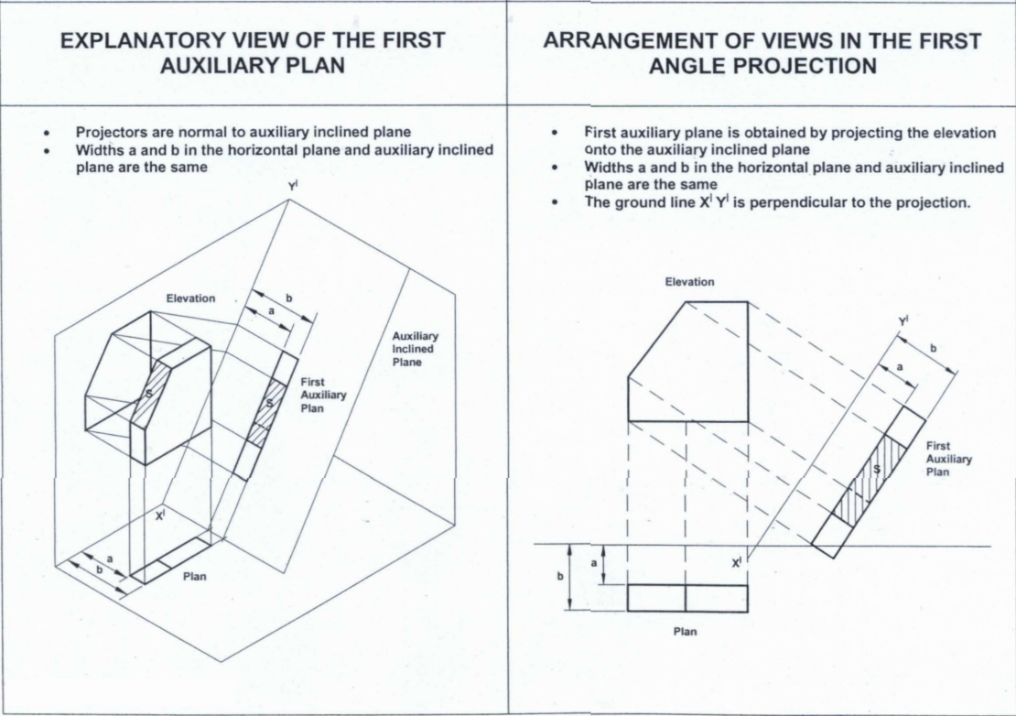
WEEK 5 – Auxiliary Projection – Auxiliary Plan
Some Kind of Plan:
– More Like Plan
– Projected from Elevation View (i.e. Perpendicular to Elevation View)

Slide 8
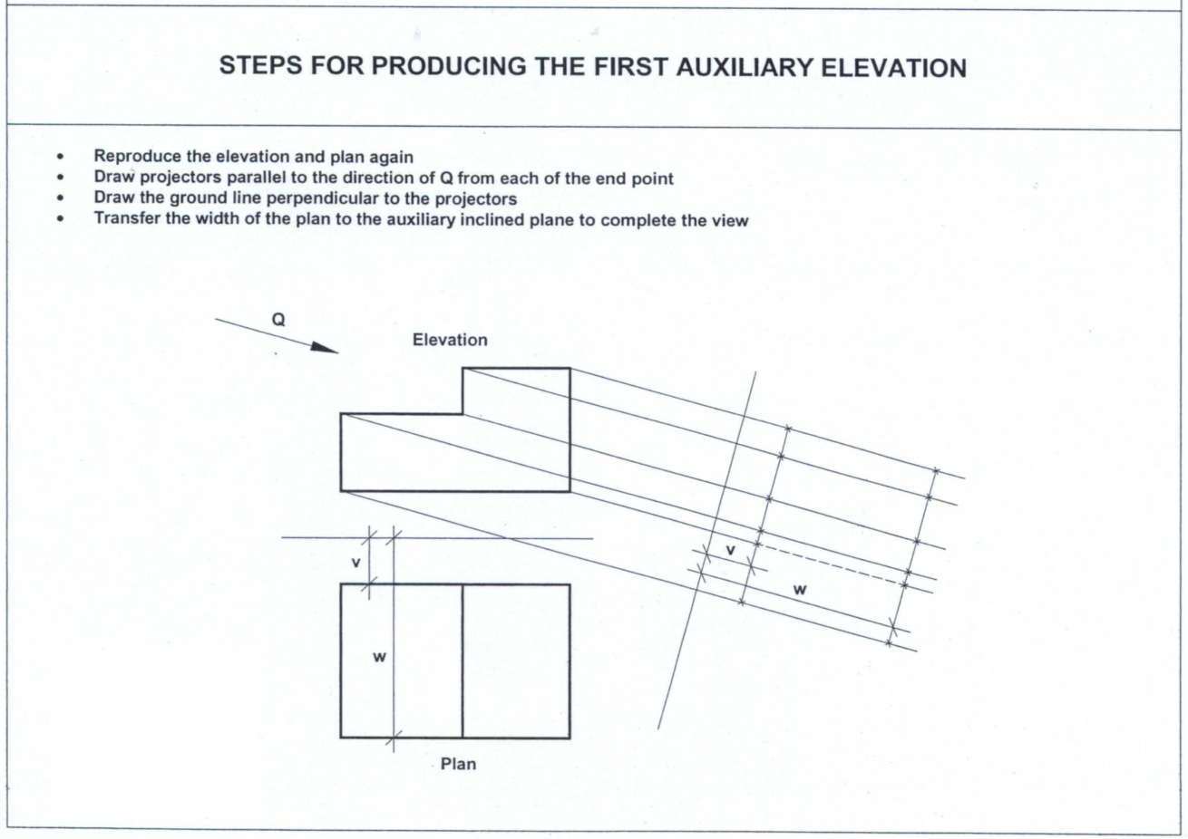
PLAN
Ground line

Slide 9
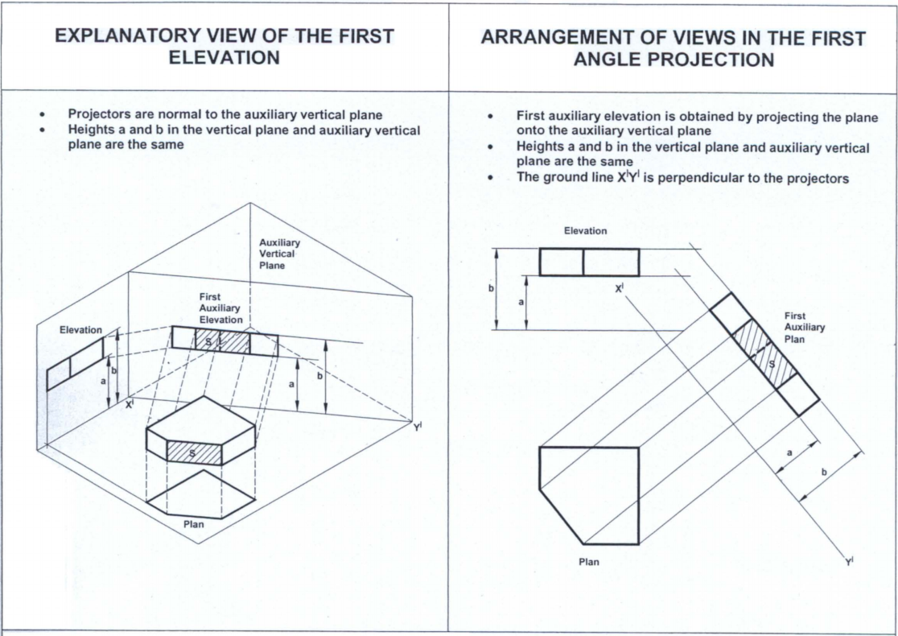
WEEK 5 – Auxiliary Projection – Auxiliary Elevation
Some Kind of Elevation:
– More Like Elevation
– Projected from Plan View (i.e. Perpendicular to Plan View)

Slide 10
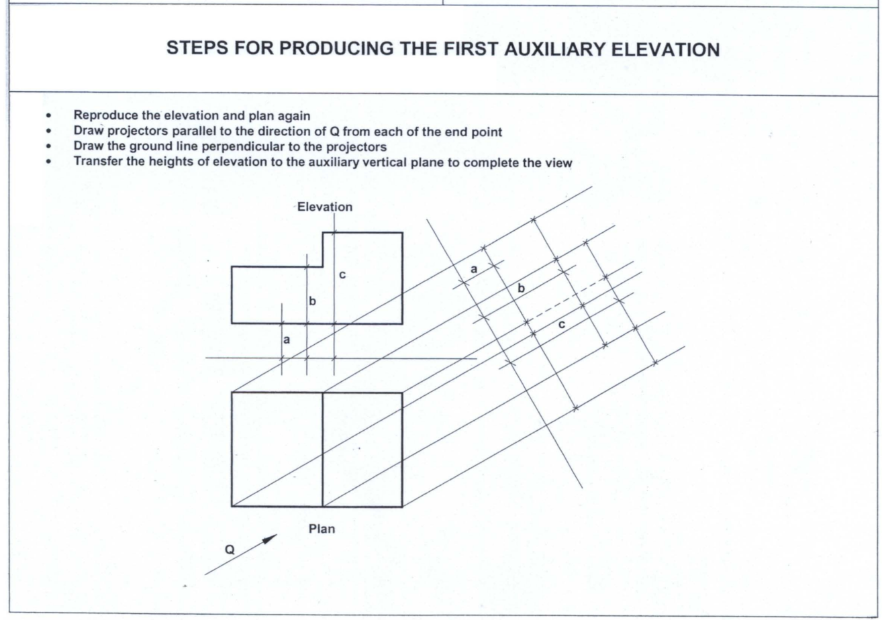
WEEK 5 – Auxiliary Projection

Slide 11
WEEK 5 – Auxiliary Projection
First Quadrant (Angle)
Auxiliary Plan
Third Quadrant (Angle)
Auxiliary Elevation

Slide 12
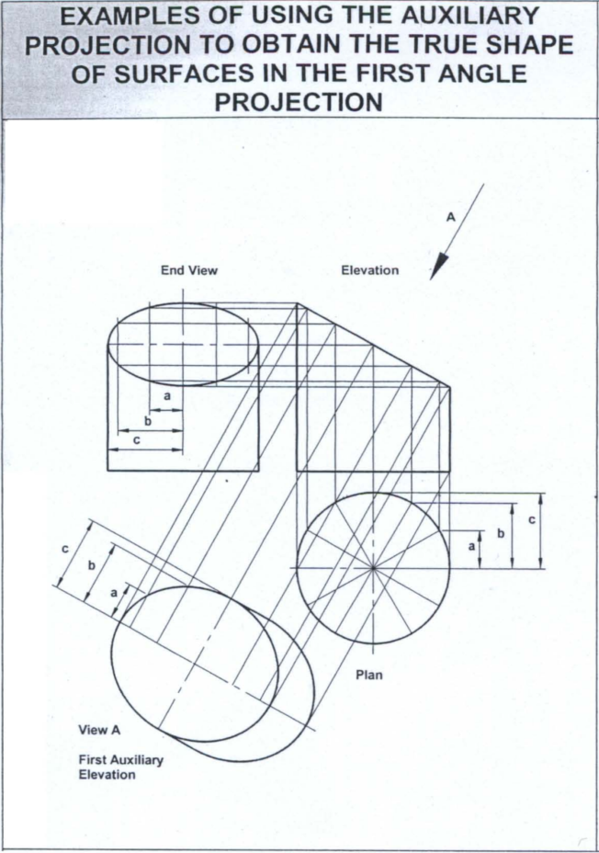
Example
- First Angle
- First Auxiliary Plan
Features:
- Projection behind the Object
- Perpendicular to Elevation View Projection

Slide 13
Example
- First Angle
- First Auxiliary Elevation
Features:
- Projection behind the Object
- Perpendicular to Plan View Projection

Slide 14
AUXILIARY PROJECTION – CURVES APPROXIMATION
How many points ? Up to you
Generally: 2 pts in the middle for a quarter of a circle
L
30°
30°
30°
L/3
L/3
L/3

Slide 15
AUXILIARY PROJECTION – FURTHEST POINTS
Generally: draw a line to connect furthest points (visible – solid; invisible – dashed).

Slide 16
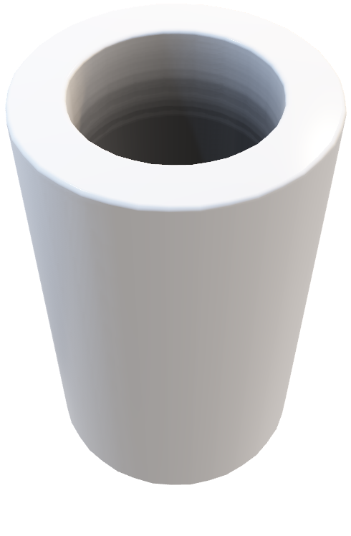
AUXILIARY PROJECTION – EDGE OF COLUMNS
Generally: draw a line to connect furthest points (visible – solid; invisible – dashed).
Inner surface
90°
View direction

Slide 17
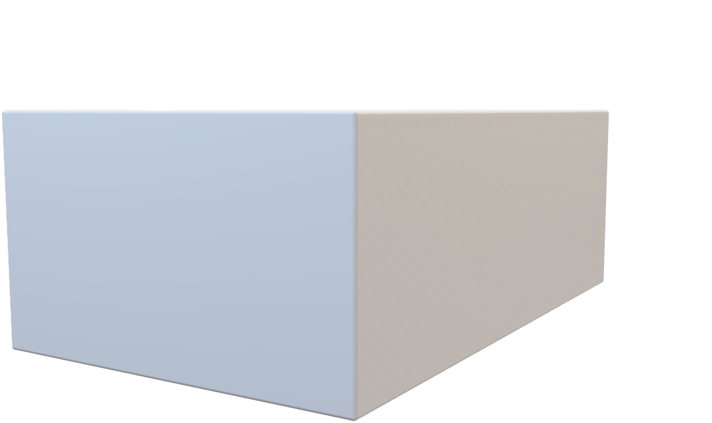
AUXILIARY PROJECTION – HIDDEN LINES
When a hidden line coincide with a solid line, only keep the SOLID line.

Slide 18
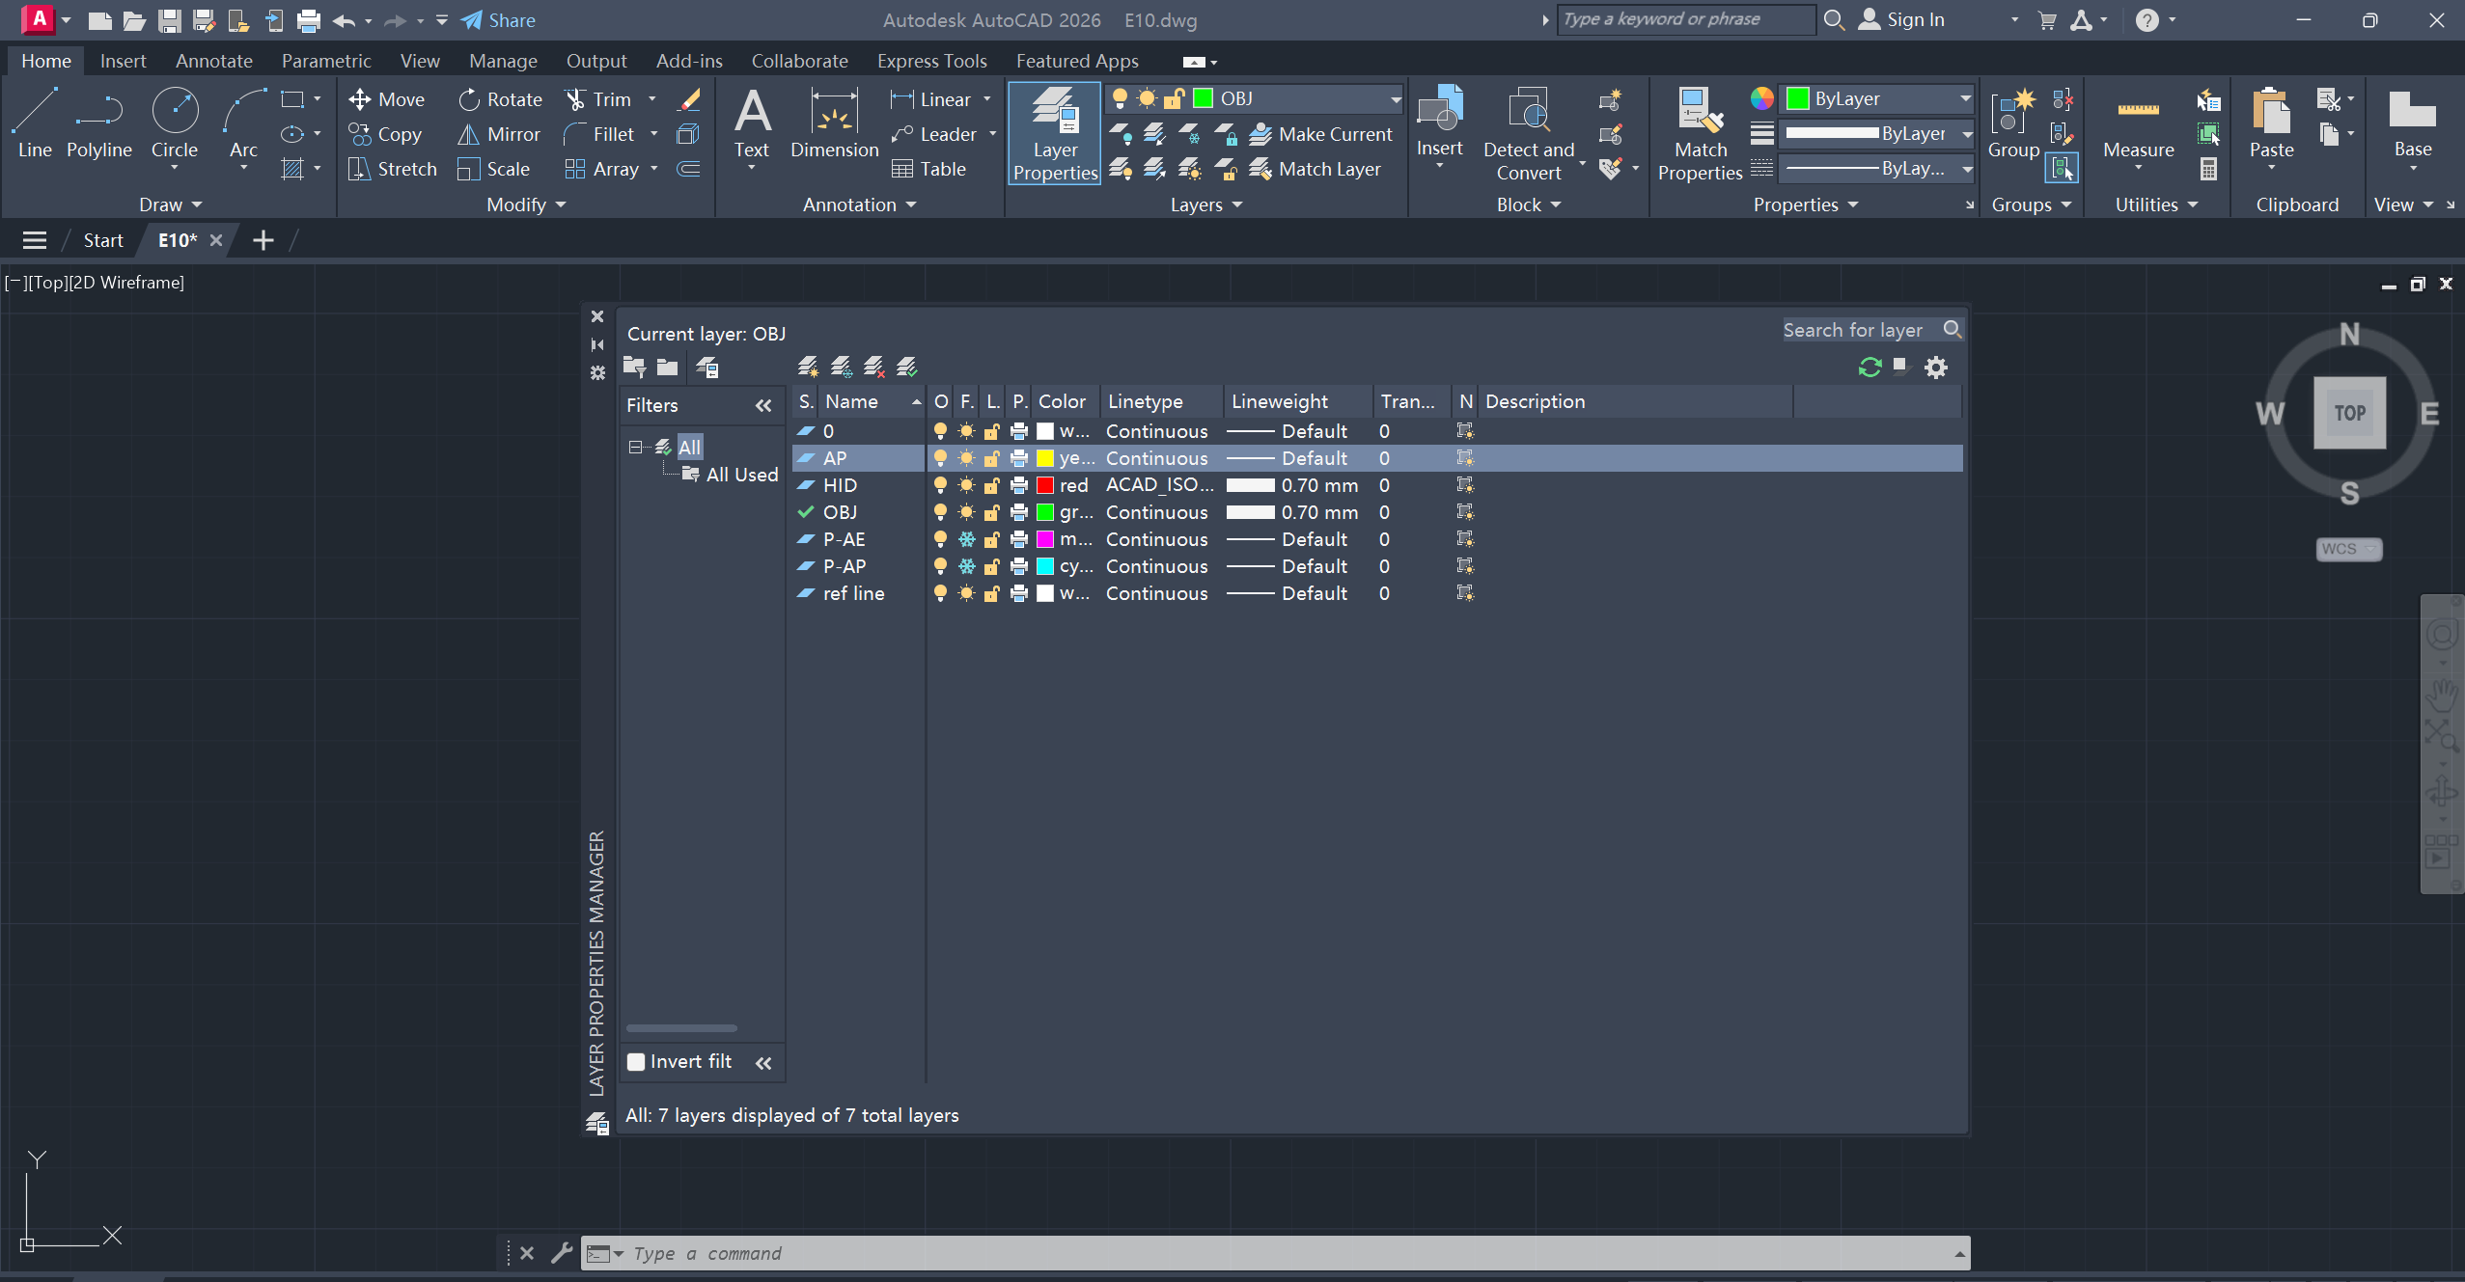
AUXILIARY PROJECTION – HIDDEN LINES
Visible lines/curves, use solid lines/curves;
Hidden lines/curves, use dashed lines/curves.
‘Layer Properties’ > ‘Linetype’ to change solid/dashed lines

Slide 19
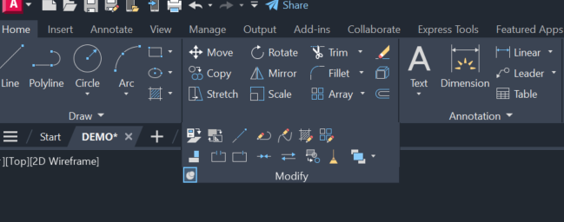
AUXILIARY PROJECTION – BREAK AT A POINT
‘Modify’ > ‘Break at a point’: break the line into 2 parts

Slide 20
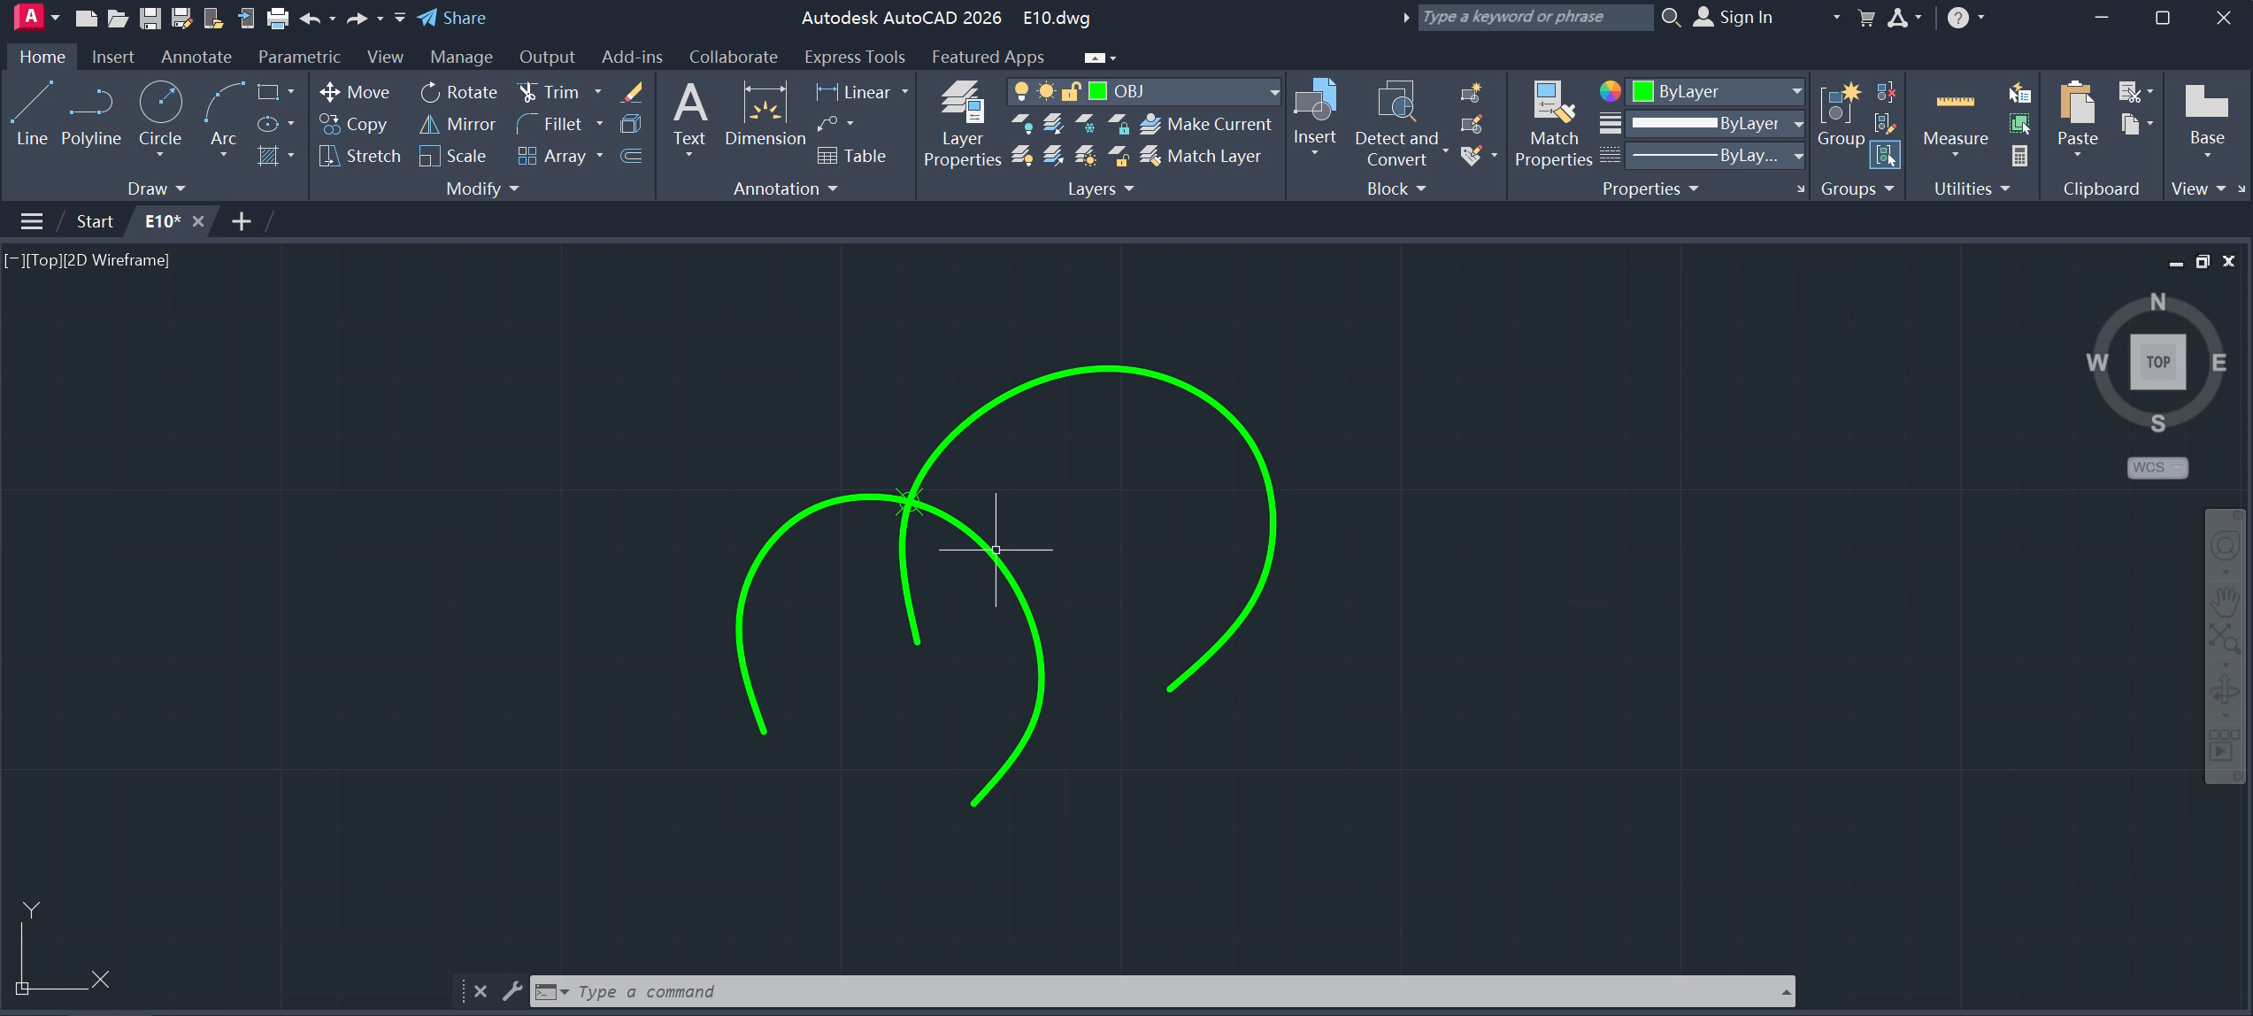
AUXILIARY PROJECTION – HIDDEN LINES & BREAK AT A POINT – EXAMPLE - Video

Slide 21


Where to download the slides?

