Slide 1

CV1711 ENGINEERING DRAWING & 3D BUILD
INFO MODEL (LAB)

Slide 2
WEEK 12
NO exercise for Week 12 (home-based learning)
Prepare for Quiz 2 in Week13
Can come to the EST Lab for practice

Slide 3
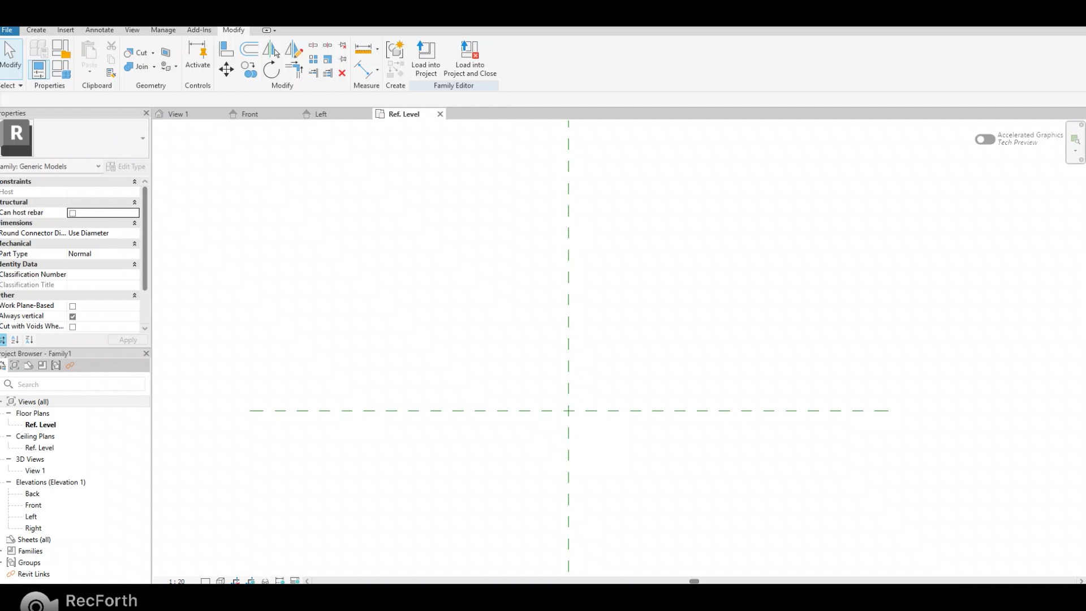
RECAP
Extrusion: Create a 3D solid by extruding a 2D shape (profile)
  Example: Create a cylinder with diameter of 50mm and height of 100mm

Slide 4
RECAP
Sweep: create a 3D shape by sweeping a 2D profile along a path
Procedure:
Make sure you are on the correct working plane where you want to sketch path (VERY IMPORTANT FOR R5)
Sketch the path (Remarks: Sometimes, Pick Path will not work; use Sketch Path instead)
Before finishing the path, drag the cross section to the desired position. Then Finish edit mode
Select profile > Edit Profile > Draw the 2D profile on the correct plane
Finish edit mode

Slide 5
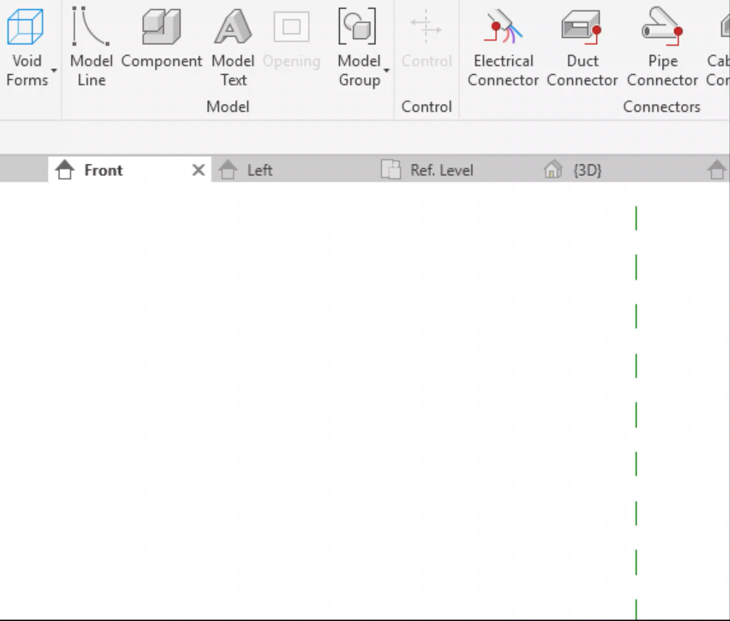
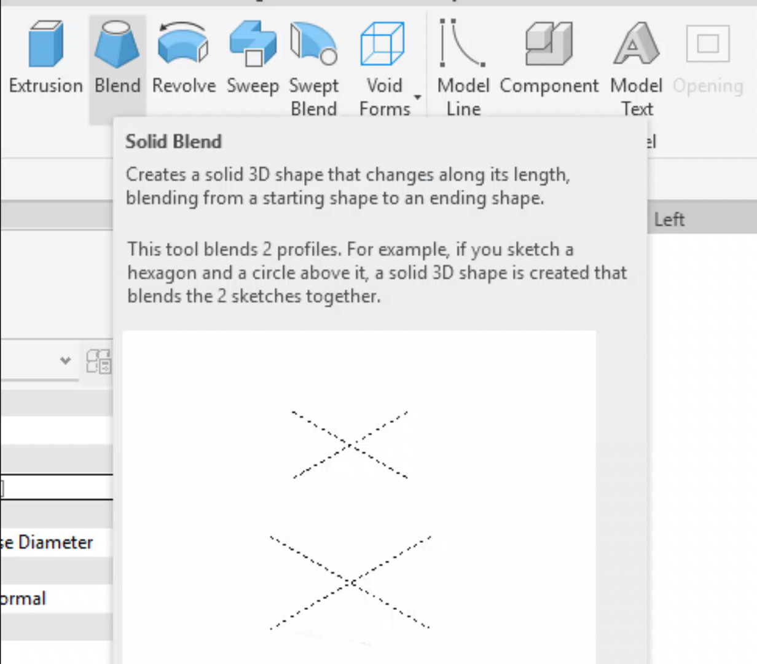
RECAP
Void: Remove material from the existing 3D shape
Blend: Create a solid 3D shape that changes along its length, blending from a starting shape to an ending shape

Slide 6
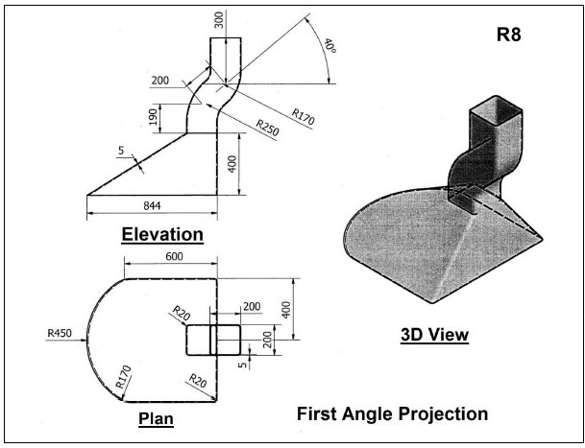
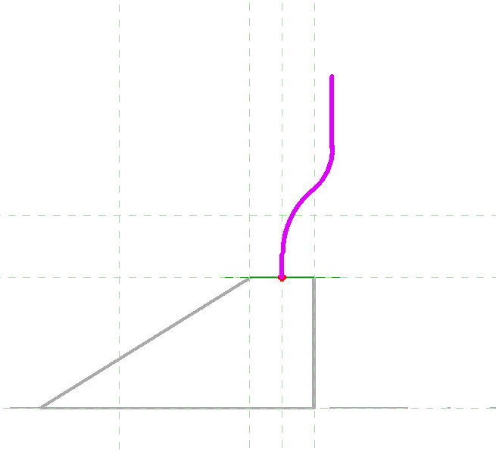
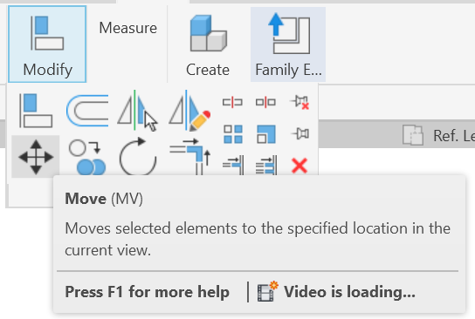
R8
Notes
You need to use Blend, Sweep and Void to do this exercise
Remember to fillet the corners
Sweep: draw the path in the middle / at the edge like in the video. If the Sweep object is off from the Blend base, you can use Move to align the 2 parts after you finish
Move function
Sweep path

Slide 7
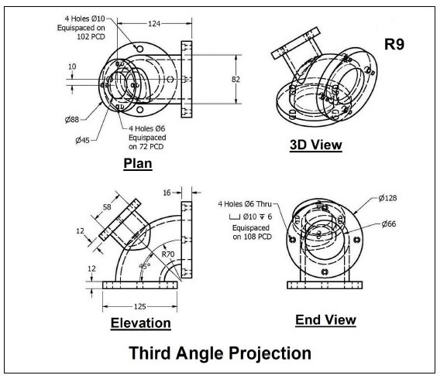
R9
R9
Notes
There are multiple ways to do this exercise. You can use Extrusion/Sweep/Void
Remember select the correct working plane for the small tube!!!
In the last step in the solution video, they use Void Revolve, but you can also use Void Sweep

Slide 8
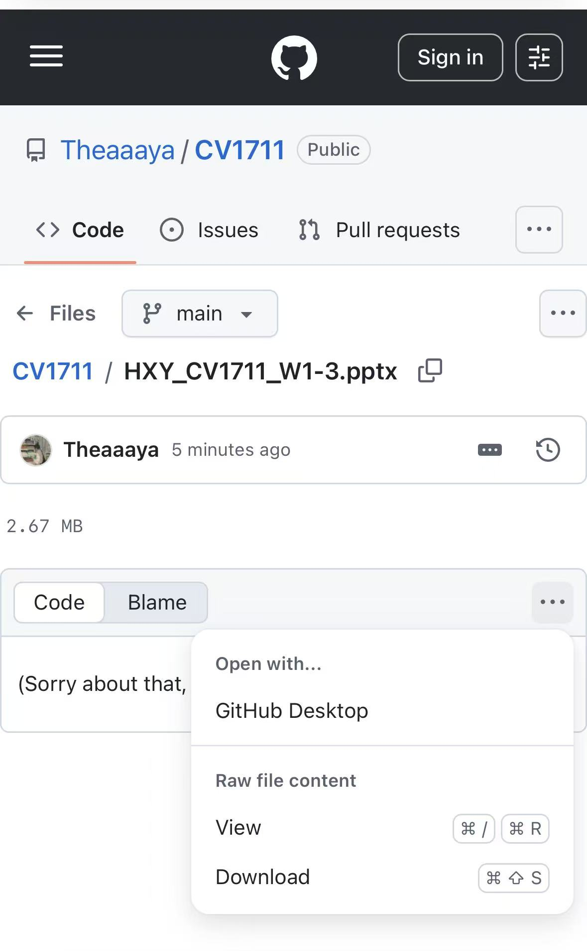

Where to download the slides?

