Slide 1

CV1711 ENGINEERING DRAWING & 3D BUILD INFO MODEL (LAB)

Slide 2

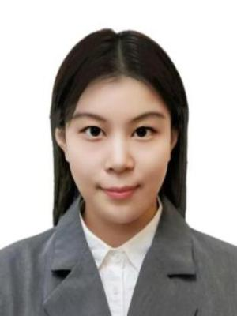


Course Coordinator & Instructors
Feel Free to Reach Out!
Coordinator
Asst. Prof. Shi Chao
TEL: 67905289
EMAIL: chao.shi@ntu.edu.sg
Instructor
Ms. Yu Xiao
TEL: 88635869
EMAIL: xiao004@e.ntu.edu.sg
Instructor
Mr. Jiang Shuo
TEL: 81733652
EMAIL: jian0142@e.ntu.edu.sg
Instructor
Mr. Cui Shuaiwen
TEL: 83071903
EMAIL: shuaiwen001@e.ntu.edu.sg

Slide 3
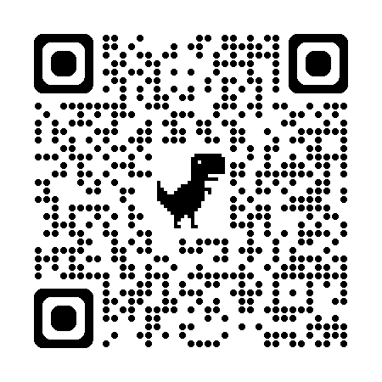
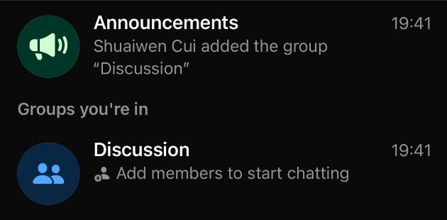
Group Chats – Scan to Join WhatsApp Community
Join this for discussion.
https://chat.whatsapp.com/KARMGvOYONM17iGIYtOdJn

Slide 4
Course Structure
PART I - Engineering Drawing – 2D – Autodesk CAD
W1
W2
W3
W4
W5
W6
W7
Recess
Week
1st Angle
3rd Angle
AutoCAD Basics
Orthographic
Projection
Quiz1
Auxiliary Projection
PART II – Building Information Model – 3D – Autodesk Revit
W8
W9
W10
W11
W12
W13
Revit
Basics
Handson Practice
Review
Self-based Learning
Quiz2

Slide 5
Grade & Attendance
Grade Structure
Quiz1 (50%) + Quiz2 (50%)
Attendance
Attendance will be taken during the last 15 minutes of class.
Attendance does not count toward the final grade; however, students are encouraged to attend in person, as exam-related tips will be shared in class.

Slide 6
Quiz Absence Policy
Request an Absence
(1) Submit your Medical Certificate (MC) to the School administration.
(2) Email the Course Coordinator.
(3) Email the instructor(s) (preferably notify all three instructors).
Grade Structure with Absence
With an approved MC or valid reason, the remaining quiz will count as 100%.
Otherwise, 50% will be deducted for a missed quiz.
Missing both quizzes will result in a Fail.

Slide 7
Tips
Questions? Please ask the instructors or student helpers.
Please save your work before leaving the lab (OneDrive, email, or USB drive).
Remember to sign out before you leave.
NTULearn may occasionally contain incorrect information; please do not follow it blindly.
Content in Weeks 1–3 is relatively easy. Starting from Week 4, the material becomes more challenging, so please preview the materials before coming to the lab.

Slide 8
Autodesk CAD Basics
These basics serve as the foundation for later course content.
Make sure you are familiar with the core operations.
Go to NTULearn -> Follow the Linkedin Videos to learn.
Follow the notes (Course Content > Content > Note-Part 1) on NTULearn, you do not need to watch all the videos.
Assignments:
E2 – Submission by the end of Week 2.
E3 & E5 – Submission by the end of Week 3.

Slide 9
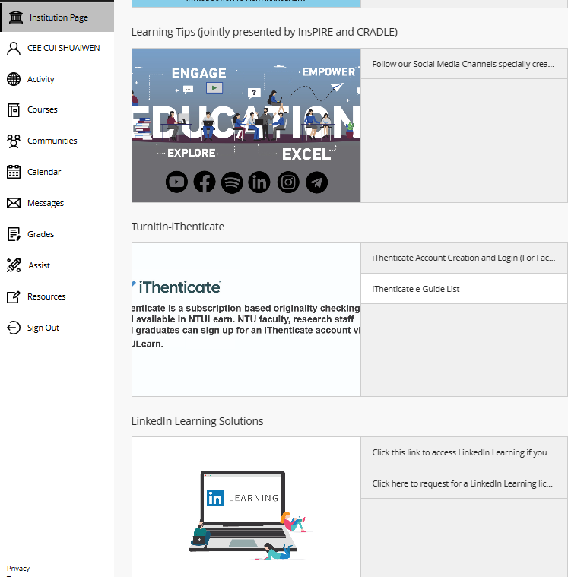
Linkedin Video Access Issue?

Slide 10
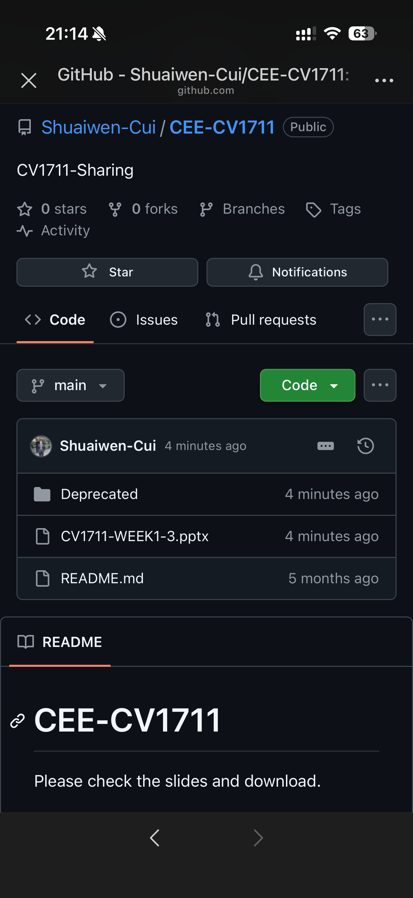
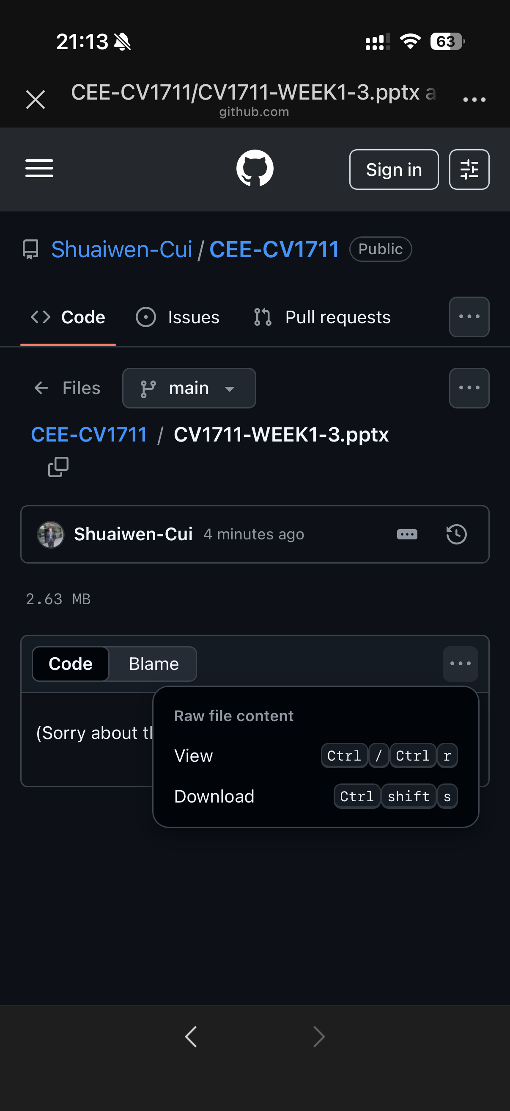
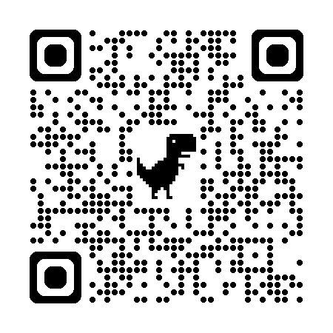
Where to download the slides?

