Slide 1

CV1711 ENGINEERING DRAWING & 3D BUILD
INFO MODEL (LAB)

Slide 2
WEEK 8 – BIM & Autodesk Revit Basics
Building Information Modeling (BIM)
BIM is an intelligent digital process that uses 3D models enriched with multidisciplinary data to support the planning, design, construction, and lifecycle management of buildings and infrastructure, enabling collaboration, efficiency, and informed decision-making across stakeholders.
Autodesk Revit
Autodesk Revit is the most widely used BIM software, enabling architects, engineers, and construction professionals to collaboratively design, visualize, and manage building projects across their lifecycle.

Slide 3
WEEK 8 – BIM & Autodesk Revit Basics
Following NTLearn and Linkedin videos to learn Revit basic operations (Course Content > Content > Note-Part 2)
Submit: R1-4 by the end of WEEK 8.

Slide 4
WEEK 8 – Basic concepts
Family – System/Component/In-place
Family Anatomy – Reference/Dimension/Parameter/3D Mass
Basic Operations – Extrusions/Sweeps/Blends/Voids/Profile
For sweeping, two phases – I Path / II Profile

Slide 5
WEEK 8 – Scope of Quiz 2
Create 3D Mass/Void
Understanding the use of :
  Extrusion
  Sweep
  Blend

Slide 6
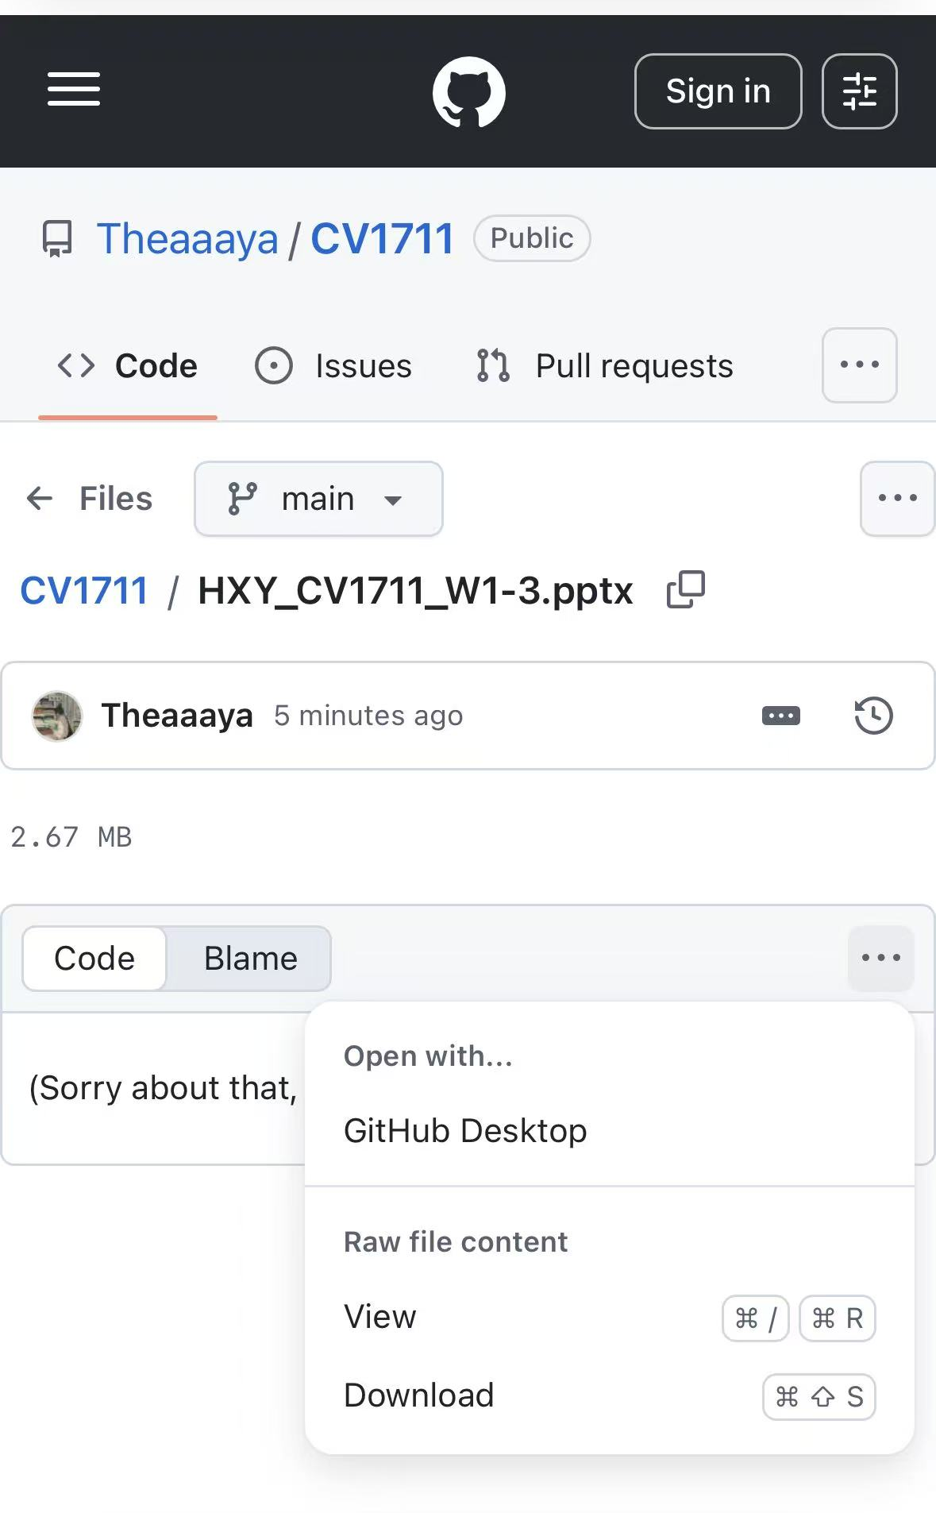

Where to download the slides?

Slide 7
WEEK 9 – Recap
Recap:
Family – System/Component/In-place
Family Anatomy – Reference/Dimension/Parameter/3D Mass
Basic Operations – Extrusions/Sweeps/Blends/Voids/Profile
For sweeping, two phases – I Path / II Profile

Slide 8
WEEK 9 – Revit Handson
Finish – R5, R6 & R7
Submit – R5 by the end of WEEK 9

Slide 9
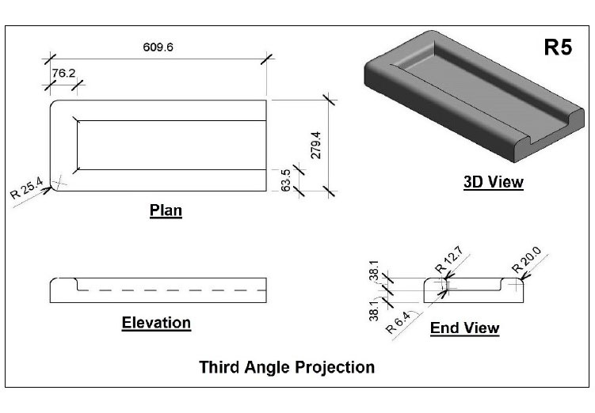
WEEK 9 –Revit Handson
R5
Floor Plan
Extrusion
Elevation Right
Sweep
Void Sweep
Sketch Sweep Path on Floor Plan

Slide 10
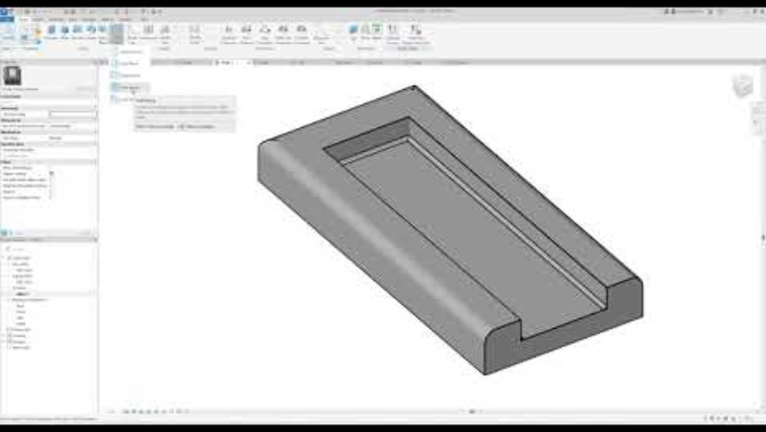
WEEK 9 –Revit Handson
Void Sweep

Slide 11
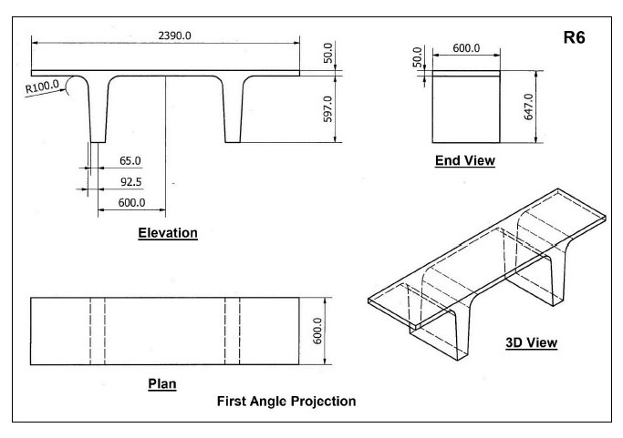
WEEK 9 –Revit Handson
R6
Elevation Front
Mirror
(Symmetric cross-section)
Extrusion

Slide 12
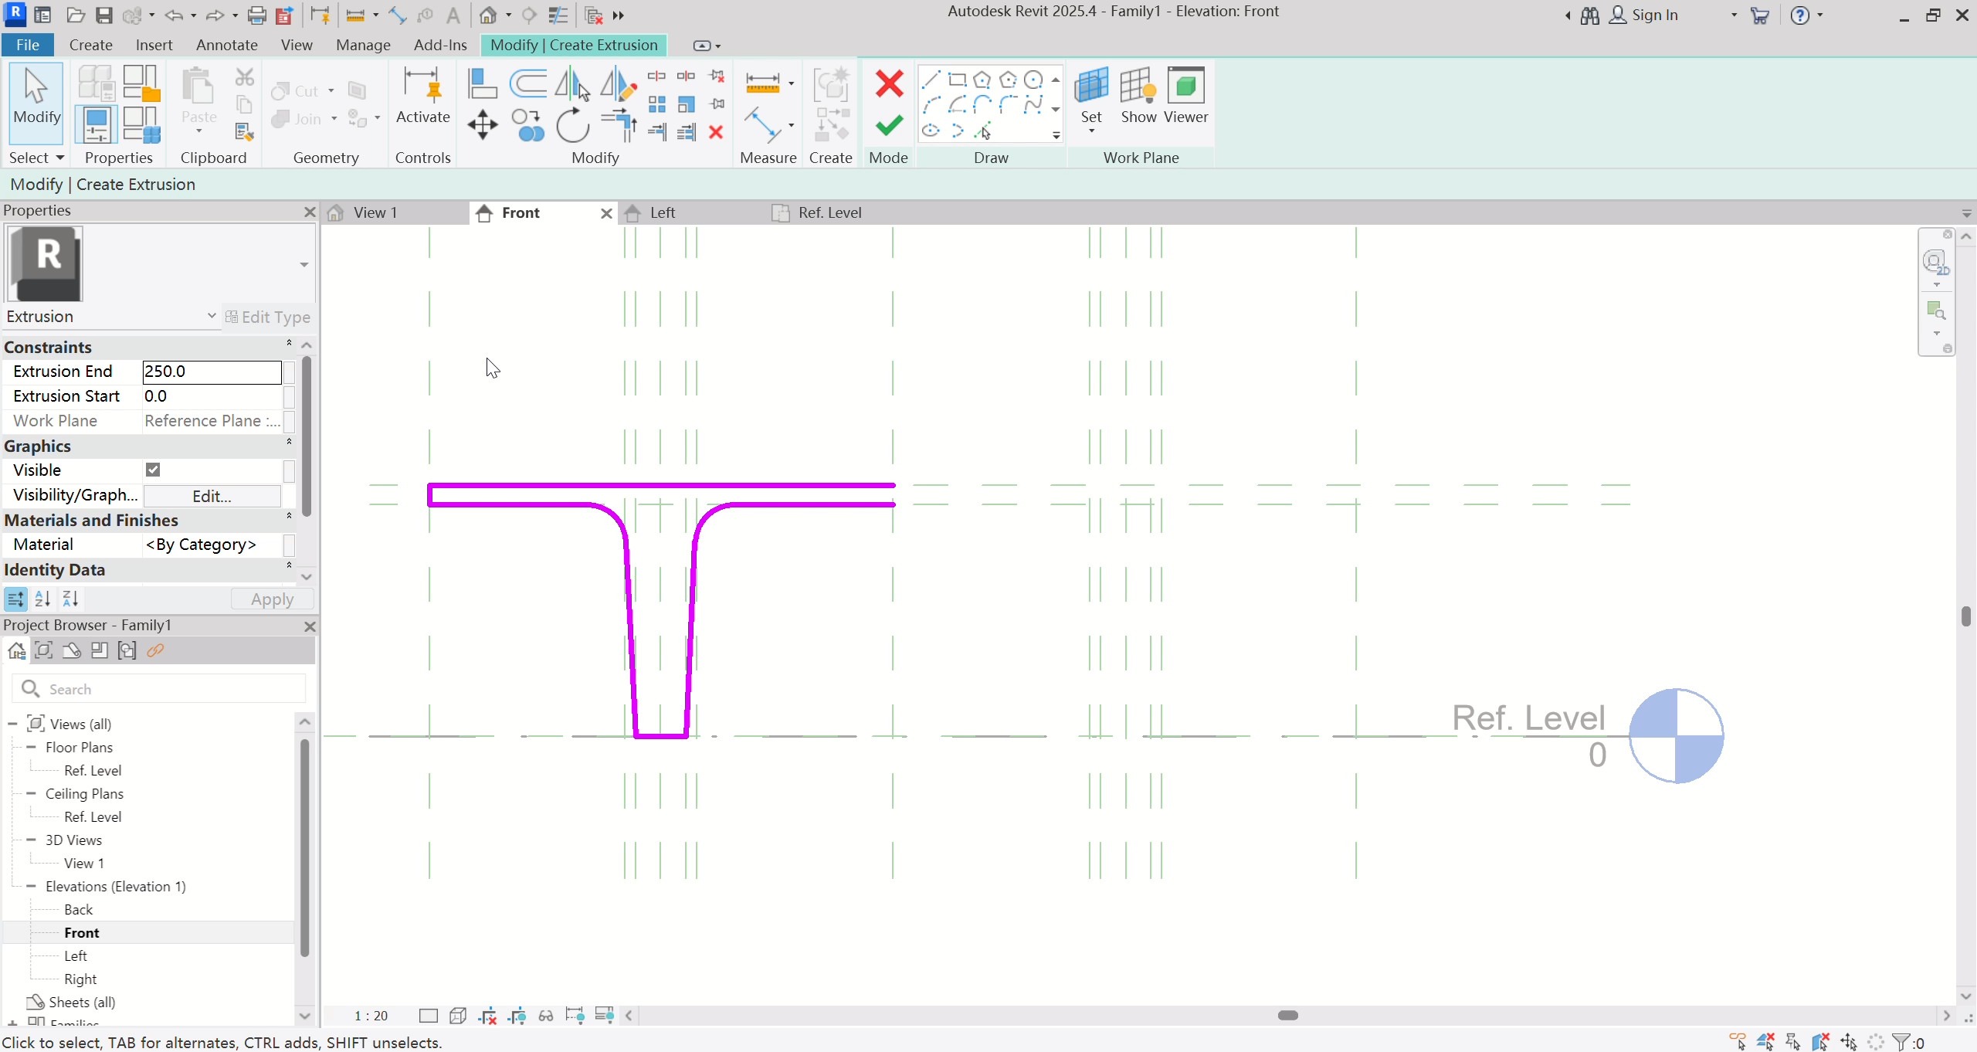
WEEK 9 –Revit Handson
Mirror

Slide 13
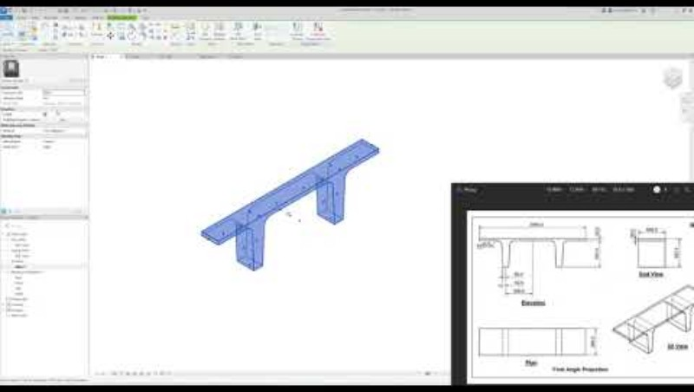
WEEK 9 –Revit Handson
R6

Slide 14
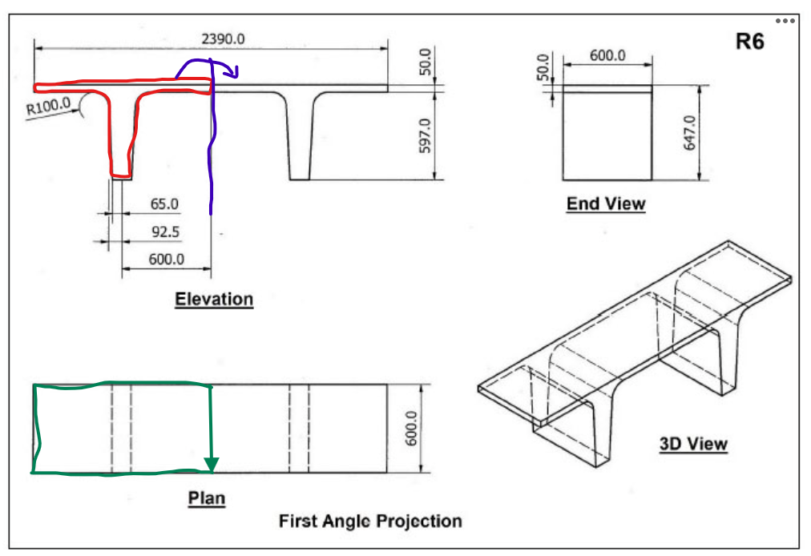
R6 instructions
R6
/2
On Elevation Front and Ref Level, use Create similar to mark all necessary dimensions (blue dashes)
On Elevation Front, select Extrusion and draw the 2D profile (red)
On Ref Level, align to the correct shape (green). Check 3D view
On Elevation Front, select the 2D shape. Under tab Modify, select Mirror. Click on the axis (purple)
3D View. Under tab Modify, select Join. Click on 2 objects to join

Slide 15
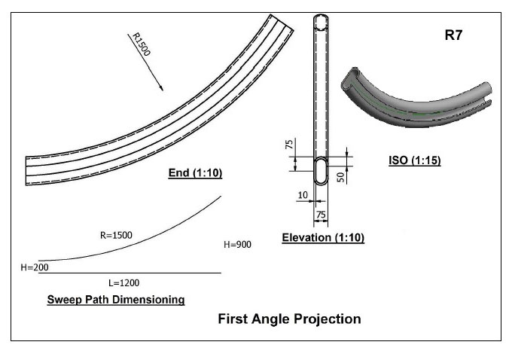
WEEK 9 –Revit Handson
R7
Elevation Right
Sweep Path
Elevation Front
Sweep
Mirror (symmetric cross-section)
R37.5

Slide 16
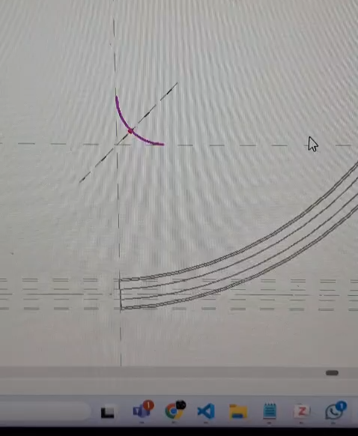
WEEK 9 – Revit Handson
Hint:
Relocate the origin of Sweep Path

Slide 17
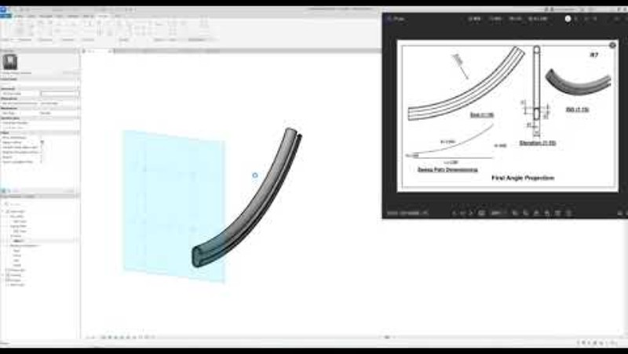
WEEK 9 –Revit Handson
R7

Slide 18
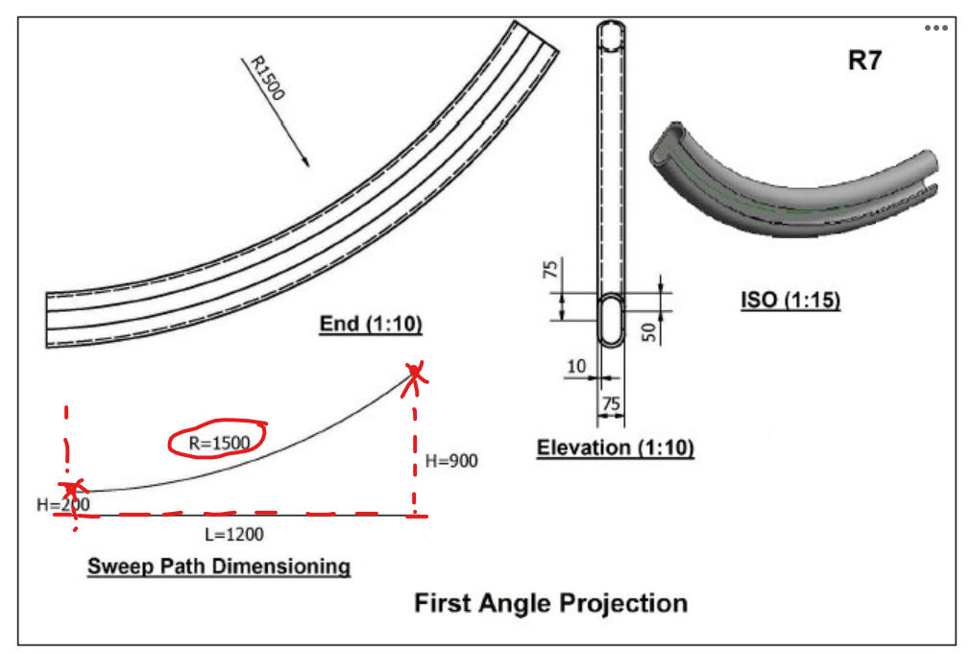
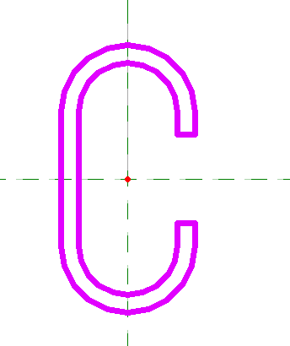
R7 instructions
R7
On Elevation Right, use Create similar to mark all necessary dimensions (red dashes)
On Elevation Right, select Sweep and draw the 2D profile using Start-End-Radius Arc. Drag the cross section to the Start of the arc. Finish sketching
Select Profile > Edit Profile. Go to Elevation Front
Draw the C cross section profile (orange) (remarks: the fillet radius is not given, so you can use any radius as you want. The screenshot given here is for R=37.5)
Finish edit mode

Slide 19
Where to download the slides?

Slide 20
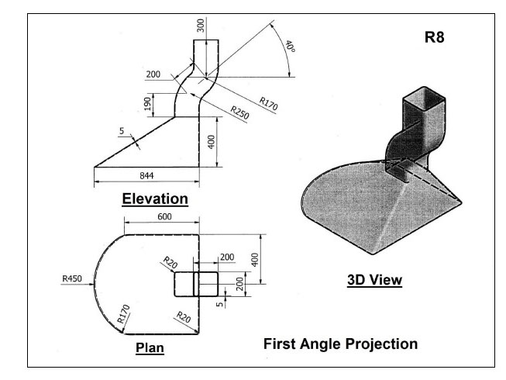
WEEK 10 –Revit Handson
R8
Finish and Submit R8

Slide 21
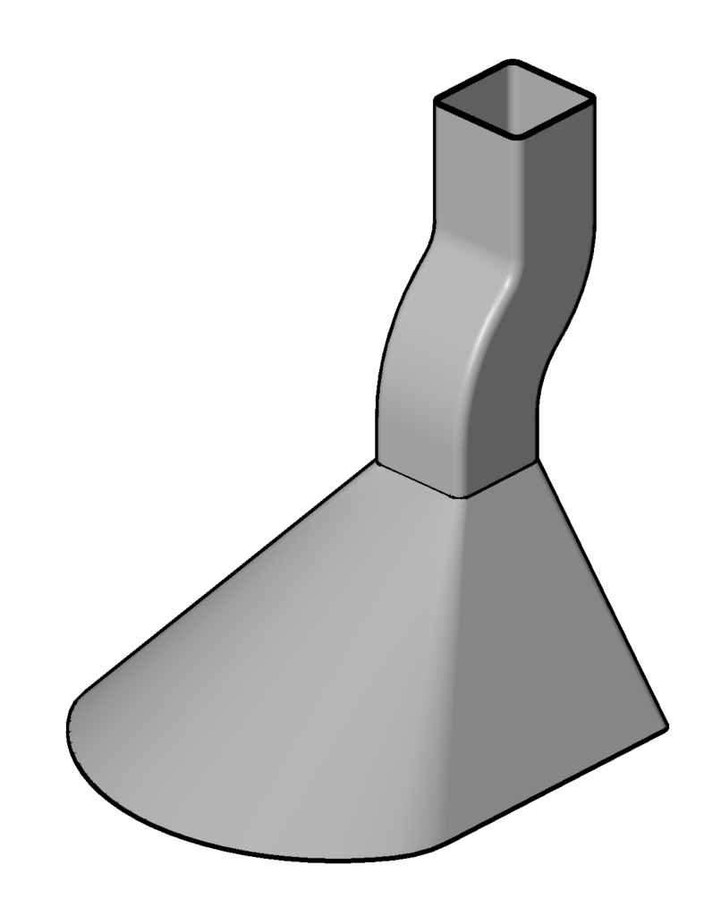
WEEK 10
R8
Sweep
Blend + Void Blend
Smoke Hood

Slide 22
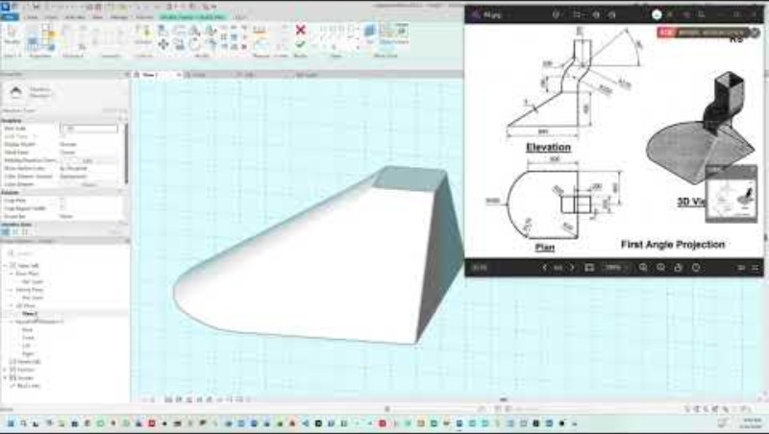

Slide 23
Where to download the slides?

Slide 24
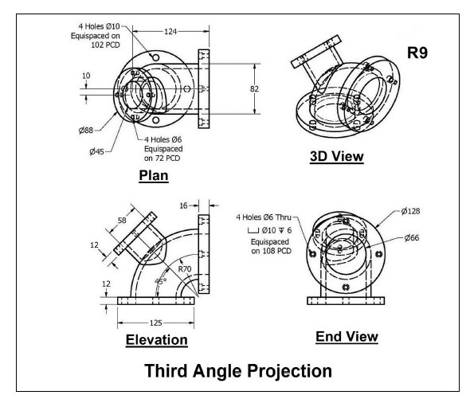
WEEK 11 –Revit Handson
R9
Finish and Submit R9

Slide 25
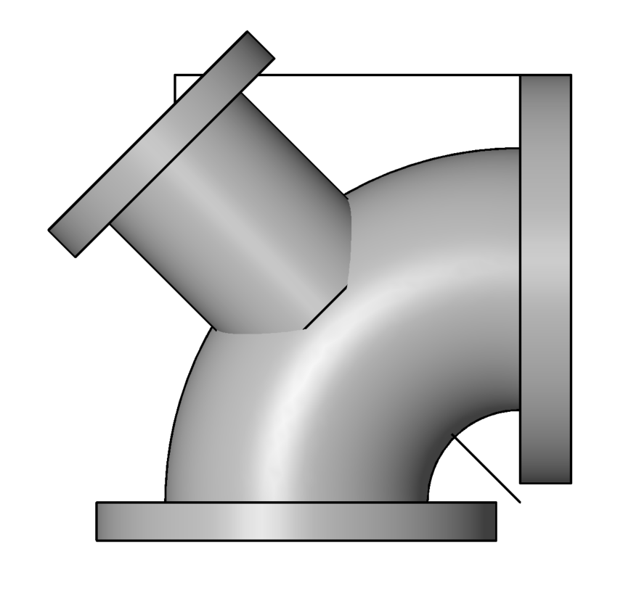
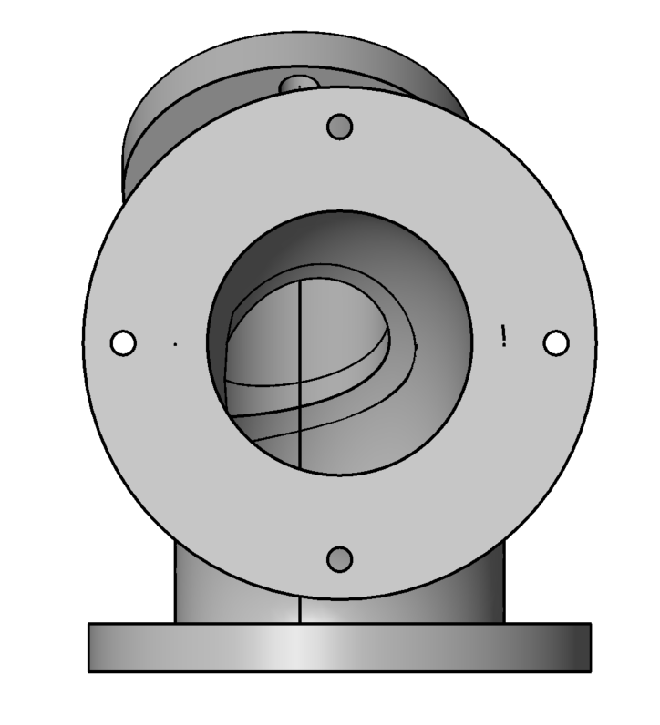
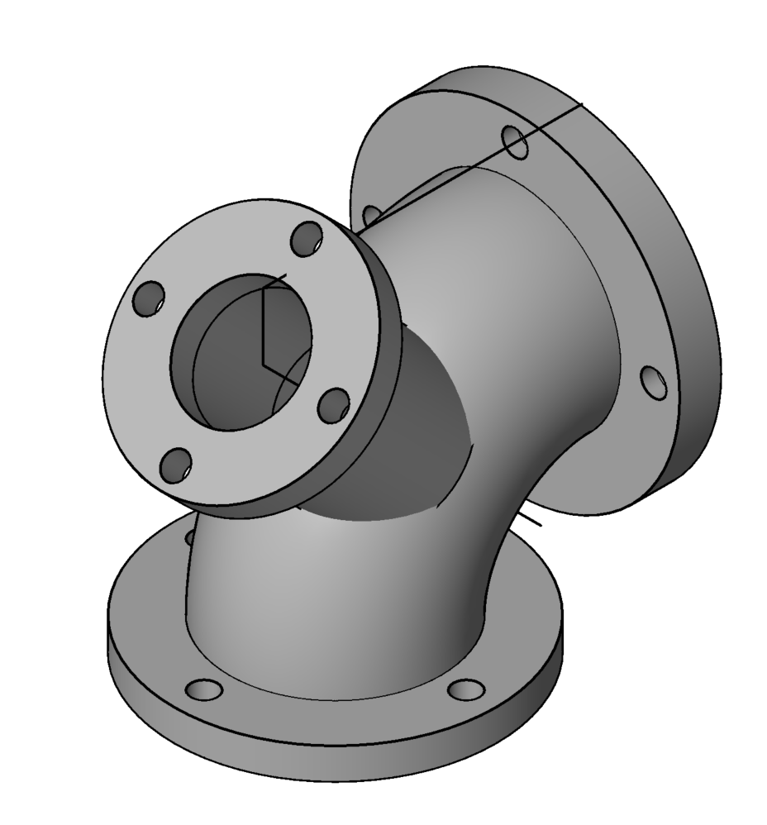
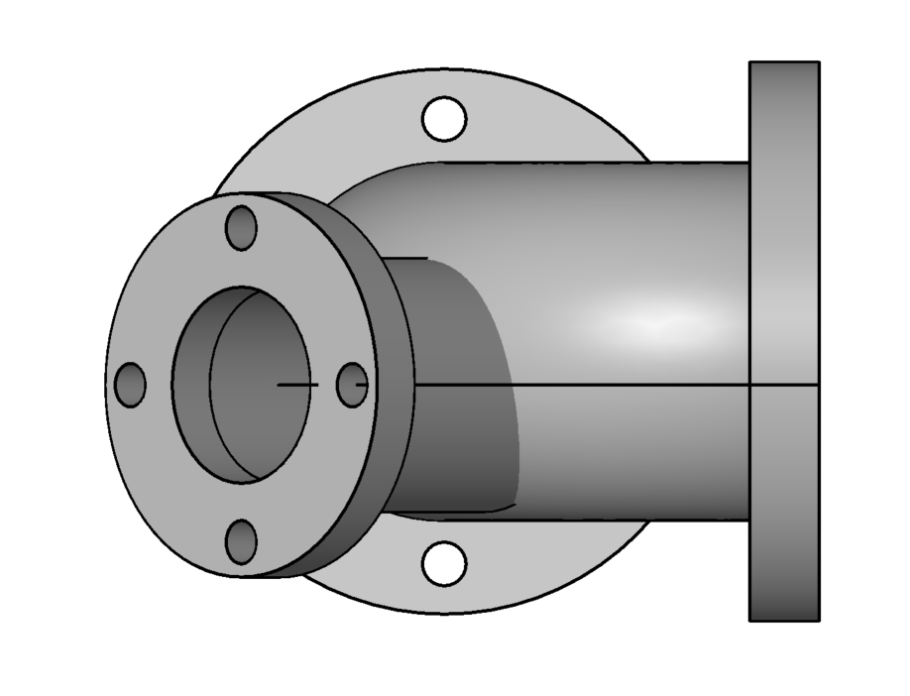
WEEK 11
4TH STEP: Extrusion
3RD STEP: Extrusion
Elevation
End
2ND STEP: Revolve + Void Revolve
1st STEP: Extrusion
Plan

Slide 26
WEEK 11
NO exercise for Week 12 (home-based learning)
Prepare for Quiz 2 in Week13
Can come to the EST Lab for practice

Slide 27
Where to download the slides?

Slide 28
WEEK 12
NO exercise for Week 12 (home-based learning)
Prepare for Quiz 2 in Week13
Can come to the EST Lab for practice

Slide 29
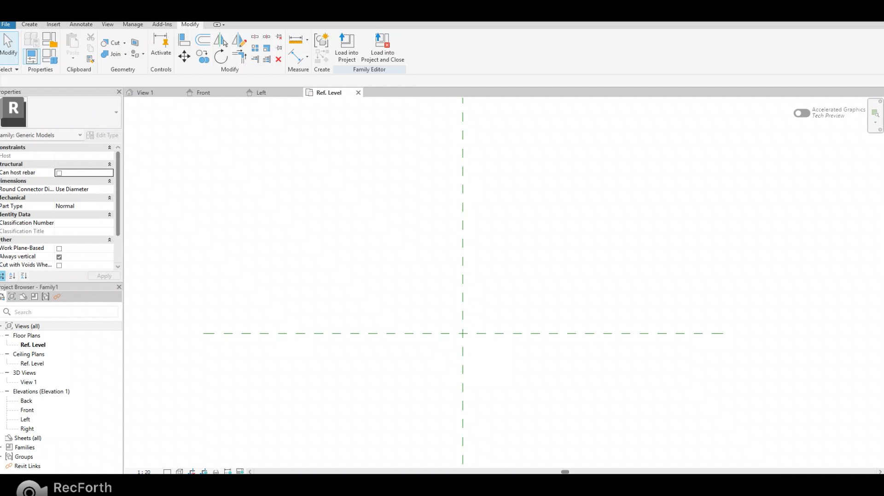
RECAP
Extrusion: Create a 3D solid by extruding a 2D shape (profile)
  Example: Create a cylinder with diameter of 50mm and height of 100mm

Slide 30
RECAP
Sweep: create a 3D shape by sweeping a 2D profile along a path
Procedure:
Make sure you are on the correct working plane where you want to sketch path (VERY IMPORTANT FOR R5)
Sketch the path (Remarks: Sometimes, Pick Path will not work; use Sketch Path instead)
Before finishing the path, drag the cross section to the desired position. Then Finish edit mode
Select profile > Edit Profile > Draw the 2D profile on the correct plane
Finish edit mode

Slide 31
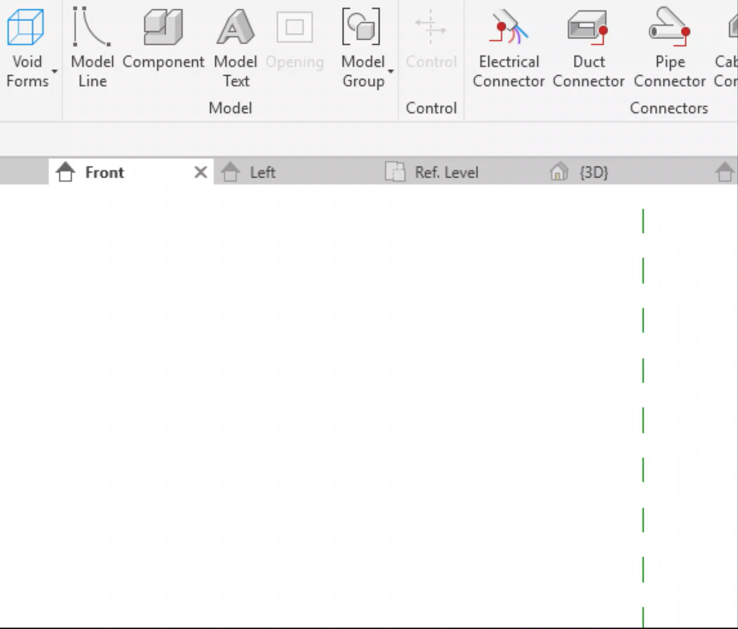
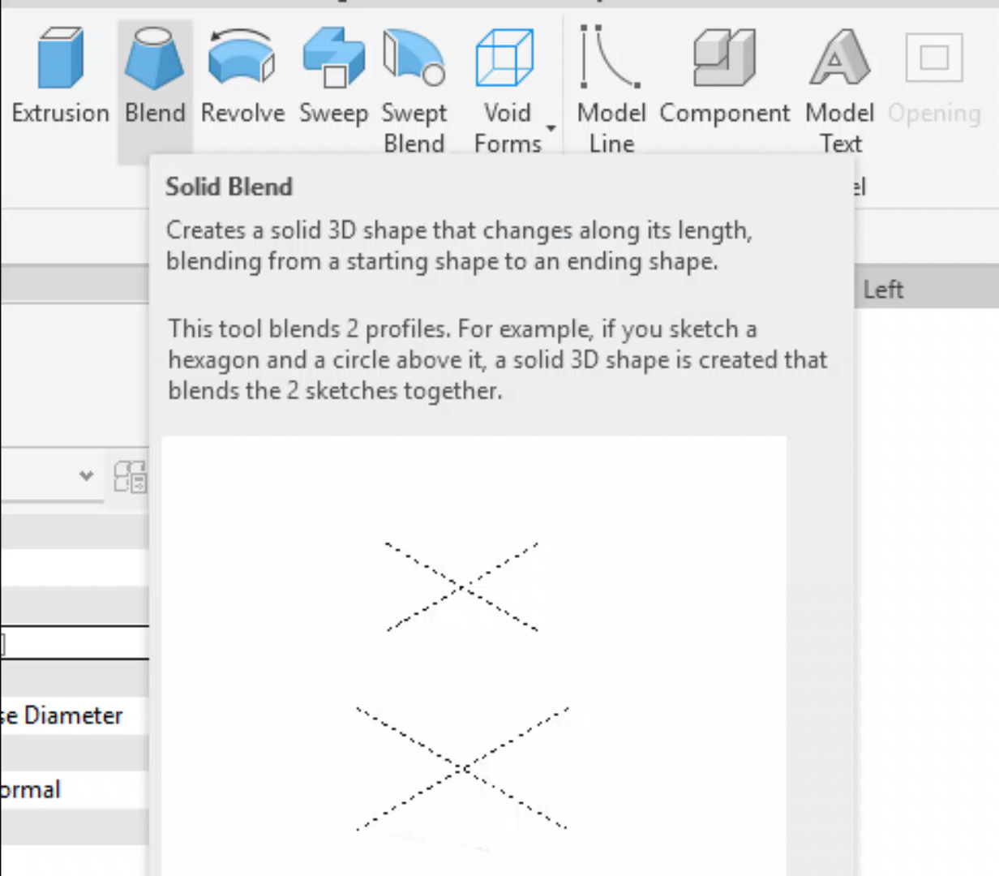
RECAP
Void: Remove material from the existing 3D shape
Blend: Create a solid 3D shape that changes along its length, blending from a starting shape to an ending shape

Slide 32
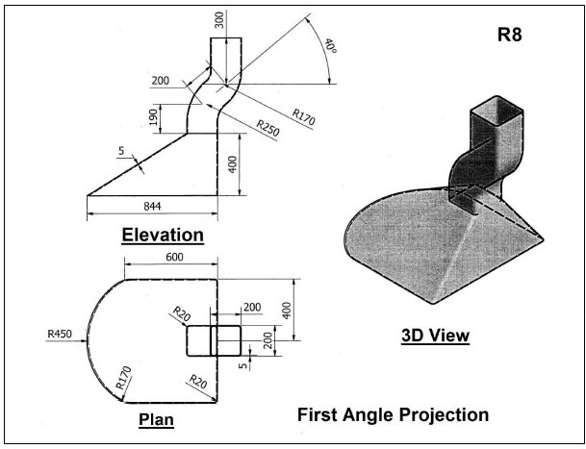
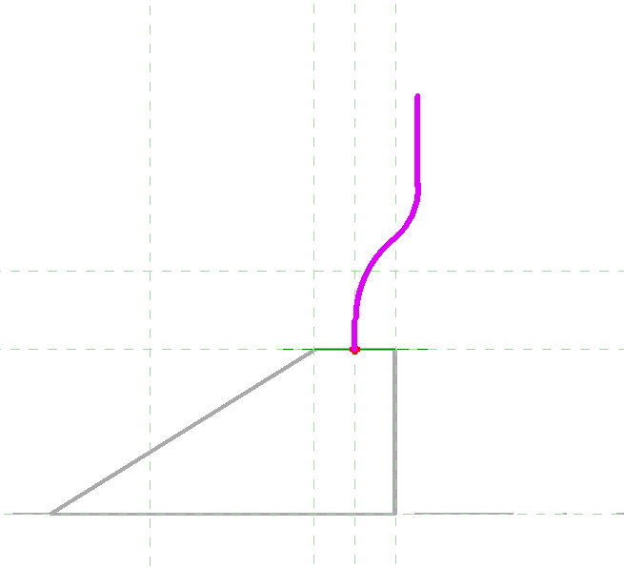
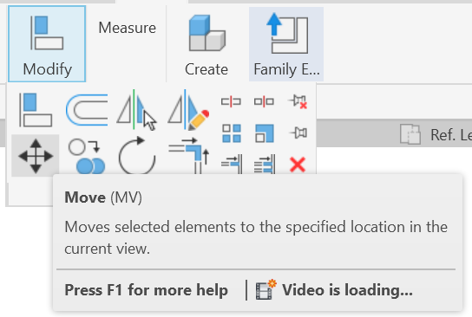
R8
Notes
You need to use Blend, Sweep and Void to do this exercise
Remember to fillet the corners
Sweep: draw the path in the middle / at the edge like in the video. If the Sweep object is off from the Blend base, you can use Move to align the 2 parts after you finish
Move function
Sweep path

Slide 33
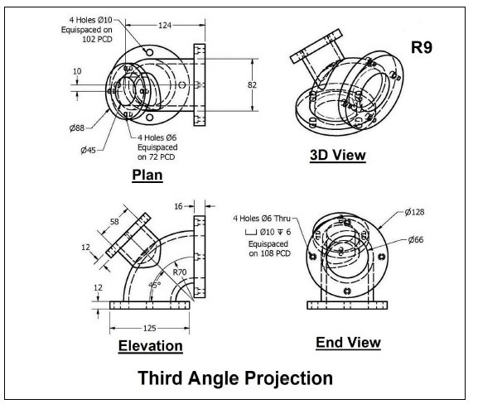
R9
R9
Notes
There are multiple ways to do this exercise. You can use Extrusion/Sweep/Void
Remember select the correct working plane for the small tube!!!
In the last step in the solution video, they use Void Revolve, but you can also use Void Sweep

