Slide 1
WEEK 5 – Auxiliary Projection
Very Import, Please Pay Close Attention!

Slide 2
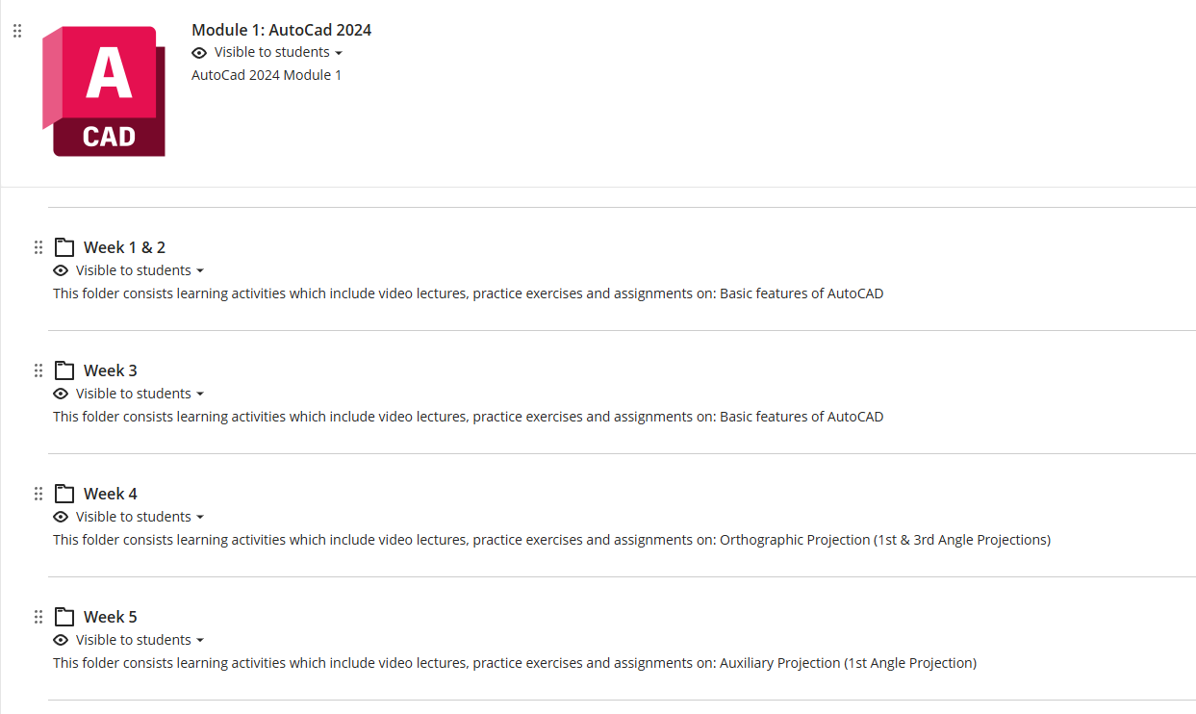

WEEK 5 – Auxiliary Projection – Self-learning

Slide 3
WEEK 5 – Auxiliary Projection – Assignments
Finish – E9, E10, E11
Submit – E10

Slide 4

WEEK 5 – Auxiliary Projection – Recap
First Angle Projection
Third Angle Projection

Slide 5
WEEK 5 – Auxiliary Projection – Terms
First (Primary) Auxiliary Projection: A view projected onto a plane that is perpendicular to one principal view, used to show an inclined surface in its true size and shape.
First / Primary: The projection obtained by rotating once from a principal view (front, top, or side). NOT First Quadrant/First Angle Projection.

Slide 6
WEEK 5 – Auxiliary Projection
First Auxiliary Elevation (using 1st Angle Projection)
https://www.youtube.com/watch?v=Q8YeCa0tB0I&list=PLILX3iYME5rHp4AplmfQXYfMYkzTCIVat&index=76
First Auxiliary Plan (using 1st Angle Projection)
https://www.youtube.com/watch?v=xPUgz6Pj0ds&list=PLILX3iYME5rHp4AplmfQXYfMYkzTCIVat&index=73

Slide 7
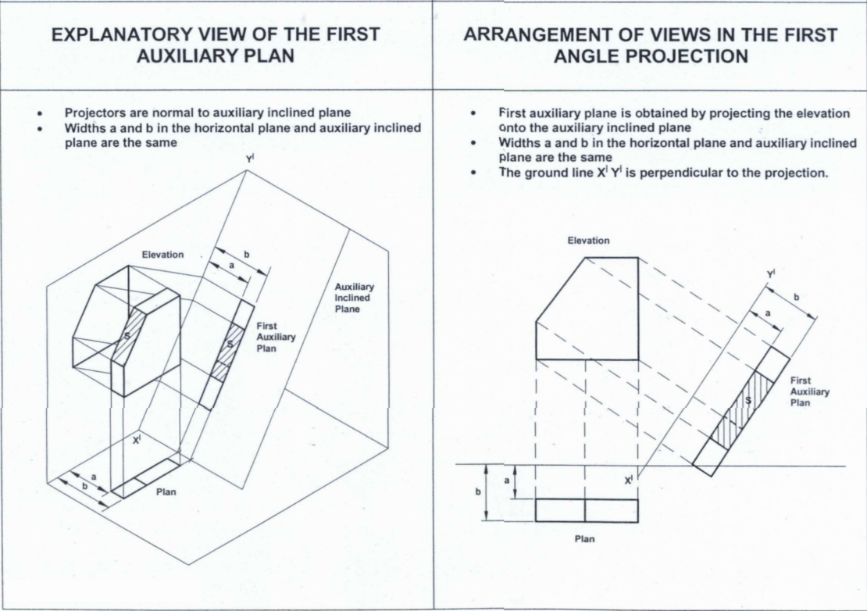
WEEK 5 – Auxiliary Projection – Auxiliary Plan
Some Kind of Plan:
– More Like Plan
– Projected from Elevation View (i.e. Perpendicular to Elevation View)

Slide 8
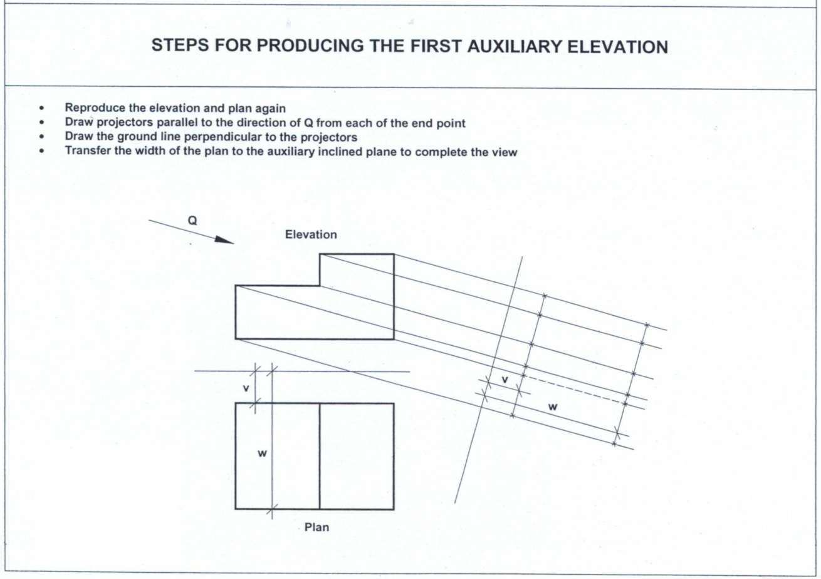
PLAN
Ground line

Slide 9
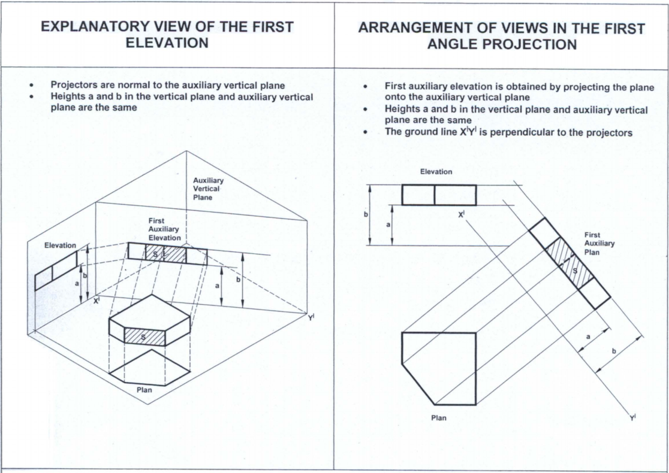
WEEK 5 – Auxiliary Projection – Auxiliary Elevation
Some Kind of Elevation:
– More Like Elevation
– Projected from Plan View (i.e. Perpendicular to Plan View)

Slide 10
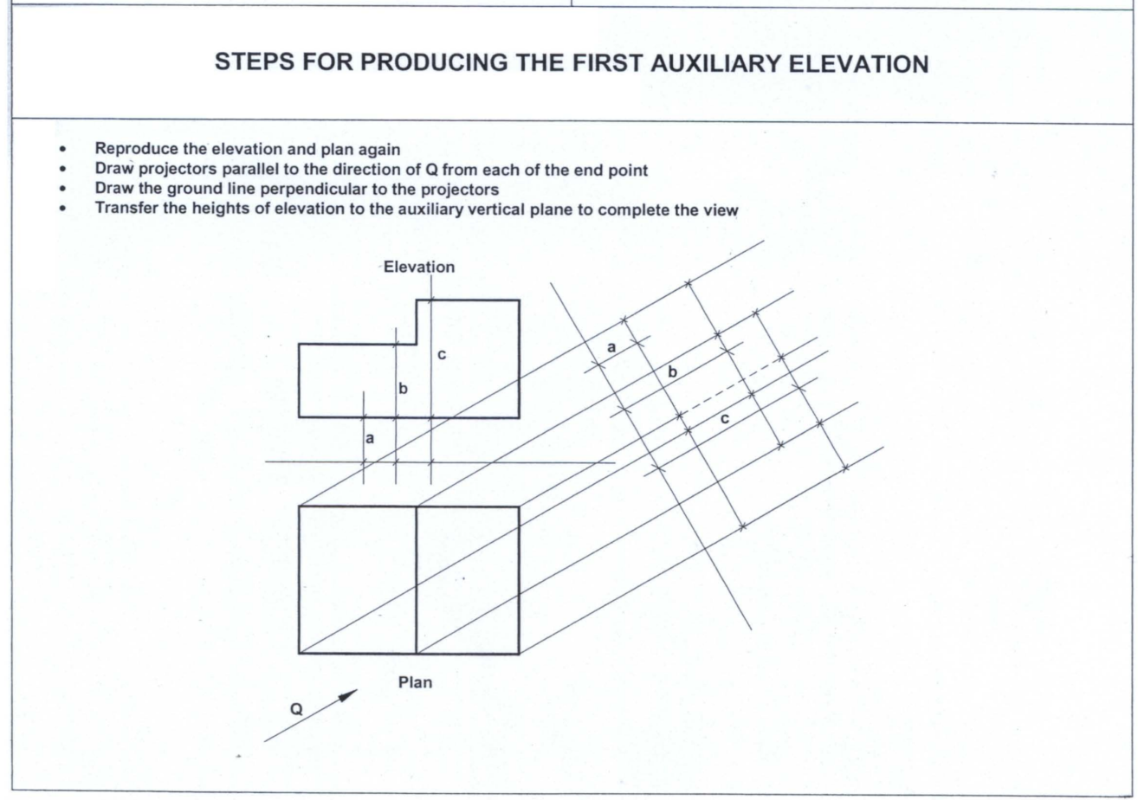
WEEK 5 – Auxiliary Projection

Slide 11
WEEK 5 – Auxiliary Projection
First Quadrant (Angle)
Auxiliary Plan
Third Quadrant (Angle)
Auxiliary Elevation

Slide 12
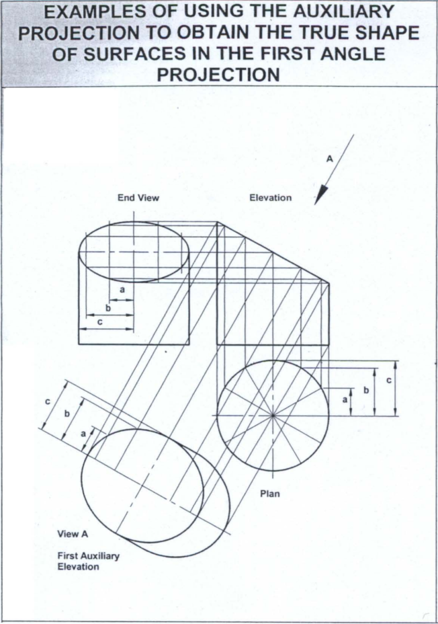
Example
- First Angle
- First Auxiliary Plan
Features:
- Projection behind the Object
- Perpendicular to Elevation View Projection

Slide 13
Example
- First Angle
- First Auxiliary Elevation
Features:
- Projection behind the Object
- Perpendicular to Plan View Projection

Slide 14
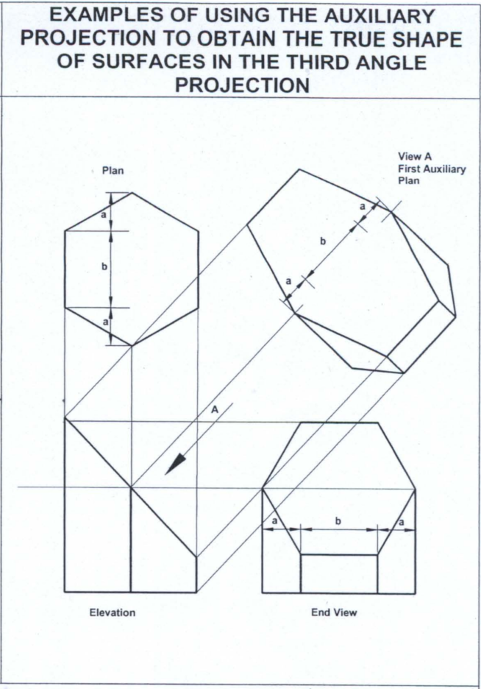
Example
- Third Angle
- First Auxiliary Plan
Features:
- Projection in front of the Object
- Perpendicular to Elevation View Projection

Slide 15
Example
- Third Angle
- First Auxiliary Elevation
Features:
- Projection in front of the Object
- Perpendicular to Plan View Projection

Slide 16
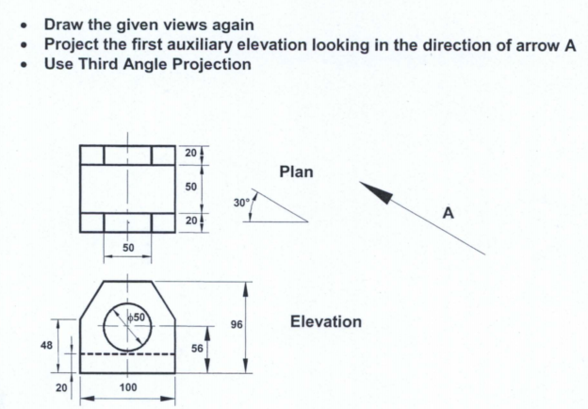
EXAMPLE 3

Slide 17
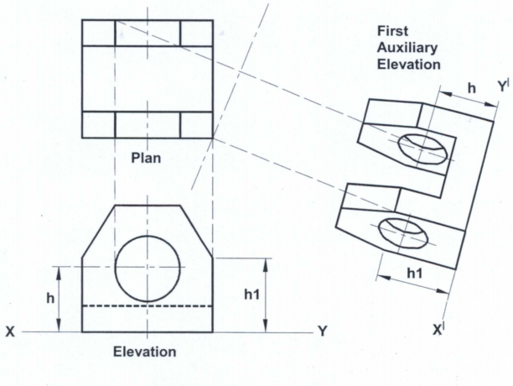
EXAMPLE 3
Hidden lines missed!

Slide 18
EXAMPLE 3

Slide 19
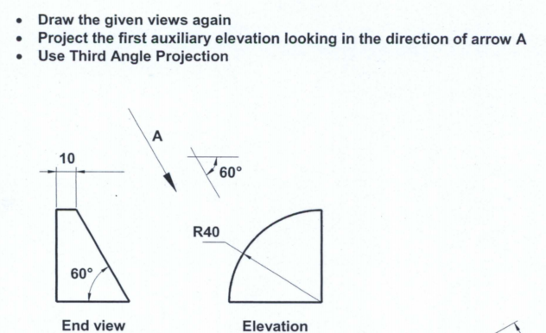
Appendix 2 - EXAMPLE 1
plan

Slide 20
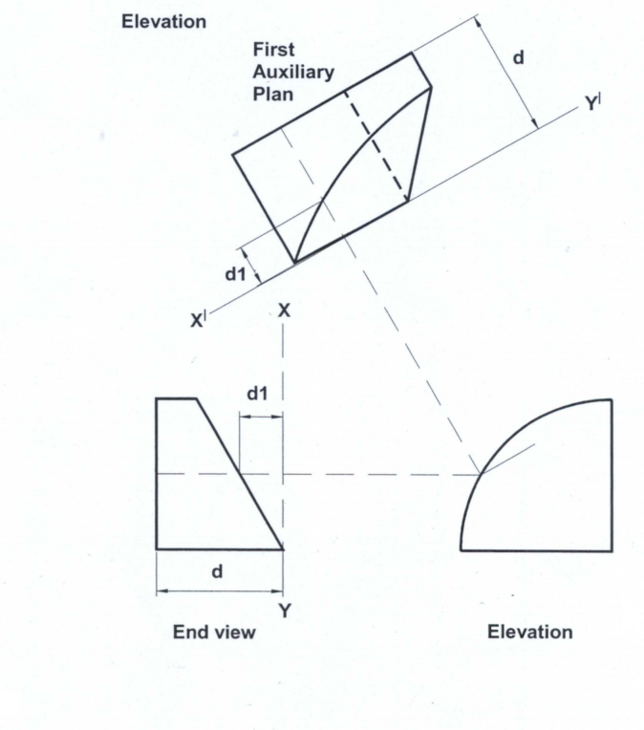
Appendix 2 - EXAMPLE 1

Slide 21
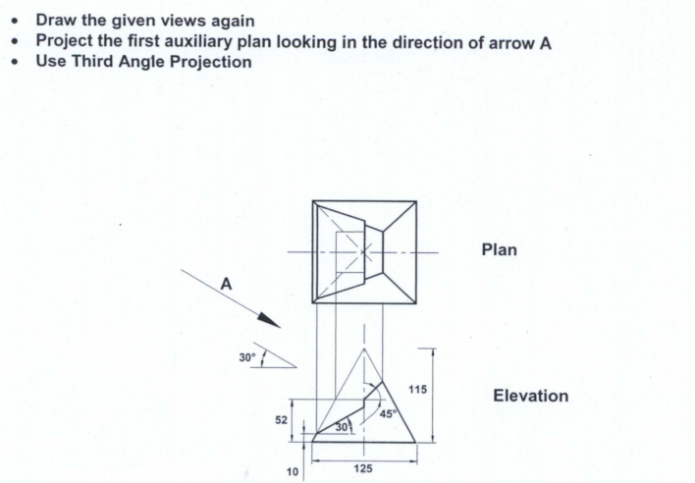
Appendix 2 - EXAMPLE 2

Slide 22
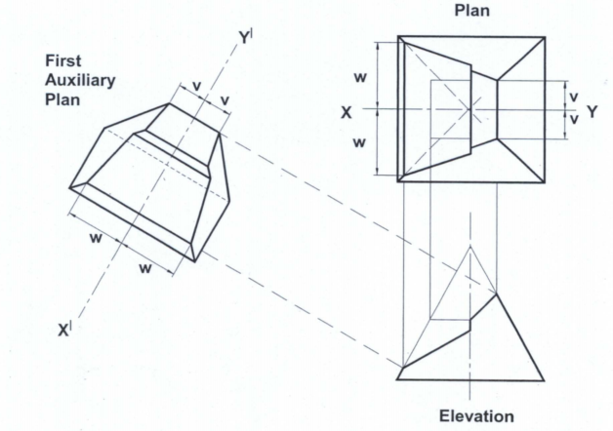
Appendix 2 - EXAMPLE 2

Slide 23


Where to download the slides?

