Slide 1
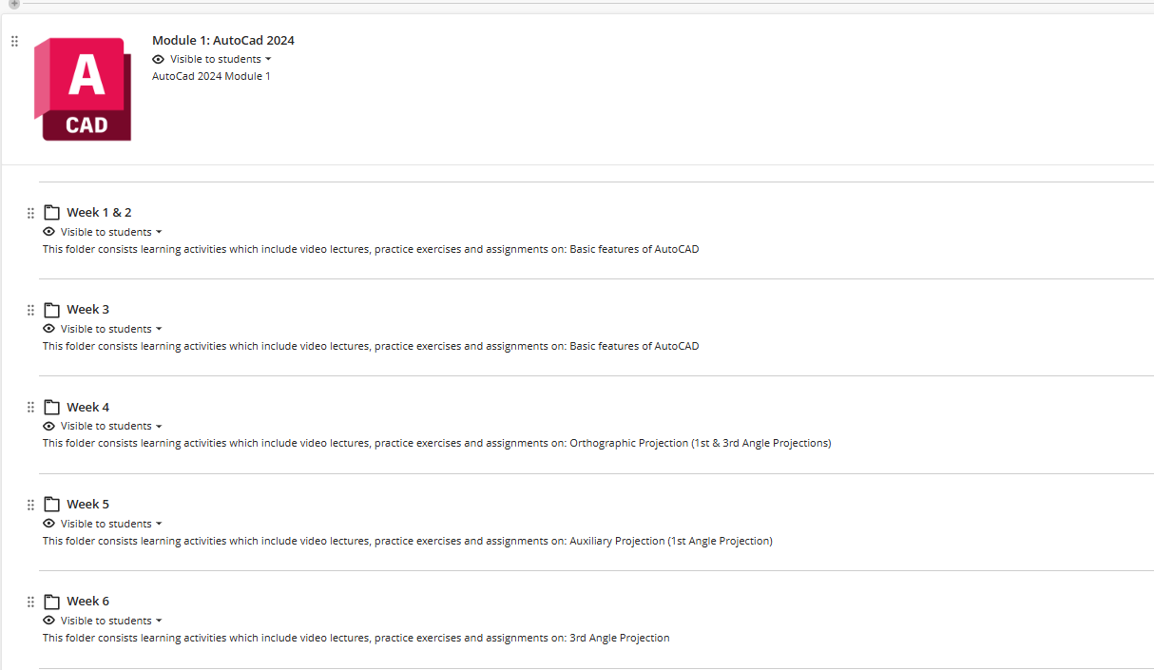
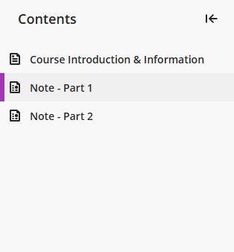
WEEK 6 – Auxiliary Projection – Self-learning

Slide 2
WEEK 6 – Auxiliary Projection – Assignments
Finish – E12, E13, E14
Submit – E13

Slide 3
WEEK 6 – Recap
1st Angle Projection: Projection behind the object
3rd Angle Projection: Projection in front of the object
Auxiliary Plan: Projected from the elevation view
Auxiliary Elevation: Projected from the plan view

Slide 4
AUXILIARY PROJECTION - Recap
1. Reproduce the principal views (Elevation & Plan)
2. Projectors parallel to the given direction from end points
3. Ground line perpendicular to the projectors
4. Transfer heights/widths

Slide 5
AUXILIARY PROJECTION – CURVES APPROXIMATION
How many points ? Up to you
Generally: 2 pts in the middle for a quarter of a circle
L
30°
30°
30°
L/3
L/3
L/3

Slide 6
AUXILIARY PROJECTION – FURTHEST POINTS
Generally: draw a line to connect furthest points (visible – solid; invisible – dashed).

Slide 7
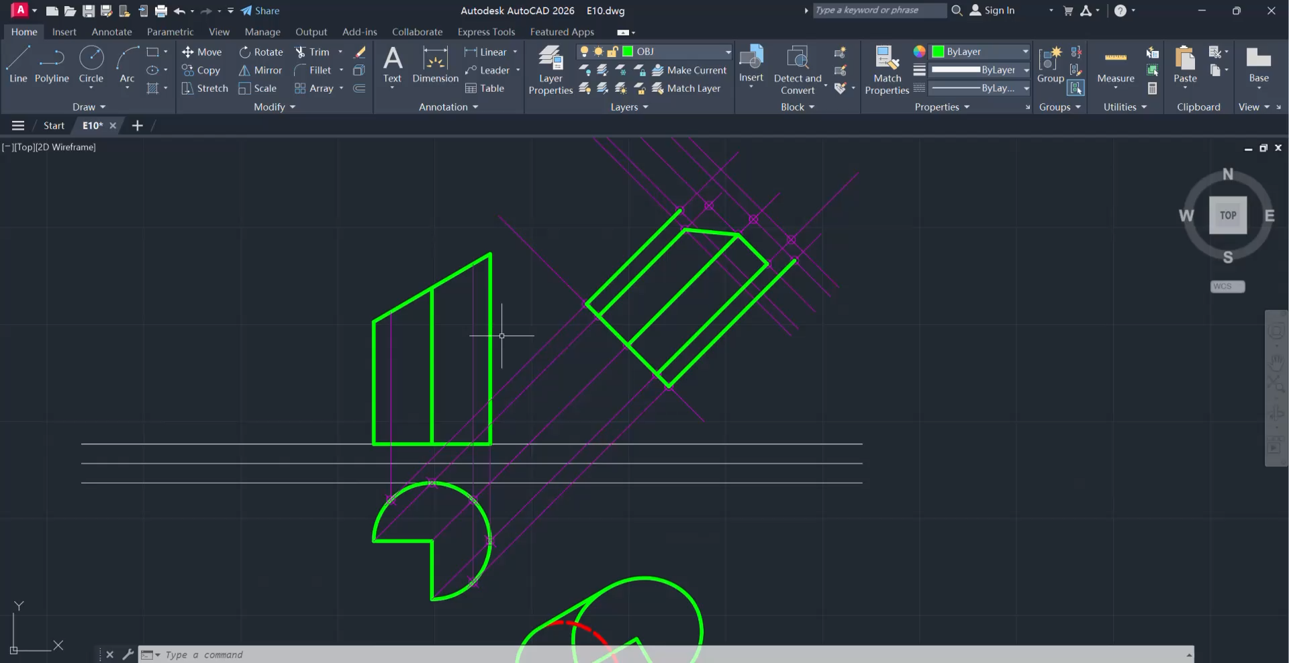
AUXILIARY PROJECTION – SPLINE FIT (Auxiliary Projection for curves)
‘Draw’ > ‘Spline Fit’: a smooth curve fitted to defined points

Slide 8

AUXILIARY PROJECTION – EDGE OF COLUMNS
Generally: draw a line to connect furthest points (visible – solid; invisible – dashed).
Inner surface
90°
View direction

Slide 9
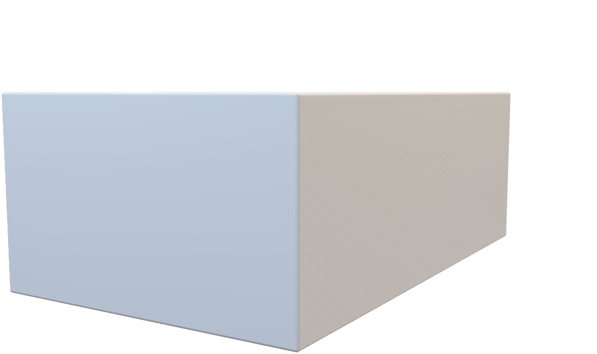
AUXILIARY PROJECTION – HIDDEN LINES
When a hidden line coincide with a solid line, only keep the SOLID line.

Slide 10
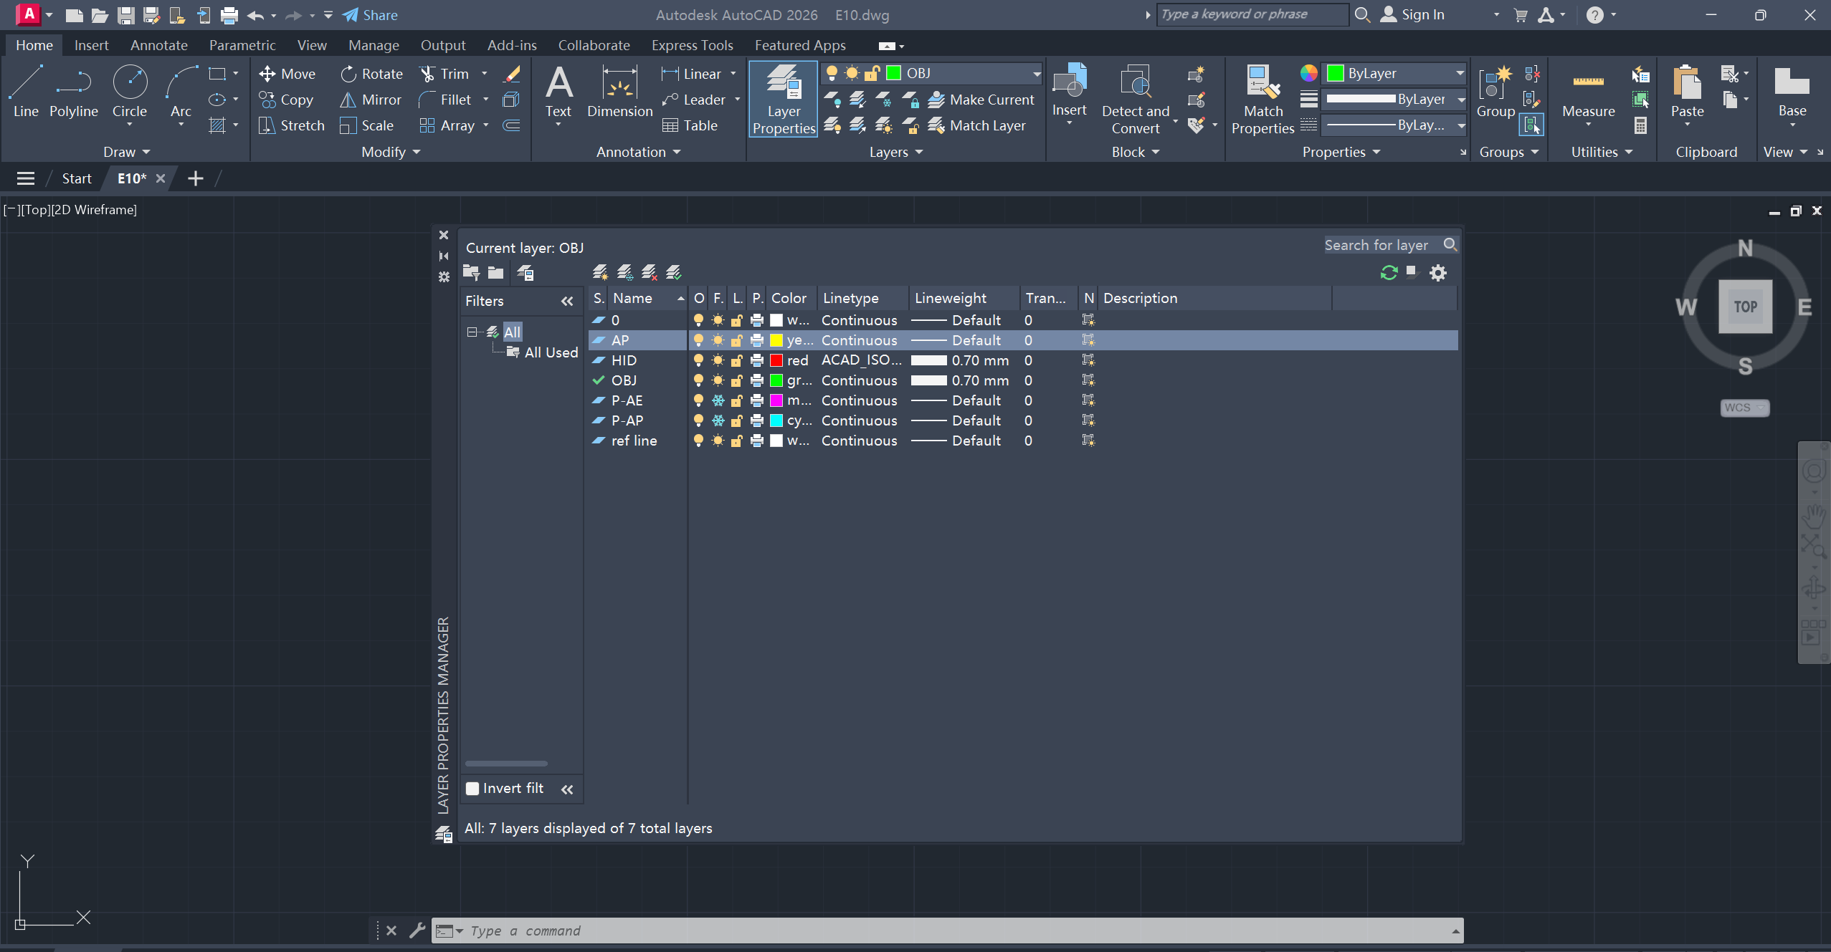
AUXILIARY PROJECTION – HIDDEN LINES
Visible lines/curves, use solid lines/curves;
Hidden lines/curves, use dashed lines/curves.
‘Layer Properties’ > ‘Linetype’ to change solid/dashed lines

Slide 11
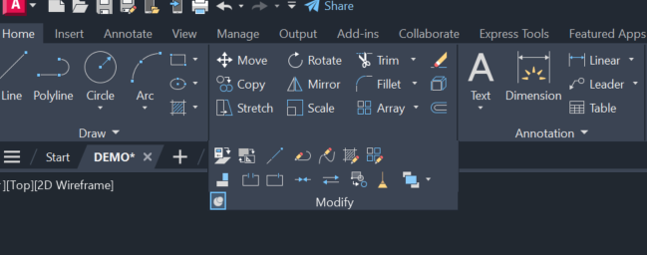
AUXILIARY PROJECTION – BREAK AT A POINT
‘Modify’ > ‘Break at a point’: break the line into 2 parts

Slide 12
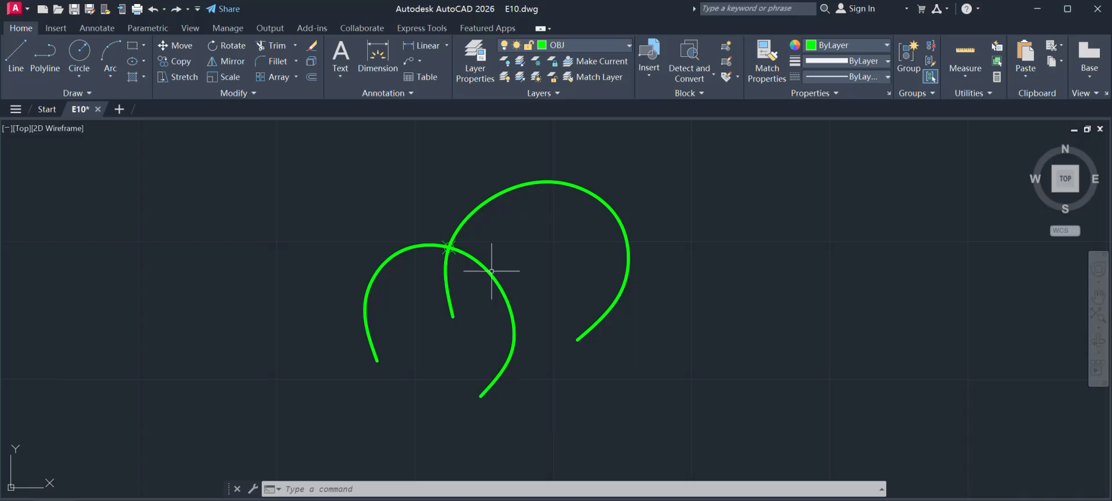
AUXILIARY PROJECTION – HIDDEN LINES & BREAK AT A POINT – EXAMPLE - Video

Slide 13
WEEK 6 – Prepare for Quiz 1
Scope: Auxiliary Projection
Review: E9-E14

Slide 14
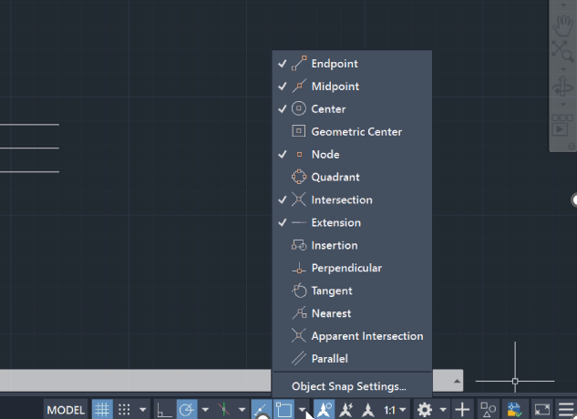
WEEK 6 – Prepare for Quiz 1
To capture nodes in the line/curve
‘Object snap mode’ > Select ‘Node’

Slide 15
WEEK 6 – Prepare for Quiz 1
QUIZ PAPER (cannot be taken out) – Write down Name + Matr.No.
NO INTERNET CONNECTION, ONLY NTULearn Access
Files to submit: DWG + PDF

Slide 16
WEEK 6 – Prepare for Quiz 1
Export DWG:
‘FILE’ (i.e. Autocad icon) > ‘Save As’ > ’.dwg’
Export PDF:
Type ‘print’ > Select printer ‘Microsoft print to pdf’ > Select paper size ‘A3’ > Choose ‘window’ as plot area > Specify window for printing> ‘Preview’ to check > ‘ESC’ exit preview > ‘OK’ to save PDF file

Slide 17
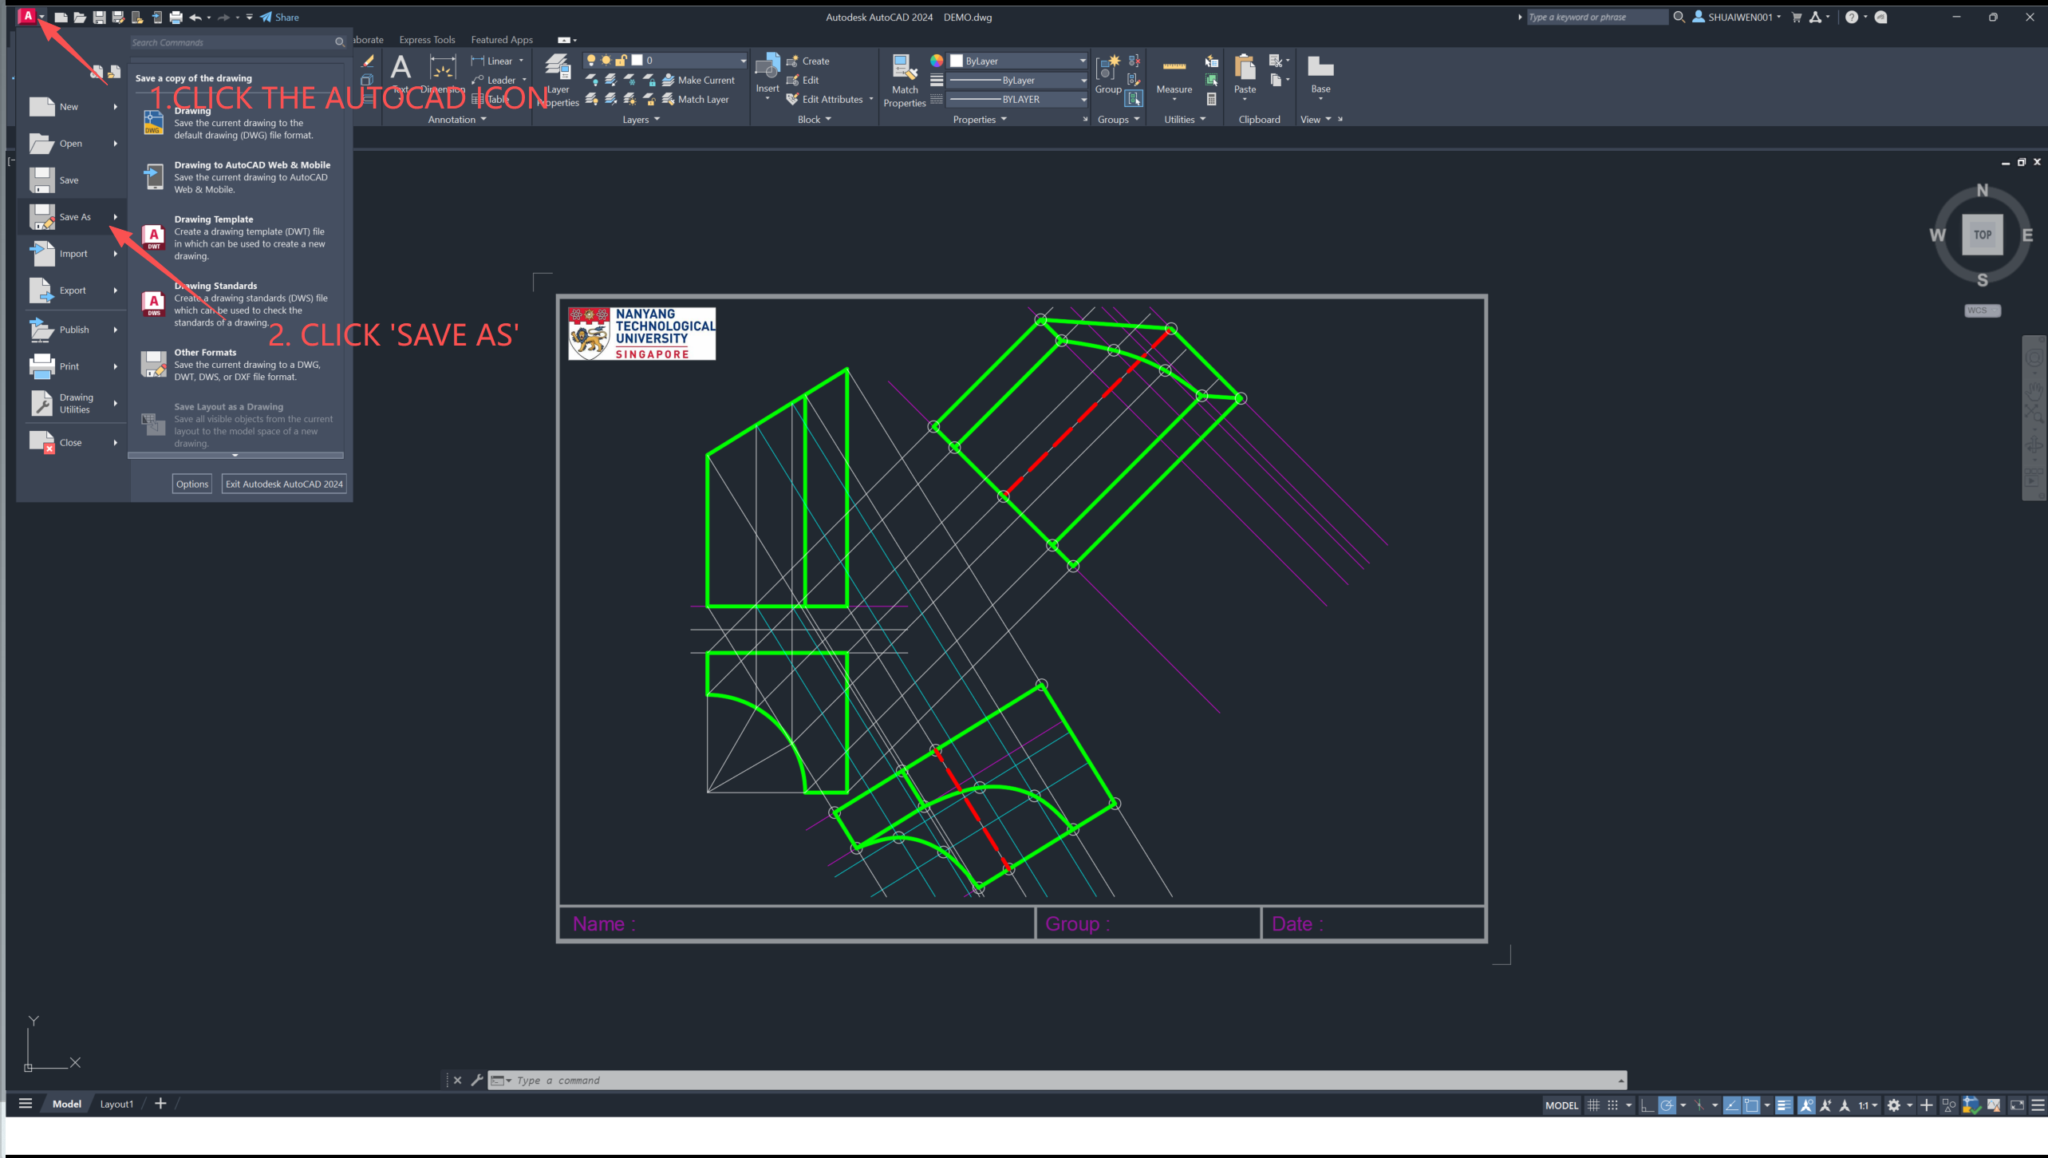

Slide 18
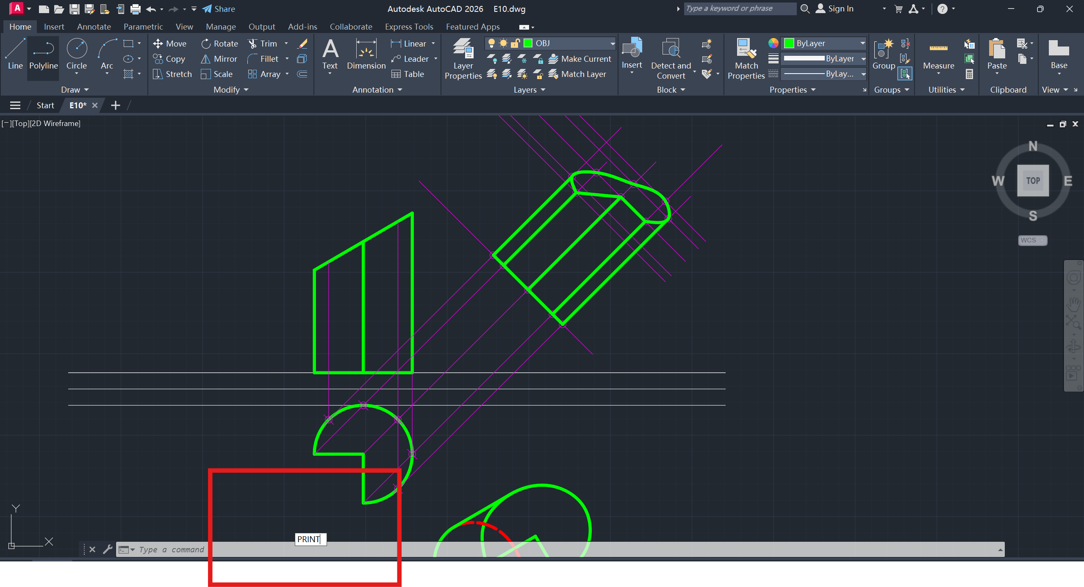
1. Type ‘Print’ & press Enter

Slide 19
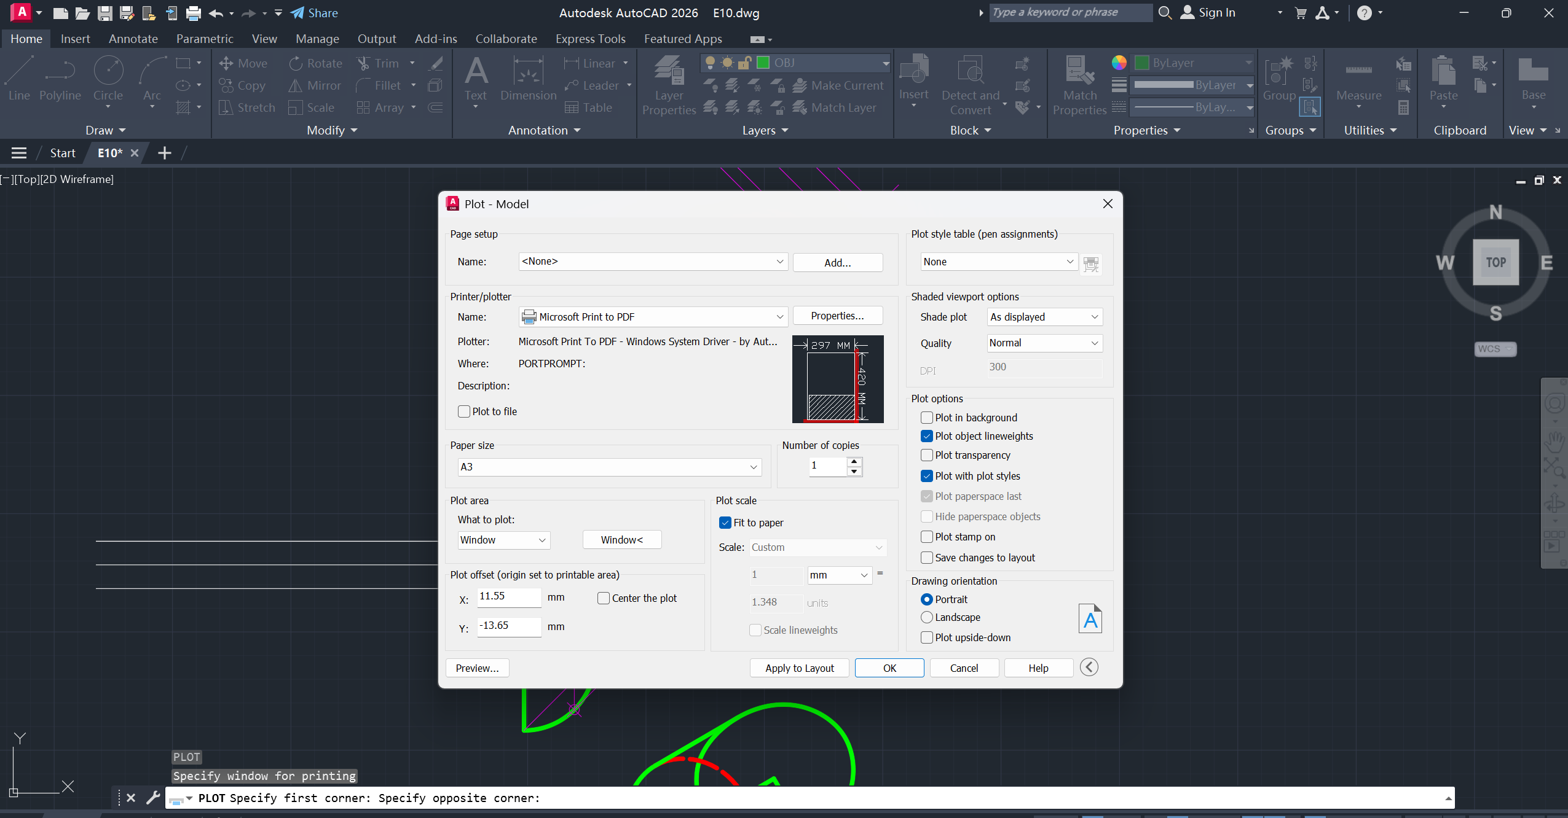
2. Select Microsoft Print to PDF
3. Choose Paper size – A3
4. Select Plot Area – Window
5. Specify window for printing
6. Preview before printing
7. Click ‘OK’ to export PDF

Slide 20
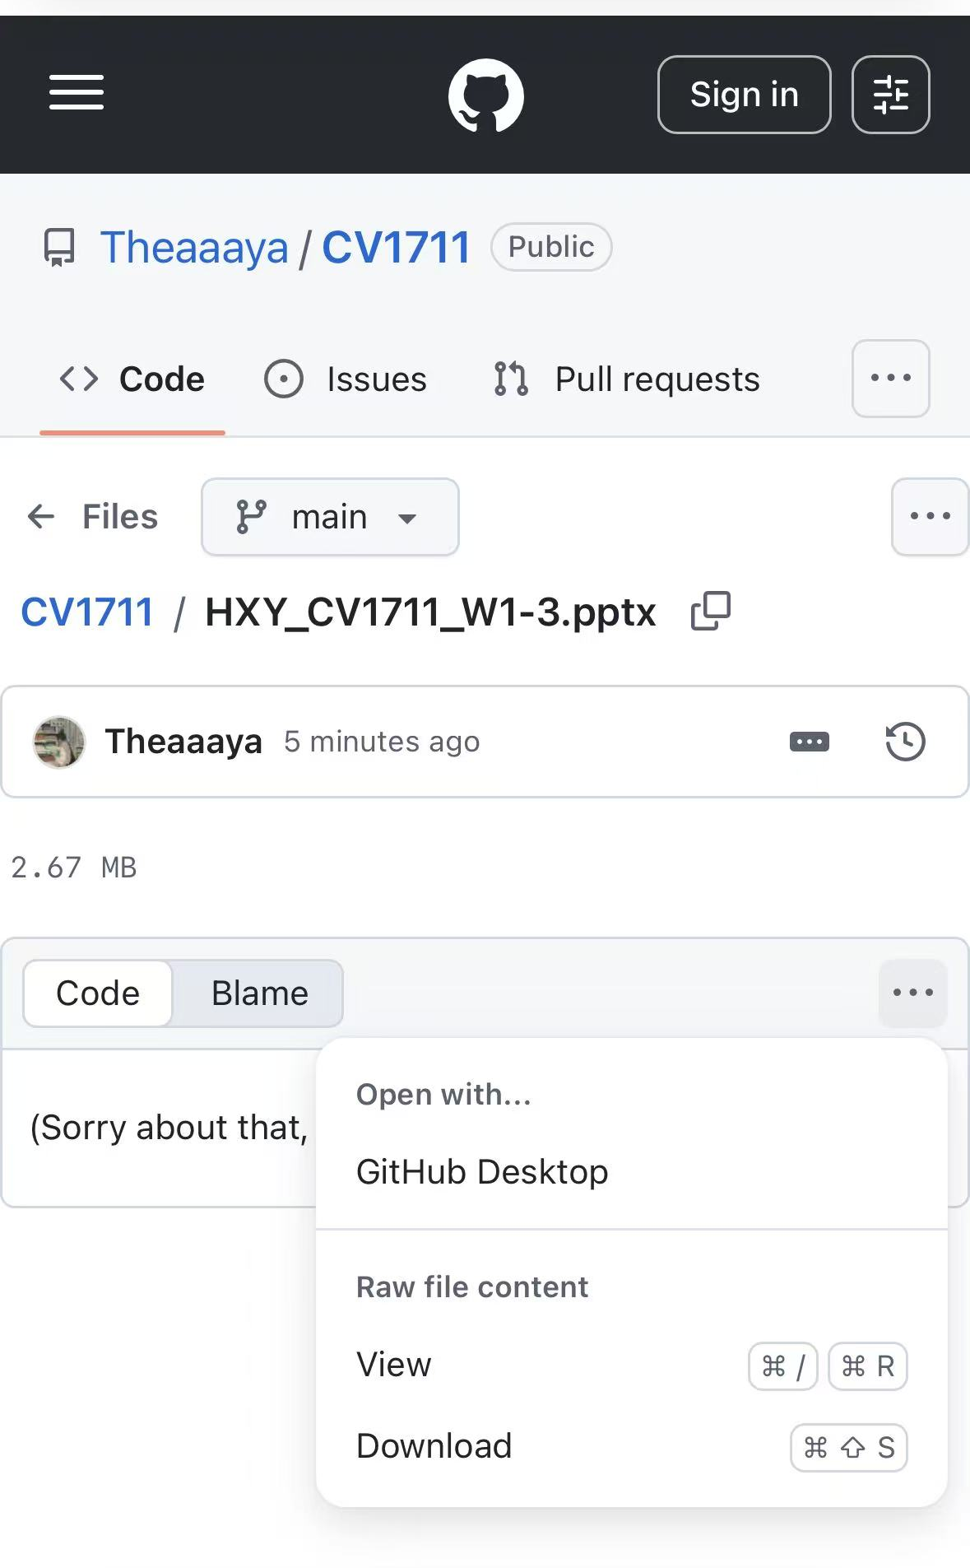

Where to download the slides?

