Slide 1
二分搜索

Slide 2
Binary Search (在检索中识别与target相同的record)
Examines the element in the middle of the array. Is it the sought item? If so, stop searching. Is the middle element too small? Then start looking in second half of array. Is the middle element too large? Then begin looking in first half of the array.
Repeat the process in the half of the data that should be examined next.
Stop when item is found, or when there is nowhere else to look and item has not been found.

Slide 3
Trace of Binary Search
item = 84
15 26 38 57 62 78 84 91 108 119
data[0] [1] [2] [3] [4] [5] [6] [7] [8] [9]
first middle last
item > data [ middle ] first = middle + 1
15 26 38 57 62 78 84 91 108 119
data[0] [1] [2] [3] [4] [5] [6] [7] [8] [9]
first middle last
item < data [ middle ] last = middle - 1

Slide 4
Trace continued
item = 84
15 26 38 57 62 78 84 91 108 119
data[0] [1] [2] [3] [4] [5] [6] [7] [8] [9]
first, last
middle
item > data [ middle ] first = middle + 1
15 26 38 57 62 78 84 91 108 119
data[0] [1] [2] [3] [4] [5] [6] [7] [8] [9]
first,
last,
middle
item == data [ middle ] found = true

Slide 5
Another Binary Search Trace
item = 45
15 26 38 57 62 78 84 91 108 119
data[0] [1] [2] [3] [4] [5] [6] [7] [8] [9]
first middle last
item < data [ middle ] last = middle - 1
15 26 38 57 62 78 84 91 108 119
data[0] [1] [2] [3] [4] [5] [6] [7] [8] [9]
first middle last
item > data [ middle ] first = middle + 1

Slide 6
Trace continued
item = 45
15 26 38 57 62 78 84 91 108 119
data[0] [1] [2] [3] [4] [5] [6] [7] [8] [9]
first, last
middle
item > data [ middle ] first = middle + 1
15 26 38 57 62 78 84 91 108 119
data[0] [1] [2] [3] [4] [5] [6] [7] [8] [9]
first,
middle,
last
item < data [ middle ] last = middle - 1

Slide 7
Trace concludes
item = 45
15 26 38 57 62 78 84 91 108 119
data[0] [1] [2] [3] [4] [5] [6] [7] [8] [9]
last first
first > last found = false

Slide 8
递归实现代码
Error_code recursive_binary_2(const Ordered_list &the_list, const Key &target, int bottom, int top, int &position)
{
Record data;
if (bottom <= top) {
int mid = (bottom + top)/2;
the_list.retrieve(mid, data);
if (data == target) {
position = mid;
return success;
}
else if (data < target)
return recursive_binary_2(the_list, target, mid + 1, top, position);
else
return recursive_binary_2(the_list, target, bottom, mid - 1, position);
}
else return not_present;
}

Slide 9
循环实现代码
Error_code binary_search_2(const Ordered_list &the_list, const Key &target, int &position)
/* Post: If a Record in the list has key equal to target , then position locates
one such entry and a code of success is returned. Otherwise, not present is returned
and position is undefined.
Uses: Methods for classes Ordered_list and Record . */
{
Record data;
int bottom = 0, top = the_list.size( ) - 1;
while (bottom <= top) {
position = (bottom + top)/2;
the_list.retrieve(position, data);
if (data == target) return success;
if (data < target) bottom = position + 1;
else top = position - 1;
}
return not_present;
}

Slide 10
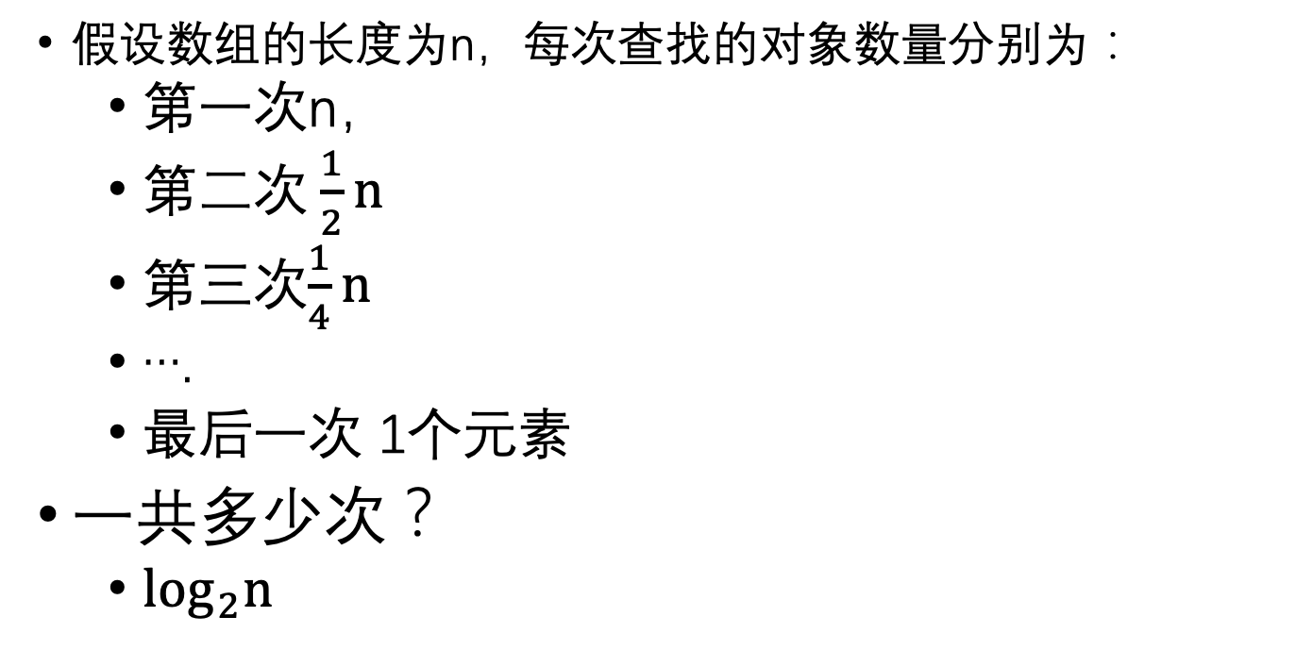
二分法的效率分析
假设数组的长度为n，每次查找的对象数量分别为：
第一次n，
第二次$\frac{1}{2}n$
第三次$\frac{1}{4}n$
….
最后一次 1个元素
一共多少次？
$\log_{2}n$

