Slide 1



Sarvajanik Education Society Sarvajanik College of Engineering & Technology, Surat. Department of Computer Applications Academic Year: 2025 – 26
A Project On
“InvestSphere”
Presented By
Anant Soni (ET24MTCA064)
M.C.A. II Sem. 4
Under the Guidance of
Prof. Zankhana Vaishnav

Slide 2
AGENDA
Company Profile
System Description
Project Overview
Database Design
File System
Use Case Diagram
Class Diagram
Interaction Diagram
Activity Diagram
Data Dictionary
Screen Shots
References

Slide 3
Company Profile:
CODING HOUSE – Company Overview
CODING HOUSE is a technology-driven software development company focused on building reliable, scalable, and user-centric digital solutions. We help startups, small businesses, and growing enterprises turn ideas into high-quality products using modern technologies and proven development practices.
What We Do:
● Mobile App Development (Flutter, Android, iOS)
● Web Development (React, Node.js, PHP, WordPress)
● UI/UX Design (Figma-based, conversion-focused designs)
● Custom Software Solutions
● API Development & Integrations
Our Approach:
At CODING HOUSE, we follow a transparent and collaborative development process:
● Clear understanding of client requirements
● Structured planning and architecture
● Agile development with regular updates

Slide 4
System Description
Database:
MongoDB Atlas (Cloud Database) used for data storage
Stores:
User data
Investments Watchlists
Scalable and accessible from anywhere
Media Storage:
Cloudinary used for storing images and media files
Fast CDN delivery and optimized asset handling
Authentication & Security:
OTP-based email authentication system
Secure login and user verification
JWT (JSON Web Token) for session management
Development Framework:
Frontend developed using React.js
Backend built with Node.js and Express.js
RESTful APIs for seamless client-server communication
UI / Frontend Design:
Component-based architecture using React.js
Styled using Tailwind CSS for modern, responsive UI
Mobile-friendly and optimized user experience
Programming Language:
JavaScript (ES6+) used across frontend and backend
Ensures consistency and faster development

Slide 5
Project Overview:
InvestSphere is a MERN-based web application for managing and tracking investments efficiently.
It provides a centralized platform to monitor Stocks, SIPs, IPOs, Market News and Watchlists with real-time insights.
Built on a modular and scalable architecture, ensuring high performance and maintainability.
Includes secure authentication, data visualization, and interactive dashboards.
Designed using scalable MERN architecture with cloud integration (MongoDB Atlas & Cloudinary)
Core System Features
OTP-based Login & Registration
Dashboard for SIP, Stocks & IPO tracking
Watchlist with real-time market data
Reports & Analytics for performance tracking
Profile management with Cloudinary (image upload)
Data stored securely in MongoDB Atlas
API-based communication (Frontend ↔ Backend)
User Functional Capabilities
Manage investments including SIP, Stocks, and IPOs
Add and track assets in a personalized watchlist
View real-time market data and insights
Access reports and analytics for better decision-making
Update profile details and upload images using Cloudinary integration
Secure authentication using OTP & JWT

Slide 6
Database Design:
Database Name:
investsphereDB
Collection Name:
1. Register (Users Table)
2. Watchlists
3. Wallets
4. Transactions
5. StockInvestment
6. IpoInvestments
7. SipInvestments
8. Reports
9. Notification
10. Messages

Slide 7
Collection: Register (Users Table)
Field Name | Data Type | Description
_id | ObjectId | Unique user ID
name | String | User full name
email | String | User email address
password | String | Encrypted password
phone | String | Contact number
country | String | User country
State | String | User state
Dob | Date | Date of birth
Pan | String | PAN card number
Verified | Boolean | Email verification status
profileImage | String | Cloudinary image URL
profileImageId | String | Cloudinary public ID
createdAt | Date | Account creation date
updatedAt | Date | Last update date

Slide 8
Collection: Reports
Field Name | Data Type | Description
_id | ObjectId | Unique report ID
title | String | Issue title
description | String | Issue description
userEmail | String | User email
username | String | User name
createdAt | Date | Report created date
updatedAt | Date | Last updated date

Slide 9
Collection: Watchlists
Field Name | Data Type | Description
_id | ObjectId | Unique ID
email | String | User email
itemCode | String | Asset code (IPO/Stock)
itemName | String | Asset name
type | String | Type (IPO / Stock / SIP)
createdAt | Date | Added date
updatedAt | Date | Last updated date

Slide 10
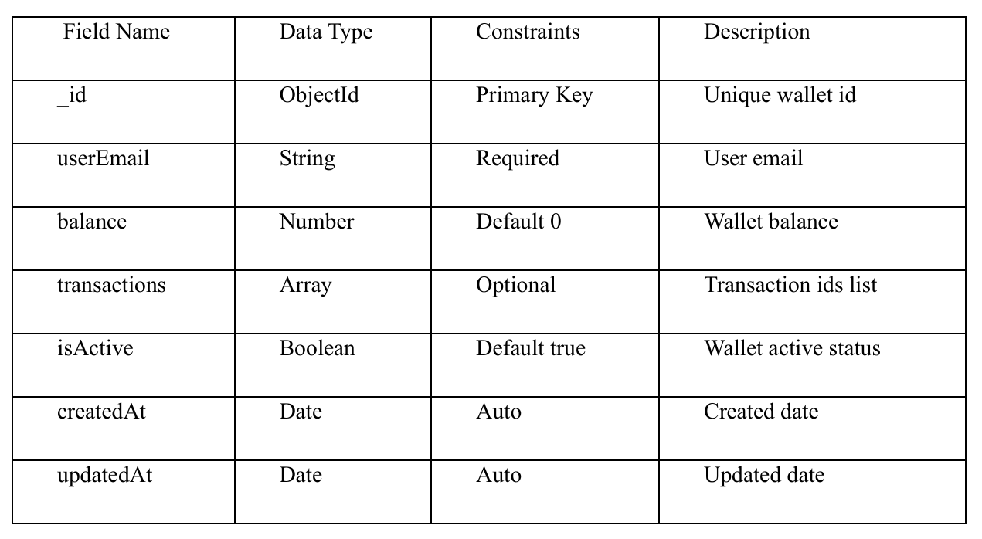
Collection: Wallets

Slide 11
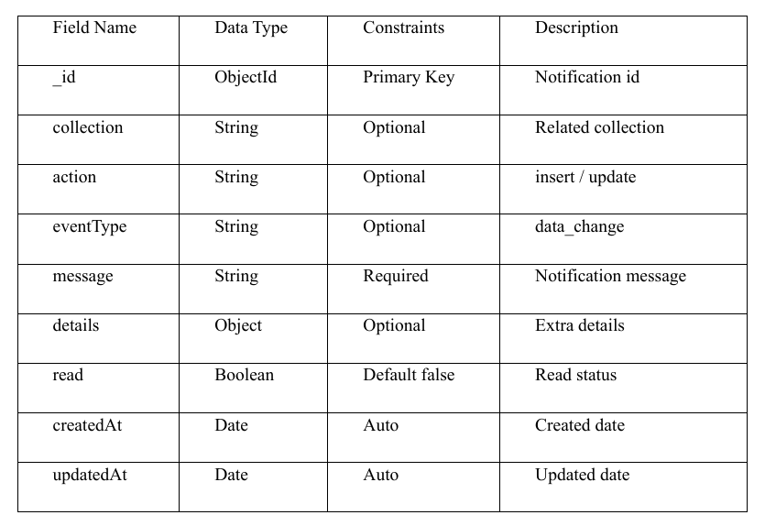
Collection: Notification

Slide 12
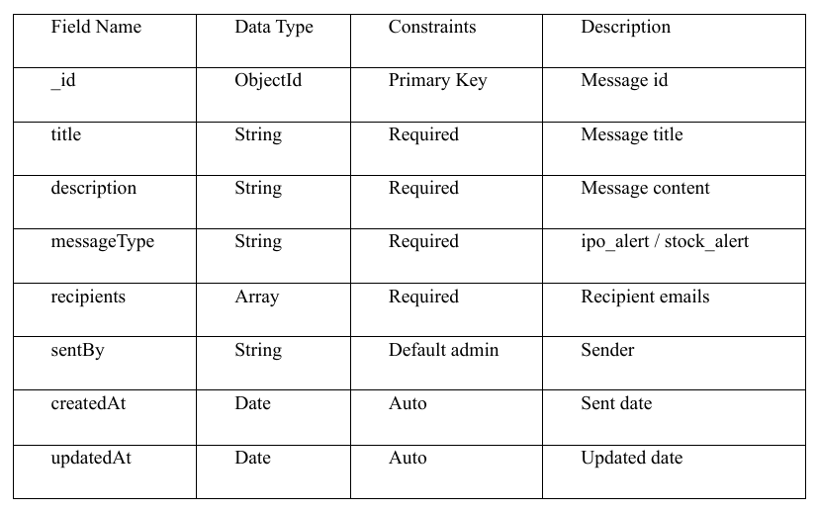
Collection: Messages

Slide 13
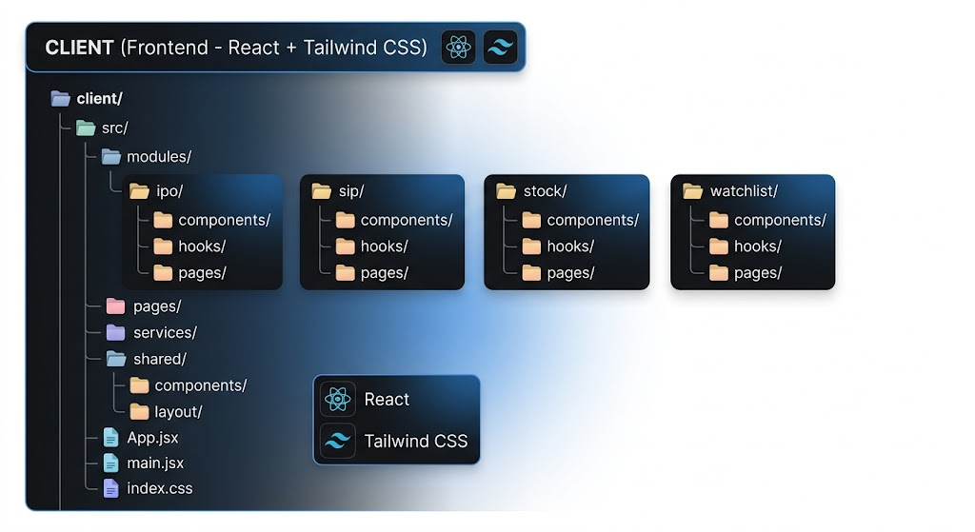
File System: (Client)

Slide 14
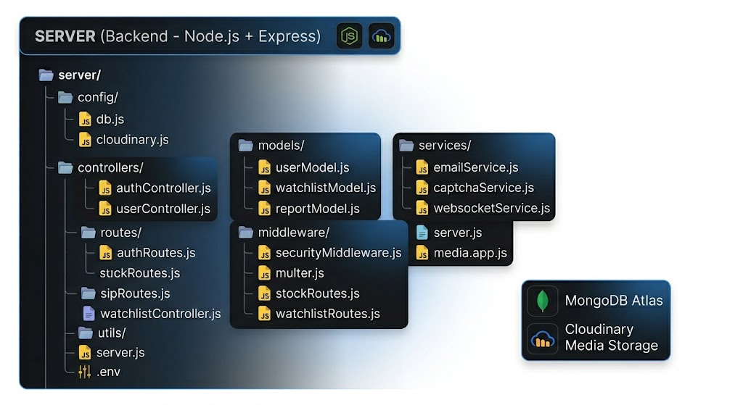
File System: (Server)

Slide 15
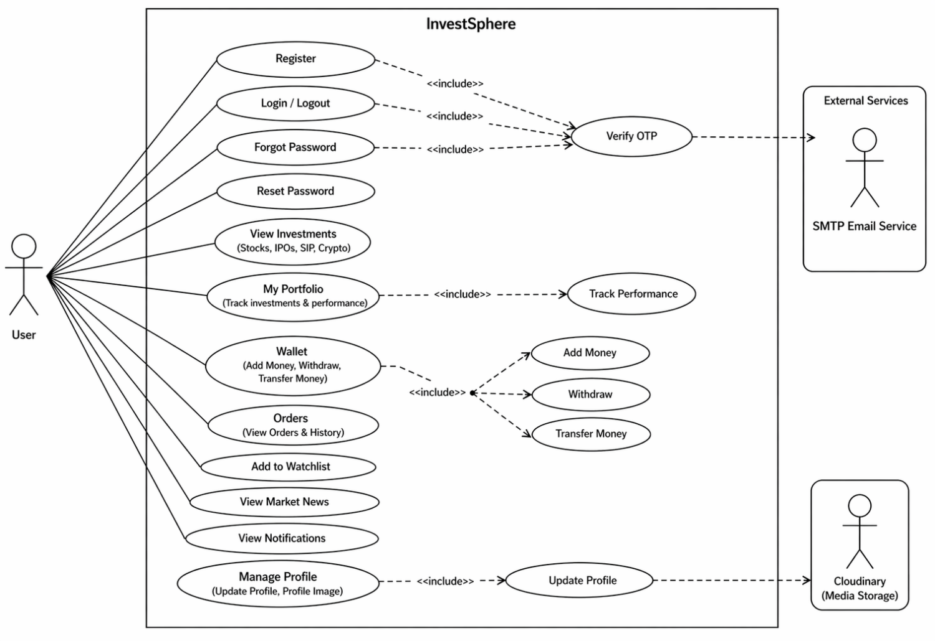
Use Case Diagram: (Client)

Slide 16
Use Case Diagram: (Admin)

Slide 17
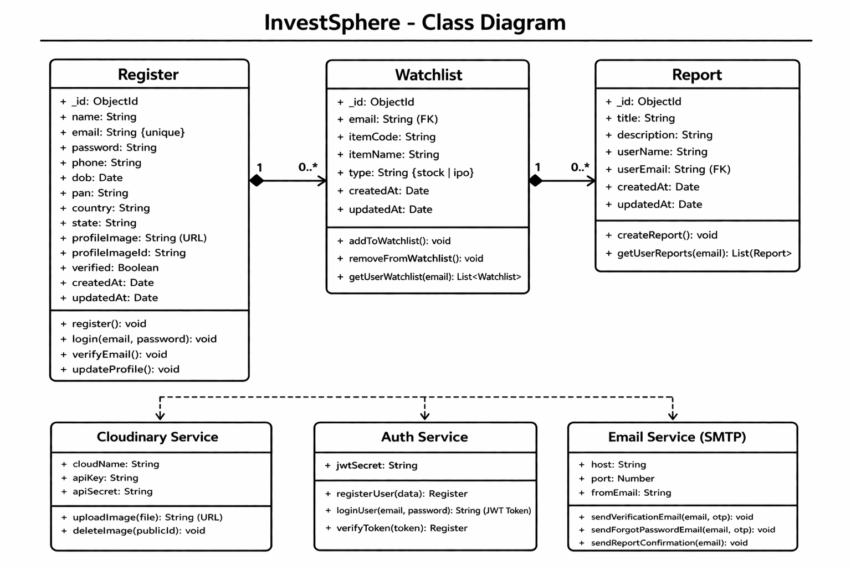
Class Diagram:

Slide 18
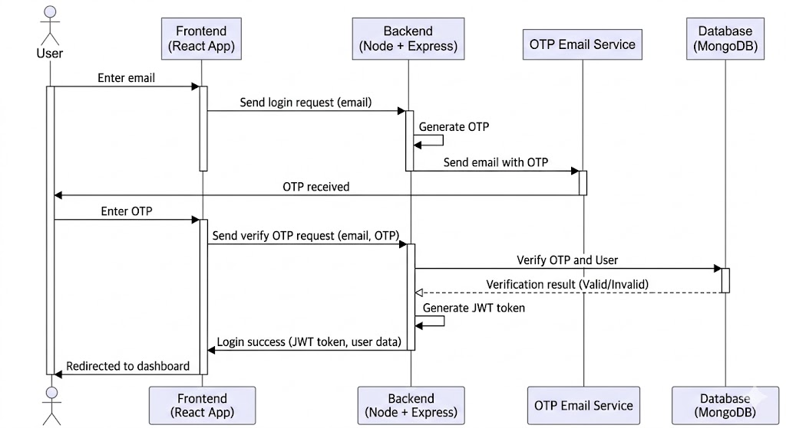
Interaction Diagram:

Slide 19
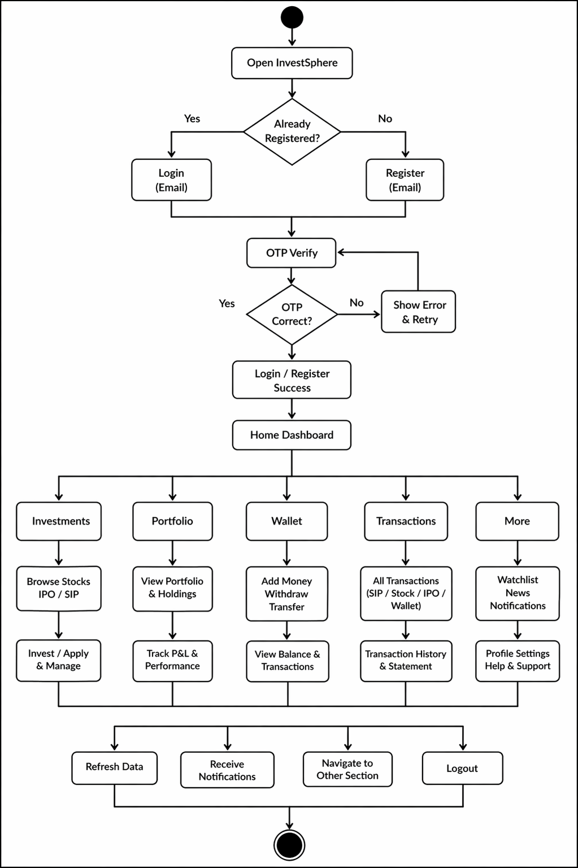
Activity Diagram : (client)

Slide 20
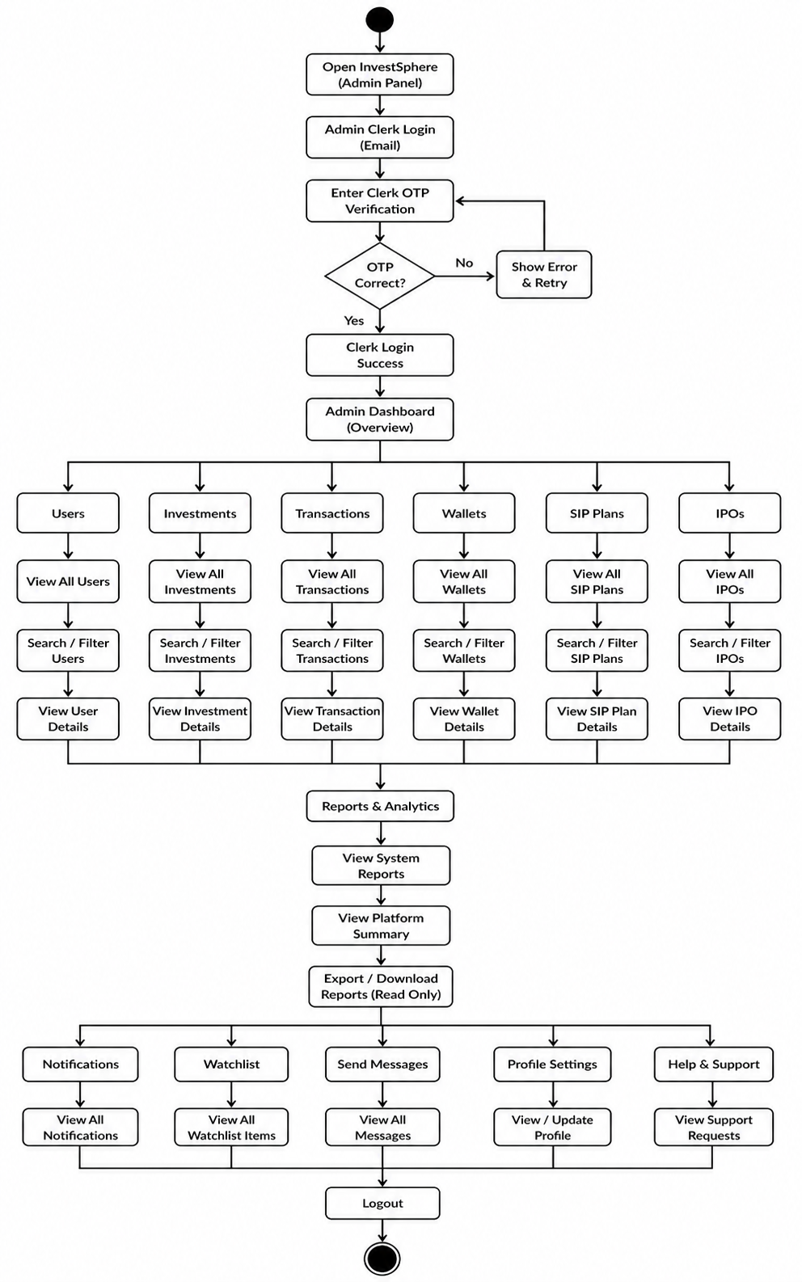
Activity Diagram : (Admin)

Slide 21
Data Dictionary:
1. User Collection • Stores user account details like name, email, encrypted password, and profile image (Cloudinary). • Used for authentication, authorization, and maintaining user identity in the system.
2. Investment Collection • Tracks all user investments including IPO, Stock, and SIP with amount and timestamps. • Helps users manage and monitor their portfolio in a centralized dashboard.
3. Watchlist Collection • Stores assets that users want to track for future investment decisions. • Allows easy monitoring of IPOs, stocks, and SIPs without investing.

Slide 22
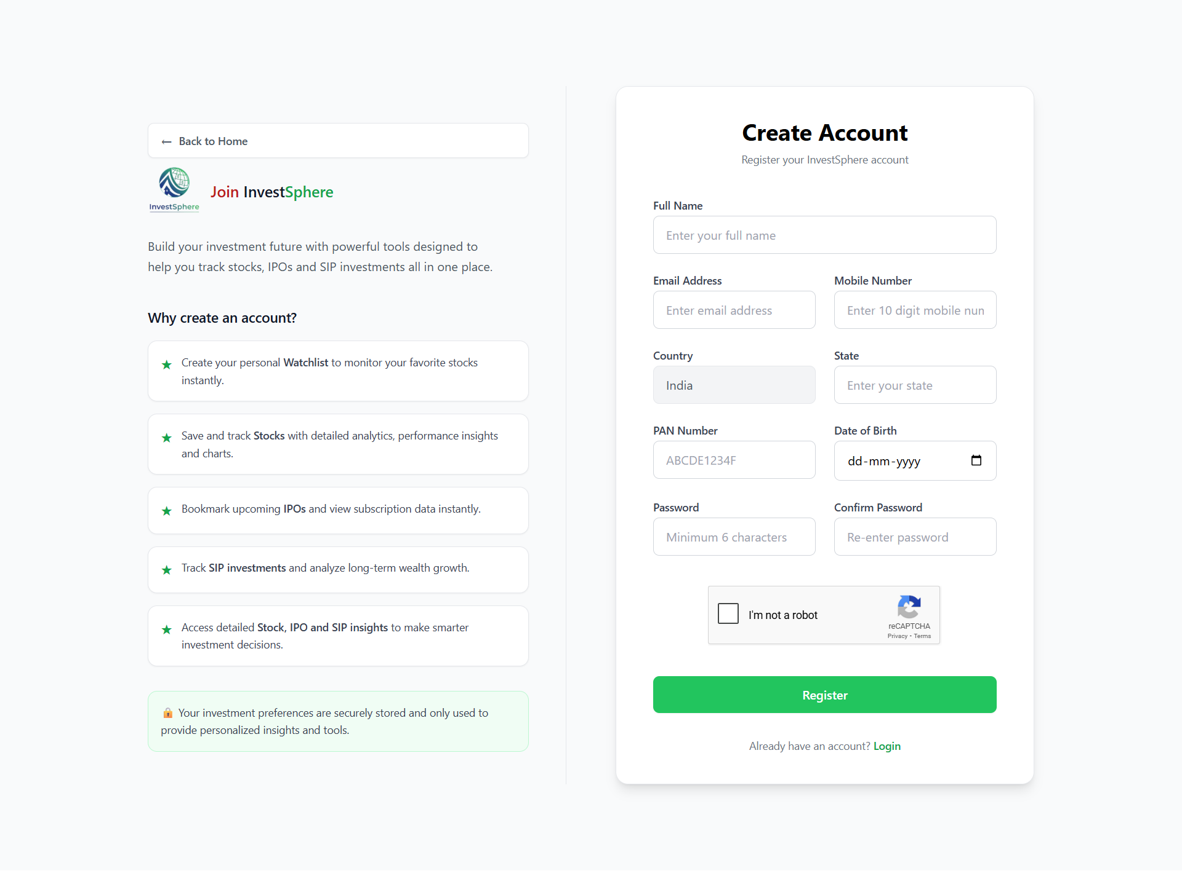
Screenshots:
Registration Page:

Slide 23
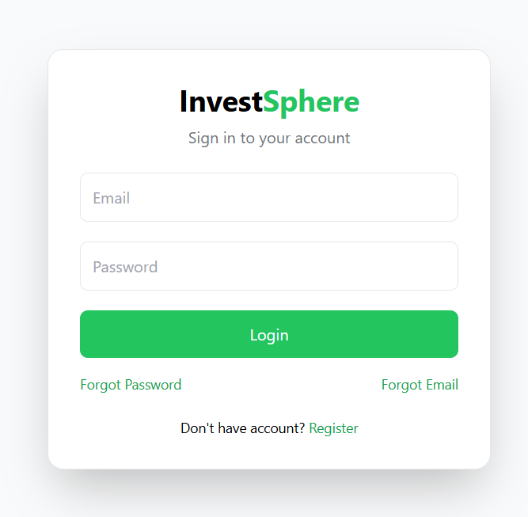
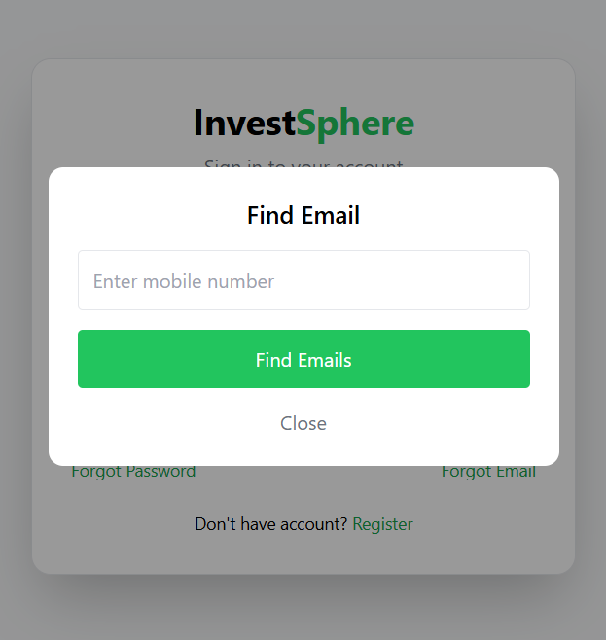
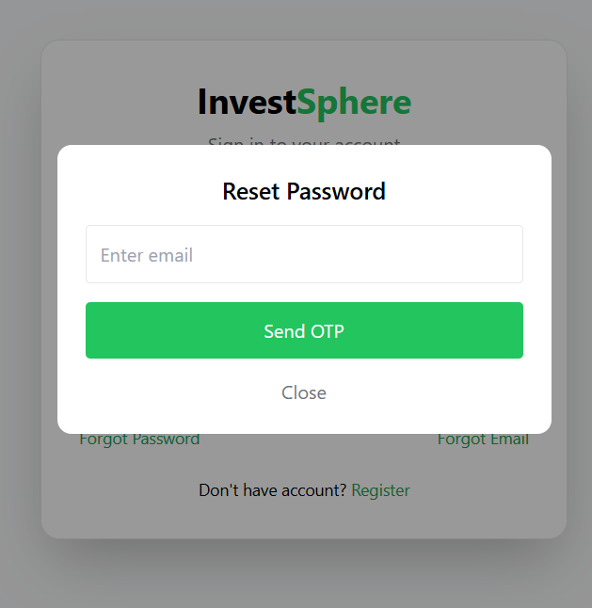
Login Page:

Slide 24
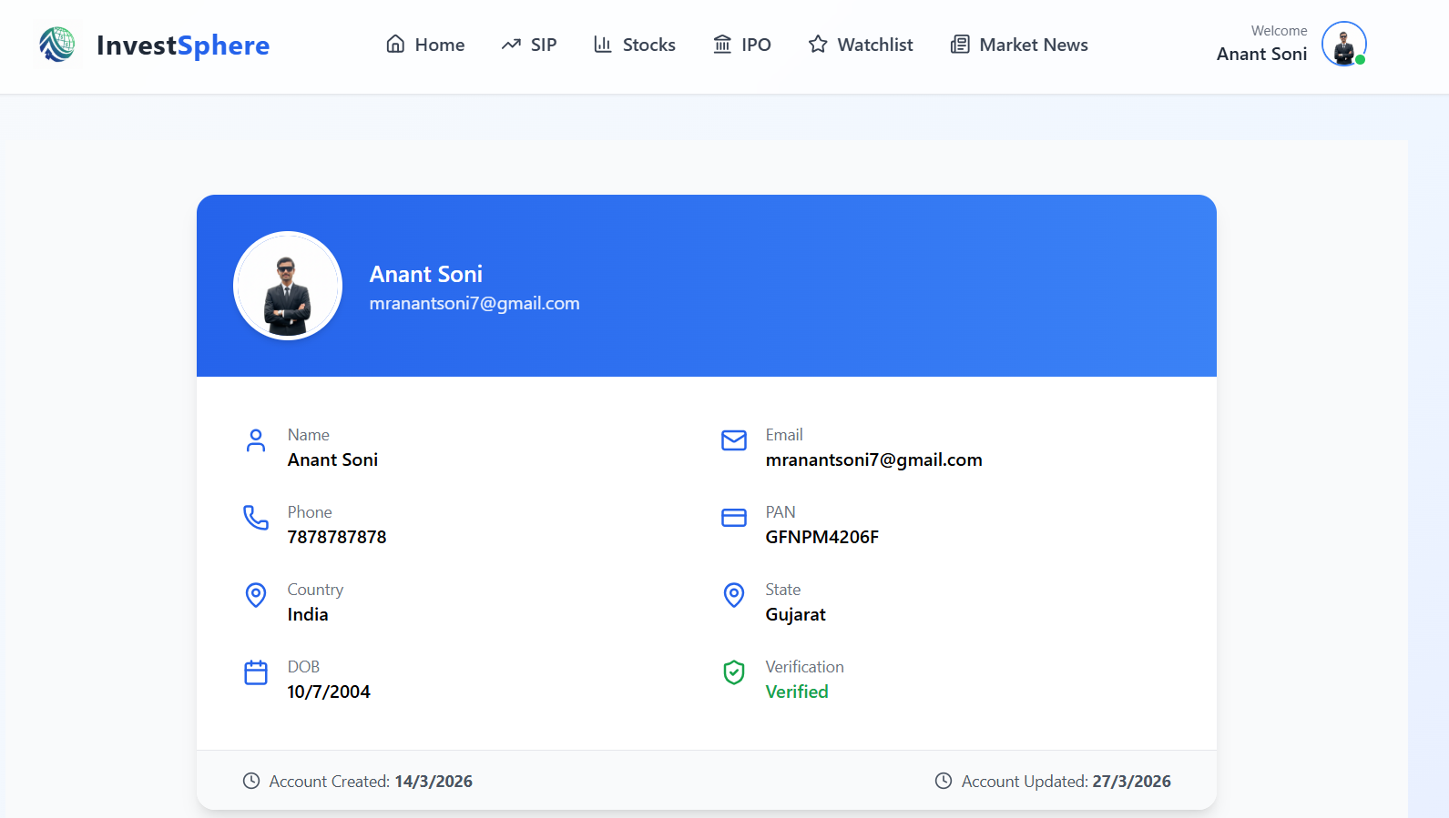
User Profile Page:

Slide 25
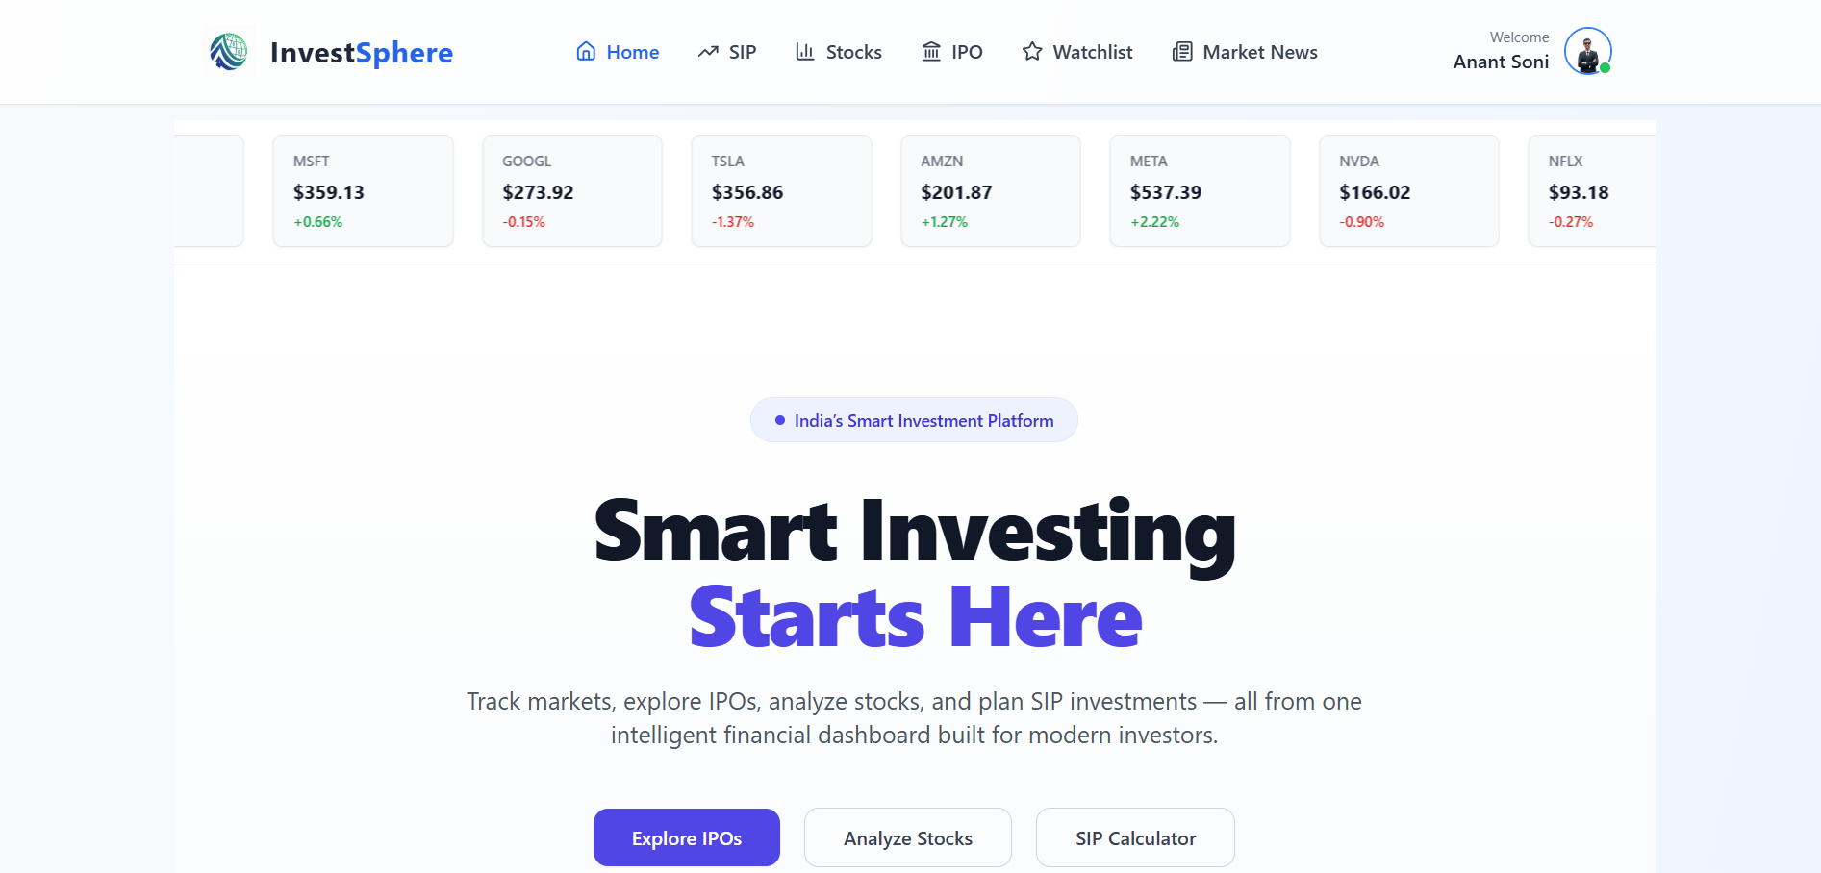
Home Page:

Slide 26
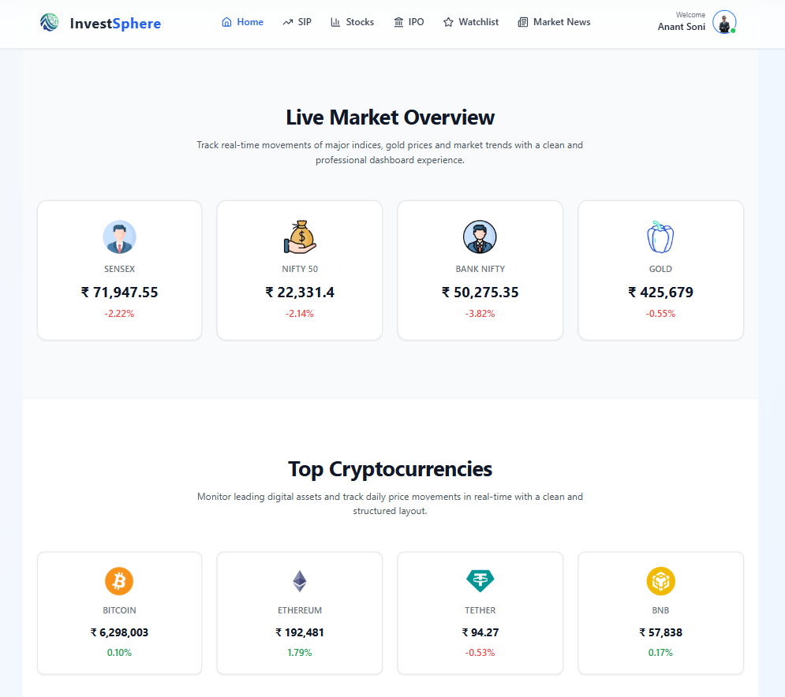
Home Page:

Slide 27
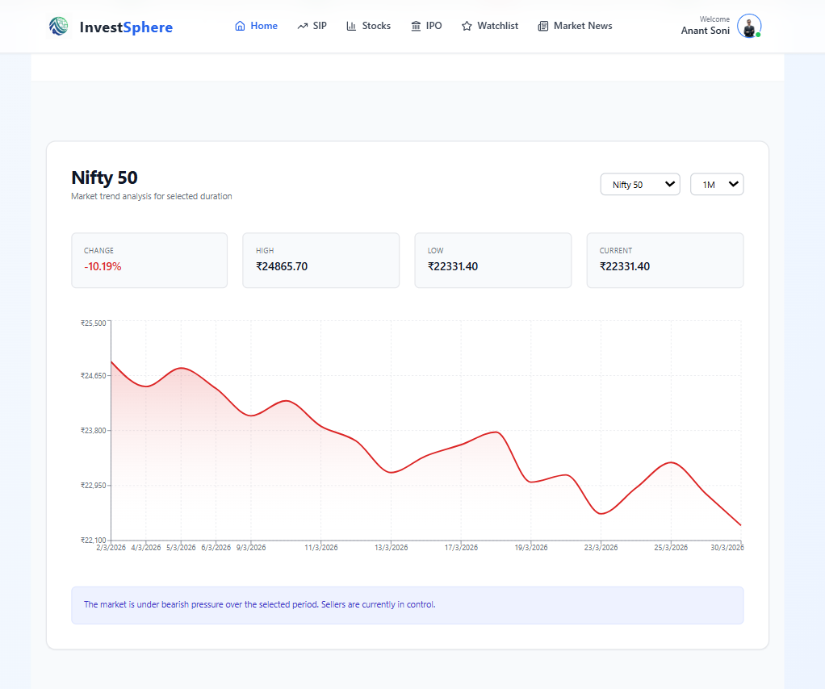
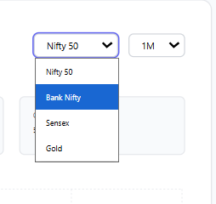
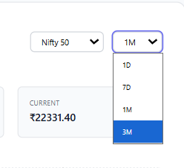
Home Page:

Slide 28
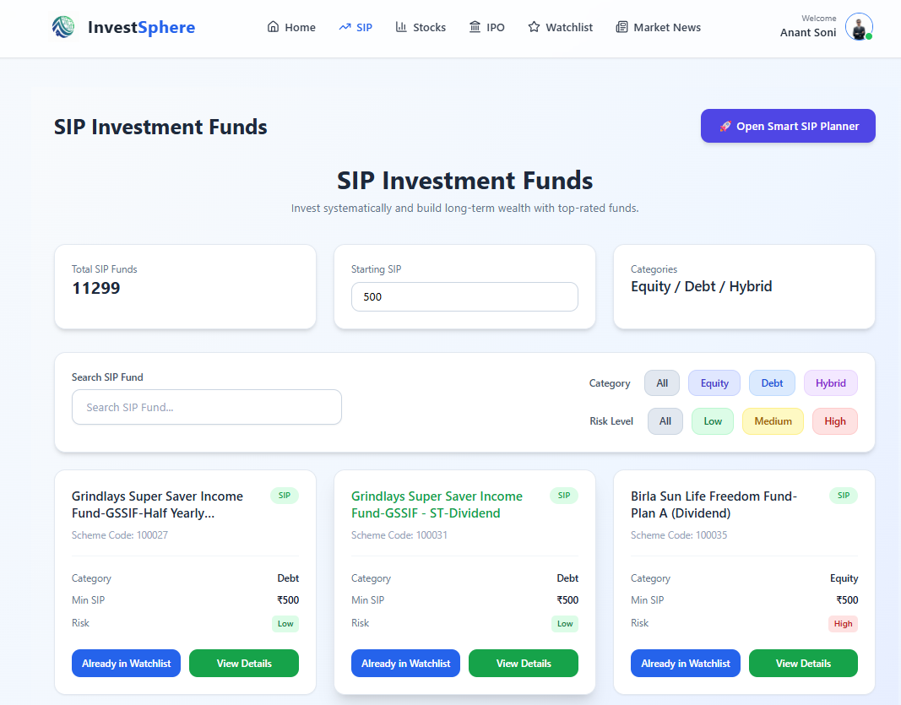
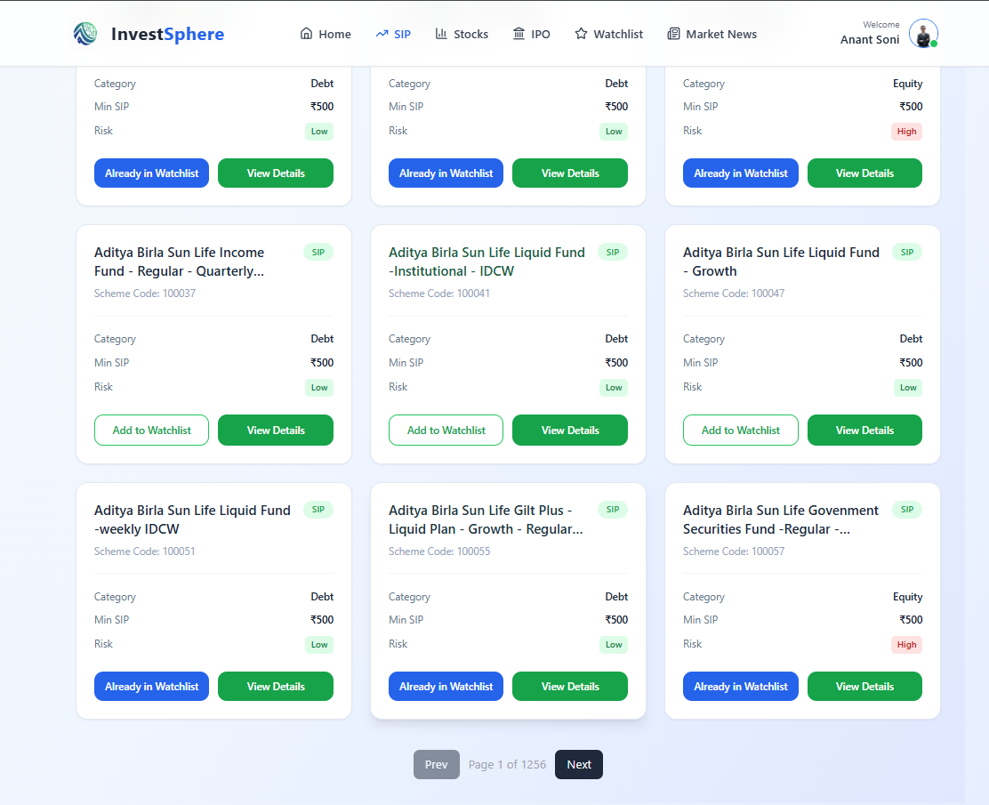
SIP Page:

Slide 29
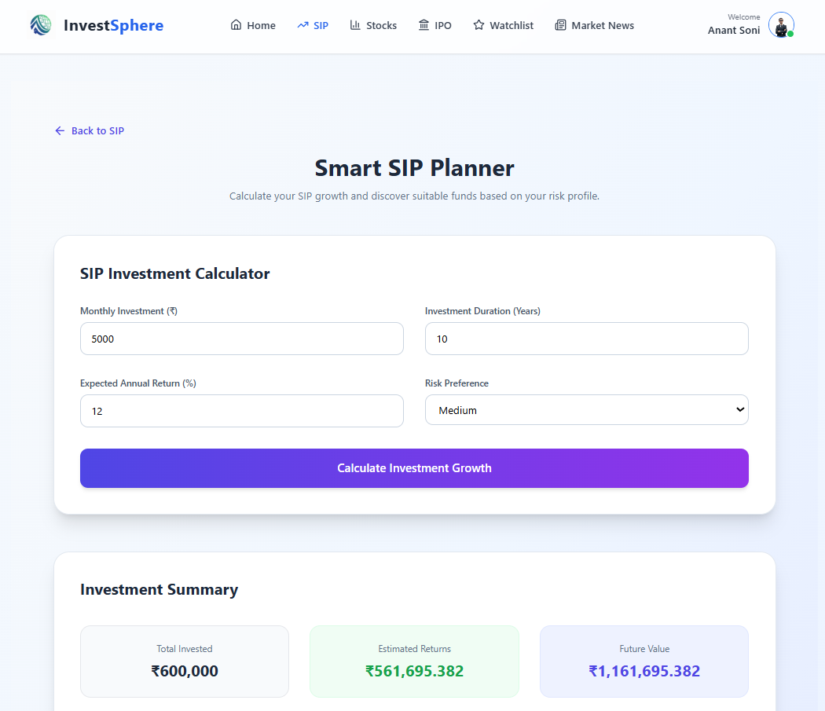
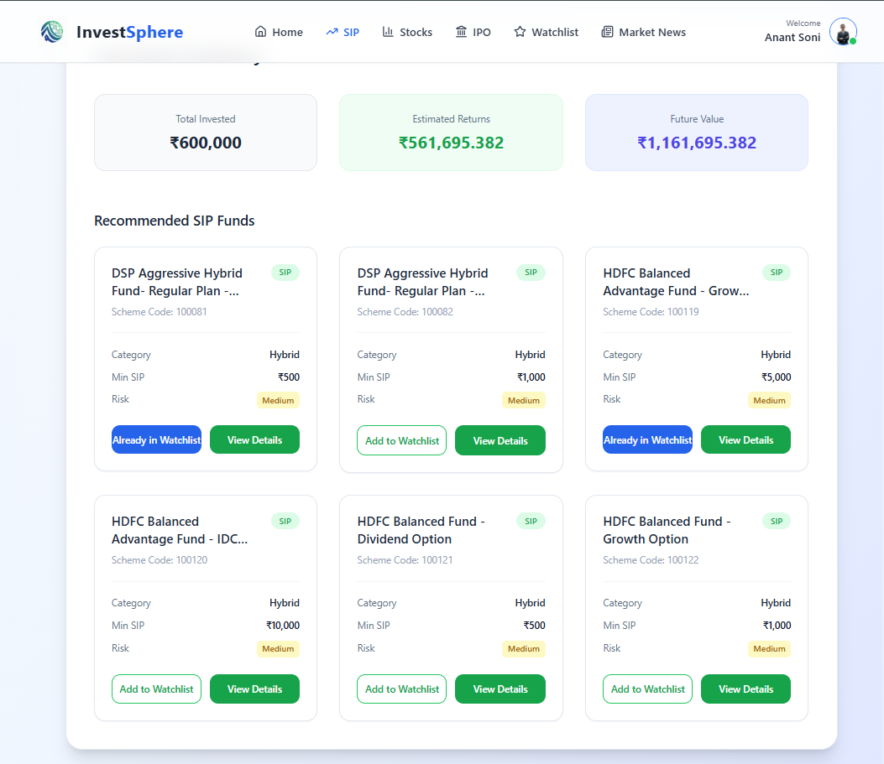
SIP Page:

Slide 30
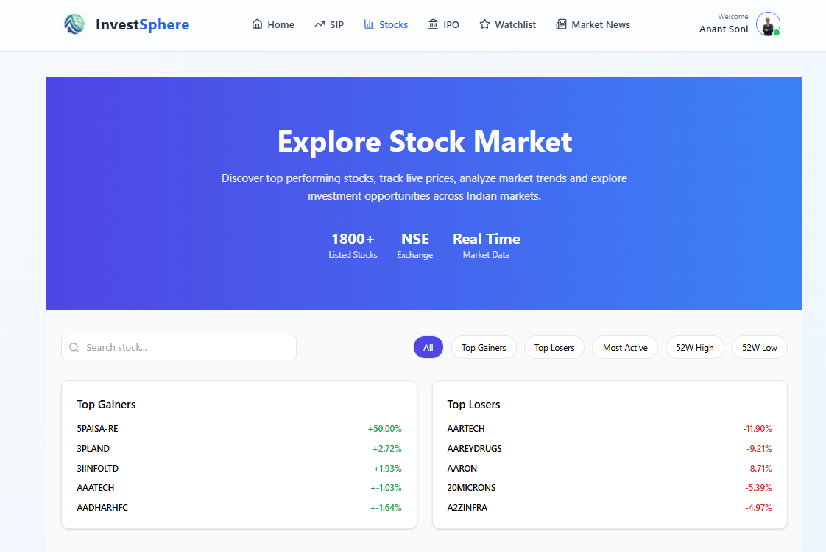
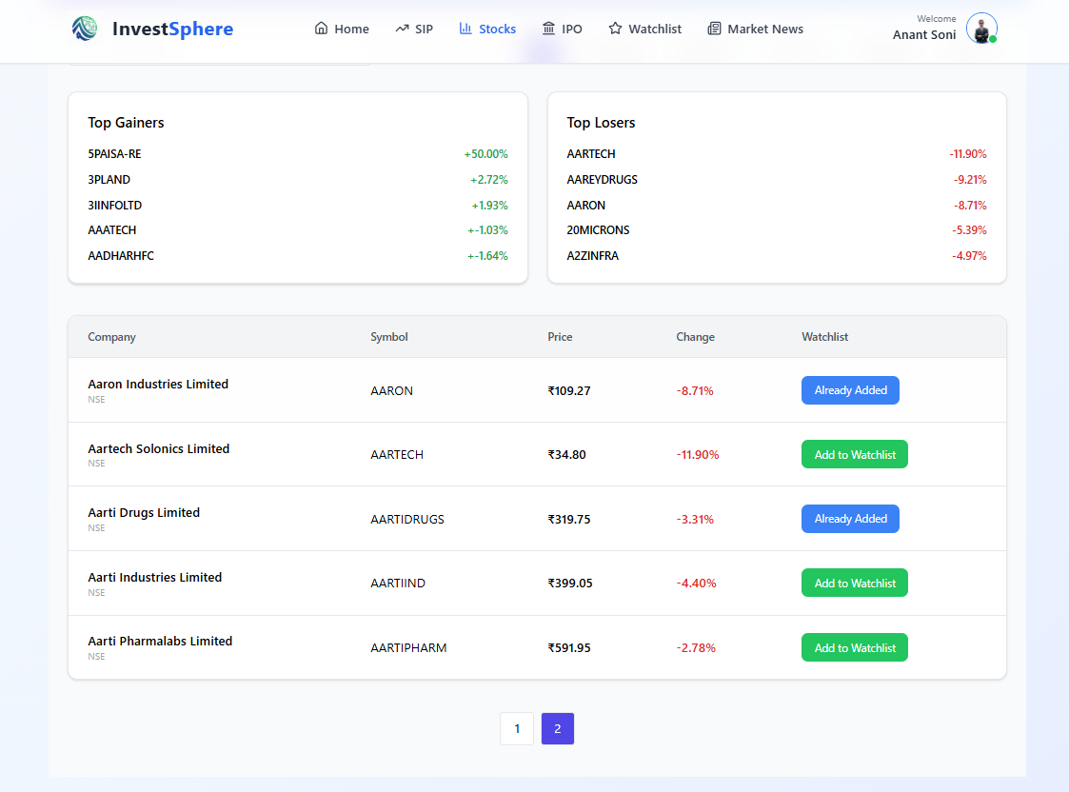
Stock Page:

Slide 31
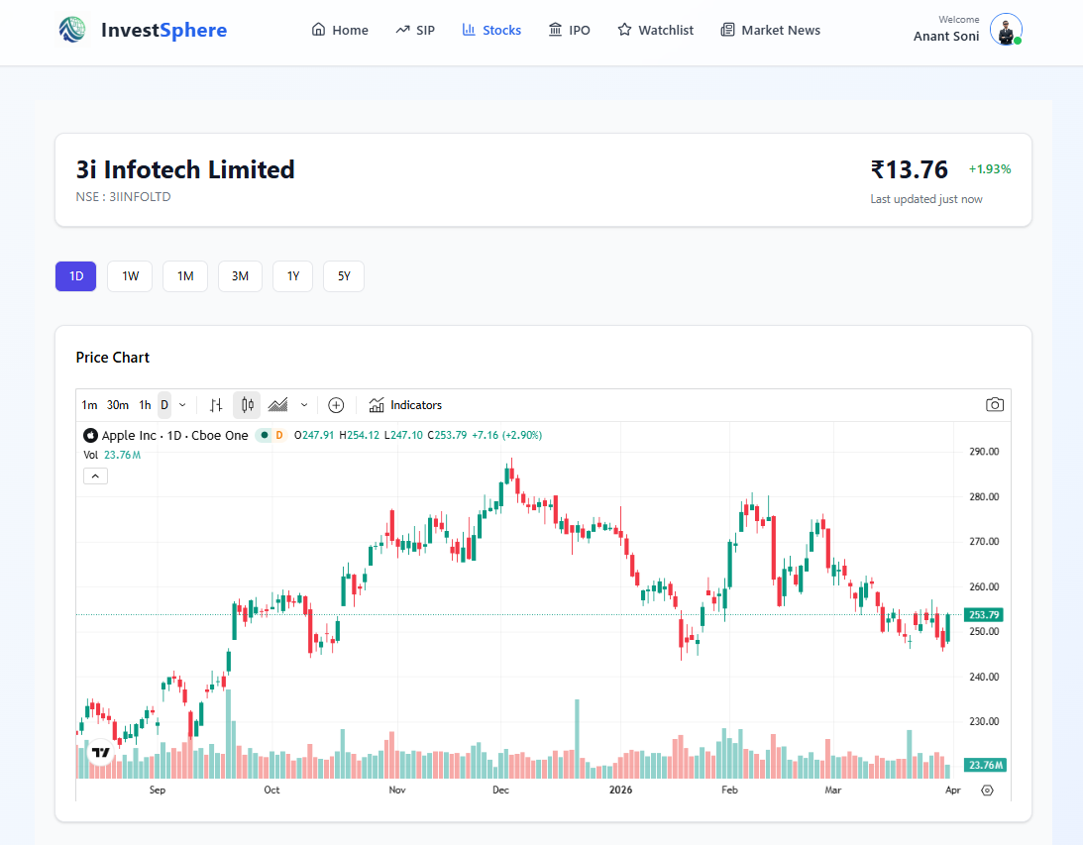
Stock Page:

Slide 32
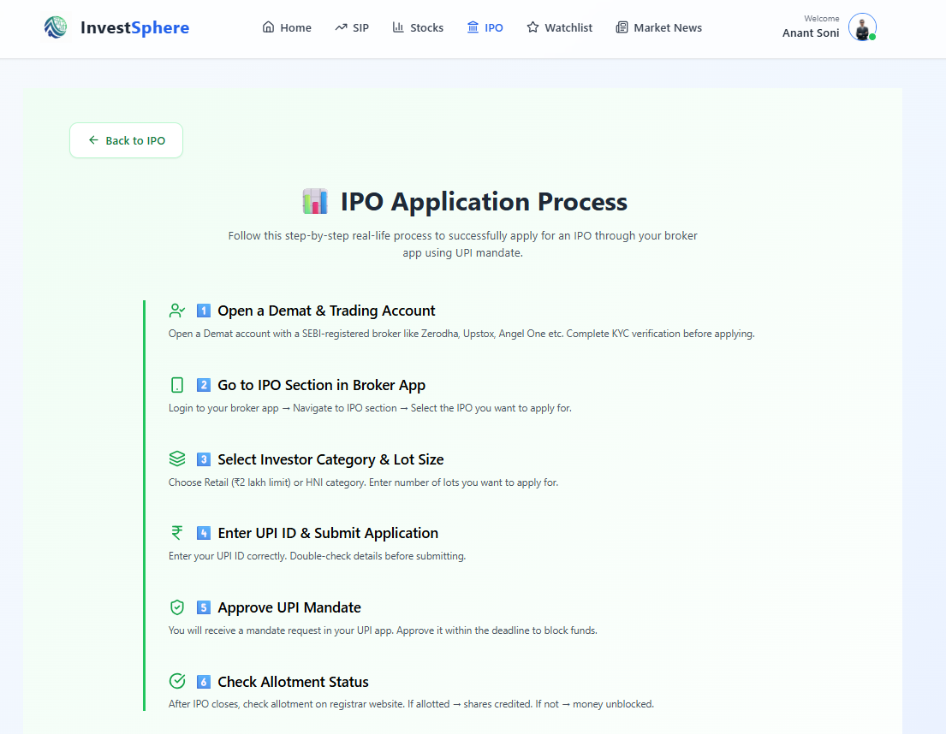
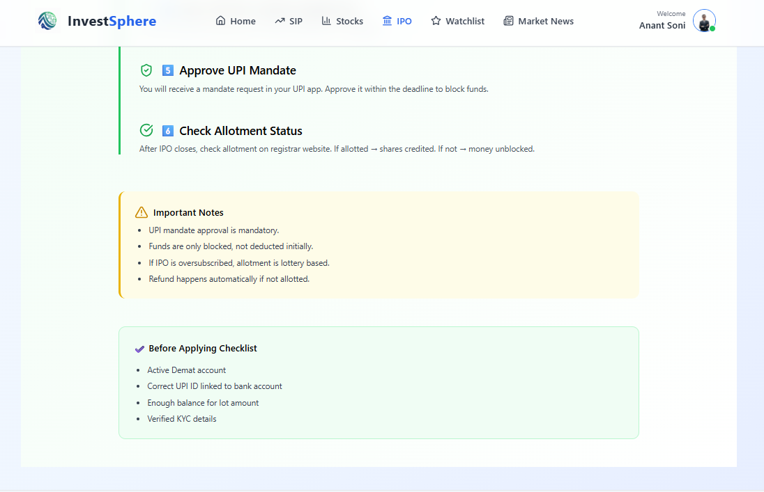
IPO Page:

Slide 33
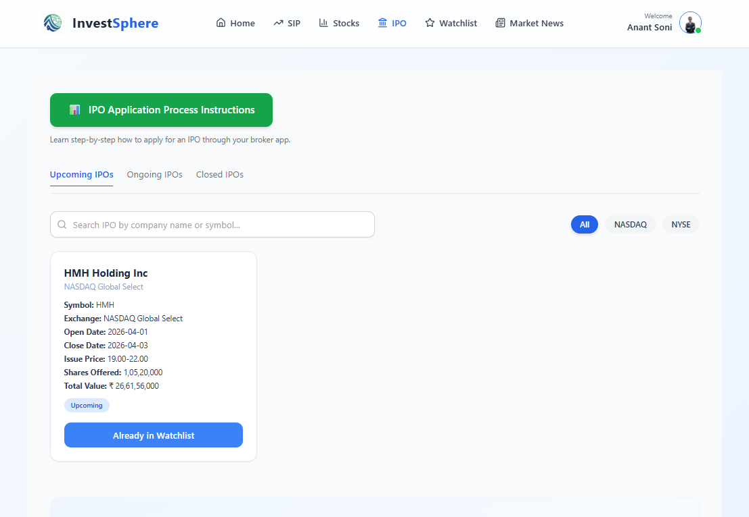
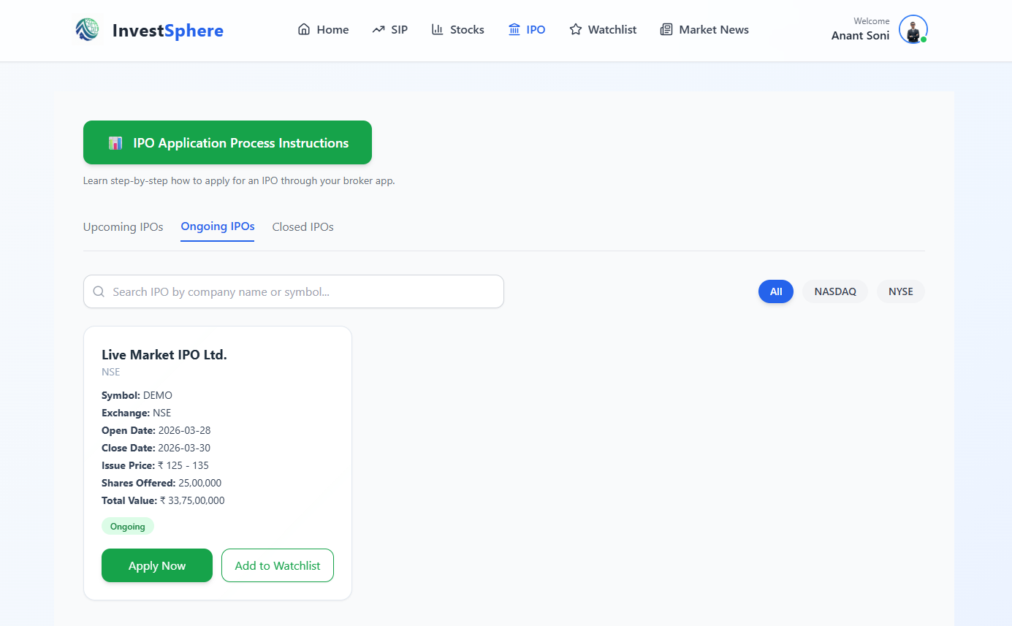
IPO Page:

Slide 34
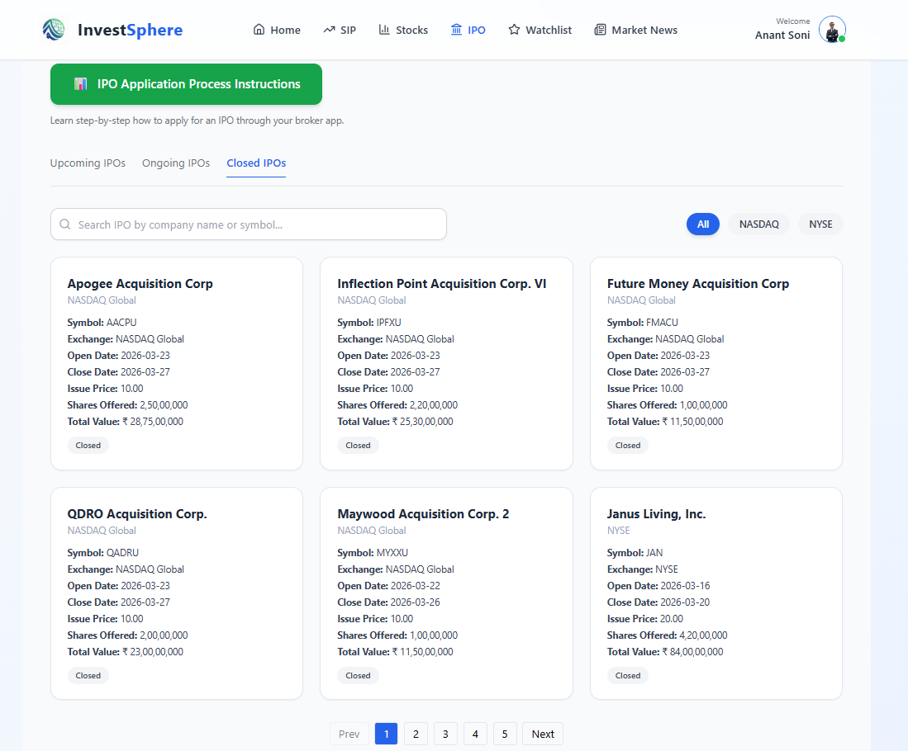
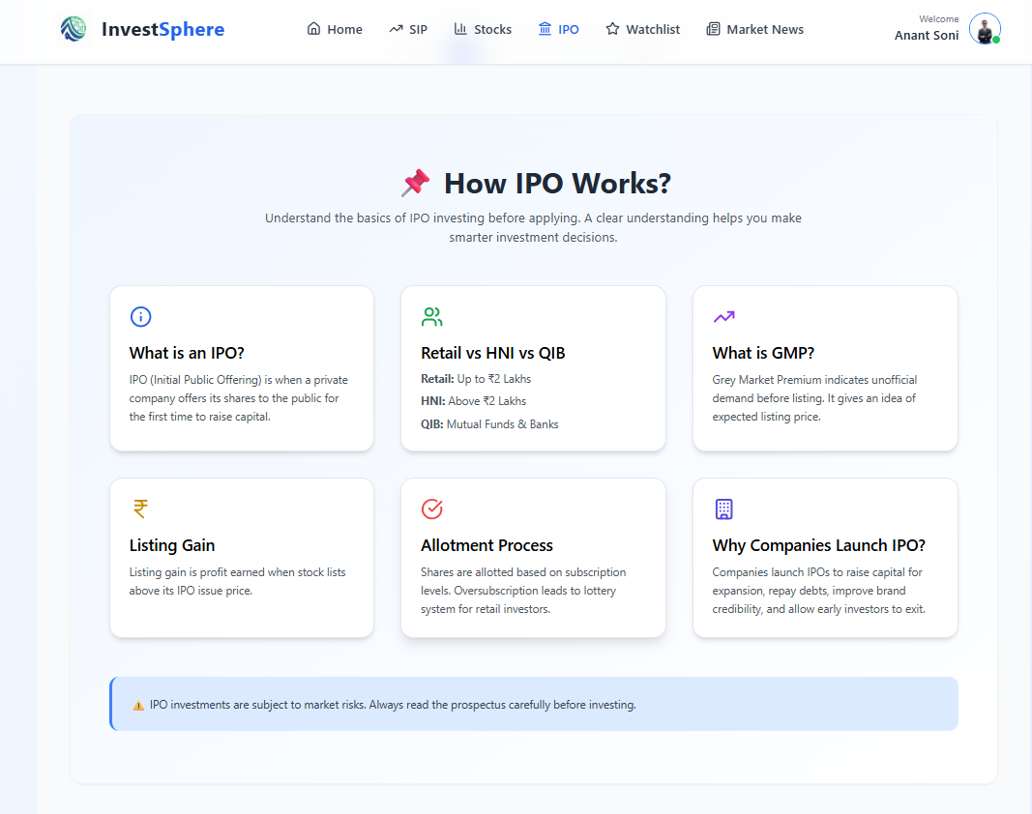
Stock Page:

Slide 35
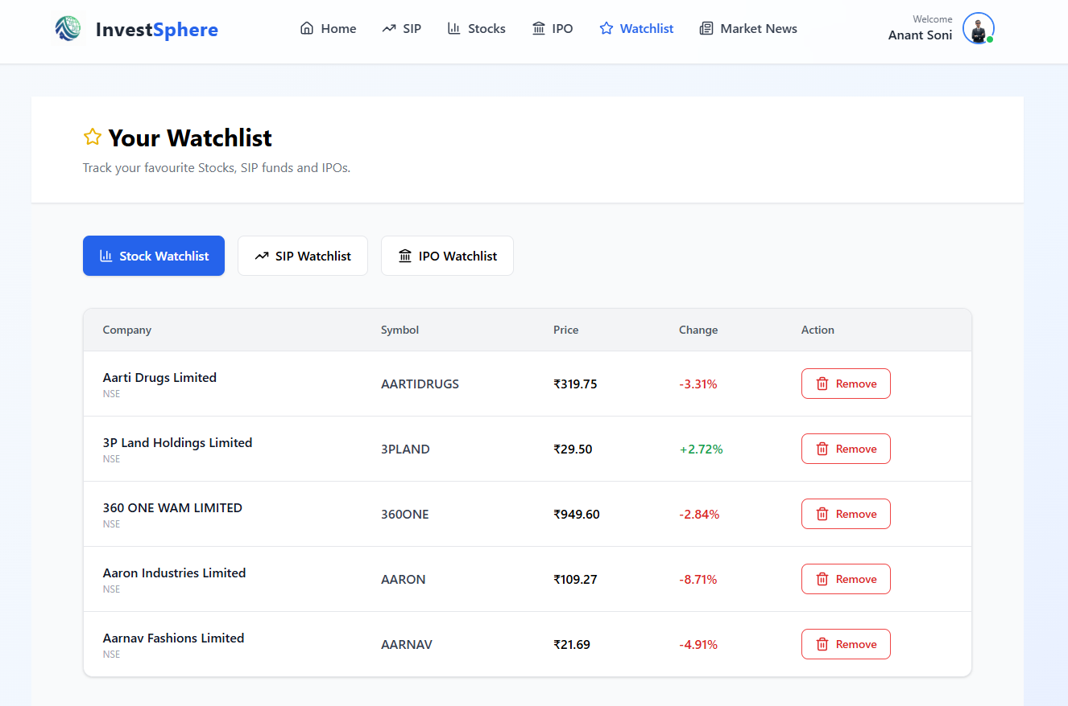
Watchlist Page: (Stock Watchlist)

Slide 36
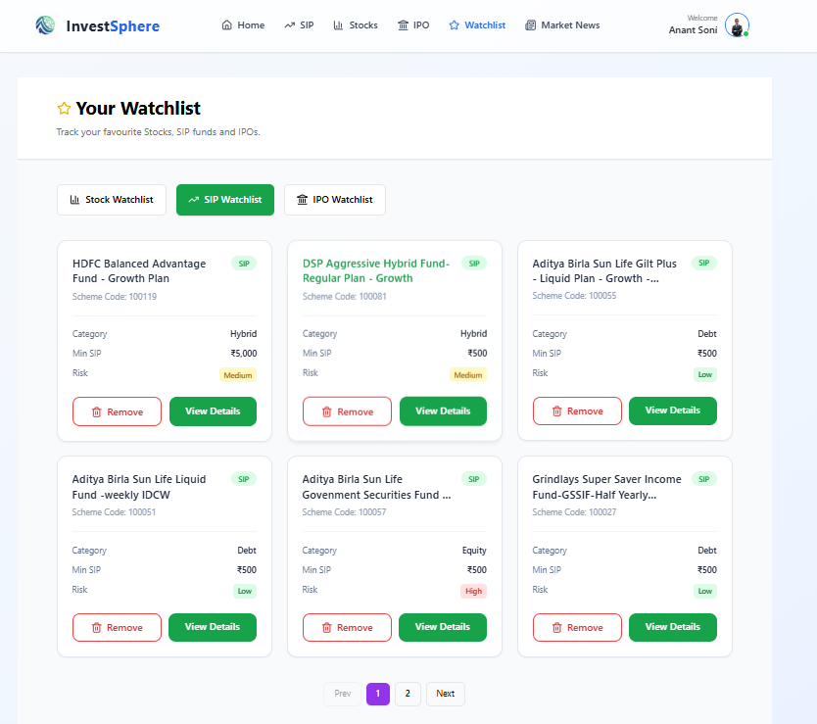
Watchlist Page: (SIP Watchlist)

Slide 37
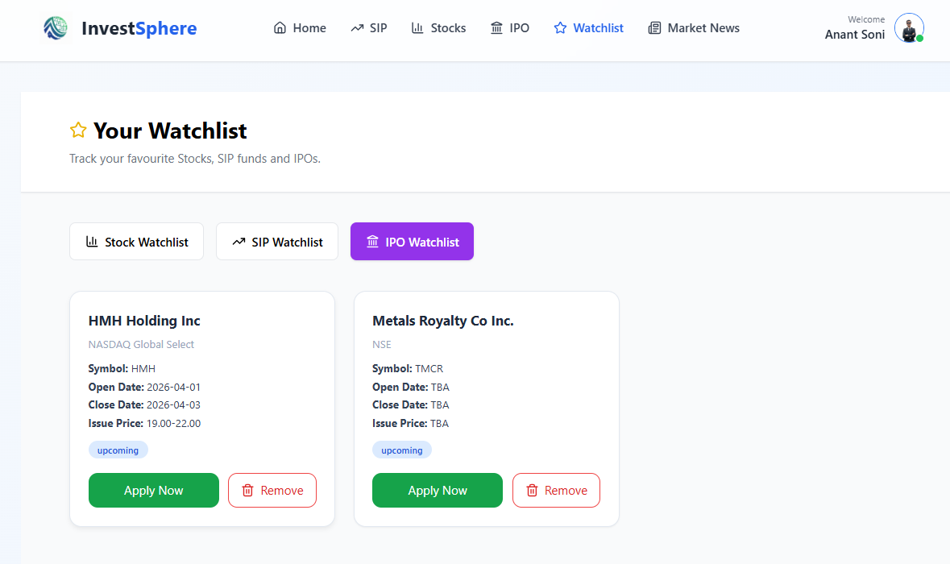
Watchlist Page: (IPO Watchlist)

Slide 38
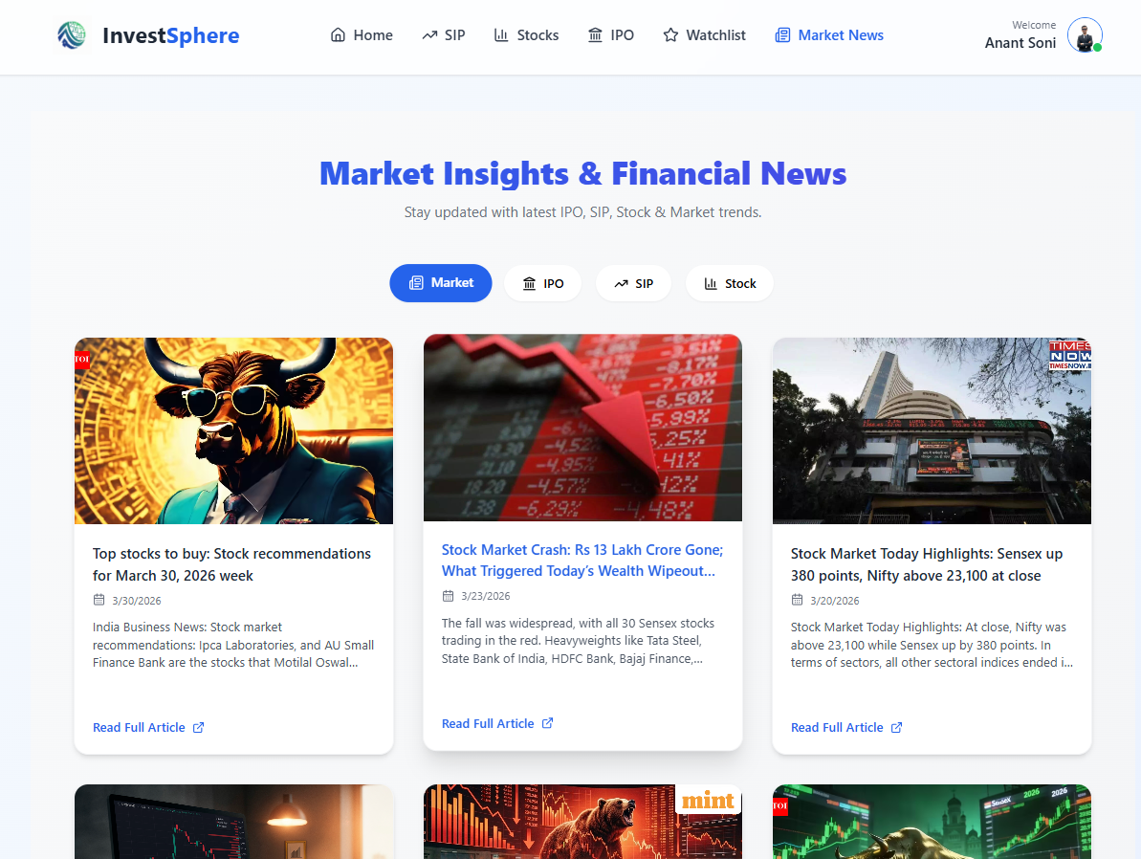
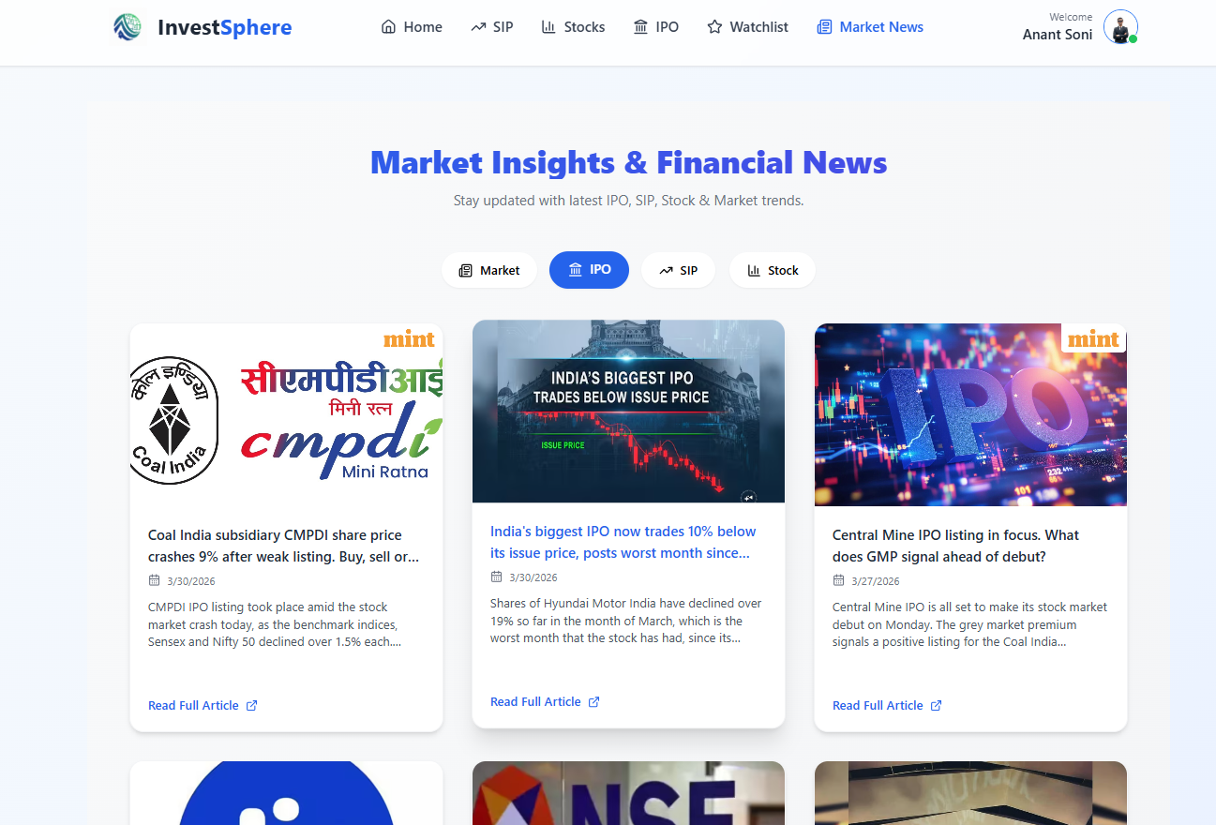
Market News Page:

Slide 39
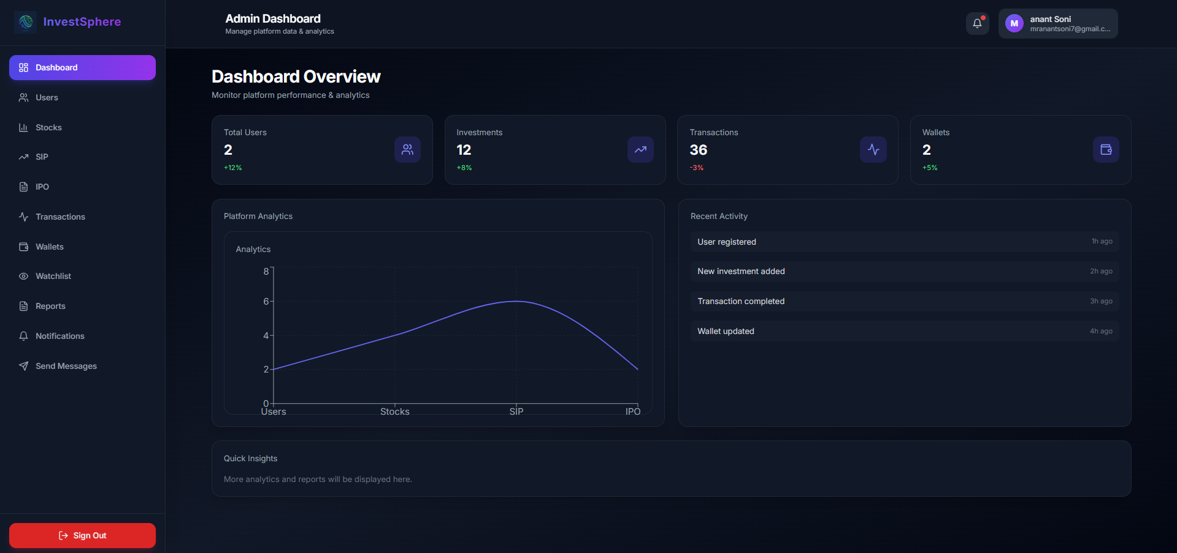
Admin Dashboard:

Slide 40
API References & Integrations
Crypto & Gold API https://api.coingecko.com/api/v3/coins/markets
IPO Data API - https://finnhub.io/api/v1/calendar/ipo
Stock Market Data API - https://query1.finance.yahoo.com/v8/finance/chart
SIP / Mutual Fund API - https://api.mfapi.in/mf
Market News API - https://gnews.io/api/v4/search
NSE Stock List Data - https://archives.nseindia.com/content/equities/EQUITY_L.csv
Cloud Storage (Images) - https://console.cloudinary.com/
Additional Reference Platforms
Grow Platform - https://groww.in/
Angel One - https://www.angelone.in/
Moneycontrol - https://www.moneycontrol.com/
Yahoo Finance - https://finance.yahoo.com/
Upstox - https://upstox.com/

Slide 41
Thank You.

