Slide 1
Smart City
Here are the names of 10 cities that are often considered as "smart cities" due to their advanced use of technology and data to improve urban living

Slide 2
1. Singapore:
Known for its extensive use of technology in various aspects of urban life.

Slide 3
2. Barcelona, Spain:
Emphasizes the use of smart grids, smart buildings, and extansive data analytics.

Slide 4
3. Tokyo, Japan:
Utilizes technology for efficient transportation, waste management, and public services.

Slide 5
4. Copenhagen, Denmark:
Focuses on sustainabilities, smart mobility, and environmental monitoring.

Slide 6
5. Dubai, UAE:
Integrates advanced technology in various sectors, including transportation and public safety.

Slide 7
6. Seoul, South Korea:
Embraces smart solutions for transportation, energy, and urban planning.

Slide 8
7. Amsterdam, Netherlands:
Uses smart technologies for efficient resource management and sustainability.

Slide 9
8. Vienna, Austria:
Emphasizes digital services, smart infrastructure, and citizen engagement.

Slide 10
9. Hangzhou, China:
Known for its use of technology in urban management, public services, and transportation.

Slide 11
10.Songdo, South Korea:
A planned smart city built with the latest technology and urban planning concepts.

Slide 12
Duplicate me

Slide 13
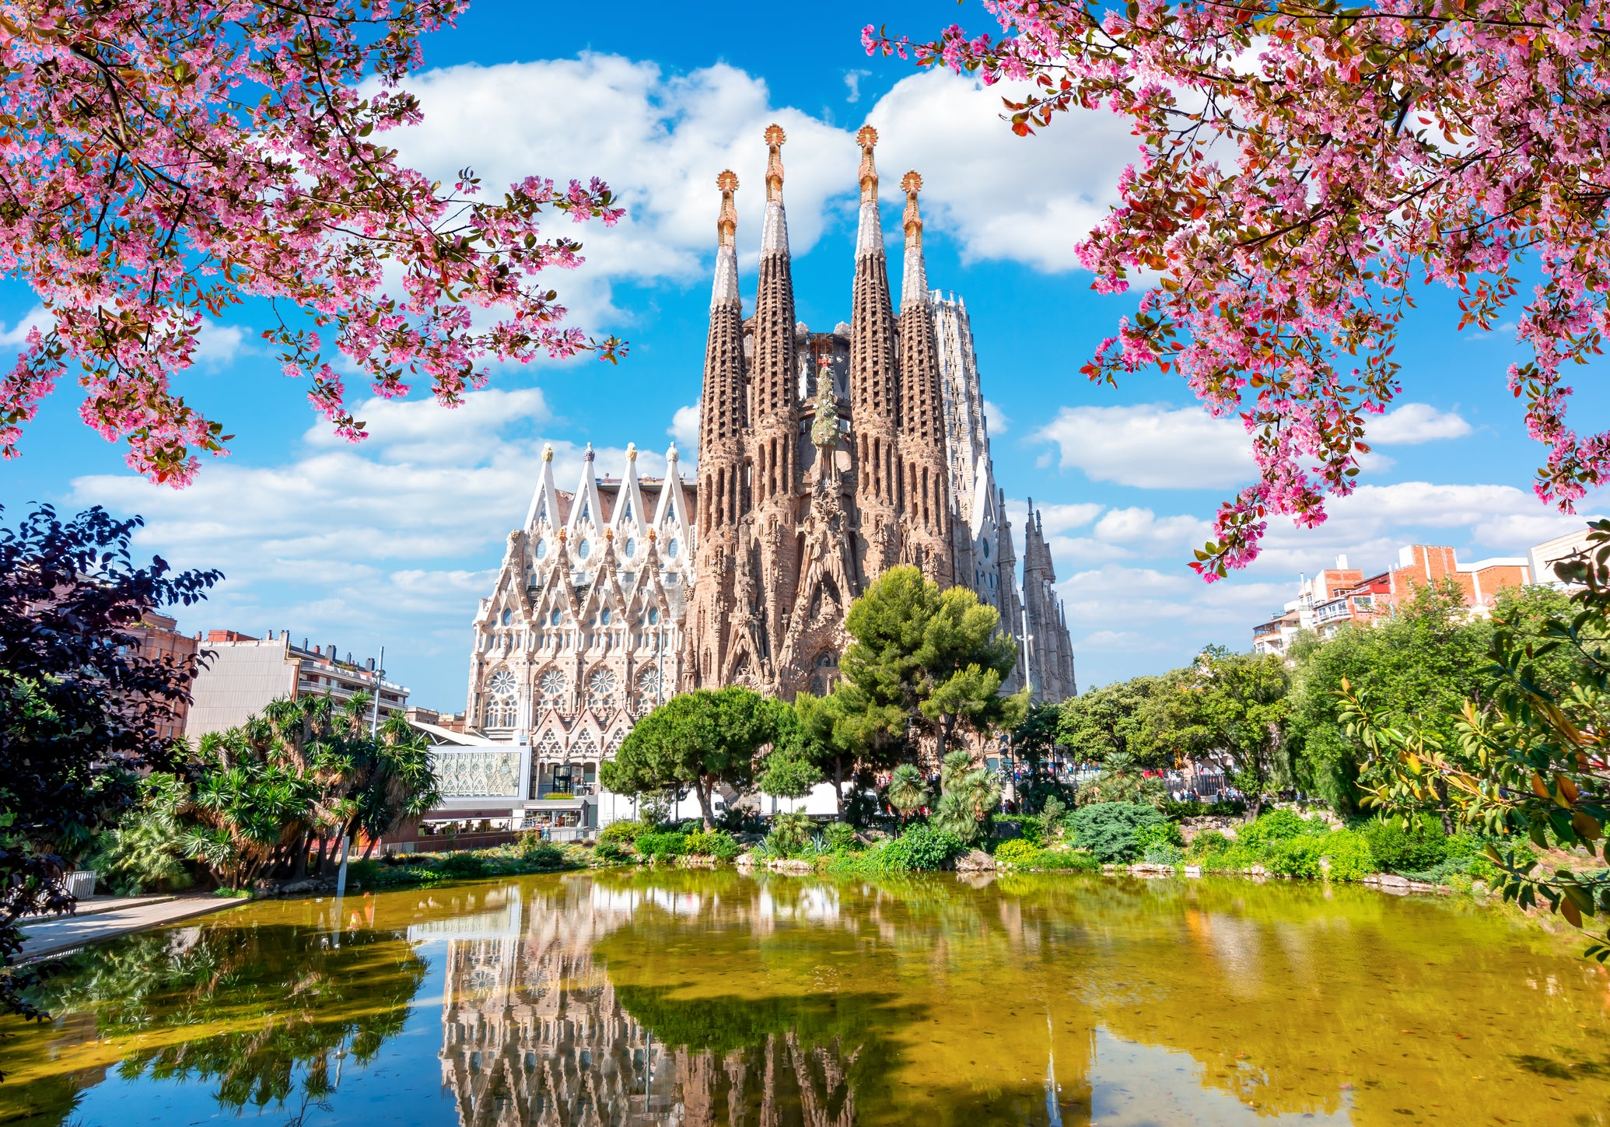
My favorite smart city
My favorite smart city is Barcelona, Spain. Renowned for its innovative urban solutions, Barcelona seamlessly integrates cutting-edge technology into its urban fabric, creating a city that is not only efficient but also environmentally conscious. The city boasts a sophisticated network of smart grids, intelligent transportation systems, and interconnected public services. Barcelona's commitment to sustainability is evident in its use of data analytics for efficient waste management and energy consumption. The incorporation of smart technology enhances the overall quality of life for its residents, making daily activities more seamless and contributing to a vibrant, forward-thinking urban environment. The city's blend of historic charm and modern innovation truly sets it apart as a beacon of smart urban living.

Slide 14
LIST OF SOME CITIES AROUND THE WORLD
Singapore
Barcelona, Spain
Tokyo, Japan
Copenhagen, Denmark
Dubai, UAE
Seoul, South Korea
Amsterdam, Netherlands
Vienna, Austria
Songdo, South Korea
Hangzhou, China

