Slide 1
Rocket Shooter
Trinh Vu The Anh – ITCSIU22009

Slide 2
Outline
Introduction
Rules and gameplay
Game technique
Conclusion

Slide 3
Introduction
Apply knowledge learned in theoretical OOP classes to make games.
Take advantage of different libraries.

Slide 4
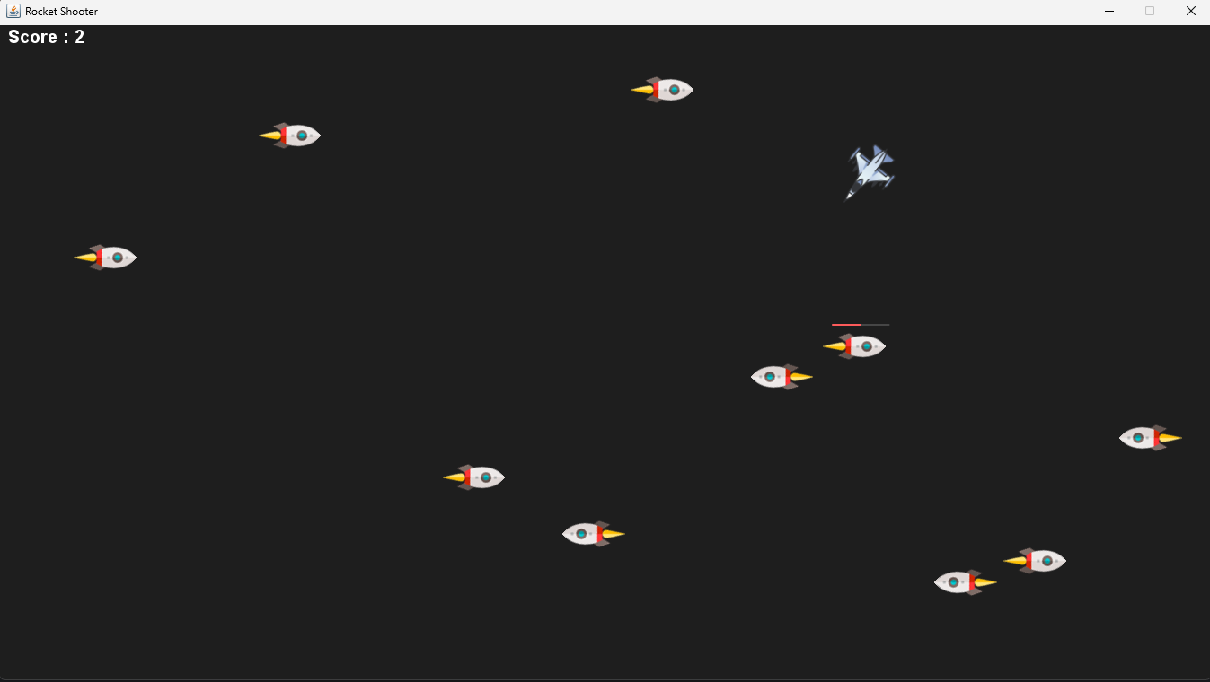
Rules and gameplay

Slide 5
Technology used in the project
Javax.Swing.* : for UI.
Java.awt.*: for drawing, keyboard input.
Java.util.Random: for generate ranmdom number

Slide 6
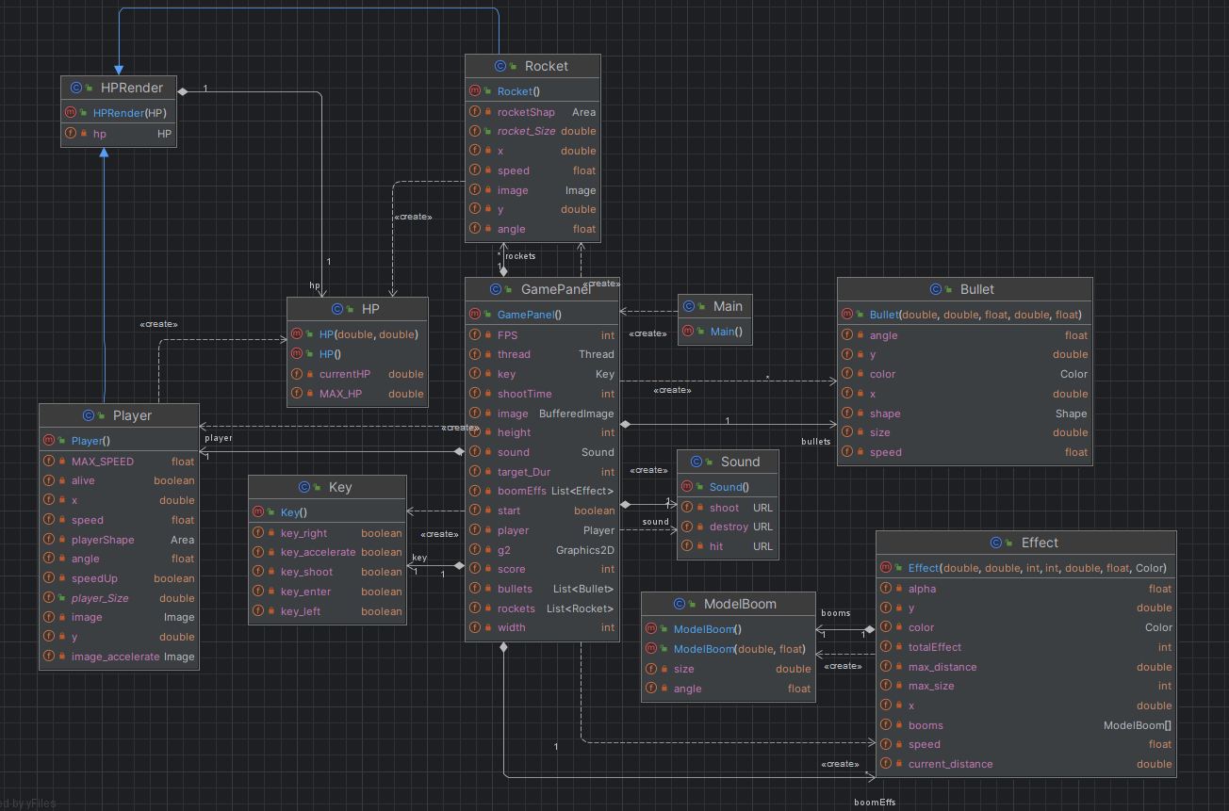
UML Diagrams

Slide 7
Conclusion
Thank you for listening

