Slide 1
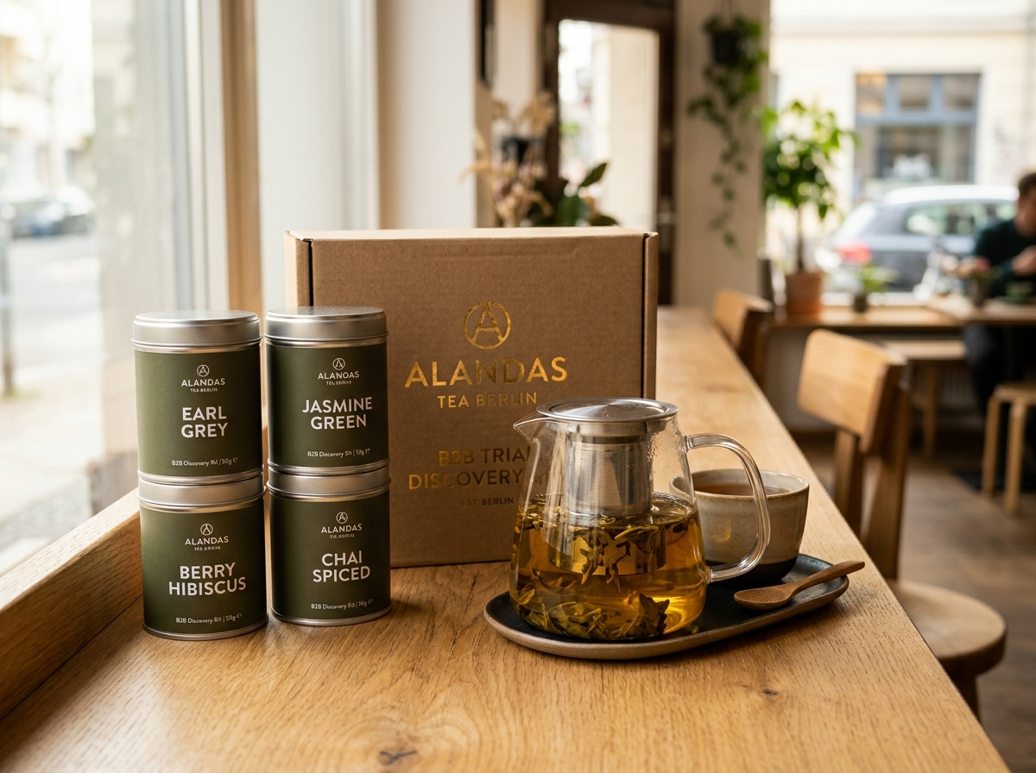
ALANDAS TEA BERLIN // STRATEGIC ROADMAP
The Path from 25 to 100 Cafes
A plain-English strategic blueprint for Sidy Sow: How we automate sales grunt work, protect brand integrity, scale predictable wholesale reorders, and get you back to being your own boss full-time.
THE TARGET
100 Partner Cafes
€15k–€30k/mo predictable income so Sidy quits his Swiss job
THE ENGINE
24/7 Digital Copilot
Scrapes cafe leads, drafts pitches, deciphers order note photos
THE CONTROL
3 Governed Tiers
Sidy retains 100% authority via WhatsApp; zero brand risk
THE B2B CONVERSION WEAPON // €19 TRIAL KIT
Borosilicate Teapot + 4 Signature Blends
The physical Trojan Horse that turns cold Berlin cafes into lifelong wholesale accounts. 100% of the €19 is credited back on their first commercial order.

Slide 2
01 // THE BIG PICTURE
Why Are We Doing This? Sidy's Reality vs. The Goal
Sidy imports exceptional organic tea, but current manual operations demand too much time for too little cashflow.
CURRENT REALITY // THE FOUNDER'S TRAP
Why Sidy Is Stuck in a Day Job
• High Swiss Living Costs: Moved to Switzerland; tea business doesn't yet yield steady monthly cashflow to live on.
• Exhausting Day Job: Working for a Norwegian firm: 'It's been a long walk... I'm tired. I want to become again my own boss.'
• 25 Happy Accounts Capped: Has ~25 great cafes buying regularly, but customer acquisition is stalled due to lack of time.
• Manual Friction: Sidy spends evenings manually messaging cafes on Instagram and deciphering crumpled paper orders.
THE TARGET // THE 100-CAFE EQUATION
What 100 Accounts Actually Unlocks
• 100 Cafes @ €200–€350 / Month: Generates €15,000 to €30,000 every month in predictable wholesale revenue.
• 90%+ Gross Margin: Premium tea carries extraordinary margins when shipped directly in wholesale volume.
• Full-Time Freedom: Sidy hands in his notice in Switzerland and returns to Berlin as his own full-time boss.
• Zero Additional Headcount: Operates the entire 100-cafe network without hiring expensive administrative staff.
THE CORE METRIC: Every system and architecture tier Cyril designs serves ONE metric — Getting Sidy back to Berlin as his own full-time boss.
ALANDAS TEA BERLIN • EXECUTIVE CHEAT SHEET | SLIDE 02 OF 11

Slide 3
02 // OPERATIONAL DIAGNOSIS
The 5 Bottlenecks Holding Alandas Back Today
The exact friction points stopping Alandas from scaling from 25 to 100 cafes.
BOTTLENECK 01
Manual Scraping Sucks Time
• Searching Google Maps & digging for cafe owners burns 20+ hours every week without leverage.
BOTTLENECK 02
Cafes Ignore Cold Emails
• Baristas and cafe owners are busy on the floor. They run their entire business on WhatsApp.
BOTTLENECK 03
Order Processing Is Messy
• Crumpled paper order photos texted late at night cause invoice errors and delayed delivery.
BOTTLENECK 04
Silent Cafe Churn
• Cafes run out on Day 28. If Sidy doesn't text on Day 25, they panic-buy supermarket tea bags.
BOTTLENECK 05
Burned by Hermes AI
• Previous low-code bot crashed and wiped memory. Sidy rightly refuses fragile toys.
THE OPPORTUNITY
The Durable Solution
• Replace manual hustle with a crash-resilient revenue machine backed by solid code and clear rules.
ALANDAS TEA BERLIN • EXECUTIVE CHEAT SHEET | SLIDE 03 OF 11

Slide 4
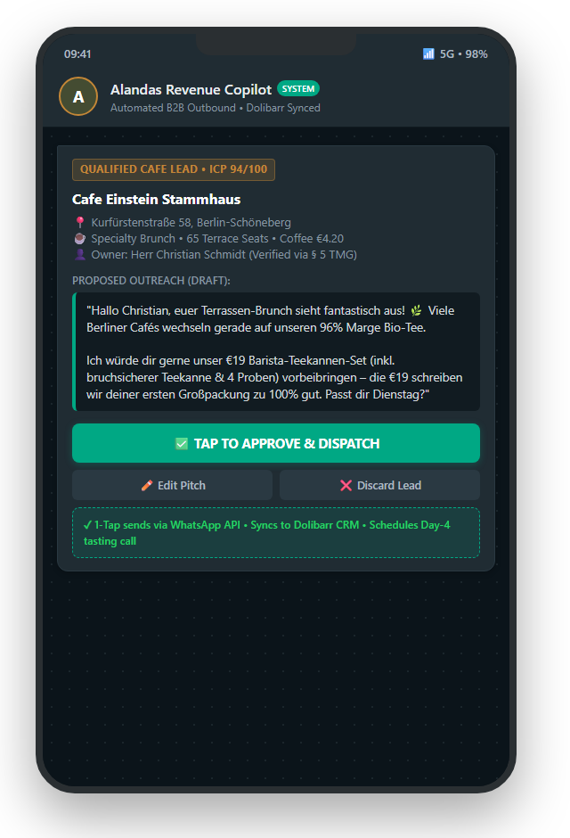
03 // THE SOLUTION
What We Are Building: Your 24/7 Digital Revenue Machine
A tireless digital sales and operations assistant that handles the tedious grunt work while Sidy retains total authority.
THE 6-STAGE REVENUE PIPELINE
01 // DISCOVER: Scans Google Maps & IG for >30-seat specialty brunch cafes in Berlin & Munich.
02 // ENRICH: Extracts verified owner WhatsApp numbers via German § 5 TMG Impressum for €0.00.
03 // OFFER: Pitches the €19 Teapot Starter Kit (100% credited back on wholesale crate).
04 // 1-TAP APPROVAL: AI drafts warm message; Sidy reviews on his phone & taps 'Approve'.
05 // INVOICE OCR: AI deciphers handwritten barista notes into draft Dolibarr CRM invoices.
06 // DAY-25 REFILL: Automated WhatsApp refill alert before cafes run dry, ending silent churn.
WHAT SIDY SEES ON HIS IPHONE // 1-TAP APPROVAL
ALANDAS TEA BERLIN • EXECUTIVE CHEAT SHEET | SLIDE 04 OF 11

Slide 5
04 // ARCHITECTURAL LAW
Why 3 Tiers? 'Don't Build a Spaceship on Day 1'
We do not give AI full control on Day 1. Each tier earns complexity based on proven business scale.
TIER 3 // AUTONOMOUS PLATFORM (100+ CAFES)
The Self-Running Business Machine
• Closed-loop commercial machine across Germany, Austria & Switzerland.
• Cafe reorder velocity automatically triggers and refines Meta Ad experiments.
• Sidy acts as Chairman reviewing weekly revenue digests while enjoying tea.
TIER 2 // GOVERNED INTELLIGENCE (40–70 CAFES)
The Smart Assistant with Guardrails
• AI recommends smart moves (e.g. +30% ad budget), but strict Policy Engines enforce rules.
• Any budget delta > €5 requires Sidy's 1-tap WhatsApp sign-off.
• Mathematically impossible for an AI bug to drain bank accounts or leak pricing.
TIER 1 // ESSENTIAL AUTOMATION (25–40 CAFES) — START HERE
The Tireless Grunt Worker (Sidy is Pilot)
• Machine scrapes cafes, gets WhatsApps, drafts pitches, and parses order notes.
• Sidy retains 100% approval authority on every outbound message and invoice.
• 100% brand safe. Saves 15+ hours/week. Starts today with ZERO fragility.
ALANDAS TEA BERLIN • EXECUTIVE CHEAT SHEET | SLIDE 05 OF 11

Slide 6
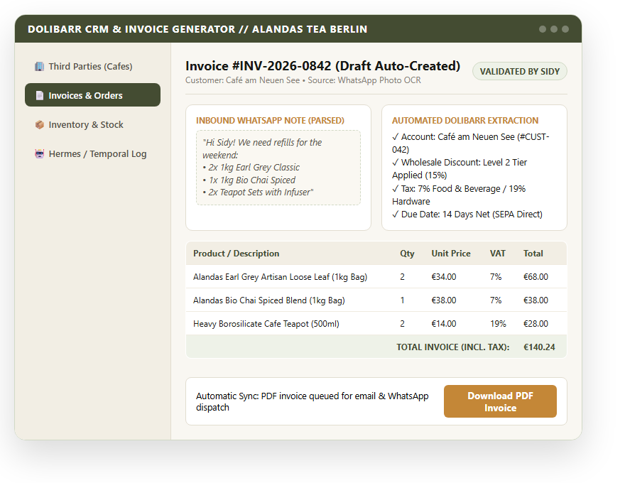
05 // TIER 1 IN PLAIN ENGLISH
Tier 1: 'The Tireless Assistant' (Sidy is Pilot)
The machine gathers facts and proposes actions; Sidy taps Approve before anything is dispatched.
WHAT DOLIBARR LOOKS LIKE // HANDWRITTEN NOTE ➔ AUTO INVOICE
THE 5-STAGE WORKFLOW // 100% HUMAN-IN-THE-LOOP
Read ➔ Analyze ➔ Propose ➔ Approve ➔ Execute
• 1. Read: Scans Google Maps & Instagram for specialty brunch cafes with >30 seats.
• 2. Analyze: Evaluates menu pricing, specialty coffee aesthetic, and owner details.
• 3. Propose: Drafts personalized WhatsApp message pitching the €19 teapot kit.
• 4. Sidy Approves: Message appears on Sidy's phone. Sidy taps Approve or edits.
• 5. Execute: Temporal sends WhatsApp, creates Dolibarr card, schedules follow-up.
• Zero Brand Risk: Sidy protects botanical integrity & tone; AI never sends alone.
• Saves 15+ Hours/Week: No more late-night manual typing or deciphering notes.
• Target: 25 ➔ 40 Cafes | ~€5,000/month steady wholesale revenue.
ALANDAS TEA BERLIN • EXECUTIVE CHEAT SHEET | SLIDE 06 OF 11

Slide 7
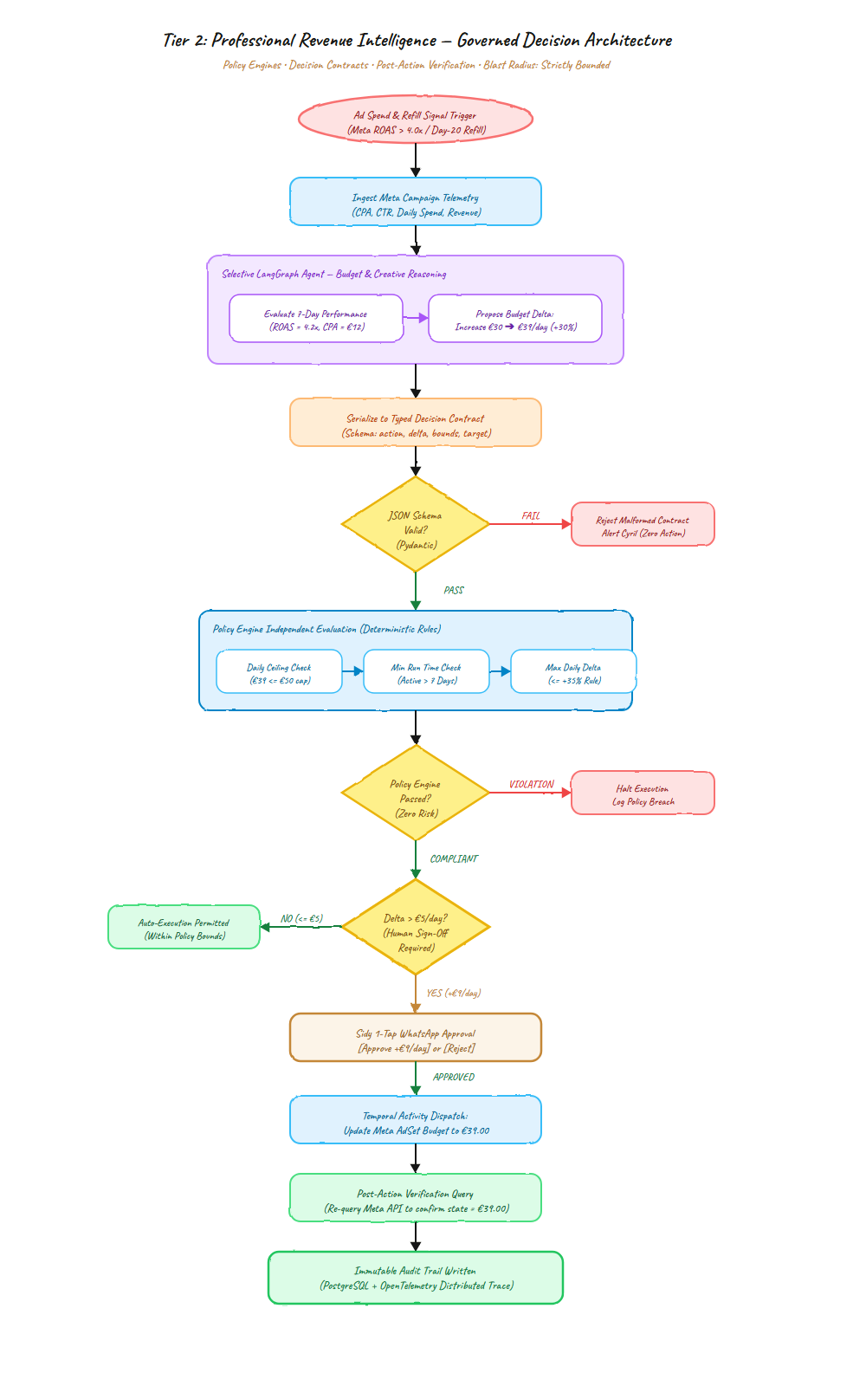
06 // TIER 2 IN PLAIN ENGLISH
Tier 2: 'The Smart Assistant with Guardrails'
AI suggests business optimizations, but unbreakable Policy Engines prevent errors or runaway spend.
THE GOVERNED DECISION CONTRACT GATE // STRICT BOUNDARIES
REAL-WORLD EXAMPLE
Increasing Meta Ad Budget by +30%
• 1. AI Observes: Berlin brunch ad has 4.2x ROAS. Suggests raising €30 ➔ €39/day.
• 2. Hard Ceiling Check: Is €39 under our maximum €50/day policy cap? (YES).
• 3. Threshold Check: Does delta (>€5) require human sign-off? (YES).
• 4. Sidy Signs Off: WhatsApp ping dings: [Approve +€9/day for Berlin Brunch Ad?].
• 5. Verify State: AI calls Meta API, then re-queries Meta to confirm €39.00 (NOT €390).
• Zero Runaway Spend: Mathematically impossible for AI glitch to drain accounts.
• Zero Pricing Leaks: Wholesale volume discounts follow strict tables, not whims.
• Target: 40 ➔ 70 Cafes | ~€12,000/month recurring wholesale revenue.
ALANDAS TEA BERLIN • EXECUTIVE CHEAT SHEET | SLIDE 07 OF 11

Slide 8
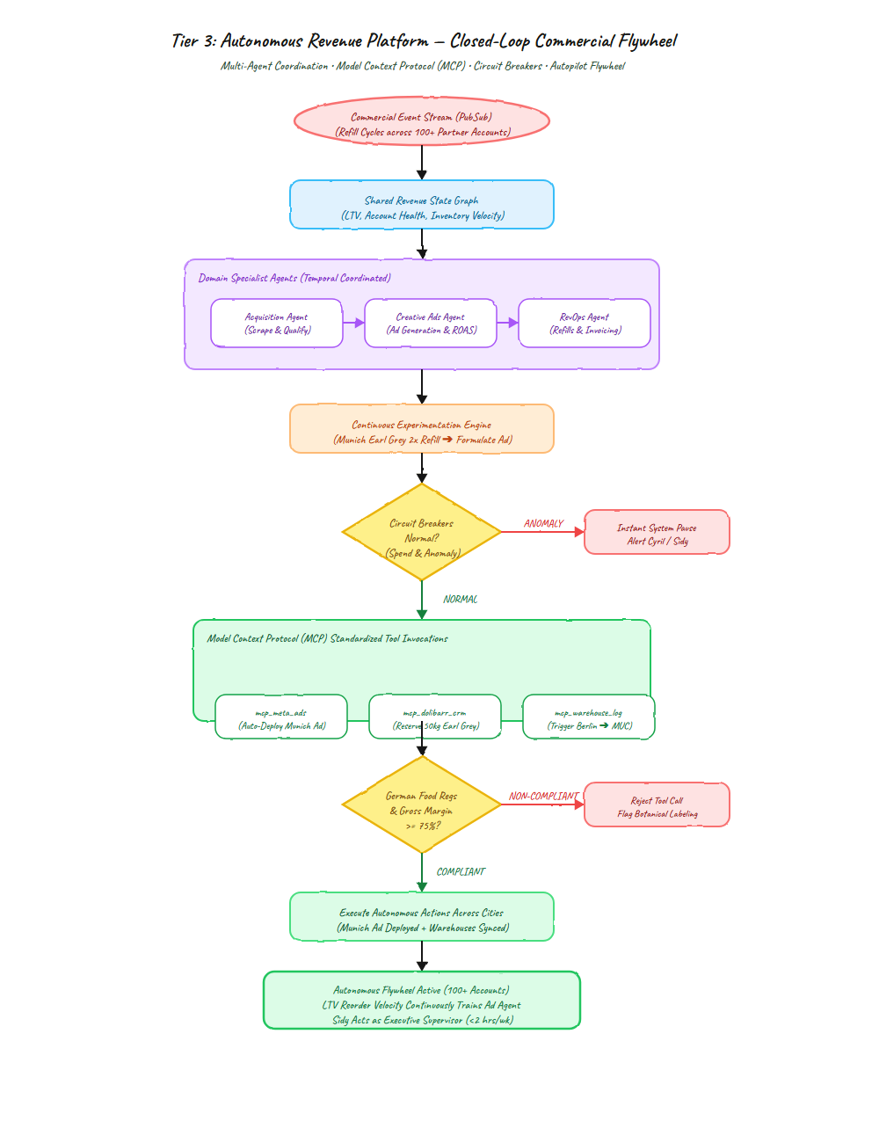
07 // TIER 3 IN PLAIN ENGLISH
Tier 3: 'The Self-Running Business Machine'
Alandas runs like a multi-million-euro beverage brand with zero extra office staff.
THE AUTONOMOUS CLOSED-LOOP COMMERCIAL FLYWHEEL
THE CLOSED-LOOP FLYWHEEL
Munich Terrace Summer Scenario
• 1. Reorder Surge: In July, Munich cafes reorder Earl Grey 2x faster for iced tea.
• 2. Operations Alerts Marketing: System detects Munich terrace surge in real time.
• 3. Automated Ad Copy: Marketing Agent writes: 'Serving iced tea on your terrace? Try our €19 kit.'
• 4. Closed-Loop Optimization: Launches tests and scales ad spend without manual human effort.
• Zero Linear Headcount: Operates across Germany, Austria & Switzerland.
• Automated Circuit Breakers: Any anomaly halts the system instantly.
• Sidy Acts as Chairman: Reviews weekly digests while enjoying tea.
• Target: 100+ Cafes | €20k–€30k/month. Sidy is 100% his own boss.
ALANDAS TEA BERLIN • EXECUTIVE CHEAT SHEET | SLIDE 08 OF 11

Slide 9
08 // TECHNICAL DEFENSE MADE SIMPLE
The 3 Technical 'Secret Weapons' (In Plain English)
Three simple metaphors to explain the architecture to Sidy or investors without confusing jargon.
SECRET WEAPON 01
Temporal vs. n8n
Carving in Stone vs. Sticky Notes
• n8n writes orders on sticky notes. When the server crashes, notes blow away and data is lost.
• Temporal carves every step into solid rock. If the server reboots, it resumes at the exact line of code.
• Zero lost invoices, zero lost cafe leads. 100% durable code.
SECRET WEAPON 02
Impressum Waterfall
Cheapest Tool First (87% Savings)
• Normal agencies waste €80 looking up 1,000 leads.
• Under German § 5 TMG law, every site publishes owner details. Our free scraper gets 48% of leads for €0.00.
• We only call paid tools for the missed few. Total cost: €10 instead of €80.
SECRET WEAPON 03
Policy Engine Bouncer
The Guardrail at the Bank Vault
• No AI is ever handed Sidy's credit card or pricing authority.
• AI writes a typed proposal. The Policy Engine checks: Is discount allowed? Is budget safe?
• If unusual, it rings Sidy's phone for 1-tap confirmation.
CORE ARCHITECTURAL DEFENSE: Zero low-code toys. Zero lost data via Temporal state durability. Zero runaway spend via deterministic Policy Engines.
ALANDAS TEA BERLIN • EXECUTIVE CHEAT SHEET | SLIDE 09 OF 11

Slide 10
09 // ARCHITECTURE COMPARISON & SELECTION
Choose Your Tier: Modular Revenue Architecture
Sidy chooses which tier fits his current stage and comfort. Every tier is modular—you never discard code.
OPTION 01 // RECOMMENDED START
Tier 1: Essential
• The Tireless Assistant (Sidy is Pilot)
• What It Solves: Stops 20+ hours of manual Google Maps scraping & messaging.
• Core Engine: Legal Impressum § 5 TMG scraper, AI drafts, Dolibarr invoice OCR.
• Human Control: Sidy approves every outbound message on WhatsApp.
• Sidy's Routine: Spends just 30 mins/day on WhatsApp reviews.
• Target Scale: 25 ➔ 40 Cafes | ~€5,000 / month recurring cashflow.
OPTION 02 // GROWTH & PROTECTION
Tier 2: Governed
• Smart Assistant with Guardrails
• What It Solves: Eliminates silent cafe churn and prevents runaway ad spend.
• Core Engine: Policy Engine (+30% ad rules, hard caps), Day-25 refill alerts.
• Human Control: Any budget change >€5 requires Sidy's 1-tap WhatsApp sign-off.
• Sidy's Routine: Admin drops to < 4 hrs/week. Sidy prepares notice at Swiss firm.
• Target Scale: 40 ➔ 70 Cafes | ~€12,000 / month recurring cashflow.
OPTION 03 // ENTERPRISE SCALE
Tier 3: Autonomous
• Self-Running Multi-City Flywheel
• What It Solves: Scales across Germany, Austria & Switzerland without hiring reps.
• Core Engine: Closed-loop reorder-to-ad flywheel, multi-city warehouse sync.
• Human Control: Automatic circuit breakers halt anomalies; Sidy acts as Chairman.
• Sidy's Routine: 100% full-time independent founder & CEO (< 2 hrs/week oversight).
• Target Scale: 100+ Cafes | €20,000–€30,000 / month recurring.
THE FREEDOM PRINCIPLE: Sidy chooses where to begin. No fixed timeline. Tier 1 gives immediate relief on Day 1; higher tiers unlock whenever Sidy wants to scale.
ALANDAS TEA BERLIN • EXECUTIVE CHEAT SHEET | SLIDE 10 OF 11

Slide 11
10 // IMMEDIATE NEXT STEPS
Starting Sprint 1 Today: The First 4 Concrete Steps
We do not need months of planning. We kick off Tier 1 immediately with 4 clear deliverables.
STEP 01
Stabilize Dolibarr CRM
• Automate daily cloud backups
• Clean existing 25 cafe accounts
• Ensure order history is never lost
STEP 02
Standardize €19 Trial Kit
• Assemble borosilicate teapot kit
• Pack 4 signature tea blends
• Include 100% wholesale credit voucher
STEP 03
Run § 5 TMG Scraper
• Extract 200 brunch cafes in Berlin & Munich
• Resolve owner names & emails for €0.00
• Zero wasted lead spend
STEP 04
1-Tap WhatsApp Pilot
• Generate first 10 personalized drafts
• Send to Sidy's WhatsApp for review
• Sidy taps Approve with one click
SPRINT 1 TANGIBLE DELIVERABLE
The €19 Trial Teapot Starter Kit is ready to dispatch to the first 10 Berlin cafes this week. Real, tangible progress on Day 1.
ALANDAS TEA BERLIN • EXECUTIVE CHEAT SHEET | SLIDE 11 OF 11

