Slide 1

Chocolate Sales Analytics and Revenue Prediction
DSAI 4103 Business Analytics Project End-to-End Business Analytics & ML Pipeline
Delson Fernandes | Student ID: 60302101

Slide 2


Project Overview: Analyzing Performance & Predicting Future Revenue
•
Analyzes chocolate sales data spanning 2023–2024.
•
Primary Goal: Understand sales performance and predict future revenue.
•
Combines data analysis, machine learning, explainability, and deployment preparation.
[SCREENSHOT PLACEHOLDER] Insert Project Overview Screenshot Here
•
Helps support better business decisions using data-driven insights.

Slide 3
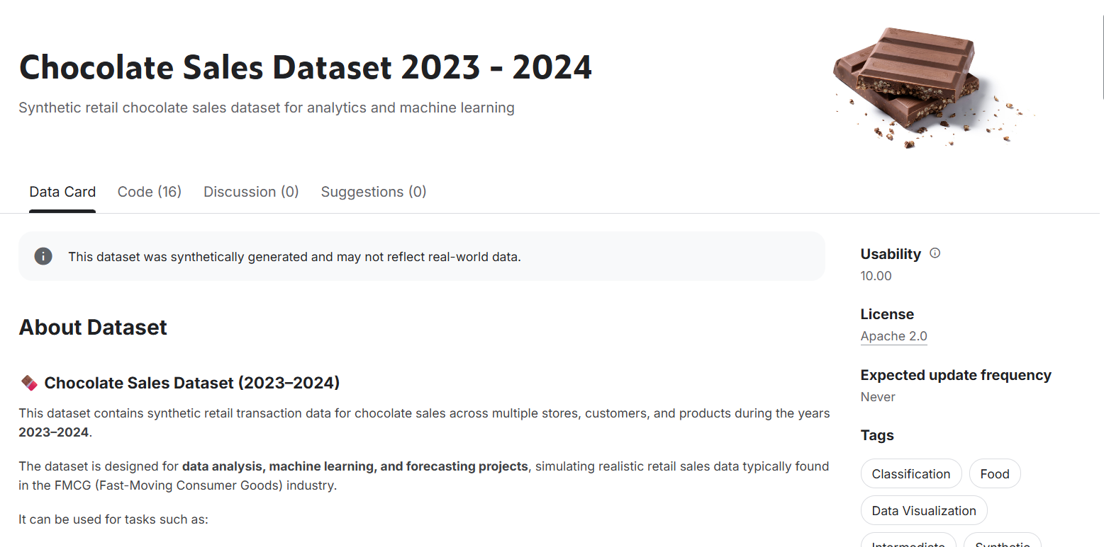
Business Problem and Objectives: Identifying Strategic Drivers
•
Business Problem: Identify what drives chocolate sales and revenue for pricing and promotions.
•
Main Objectives:
•
Analyze customer, product, and store performance.
[SCREENSHOT PLACEHOLDER] Insert Business Problem/Objectives Screenshot Here
•
Identify key factors affecting revenue.
•
Build a high-accuracy revenue prediction model.
•
Explain results using SHAP and check model fairness.

Slide 4
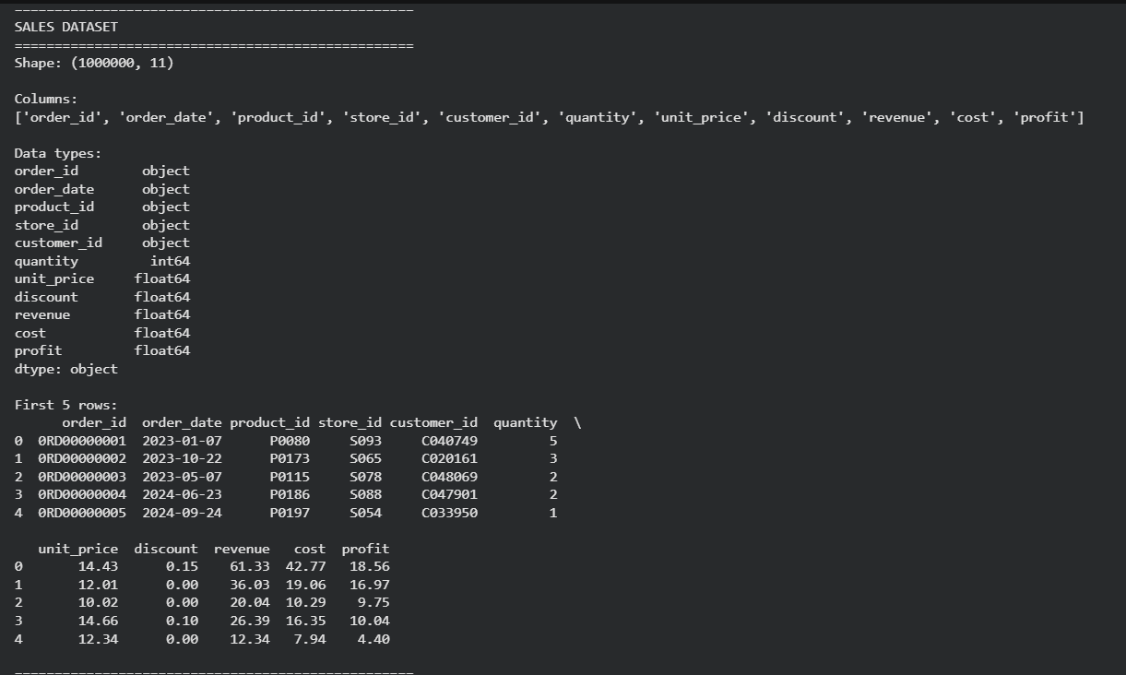
Dataset Description: High-Volume Data Source
•
Source: Kaggle Chocolate Sales Dataset 2023–2024.
•
Structure: 5 integrated CSV files (Sales, Customers, Products, Stores, Calendar).
•
[SCREENSHOT PLACEHOLDER] Insert Dataset Schema or Source Screenshot Here
Scale: Large dataset featuring 1,000,000 sales records.
•
Dimensions: Includes transaction, customer, product, store, and time data.
Dataset size:
* sales: 1,000,000 rows × 11 columns
* customers: 50,000 rows × 5 columns
* products: 200 rows × 6 columns
* stores: 100 rows × 5 columns
* calendar: 731 rows × 6 columns

Slide 5

Data Preparation and Feature Engineering: Transforming Raw Data
•
Data Integration: Merged 5 relational files using IDs and order dates as primary keys.
•
Data Cleaning:
•
Filled missing text values with "Unknown".
•
Filled missing numeric values with the median.
[SCREENSHOT PLACEHOLDER] Insert Data Preparation Screenshot Here
•
Feature Engineering: Created high-value features including:
•
Age Group & Weekend Flag
•
Discount Flag & Discount Band
•
Profit Margin calculation

Slide 6
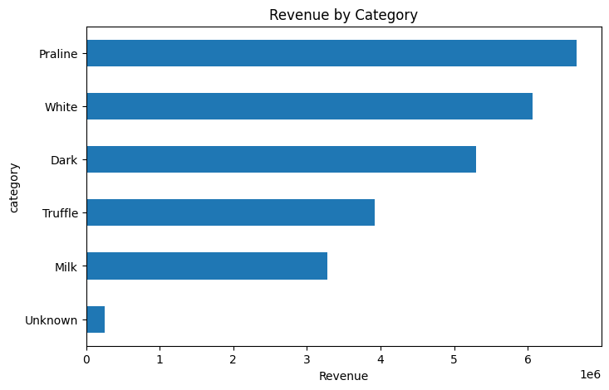
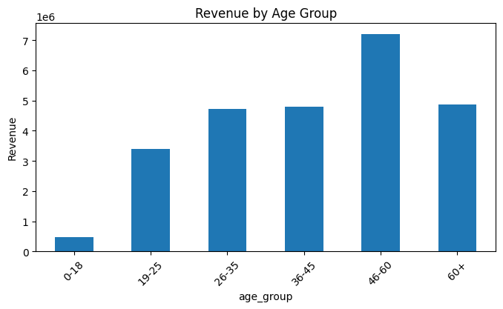
Exploratory Data Analysis: Key Performance Metrics
25.49M
10.19M
TOTAL REVENUE
TOTAL PROFIT
2.99M
Stable
QUANTITY SOLD
2023-24 TREND
[SCREENSHOT PLACEHOLDER] Insert EDA Dashboard Screenshot Here
•
Top Categories: Praline, White, and Dark chocolate led sales.
•
Top Brands: Ferrero, Cadbury, and Lindt dominated the market share.
•
Demographics: Customers aged 46–60 contributed the highest revenue share.
•
Revenue performance remained consistent across both fiscal years.

Slide 7
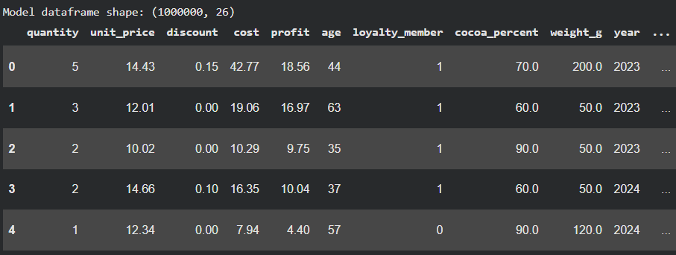
Model Development: Building the Predictive Engine
•
Target Variable: Revenue (order-level prediction).
•
Feature Engineering: Final dataset used 26 input features after removing leakage.
•
Preprocessing Pipeline:
•
[SCREENSHOT PLACEHOLDER] Insert Model Development / Training Screenshot Here
StandardScaler for numeric data.
•
OneHotEncoder for categorical data.
•
Model Selection: Random Forest Regressor for robust performance.

Slide 8
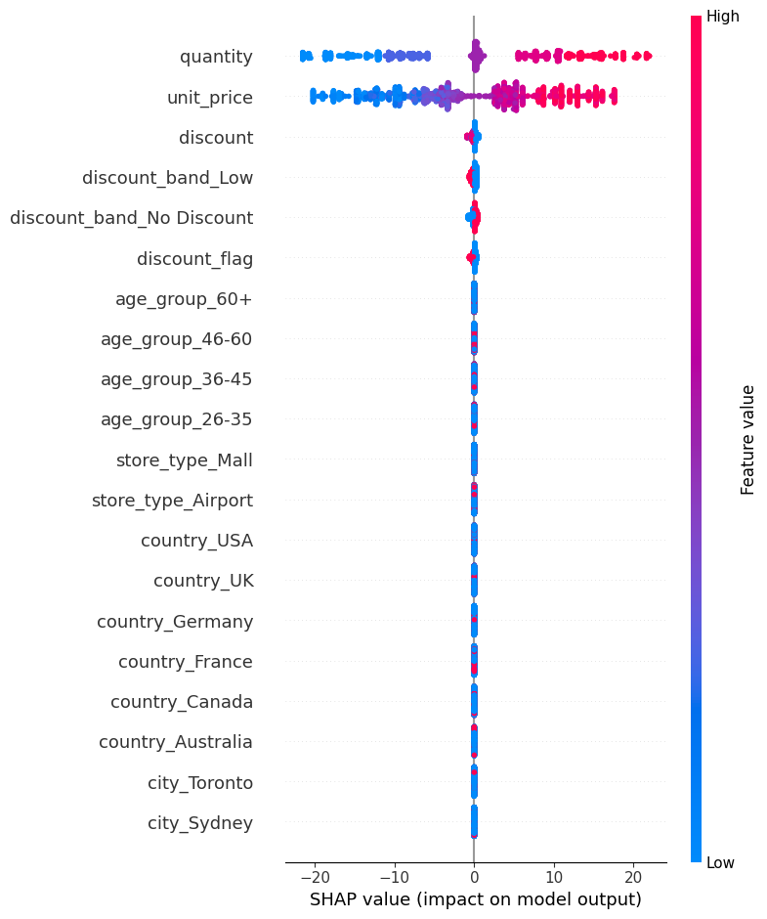
Model Results and SHAP Explainability: High-Accuracy Predictions
RMSE: 2.6596
R² Score: 0.9736
•
Model performed exceptionally well for order-level revenue prediction.
[SCREENSHOT PLACEHOLDER] Insert Model Results / SHAP Summary Plot Here
•
SHAP was utilized to explain individual and global model predictions.
•
Most Important Features:
•
Quantity
•
Unit Price
•
Discount
SHAP confirmed that quantity and unit price are the strongest drivers of revenue.
•

Slide 9

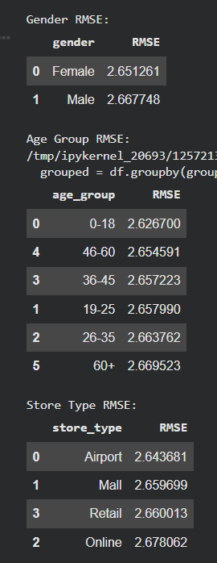
Bias Analysis and Model Fairness: Ensuring Equitable Predictions
•
Methodology: Evaluated model error (RMSE) across protected groups to ensure fairness.
•
Gender Comparison:
Female RMSE
2.651
Male RMSE
2.668
•
Consistency: Error rates remained stable across all age groups and store types.
•
Conclusion: The model demonstrates no major fairness issues or demographic bias. Differences are minimal, indicating fair model performance

Slide 10

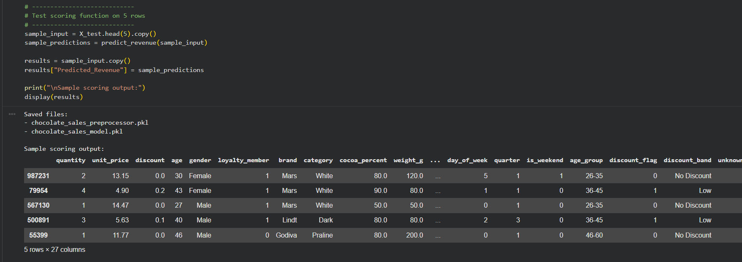
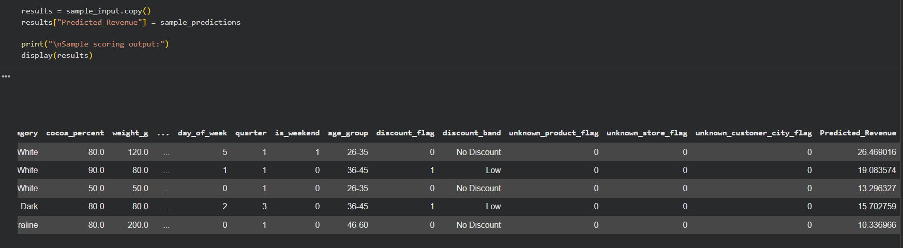
Deployment Preparation: Ready for Integration
•
Model Serialization: Saved trained components as:
•
chocolate_sales_preprocessor.pkl
•
chocolate_sales_model.pkl
•
Scoring Function:
Built a robust
predict_revenue()
function for real-time inference.
•
Validation: Successfully tested the function on sample rows, ensuring production readiness.
•
The model is now prepared for seamless deployment and reuse in business applications.
END-TO-END ANALYTICS PIPELINE COMPLETE

Slide 11

Power BI Sales Dashboard Overview
A Comprehensive Guide to Data-Driven Business Insights

Slide 12

Building the Foundation — Data Model & Key Measures
•
Created an Age Group column from customer age to segment customers into meaningful demographic groups.
Measure
Purpose
Tracks overall sales income
Total Revenue
•
Measures net business gain
Used age bands: 18–25, 26–35, 36–45, 46–60, and 60+ for granular demographic analysis.
Total Profit
Counts units sold
•
Total Quantity
Built the data model with Sales as the central fact table.
Reveals per-transaction performance
Average Order Value
•
Linked Sales with Products, Customers, Stores, and Calendar dimension tables.
•
All relationships set as Many-to-One with Single-Direction Filtering for accurate, reliable analysis.

Slide 13
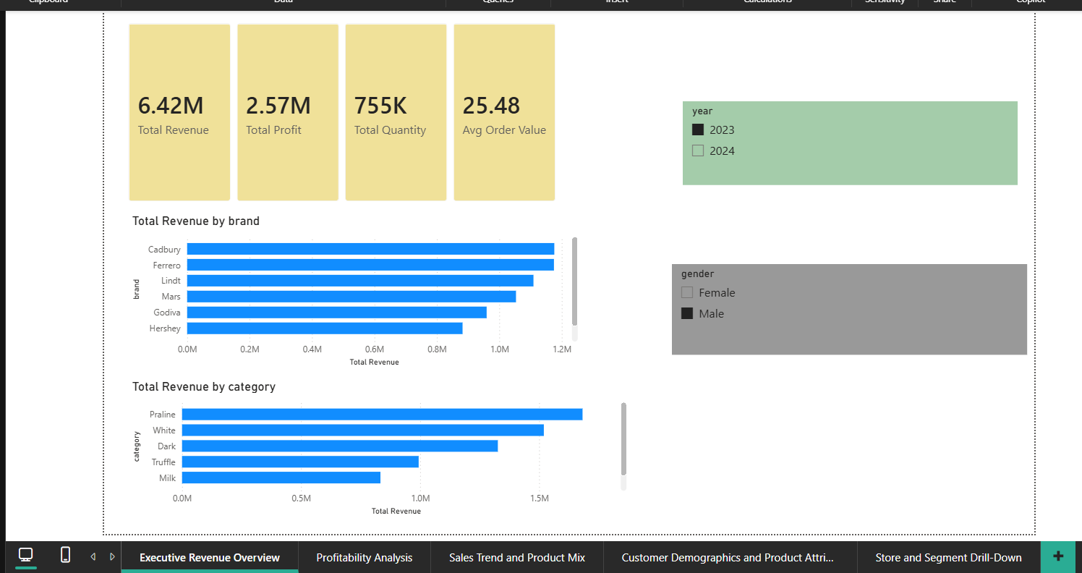
At-a-Glance Business Performance — Revenue, Profit & Top Brands
•
KPI Cards display Total Revenue, Total Profit, Total Quantity, and Average Order Value at a glance.
•
Bar charts compare revenue performance across brands and product categories.
•
Year and Gender slicers enable quick, targeted filtering for specific segments.
[SCREENSHOT PLACEHOLDER] Insert Page 1 Dashboard Screenshot Here
•
Empowers leadership to instantly identify top-performing brands and categories.
•
Designed as the executive entry point for high-level business health monitoring.

Slide 14
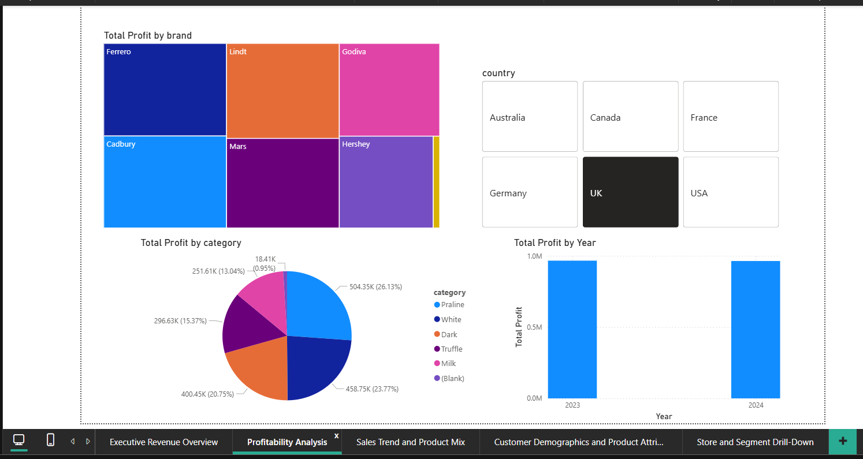
Drilling Into Profit — Which Brands and Categories Drive Margins?
•
Treemap visualizes profit contribution by brand — larger blocks indicate higher profit share.
•
Pie chart breaks down profit distribution by product category.
•
[SCREENSHOT PLACEOLDER] Insert Page 2 Dashboard Screenshot Here
Year comparison chart contrasts profit performance between 2023 and 2024.
•
Country slicer enables geographic profit analysis across different markets.
•
Helps management pinpoint which segments are most and least profitable.

Slide 15
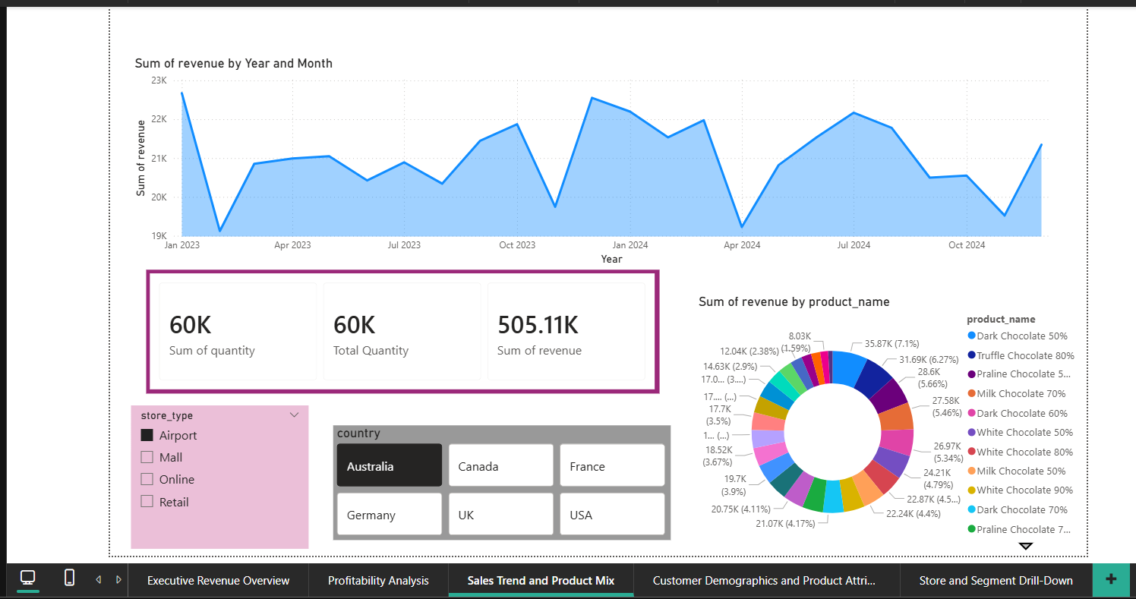
Tracking Sales Over Time — Trends, Patterns & Product Contributions
Line chart tracks monthly revenue trends, revealing seasonality and growth patterns over time.
■
KPI cards keep key sales measures visible throughout exploration.
■
[SCREENSHOT PLACEHOLDER] Insert Page 3 Dashboard Screenshot Here
Donut chart illustrates each product's revenue contribution to the overall mix.
■
Store type and country slicers support interactive, multi-dimensional filtering.
■
Ideal for identifying peak sales periods and understanding product portfolio balance.
■

Slide 16
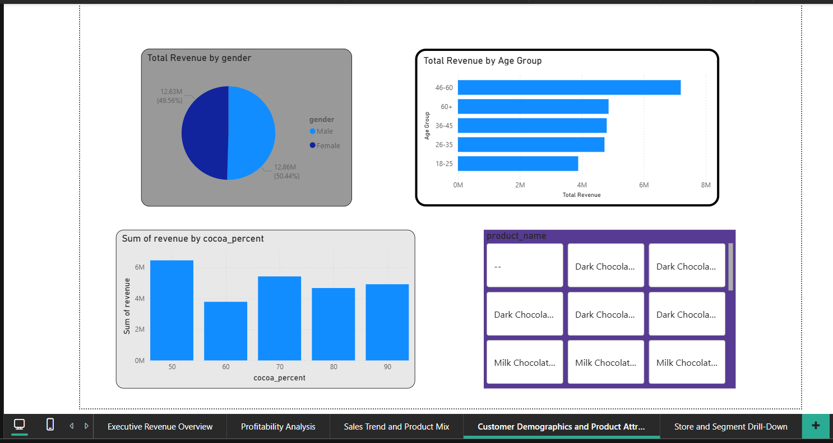
Who Buys What — Revenue by Demographics and Product Characteristics
•
Pie chart reveals revenue split by gender, highlighting purchasing behavior differences.
•
Bar chart compares revenue across Age Groups (18–25, 26–35, 36–45, 46–60, 60+).
[SCREENSHOT PLACEHOLDER] Insert Page 4 Dashboard Screenshot Here
•
Column chart shows revenue variation by cocoa percentage, linking product attributes to sales.
•
Product slicer enables product-level deep dives for targeted analysis.
•
Supports marketing and product teams in tailoring strategies to key customer segments.

Slide 17
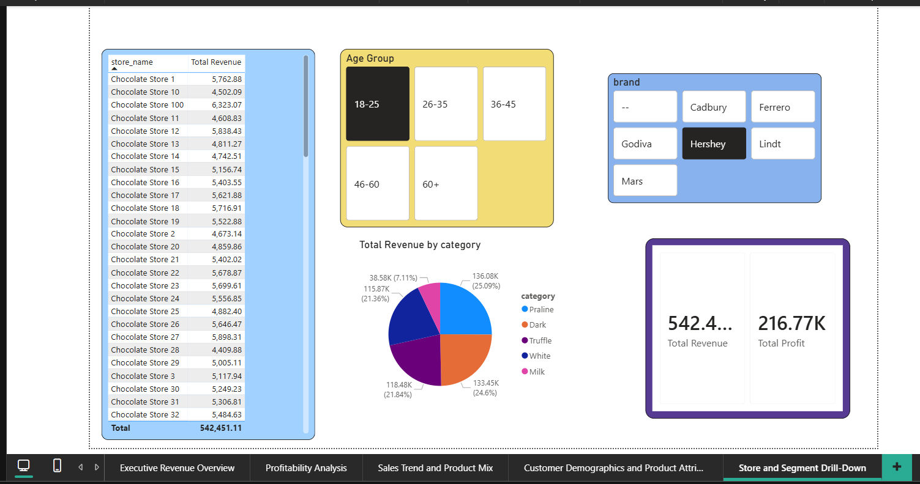
Store-Level Insights — Performance by Location and Segment
•
Store table lists revenue figures by individual store name for granular location analysis.
•
Brand and Age Group slicers allow focused, cross-segment comparisons.
•
Pie chart shows revenue share by product category for selected filters.
[SCREENSHOT PLACEHOLDER] Insert Page 5 Dashboard Screenshot
•
KPI cards dynamically summarize revenue and profit based on active filter selections.
•
Enables regional managers to assess store performance and identify underperforming locations.

Slide 18





Designed for Exploration — Slicers, Filters & Cross-Visual Interaction
Interactive Slicers
Cross-Visual Filtering
Intuitive Navigation
Every dashboard page is built with interactive slicers so users can filter by year, country, gender, brand, age group, store type, and product.
Clicking on any chart element automatically filters all other visuals on the page, enabling seamless data exploration.
Users can easily navigate between different analytical views using page tabs located at the bottom of the Power BI report.
Multi-Role Support
Dynamic Updates
The dashboard is designed to serve multiple roles simultaneously: executives, analysts, regional managers, and marketing teams.
All measures update dynamically based on the active filter context, ensuring real-time, accurate insights for decision-making.

Slide 19

Thank You!
Any Questions?
Delson Fernandes | DSAI 4103 Business Analytics Project

