Slide 1
The Behavior Based Malware Detection System For Corporate Email Traffic
E-Secure

Slide 2








How we are doing?
Get the attachment
Analyze the behavior of files
Corporate mail traffic
Pass the data to website
Behavior analyzed report
Store information to DB
Store information to DB
Identify the malware types
Cluster analyzed report
K-NN Algorithm
K-Means Algorithm

Slide 3



Website to upload files/URL and get the graphical view of malware
Analyze the behavior of files
Pass the data to website
Behavior analyzed report
Identify the malware type
K-NN Algorithm

Slide 4
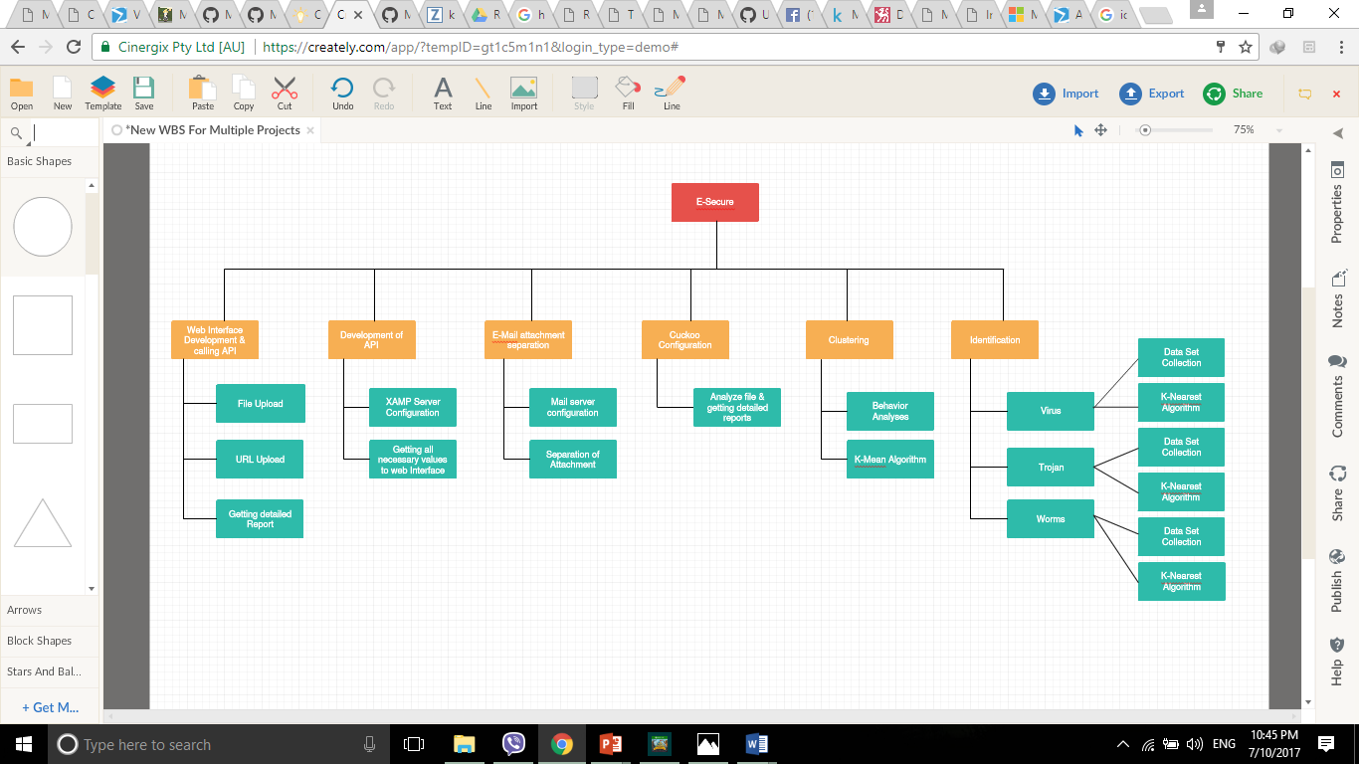

Slide 5
Integration
Website and Cuckoo Sandbox - Completed
Website Interface & API – Completed
Mail server & Cuckoo Sandbox – Not Started

Slide 6
Future Work
API
Files, Mutexes, Registry Keys, Internet traffic (Behavior Analysis)
Feature Extraction
File Extraction (The files that have been modified, created, deleted & accessed)
Mutex Extarction (Mutant Management)
Extracting Registry (Modified registry)
Feature Representation (e representations of the extracted features in in order to be used for Unsupervised Learning.)
Binary representation
Frequency representation
Sequence Representation
Combining Representations
Feature Selection & Clusteration using K-Mean algorithm

Slide 7
Future Work cont.
Collection of malware samples
Creation of data set for Trojan, virus & worms
Identification using K-Nearest Algorithm

Slide 8
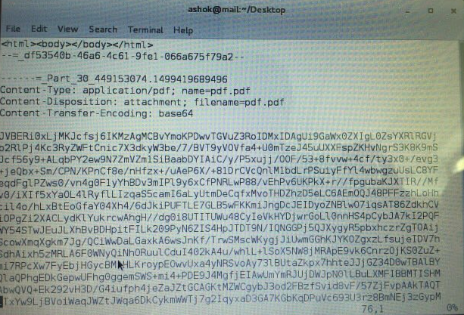
Problems
Separating the mail attachment

Slide 9
Problems
Internet access for VM
Creating data set
Malware samples
Clustering

Slide 10
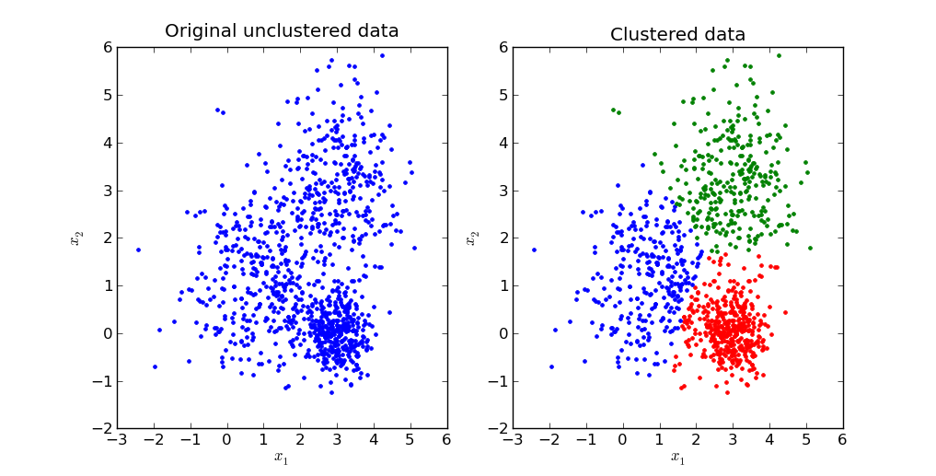
Clustering
K-Means

Slide 11
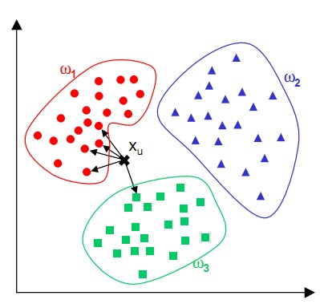
Identification
K-Nearest Neighbors

Slide 12
