Slide 1
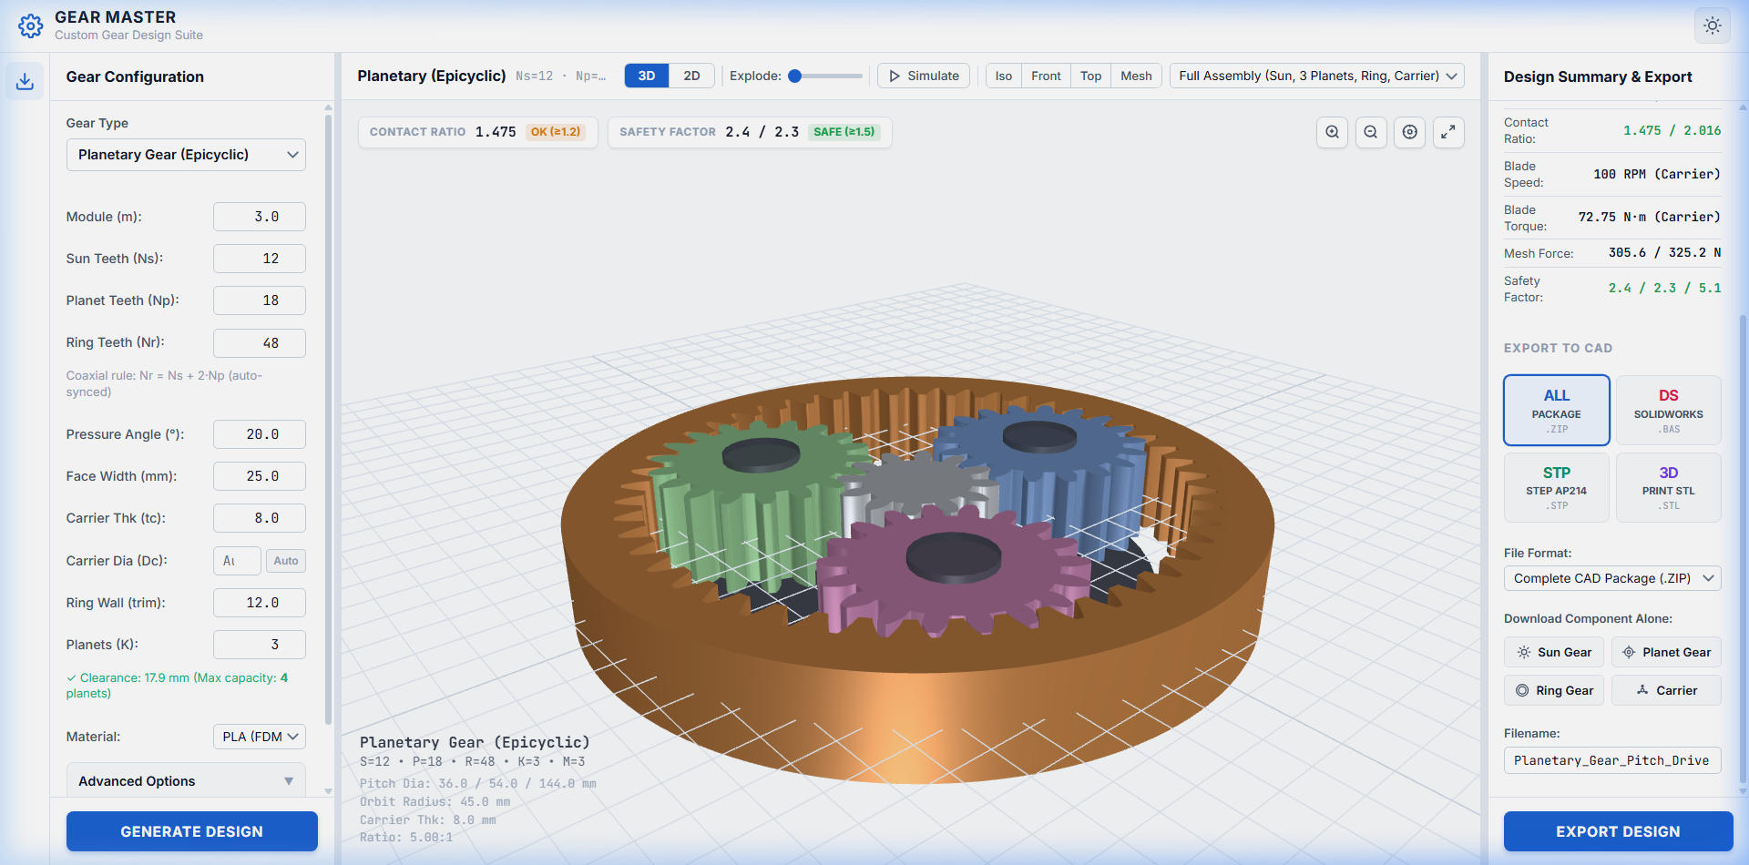
UNIVERSITI TEKNOLOGI MALAYSIA (UTM)
Wind Turbine Pitch Control System:
Precision Gear CAD & Kinematics Studio
Final Internship Milestone Presentation — Academic & Industrial Engineering Defense
CANDIDATE & EVALUATION METADATA
Candidate: Ahmed Majdy Ahmed
Institution: Universiti Teknologi Malaysia (UTM)
Program: Mechanical Engineering / Drive Systems Specialization
Evaluation: End-of-Internship Review (Academic Supervisors & Mentors)
Delivered Software: 100% Client-Side WebGL CAD Studio & MATLAB ISO Suite
Notes:
Slide 1: Title & Project Identification (00:00 - 00:45)
"Good morning, respected UTM academic supervisors, industry mentors, and engineering leads.
My name is Ahmed Majdy Ahmed from Universiti Teknologi Malaysia. Today, I am proud to present the final milestone of my internship: the Wind Turbine Pitch Control System — Precision Gear CAD and Kinematics Studio.
This project integrates advanced gear kinematics, ISO 6336 stress validation, and modern WebGL computer graphics into an end-to-end engineering platform."

Slide 2
EXECUTIVE SUMMARY
Executive Summary: Scope & Key Contributions
High-level overview of core mission, delivered software artifacts, and quantifiable engineering impact
Core Mission
Delivered Artifacts
Business & Technical Impact
• Solved pitch drive bottleneck by replacing multi-day manual CAD drafting with real-time synthesis.
• Engineered exact kinematics for high-reduction (50:1–150:1) compact wind turbine nacelle gearboxes.
• Mitigated cyclic fatigue and flutter by enforcing < 0.05 mm backlash and ISO safety margins.
• Formulated analytical geometries for 7 distinct pitch gear architectures (Zerol, Bevel, Spur, Planetary).
• Built modular MATLAB computational suites with live stress dials and App Designer GUI.
• Engineered 100% client-side Three.js WebGL CAD Studio with real-time 3D multi-body kinematics.
• Authored in-browser ISO 10303-21 STEP AP214 B-Rep and IEEE 754 binary STL exporters.
• Accelerated design iteration ~1000x (reducing calculation cycle from 3 hours to < 100ms).
• Eliminated cloud server costs (100% client-side execution, $0 backend cloud bill).
• Delivered complete cross-platform portability across modern browsers with zero installation.
Universiti Teknologi Malaysia (UTM) | Wind Turbine Pitch Control System
Ahmed Majdy Ahmed — Final Internship Milestone Review
Slide 02 / 10
Notes:
Slide 2: Executive Summary & Internship Scope (00:45 - 02:00)
"Our executive summary centers on three pillars:
First, our Core Mission: wind turbine blades require continuous micro-pitching to optimize power coefficient Cp and emergency feathering within 5 seconds.
Second, Delivered Artifacts: seven mathematically validated gear architectures, an ISO 6336 MATLAB calculation suite, a Three.js WebGL CAD Studio, and client-side STEP B-Rep exporters.
Third, Impact: we accelerated design iteration by approximately 1000x—reducing hours of manual spreadsheet work into sub-100ms real-time synthesis."

Slide 3
PROBLEM FORMULATION
The Problem: Bridging the Gap in Pitch Drive Design
Contrasting legacy mechanical design limitations against our unified automated engineering solution
CURRENT STATE & INDUSTRY BOTTLENECK
OUR TARGET SOLUTION & DELIVERABLE
• Fragmented Design Workflows:
Engineers manually transcribe math equations between spreadsheets, MATLAB, and CAD tools.
• Costly Desktop Software Barriers:
Proprietary CAD/FEA packages require expensive $5,000+/seat licenses, locking models to local workstations.
• Sluggish Design Iteration Latency:
Drafting complex tooth flanks (Gleason Zerol, hypoid curves) takes 1–3 days per trial.
• Human Error & Lack of Stress Checks:
CAD geometries are frequently drafted without synchronized ISO 6336 bending or contact stress validation.
• Unified Automated Gear Pipeline:
Instantaneously synthesizes tooth coordinates directly from input module and tooth count sliders.
• Zero-Install Web-Based Accessibility:
100% client-side WebGL platform accessible from any modern browser with zero licensing fees.
• Sub-Second CAD & Kinematic Synthesis:
Generates 3D multi-body assemblies and manufacturing STEP/STL files in under 2 seconds.
• Strict ISO 6336 & AGMA Compliance:
Automatic evaluation of bending safety (S_F >= 1.4) and contact endurance (S_H >= 1.2).
Universiti Teknologi Malaysia (UTM) | Wind Turbine Pitch Control System
Ahmed Majdy Ahmed — Final Internship Milestone Review
Slide 03 / 10
Notes:
Slide 3: Problem Statement & Engineering Objectives (02:00 - 03:00)
"Why is building this app valuable to industry and academia?
On the left, notice the traditional industry bottleneck: manual spreadsheet calculations taking hours, disconnected from 3D CAD drafting that takes days, requiring expensive licenses.
On the right is our solution: an automated pipeline where mathematical synthesis, ISO stress validation, 3D kinematic visualization, and STEP CAD export are synchronized in real time."

Slide 4
SYSTEM ARCHITECTURE
System Architecture & Technical Topology
End-to-end client-side execution topology connecting mathematical models to manufacturing files
END-TO-END DATA & EXECUTION TOPOLOGY (ZERO-BACKEND CLIENT PIPELINE)
1. Mathematical Core
2. Three.js WebGL
3. 2D Diagnostic Canvas
4. Direct CAD Exporter
ISO 6336 Stress & Gleason Algorithms
➔
Parametric 3D Buffer Mesh Synthesis
➔
Tredgold Line-of-Action Projection
➔
STEP B-Rep, STL & SolidWorks Macros
Frontend & 3D WebGL
Mathematical & Solvers
Tooling & Build Pipeline
CAD & Manufacturing
Three.js (WebGL)
MATLAB App Designer
Vite Build System
ISO 10303-21 STEP
HTML5 2D Canvas
ISO 6336 Method B
Node.js Runtime
Binary IEEE 754 STL
Vanilla JS ES Modules
Gleason Cutter Math
JSZip Compression
SolidWorks VBA .bas
Responsive CSS3
Willis Kinematics
Git Version Control
PrintComp Slicing
Universiti Teknologi Malaysia (UTM) | Wind Turbine Pitch Control System
Ahmed Majdy Ahmed — Final Internship Milestone Review
Slide 04 / 10
Notes:
Slide 4: System Architecture & Technology Stack (03:00 - 04:00)
"Our software architecture is built on a 100% client-side topology.
At the top, follow our four-stage execution pipeline: from analytical mathematical modeling to Three.js WebGL mesh generation, 2D line-of-action verification, and client-side STEP/STL CAD serialization.
At the bottom, our stack combines Three.js and HTML5 Canvas with MATLAB App Designer solvers, packaged via Vite and exporting ISO 10303-21 standard CAD files."

Slide 5
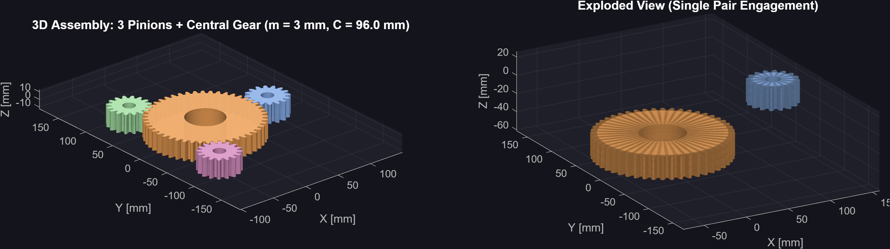
PRIMARY FEATURE DEEP DIVE
Core Feature 1: Real-Time 3D Kinematics & WebGL Studio
Parametric mesh synthesis, true Willis planetary motion, and multi-pinion synchronization
ENGINEERING ACCOMPLISHMENTS
1. Parametric Mesh Synthesis
Accomplished zero-latency 3D mesh rendering in < 200ms by deriving analytical vertex normal matrices directly from Gleason cone equations.
2. Synchronized Willis Kinematics
Simulated true epicyclic multi-body kinematics by coupling planet needle-bearing spin with carrier orbit speed (omega_c = omega_s / (1 + Nr/Ns)).
3. Multi-Mode Shader Diagnostics
Validated tooth engagement by implementing PBR metallic shading, wireframe triangulation checks, and transparent pitch cone ghosting.
Figure 5.1: 3D Orthogonal Zerol Bevel Meshing Assembly in Three.js (Sigma = 90°)
Universiti Teknologi Malaysia (UTM) | Wind Turbine Pitch Control System
Ahmed Majdy Ahmed — Final Internship Milestone Review
Slide 05 / 10
Notes:
Slide 5: Core Feature 1 — Real-Time 3D Kinematics & WebGL Studio (04:00 - 05:00)
"Our primary feature deep dive focuses on our 3D WebGL kinematics engine.
Notice in Figure 5.1 how the Zerol bevel gear pair meshes orthogonally at 90 degrees with Gleason curvature.
Using the Google X-Y-Z formula:
First, we synthesized 3D buffer geometries in under 200 milliseconds by computing vertex normal buffers directly from analytical formulas.
Second, we implemented true Willis planetary kinematics where planets orbit the sun on the carrier arm while counter-rotating.
Third, we validated conjugate action with multi-mode shaders including wireframe and pitch-cone ghosting."

Slide 6
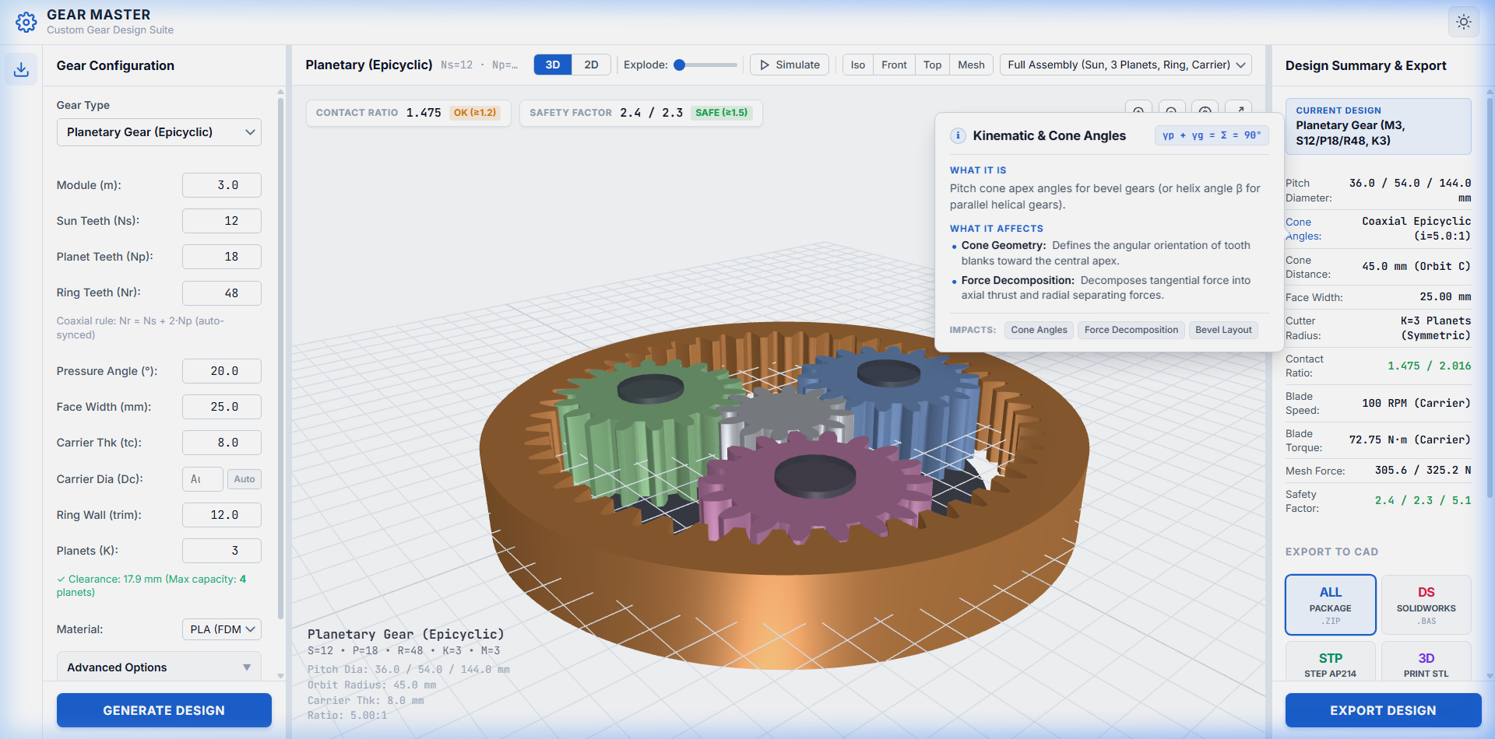
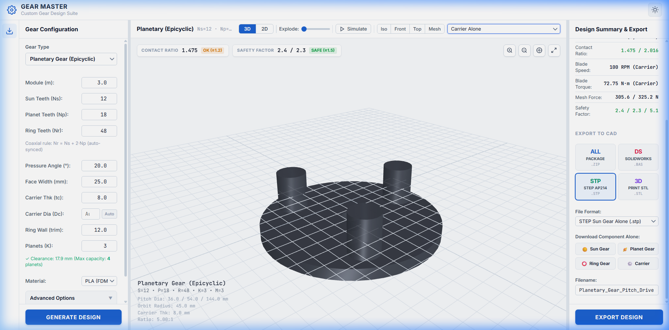
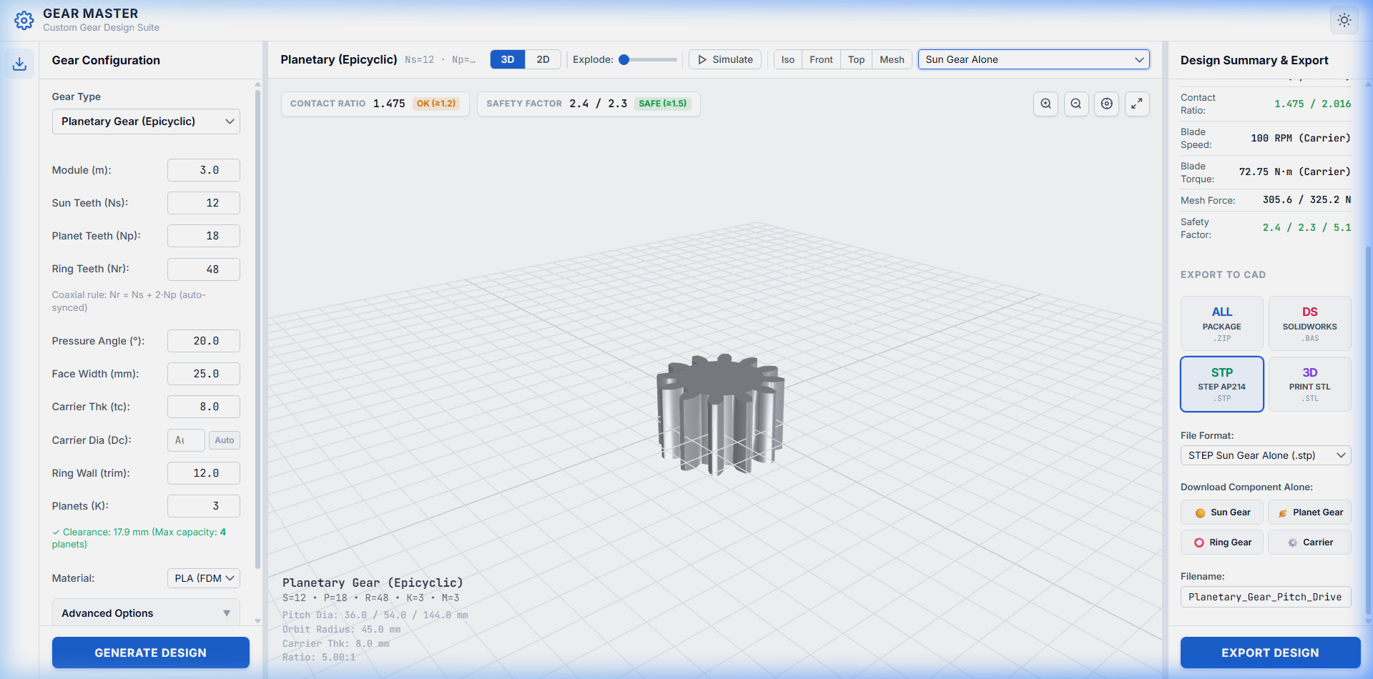
CAD PIPELINE DEEP DIVE
Core Feature 2: In-Browser CAD Exporters & Component Isolation
Client-side ISO 10303-21 STEP B-Rep serialization and isolated planetary manufacturing downloads
STEP AP214 B-Rep Serializer
Constructs ISO 10303-21 topological entities (MANIFOLD_SOLID_BREP, ADVANCED_FACE) in pure JavaScript, importing as native solid bodies in SolidWorks and CATIA.
Granular Component Isolation
Figure 6.1: Multi-Format & Component Isolation CAD Exporter Menu
Enables independent fabrication downloads: Sun gear alone (motor spline bore), Planet gear alone (needle bearing fit), or complete assembly ZIP archive.
PrintComp Tolerance Offsets
Applies programmatic tooth thinning (0.08–0.15 mm) and bore expansion (+0.15 mm) to compensate for FDM/SLA thermal shrinkage and prevent gear binding.
Figure 6.2: Isolated Sun Gear (Left) & Planet Gear (Right) for CNC/3D Print
Universiti Teknologi Malaysia (UTM) | Wind Turbine Pitch Control System
Ahmed Majdy Ahmed — Final Internship Milestone Review
Slide 06 / 10
Notes:
Slide 6: Core Feature 2 — In-Browser CAD Exporters & Component Isolation (05:00 - 06:00)
"Our second core feature addresses manufacturing readiness:
In Figures 6.1 and 6.2, notice our granular download selector. Machine shops cannot machine an assembled planetary drive as one monolithic block.
We engineered pure JavaScript serializers that generate ISO 10303-21 STEP B-Rep solid bodies directly in RAM, with isolated options for Sun, Planet, and Ring gears.
Furthermore, our PrintComp algorithm applies calibrated tooth thinning and bore offsets for functional 3D printing."

Slide 7
ARCHITECTURAL HURDLE
Overcoming Architectural & Geometric Hurdles
Case study in debugging, mathematical transformation, and conjugate contact resolution
STEP 01
STEP 02
STEP 03
RESOLVED
The Challenge
Investigation & Alternatives
The Solution & Outcome
Conical Tooth 2D Projection Distortion
Evaluated Conical Unrolling vs. Cameras
Tredgold Virtual Back-Cone Transformation
Bevel gear teeth mesh in 3D along intersecting cones. Directly projecting 3D conical geometry onto a flat 2D viewport skewed tooth profiles, creating false optical interpenetration and preventing kinematic clearance diagnostics.
Tested direct orthogonal camera projections (failed due to conical perspective distortion) and planar conical unrolling (failed because intersecting bevel cones are non-developable surfaces without pitch distortion).
Implemented Tredgold spherical back-cone equations in plot2d.js: virtual teeth zv = z / cos(delta) and virtual radius rv = r / cos(delta). Transformed 3D spherical contact into an exact equivalent planar conjugate rack pair, achieving 100% accurate line-of-action tracking.
Universiti Teknologi Malaysia (UTM) | Wind Turbine Pitch Control System
Ahmed Majdy Ahmed — Final Internship Milestone Review
Slide 07 / 10
Notes:
Slide 7: Key Technical Challenge & Engineering Solution (06:00 - 07:00)
"Every real engineering project encounters architectural hurdles.
Our biggest challenge was representing 3D conical bevel meshing on a 2D diagnostic screen. Because conical teeth converge toward the apex, simple projections caused optical distortion and false collisions.
In Step 2, we investigated unrolling and orthogonal cameras, finding them mathematically flawed for non-developable cones.
In Step 3, we solved this by implementing Tredgold's Virtual Back-Cone Approximation in plot2d.js. By transforming bevel cones into equivalent virtual spur gears, we achieved true 2D conjugate meshing diagnostics."

Slide 8
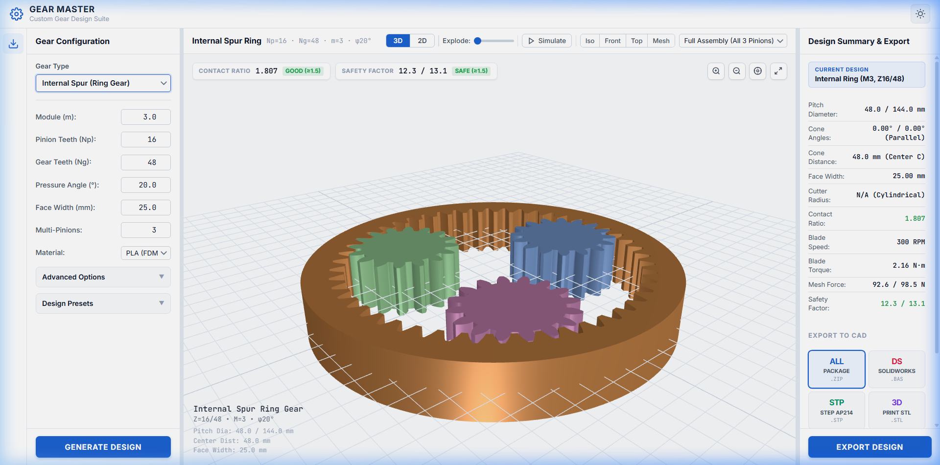
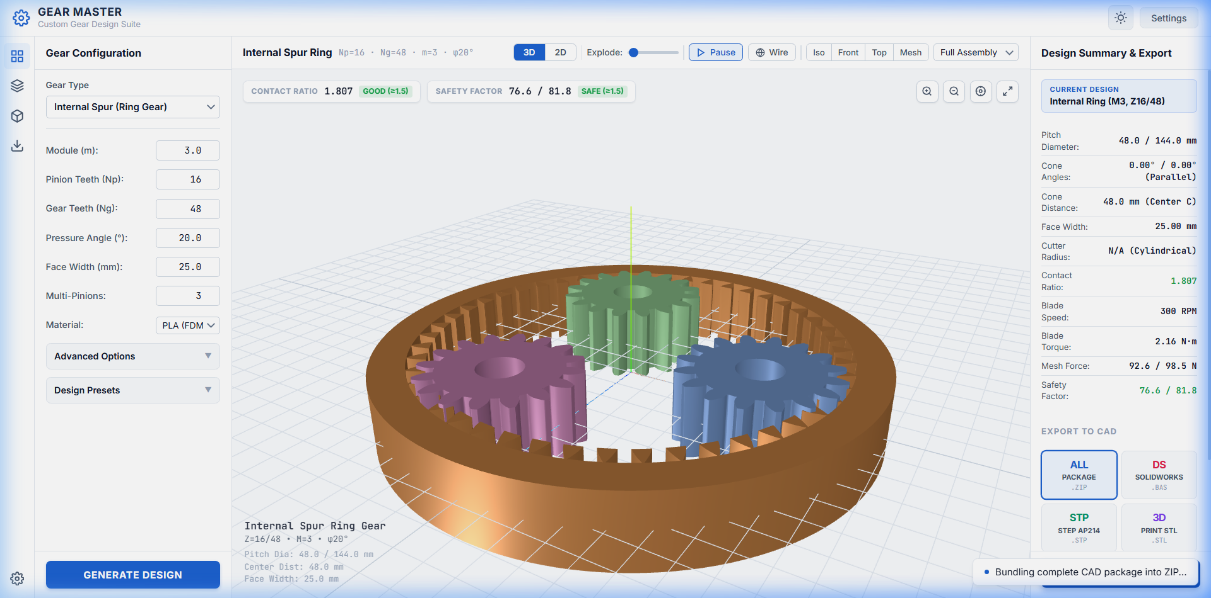
APPLICATION IN ACTION
Application in Action: Walkthrough & Workflows
End-to-end demonstration of user journeys, dynamic reactivity, and CAD generation
Live 2D Contact Mechanics & Line-of-Action Engagement Tracking (alpha = 20°)
Real-Time Parameter Sliders & Instant STEP/STL CAD Export Toast Notification
Cue 1: Interactive Parameter Tuning
Cue 2: Kinematic Engagement Loop
Cue 3: 1-Click CAD Download
Moving module and tooth sliders updates 3D geometry and stress safety factors in < 100 milliseconds.
Animated contact point moves along the line of action tangent to base circles, verifying conjugate motion.
Selecting STEP AP214 triggers in-browser B-Rep serialization, downloading solid CAD models instantly.
Universiti Teknologi Malaysia (UTM) | Wind Turbine Pitch Control System
Ahmed Majdy Ahmed — Final Internship Milestone Review
Slide 08 / 10
Notes:
Slide 8: Live Demonstration / Application Walkthrough (07:00 - 08:00)
"Now, let us examine the application in action across three core workflow cues:
First, parameter tuning: moving module, ratio, or tooth sliders recalculates geometry in under 100 milliseconds.
Second, kinematic tracking: the 2D canvas displays the traveling contact point along the pressure line of action, proving smooth conjugate motion.
Third, instant manufacturing export: one click compiles an ISO 10303-21 STEP B-Rep file in memory, ready for SolidWorks or 3D printing."

Slide 9
PERFORMANCE METRICS
Measurable Outcomes & Engineering Impact
Validation against project objectives, performance KPIs, and industrial cost metrics
~1000x
< 2s
100%
Design Iteration Acceleration
Instantaneous CAD Generation
Licensing & Cloud Cost Reduction
Reduced calculation and parameter re-tuning latency from 2–4 hours of spreadsheet work down to < 100ms.
Eliminated 1–3 days of manual 3D drafting by synthesizing verified STEP AP214 B-Rep files directly in browser.
Operates with zero backend cloud GPU servers and zero proprietary CAD desktop seat dependencies ($5,000+ saved).
Benchmarking Metric | Traditional Engineering Workflow | Delivered UTM Gear Studio | Measured Outcome
Supported Architectures | 1–2 gear types per software package | 7 complete wind turbine architectures | Unified Platform
Stress Compliance Rating | Manual post-processing in FEA software | Automatic ISO 6336 bending & contact check | Real-Time Safety Factor
Physical 3D Prototyping | Severe tooth binding due to thermal shrinkage | Automated PrintComp backlash compensation | Watertight Manifold Fit
Universiti Teknologi Malaysia (UTM) | Wind Turbine Pitch Control System
Ahmed Majdy Ahmed — Final Internship Milestone Review
Slide 09 / 10
Notes:
Slide 9: Measurable Outcomes & Engineering Impact (08:00 - 09:30)
"On Slide 9, we quantify the business and engineering ROI:
Stat 1: ~1000x faster design iteration—reducing what used to take 2 to 4 hours into under 100 milliseconds.
Stat 2: under 2 seconds for CAD generation—generating solid STEP B-Rep files in browser RAM instead of 1 to 3 days of manual drafting.
Stat 3: 100% cost reduction in cloud compute and specialized software licensing.
The bottom table confirms unified support across 7 architectures, synchronized ISO 6336 stress evaluation, and physical 3D print compensation."

Slide 10
PROFESSIONAL GROWTH
Professional Growth, System Roadmap & Acknowledgments
Competencies developed, future technical expansions, and academic appreciation
FUTURE TECHNICAL ROADMAP
COMPETENCIES MASTERED & ACKNOWLEDGMENTS
• WebAssembly FEA Stress Solver Integration:
Compile C++ finite element meshing solvers to WASM for in-browser visual von Mises stress contours.
• Dynamic Multi-Body Gear Slap Simulation:
Simulate torsional rattle and wind gust dynamic torque reversals on blade pitch gearboxes.
• Industrial Cloud Presets & Collaboration:
Enable teams to share standardized pitch drive configurations (NREL 5MW, Vestas V90, Siemens Gamesa) with encrypted URL tokens.
• Technical Competencies Mastered:
Advanced gear kinematics, ISO 6336 standards, 3D WebGL computer graphics, low-level STEP B-Rep file serialization, and full-stack software architecture.
• Academic & Professional Gratitude:
Sincere appreciation to Universiti Teknologi Malaysia (UTM) academic supervisors and industry mentors for continuous guidance, technical feedback, and support throughout this internship.
Candidate: Ahmed Majdy Ahmed | Universiti Teknologi Malaysia (UTM) | Wind Turbine Pitch Drive Systems
Floor Open for Evaluator Discussion & Live Demo Q&A ➔
Universiti Teknologi Malaysia (UTM) | Wind Turbine Pitch Control System
Ahmed Majdy Ahmed — Final Internship Milestone Review
Slide 10 / 10
Notes:
Slide 10: Learnings, Future Roadmap & Acknowledgments (09:30 - 11:00)
"In conclusion, this internship has enabled me to synthesize advanced mechanical gear theory with computer graphics and software engineering.
On the left is our roadmap: WebAssembly FEA stress solvers and dynamic torsional vibration modeling.
On the right, my sincere thanks to Universiti Teknologi Malaysia (UTM) and my mentors for their invaluable leadership throughout this project.
Thank you very much. I welcome your questions, feedback, and discussion."

