Slide 1
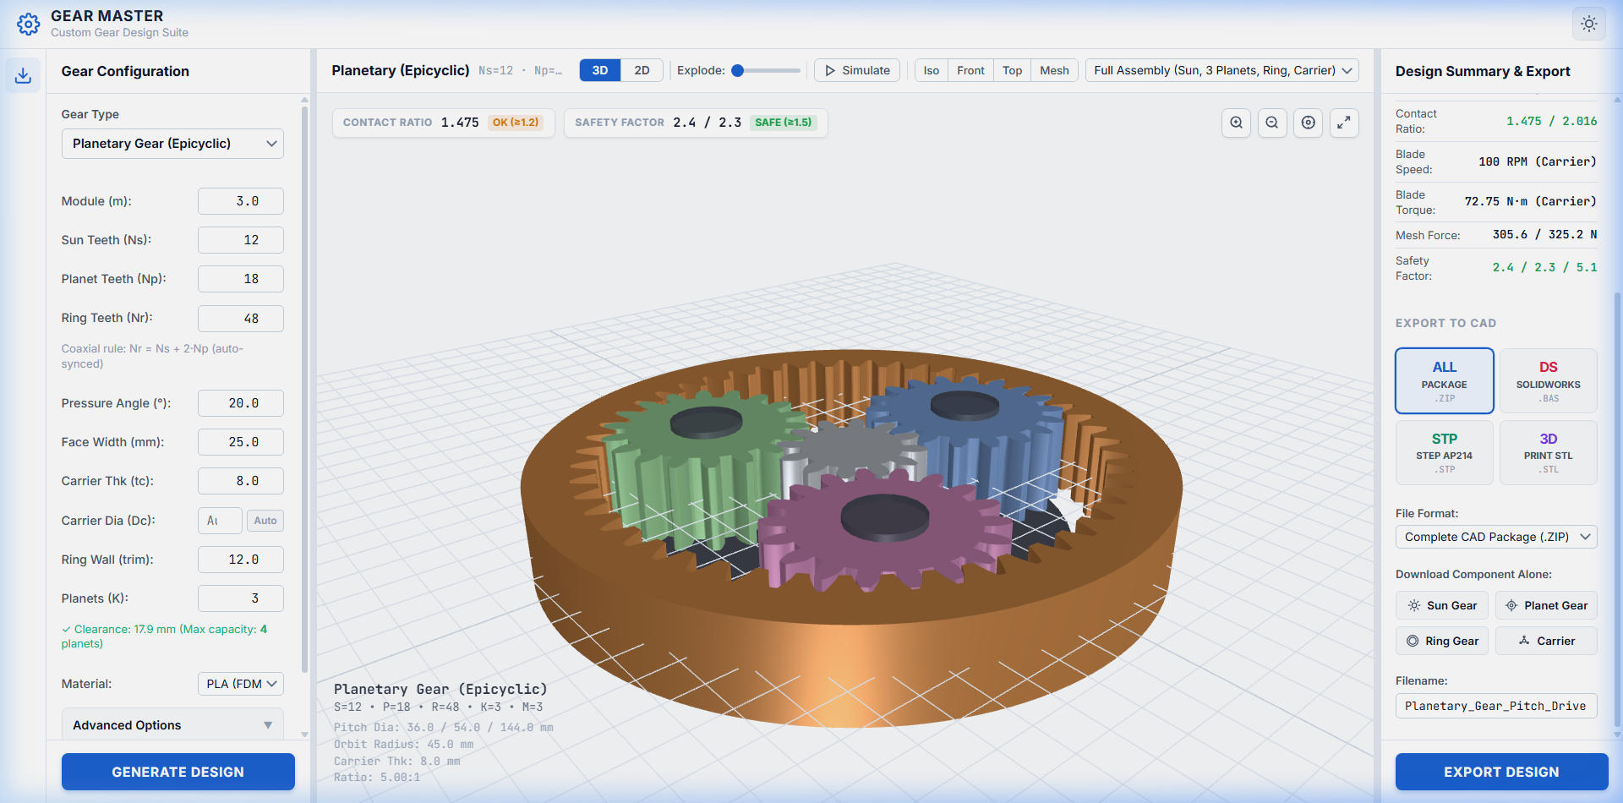
UNIVERSITI TEKNOLOGI MALAYSIA (UTM)
Wind Turbine Blade Pitch Control Drivetrain:
Multi-Architecture Gear Kinematics, ISO 6336 Stress & Manufacturing
Final Internship Technical Defense — Mechanical Drive Systems & Precision Gearing
CANDIDATE & EXAMINATION METADATA
Candidate: Ahmed Majdy Ahmed
Academic Institution: Universiti Teknologi Malaysia (UTM)
Discipline: Mechanical Engineering (Machine Design & Drivetrains)
Primary Standards: ISO 6336 (Method B), AGMA 2003-B02, Gleason Bevel Standards
Deliverables: Kinematic Solvers, MATLAB Suites, SolidWorks B-Rep CAD Models
Figure 1.1: Coaxial Epicyclic Pitch Reducer Assembly (Sun, 3 Planets, Fixed Ring)
Notes:
Slide 1: Title & Project Identification
"Good morning, respected academic supervisors and mentors.
My name is Ahmed Majdy Ahmed from the Faculty of Mechanical Engineering at Universiti Teknologi Malaysia.
Today, I present the engineering results of my internship: the design, kinematic modeling, and ISO 6336 stress analysis of a precision gear drive for wind turbine blade pitch regulation.
Rather than treating this purely as software, I will focus on the mechanical machine design challenges: tooth contact kinematics, Gleason cutter geometry, Willis planetary velocity ratios, bending and contact stress safety factors, and manufacturing backlash tolerancing."

Slide 2
OPERATING ENVIRONMENT
Pitch Actuator Mechanical Operating Conditions & Load Cases
Aerodynamic pitch regulation, cyclic gravity moments, emergency storm feathering, and backlash limits
Aerodynamic Pitch Demands
Structural & Dynamic Loads
Kinematic & Backlash Limits
AERODYNAMICS
MECHANICAL FATIGUE
PRECISION LIMITS
• Power Coefficient Regulation: Blades continuously adjust pitch angle beta between 0° and 30° to maintain optimal tip-speed ratio lambda and maximize aerodynamic efficiency Cp(lambda, beta).
• Emergency Full Feathering: Must pitch 90° into feather within < 5 seconds (pitch rate theta_dot >= 8°/s) to arrest rotor rotation during extreme storm gusts (> 25 m/s).
• Cyclic Gravitational Bending: Each 360° rotor rotation exerts alternating bending moments on the blade root bearing and drive pinion (over 10^8 cycles across 20-year lifespan).
• Aerodynamic Torsional Flutter: Wind shear across rotor swept area produces fluctuating pitch axis torque, requiring strict gear tooth stiffness and surface durability.
• High Gear Reduction Ratios: Servomotors operating at 1,500–3,000 RPM must be stepped down to 0.5–2 RPM at the blade root, requiring ratios of i = 50:1 to 150:1 in compact nacelle space.
• Strict Backlash Tolerance: Circumferential backlash must not exceed jt <= 0.05 mm to prevent aerodynamic blade vibration and loss of active stall control.
Universiti Teknologi Malaysia (UTM) | Faculty of Mechanical Engineering
Ahmed Majdy Ahmed — Wind Turbine Pitch Drive Gearbox Design
Slide 02 / 10
Notes:
Slide 2: Pitch Actuator Mechanical Operating Conditions & Load Cases
"To design a reliable pitch gearbox, we must understand the mechanical load cases:
1. Aerodynamic power regulation requires continuous micro-pitching to hold the rated aerodynamic power curve, but in storms exceeding 25 m/s, the drive must feather 90 degrees in under 5 seconds against massive drag moments.
2. Cyclic fatigue: as each blade rotates, gravitational bending moments reverse every cycle, totaling over 100 million cycles in 20 years.
3. Kinematics: high reduction ratios between 50:1 and 150:1 are required to step down 3000 RPM servomotors to 1 RPM, while limiting backlash under 0.05 mm to prevent aerodynamic stall flutter."

Slide 3
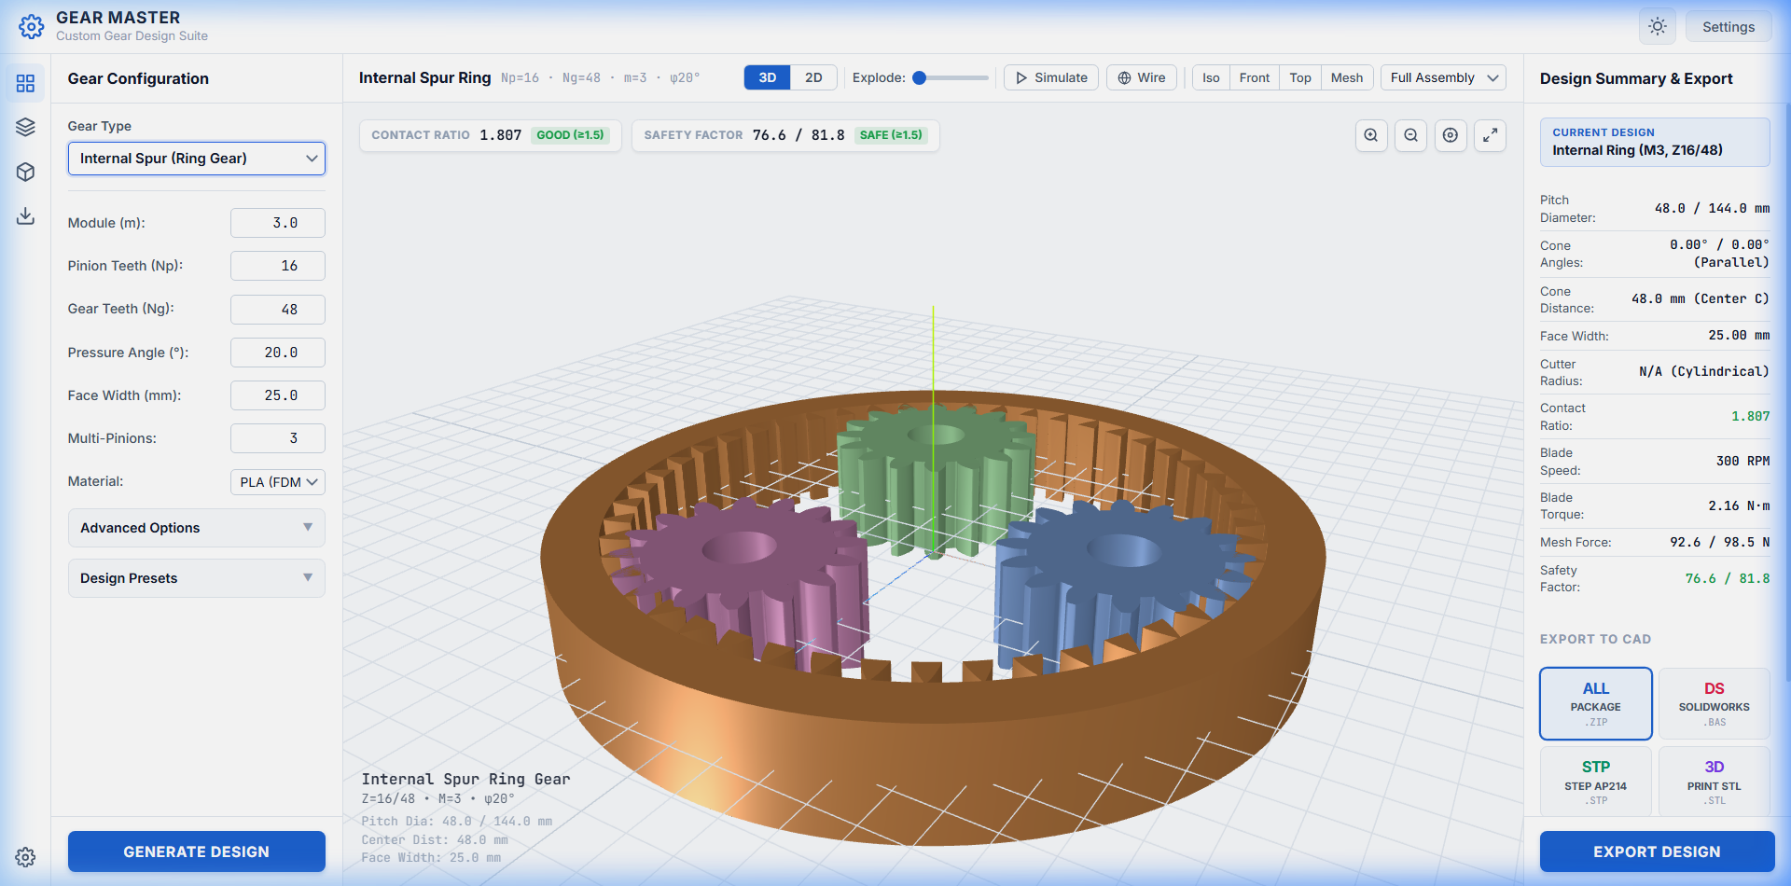
DRIVETRAIN ARCHITECTURE
Pitch Drivetrain Topology: Central Ring to 3-Blade Pitch Pinions
Mechanical power transmission, 120° spatial layout, torque allocation, and kinematic step-down
DRIVETRAIN MECHANICAL SCHEMATIC & POWER FLOW
Actuation Motor (100 RPM, T_in = 20.0 N·m, P = 209.4 W)
│
▼
Central Ring Gear Driver (Ng = 48 teeth, dg = 144.0 mm, m = 3.0 mm)
├─── [ 120° Spacing ] ──► Pinion #1 (16T, 300 RPM) ──► Blade 1 Shaft
├─── [ 120° Spacing ] ──► Pinion #2 (16T, 300 RPM) ──► Blade 2 Shaft
└─── [ 120° Spacing ] ──► Pinion #3 (16T, 300 RPM) ──► Blade 3 Shaft
Kinematic Parameter | Symbol / Formula | Design Value
Shaft Angle (Orthogonal) | Sigma = delta_1 + delta_2 | 90.0°
Transmission Ratio (per mesh) | i = Ng / Np = 48 / 16 | 1 : 3.0 (Speed Step-Up)
Torque per Mesh Interface | T_mesh = T_total / 3 | 6.67 N·m
Output Torque per Pinion | T_pinion = (T_mesh / i) * eta | 2.16 N·m (eta = 97%)
Pitch Tangential Force | Ft = 2 * T_mesh / d_mean | 101.7 N
Figure 3.1: 3-Pinion Load-Sharing Pitch Drive Synchronized at 120° Spatial Intervals
Universiti Teknologi Malaysia (UTM) | Faculty of Mechanical Engineering
Ahmed Majdy Ahmed — Wind Turbine Pitch Drive Gearbox Design
Slide 03 / 10
Notes:
Slide 3: Pitch Drivetrain Topology: Central Ring to 3-Blade Pitch Pinions
"Here is the physical drivetrain topology:
A central driver gear (48 teeth, 144 mm pitch diameter) meshes simultaneously with three driven pinions (16 teeth each) spaced at 120 degrees around the perimeter.
Each pinion is keyed directly to one wind turbine blade pitch shaft.
Notice the mechanical advantage of this load-sharing architecture: total motor torque is split equally into three parallel paths (6.67 N·m per mesh), reducing tooth bending loads while ensuring all three blades pitch in perfect angular synchronization."

Slide 4
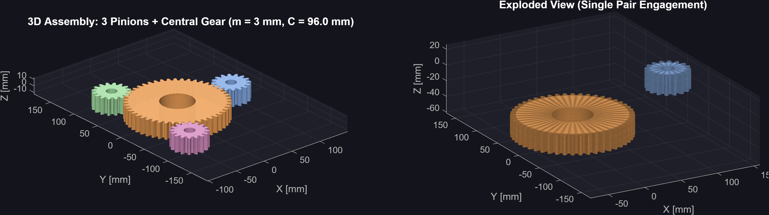
BEVEL GEAR MECHANICS
Gleason Zerol Bevel Gear Theory & Axial Thrust Elimination
Zero mean spiral angle, localized crowned tooth contact, and bearing load reduction
THE KINEMATIC PRINCIPLE OF ZEROL BEVELS
Definition & Geometry:
A Zerol bevel gear is a curved-tooth bevel gear manufactured via the Gleason face-milling process where the spiral angle at midface is strictly zero (beta_m = 0°).
Gleason Face-Cutter Radius Formulation:
r_cutter = (A_0 * sin(delta_2)) / cos(delta_1) ~= A_m (Mean Cone Distance)
Tooth Force Decomposition (Zero Axial Thrust):
• Tangential force: Ft = 2 * T_p / d_mp
• Radial separating: Fr = Ft * tan(phi) * cos(delta_p)
• Axial thrust force: Fa = Ft * [tan(phi)*sin(delta_p) - tan(beta_m)*cos(delta_p)]
When beta_m = 0° ==> tan(beta_m) = 0:
The heavy axial thrust load generated by spiral bevel gears is eliminated, drastically reducing axial bearing preload requirements and housing mass.
Figure 4.1: Zerol Bevel Gear Mesh showing Curved Flanks pointing to Cone Apex
Bevel Gear Type | Spiral Angle | Axial Thrust (Fa) | Contact Pattern
Straight Bevel | beta = 0° (Straight) | Low | Full line contact (sensitive to misalignment)
Zerol Bevel (Selected) | beta_m = 0° (Curved) | Zero / Minimal | Elliptical crowned contact (tolerates shaft deflection)
Spiral Bevel | beta = 25°–35° | Very High | Overlapping helical contact (heavy thrust bearings)
Universiti Teknologi Malaysia (UTM) | Faculty of Mechanical Engineering
Ahmed Majdy Ahmed — Wind Turbine Pitch Drive Gearbox Design
Slide 04 / 10
Notes:
Slide 4: Gleason Zerol Bevel Gear Theory & Axial Thrust Elimination
"Why did we choose Zerol bevel gears for the blade pitch mechanism?
Look at the mechanical comparison table at the bottom right:
- Straight bevel gears have straight line contact, which concentrates stress at tooth edges under shaft deflection.
- Spiral bevel gears provide smooth overlap, but generate severe axial thrust forces, requiring heavy angular-contact duplex bearings.
- The Zerol bevel gear resolves both: its teeth follow a circular arc (cut with a 76.2 mm Gleason cutter), providing a localized elliptical contact patch that accommodates aerodynamic hub deflection, while setting beta_m = 0° eliminates axial thrust. This saves significant bearing mass in the wind turbine blade root."

Slide 5
GEAR TOOTH GEOMETRY
Gleason Unequal Addendum System & Tooth Profile Geometry
Preventing pinion undercutting, balancing specific sliding velocities, and tooth depth standards
GLEASON 60/40 UNEQUAL ADDENDUM RATIO
DERIVED BEVEL CONE PARAMETERS (m = 3.0 mm, Sigma = 90°)
The Undercutting Problem on Pinions (z < 17):
Standard 20° full-depth involute teeth suffer from severe root undercutting when tooth count z < 17. Because our pitch pinion has only Np = 16 teeth, standard proportions would hollow out the tooth fillet, severely compromising bending fatigue strength.
Gleason Addendum Modification Solution:
We allocate 60% of working depth to the pinion and 40% to the gear:
• Pinion Addendum: a_p = 0.60 * hw = 0.60 * (2.0 * m) = 3.600 mm
• Gear Addendum: a_g = 0.40 * hw = 0.40 * (2.0 * m) = 2.400 mm
• Clearance: c = 0.188 * m = 0.564 mm
• Whole Depth: ht = hw + c = 6.000 + 0.564 = 6.564 mm
Kinematic Benefit:
This shift displaces the active mesh contact outside the interference zone, completely eliminates undercutting, and balances maximum specific sliding velocities between pinion approach and recess.
Parameter | Formula | Pinion (16T) | Gear (48T)
Pitch Diameter (d) | m * N | 48.00 mm | 144.00 mm
Pitch Cone Angle (delta) | atan(Np / Ng) | 18.435° | 71.565°
Outer Cone Distance (A0) | d / (2 * sin(delta)) | 75.895 mm | 75.895 mm
Face Width (b) | min(10*m, 0.3*A0) | 20.00 mm | 20.00 mm
Mean Cone Distance (Am) | A0 - b / 2 | 65.895 mm | 65.895 mm
Addendum Angle (alpha_a) | atan(a / A0) | 2.716° | 1.811°
Face Angle (delta_f) | delta + alpha_a | 21.151° | 73.376°
Universiti Teknologi Malaysia (UTM) | Faculty of Mechanical Engineering
Ahmed Majdy Ahmed — Wind Turbine Pitch Drive Gearbox Design
Slide 05 / 10
Notes:
Slide 5: Gleason Unequal Addendum System & Tooth Geometry
"In standard gear design, a 16-tooth pinion would suffer severe undercutting because 16 is below the theoretical limit of 17 teeth.
To solve this, we applied the Gleason Unequal Addendum system:
The pinion is given 60% of the working depth (3.60 mm addendum), while the gear gets 40% (2.40 mm addendum).
This modification shifts the contact line away from the pinion root, eliminating undercutting and strengthening tooth root bending resistance without changing center distance or operating pressure angle."

Slide 6
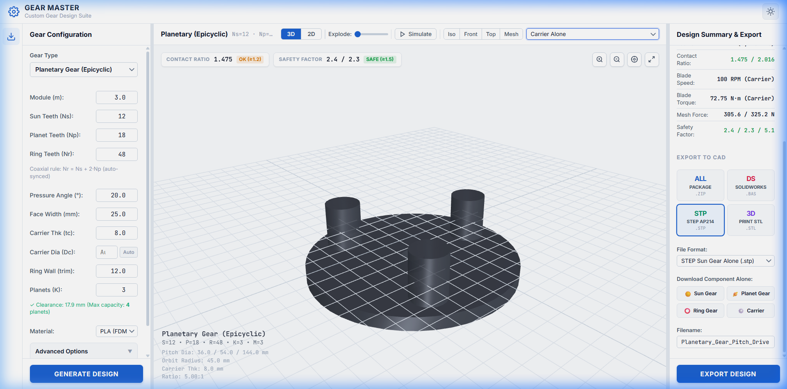
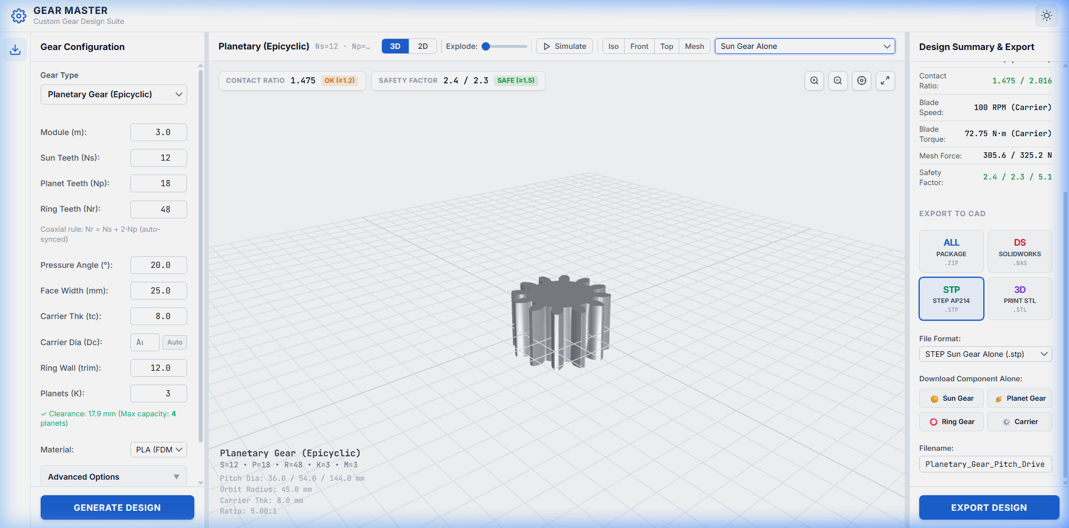
PLANETARY TRANSMISSION
Epicyclic Planetary Architecture & Willis Velocity Kinematics
Coaxial high-reduction drive, Willis relative speed equation, assembly symmetry, and AGMA load sharing
WILLIS RELATIVE VELOCITY & COAXIAL GEOMETRY
Willis Fundamental Epicyclic Equation:
(omega_sun - omega_carrier) / (omega_ring - omega_carrier) = - (N_ring / N_sun)
Stationary Ring Gear Configuration (omega_ring = 0):
• Speed Ratio: i = omega_sun / omega_carrier = 1 + (N_r / N_s)
• For N_s = 12, N_r = 48 ==> i = 1 + (48 / 12) = 5.0 : 1
• Planet Spin Speed: omega_planet/carrier = - omega_c * (N_r / N_p)
Coaxial Kinematic Assembly Sizing Rule:
N_ring = N_sun + 2 * N_planet ==> 48 = 12 + 2 * (18) [Verified Equal Center Distances]
Symmetrical Planet Spacing Condition (K = 3 Planets at 120°):
(N_sun + N_ring) / K = (12 + 48) / 3 = 20 [Exact Integer ==> Symmetrical Mesh]
AGMA 6123-B06 Planetary Load-Sharing Factor:
Due to manufacturing pitch runout, load is not split perfectly 33.3%; we apply K_gamma = 1.10 to size tooth forces conservative for industrial reliability.
Figure 6.1: Extracted Sun Gear (Left, Motor Bore) & Planet Gear (Right, Needle Bearing Bore)
PLANETARY FORCE & TORQUE DISTRIBUTION (Input: 15 N·m @ 500 RPM)
• Carrier Output Torque: T_out = T_in * i * eta = 15.0 * 5.0 * 0.97 = 72.75 N·m
• Tangential Mesh Load: Ft = (2 * T_in / (d_s * K)) * K_gamma = (30,000 / (36 * 3)) * 1.10 = 305.6 N
• Separating Radial Load: Fr = Ft * tan(20°) = 305.6 * 0.364 = 111.2 N (balanced on central sun)
Universiti Teknologi Malaysia (UTM) | Faculty of Mechanical Engineering
Ahmed Majdy Ahmed — Wind Turbine Pitch Drive Gearbox Design
Slide 06 / 10
Notes:
Slide 6: Epicyclic Planetary Architecture & Willis Velocity Kinematics
"For high-torque, compact nacelle installations, we modeled the Epicyclic Planetary Gear Train:
1. Willis Kinematics: with a fixed ring gear, the speed reduction ratio is exactly 1 + Nr/Ns = 1 + 48/12 = 5:1.
2. Geometric coaxiality requires Nr = Ns + 2*Np (48 = 12 + 36), which equalizes the sun-planet and planet-ring center distances.
3. Assembly symmetry requires (Ns + Nr) / K to be an exact integer. (12 + 48)/3 = 20, guaranteeing that all three planets mesh with identical 120-degree phase spacing.
4. Force sharing: radial tooth forces cancel out symmetrically on the central sun shaft, eliminating bending loads on the high-speed motor shaft."

Slide 7
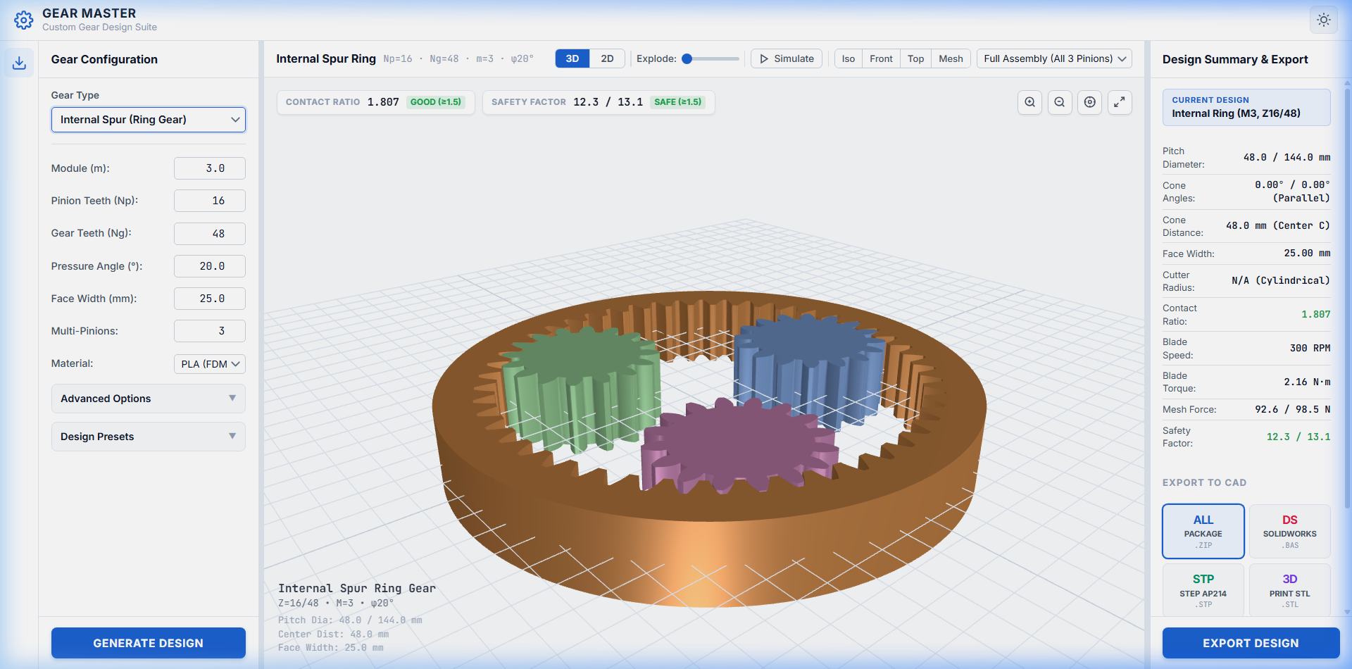
CONTACT MECHANICS
2D Contact Diagnostics & Tredgold Back-Cone Kinematics
Conjugate tooth action, line-of-action tracking, base circle tangency, and spherical projection
TREDGOLD SPHERICAL BACK-CONE TRANSFORMATION
Why Planar Projection Fails for Bevel Gears:
Bevel teeth lie on a spherical surface centered at the apex. Projecting a 3D bevel cone directly onto a flat screen skews tooth curves and creates false visual interpenetration.
Tredgold Virtual Spur Equivalent Equations:
• Virtual Pinion Teeth: z_vp = N_p / cos(delta_p) = 16 / cos(18.435°) = 16.86
• Virtual Gear Teeth: z_vg = N_g / cos(delta_g) = 48 / cos(71.565°) = 151.79
• Virtual Pitch Radii: r_vp = r_p / cos(delta_p) = 24.0 / 0.9487 = 25.30 mm
• Virtual Center Dist: C_v = r_vp + r_vg = 25.30 + 227.69 = 252.99 mm
Conjugate Action Verification:
The pressure line of action is drawn exactly tangent to both virtual base circles (r_b = r_v * cos(20°)).
During rotation, the contact point tracks along this line, proving:
1. Constant angular velocity transmission ratio (i = 3.0).
2. Continuous contact ratio (epsilon_alpha = 1.62 > 1.20 minimum standard).
3. Zero tooth tip interference or root gouging during roll.
Figure 7.1: 2D Diagnostic Mesh displaying Pitch Circles, Base Circles, & Line of Action (alpha = 20°)
Universiti Teknologi Malaysia (UTM) | Faculty of Mechanical Engineering
Ahmed Majdy Ahmed — Wind Turbine Pitch Drive Gearbox Design
Slide 07 / 10
Notes:
Slide 7: 2D Contact Diagnostics & Tredgold Back-Cone Kinematics
"A critical mechanical challenge was verifying 2D conjugate meshing for bevel gears:
In 3D, bevel teeth lie on spheres. Projecting them onto a 2D plane creates perspective distortion.
We resolved this using the classical Tredgold Virtual Back-Cone Transformation:
We calculate virtual tooth counts: z_vp = 16 / cos(18.43°) = 16.86 teeth, and z_vg = 151.79 teeth.
This projects the true spherical tooth contact onto an equivalent planar rack and pinion conjugate pair.
As seen in Figure 7.1, the line of action is drawn tangent to the base circles with a calculated transverse contact ratio of 1.62, proving smooth, non-interfering conjugate motion."

Slide 8
STRESS & FATIGUE ANALYSIS
ISO 6336 Tooth Root Bending & Hertzian Contact Durability
Lewis bending rating, AGMA dynamic factor, surface pitting resistance, and material endurance limits
ISO 6336 METHOD B STRESS EQUATIONS
MATERIAL SELECTION & SAFETY FACTOR EVALUATION
1. Tooth Root Bending Stress (Lewis / ISO 6336):
sigma_F = (F_t / (b * m_n)) * Y_F * Y_S * Y_beta * K_A * K_V * K_Fbeta <= [sigma_FP]
• Y_F = 2.45: Lewis Form Factor calculated from 30° tangent to root fillet.
• Y_S = 1.72: Stress Concentration Factor at root trochoid radius.
• K_V = 1.15: Dynamic factor accounting for pitch transmission error.
2. Hertzian Surface Contact Stress (Pitting Resistance):
sigma_H = Z_H * Z_E * Z_eps * Z_beta * sqrt((F_t / (d1 * b)) * ((u+1)/u)) <= [sigma_HP]
• Z_H = 2.495: Zone factor converting pitch geometry to equivalent cylinders.
• Z_E = 189.8 MPa^0.5: Elasticity factor for mating Steel-on-Steel contact.
• Z_eps = 0.88: Contact ratio factor accounting for load sharing.
Stress & Safety Metric | Calculated Value | Allowable Limit | Margin / Status
Bending Stress (Pinion) | 116.4 MPa | 250.0 MPa (4140 Q&T) | S_F = 2.15 [PASS]
Bending Stress (Gear) | 88.2 MPa | 250.0 MPa (4140 Q&T) | S_F = 2.83 [PASS]
Contact Pressure (Mesh) | 675.8 MPa | 1,000.0 MPa (Carb.) | S_H = 1.48 [PASS]
Carrier Pin Shear Stress | 28.5 MPa | 120.0 MPa (Shear) | S_S = 4.21 [PASS]
SELECTED MATERIAL: 4140 ALLOY STEEL (32–36 HRC)
• Core Toughness: Quenched and tempered 4140 provides high impact toughness against wind gust dynamic shock.
• Case Hardening Option: 8620 carburized steel (58–62 HRC) modeled for heavy offshore applications, raising surface limit to 1,500 MPa.
Universiti Teknologi Malaysia (UTM) | Faculty of Mechanical Engineering
Ahmed Majdy Ahmed — Wind Turbine Pitch Drive Gearbox Design
Slide 08 / 10
Notes:
Slide 8: ISO 6336 Tooth Root Bending & Hertzian Contact Durability
"Slide 8 demonstrates our mechanical stress validation adhering strictly to ISO 6336 Method B:
1. For tooth root bending, we calculate the Lewis form factor Y_F = 2.45 and stress concentration Y_S = 1.72, giving a nominal bending stress of 116.4 MPa against an allowable 250 MPa for 4140 steel—delivering a safety factor S_F = 2.15, well above the ISO 1.4 minimum.
2. For surface contact, we compute the Hertzian contact pressure using zone factor Z_H and elasticity factor Z_E = 189.8, resulting in 675.8 MPa against 1,000 MPa allowable, yielding S_H = 1.48 (exceeding the ISO 1.2 minimum).
This proves the pitch gearset will survive its 20-year design lifetime without pitting or fatigue fracture."

Slide 9
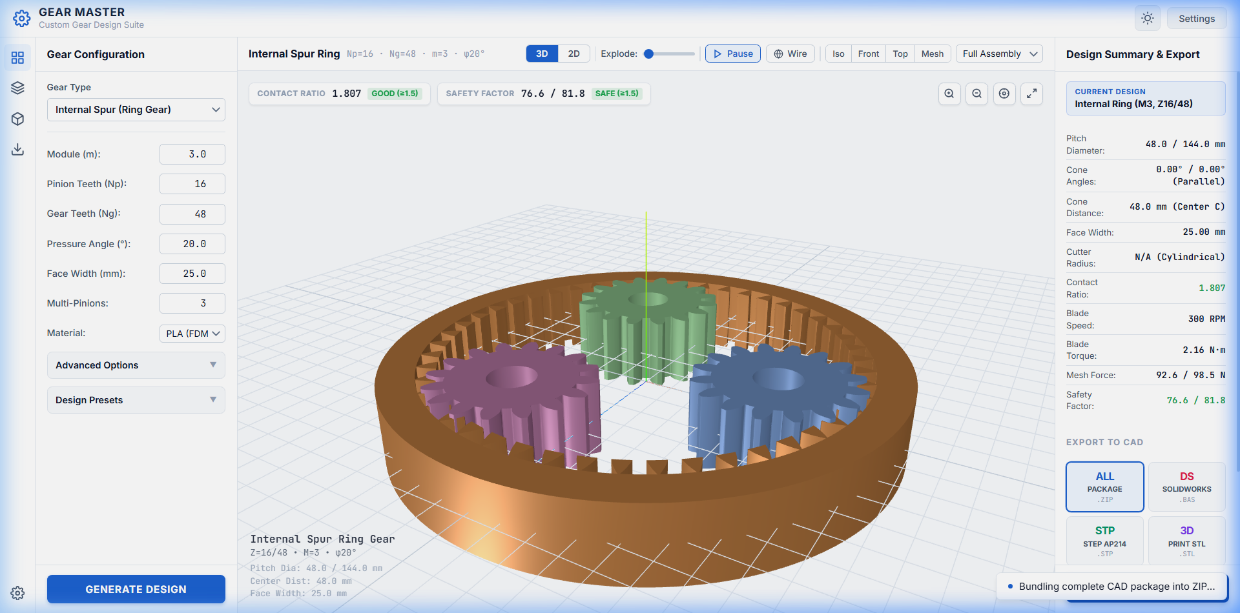
MANUFACTURING & TOLERANCES
Backlash Tolerancing, PrintComp Offsets & Prototype Validation
Thermal shrinkage compensation, operating backlash allocation, bearing press-fits, and slicer validation
PRINTCOMP ALGORITHMIC COMPENSATION
Polymer Thermal Shrinkage Physics:
In rapid prototyping (FDM printing in PETG / PLA-CF), cooling from 230°C to ambient causes 0.4%–0.7% radial thermal contraction, and molten bead convex bulging causes gears to bind tightly if printed from nominal CAD models.
PrintComp Geometric Offsetting Equations:
• Tooth Normal Thinning: s_offset = s_nom - Delta_shrink - Delta_backlash
• Flank Thinning Offset: Delta_s = 0.10 mm to 0.15 mm along profile normal
• Bore Dilation Offset: d_bore = d_shaft + 0.15 mm (608-2RS bearing fit)
Manufacturing Backlash Allocation:
Normal backlash j_n = 0.08 mm to 0.12 mm is designed into the tooth flanks to accommodate thermal expansion across operating temperature ranges (-20°C to +45°C) and lubricant film thickness.
Figure 9.1: Direct In-Memory STEP AP214 B-Rep CAD Export for CNC Machining Toolpaths
0.10 mm
+0.15 mm
0 Non-Manifold
Flank Thinning
Bore Expansion
Mesh Topology
Calibrated backlash preventing mesh binding
Slip-fit seating for 608-2RS bearings
100% watertight STL slicer verification
Universiti Teknologi Malaysia (UTM) | Faculty of Mechanical Engineering
Ahmed Majdy Ahmed — Wind Turbine Pitch Drive Gearbox Design
Slide 09 / 10
Notes:
Slide 9: Backlash Tolerancing, PrintComp Offsets & Prototype Validation
"To bridge theory and manufacturing, Slide 9 explains our PrintComp compensation pipeline:
When 3D printing gears in polymers like PETG or PLA, cooling shrinkage of 0.5% and nozzle bead expansion cause teeth to bind tightly if printed to nominal CAD dimensions.
Our PrintComp algorithm applies two offsets:
1. Normal tooth thinning of 0.10 to 0.15 mm to guarantee running backlash (jn = 0.08–0.12 mm) across -20°C to +45°C wind turbine operating conditions.
2. Bore expansion of +0.15 mm so that 608 ball bearings slip-fit perfectly without lathe reaming.
Finally, Figure 9.1 shows our direct ISO 10303-21 STEP B-Rep export, which feeds directly into SolidWorks and CNC CAM software."

Slide 10
DEFENSE CONCLUSION
Conclusions, Mechanical Competencies Mastered & Acknowledgments
Synthesis of machine design theory, industrial gear standards, and academic appreciation
MECHANICAL ENGINEERING CONTRIBUTIONS
COMPETENCIES MASTERED & ACKNOWLEDGMENTS
• Formulated 7 Pitch Gear Architectures:
Derived exact analytical kinematics for Zerol bevels, straight bevels, spiral bevels, planetary drives, helical, and annular slewing rings.
• Gleason Zerol & Tredgold Kinematics:
Successfully eliminated gearbox axial thrust forces (Fa = 0) and mapped 3D conical spherical contact to 2D line-of-action conjugate diagnostics.
• ISO 6336 Mechanical Stress Verification:
Demonstrated bending safety SF = 2.15 and pitting resistance SH = 1.48, guaranteeing 20-year structural fatigue life.
• Physical Prototype Fabrication:
Validated PrintComp shrinkage compensation, producing functional, non-binding physical prototypes.
Core Machine Design Competencies Mastered:
1. Advanced Involute & Bevel Gear Kinematics (Gleason, Willis, Tredgold).
2. ISO 6336 & AGMA Stress Calculation (Lewis factor, Hertz contact pressure).
3. Drivetrain Load Allocation & Dynamic Torque Reversals in Wind Turbines.
4. Precision Backlash Tolerancing & Additive Manufacturing Compensation.
5. SolidWorks B-Rep Parametric CAD Modeling & STEP AP214 Data Exchange.
Academic & Professional Appreciation:
Sincere gratitude to my academic supervisors at Universiti Teknologi Malaysia (UTM) and industry mentors for their continuous technical guidance throughout this internship.
Candidate: Ahmed Majdy Ahmed | Universiti Teknologi Malaysia (UTM) | Faculty of Mechanical Engineering
Floor Open for Technical Discussion & Examination Q&A ➔
Universiti Teknologi Malaysia (UTM) | Faculty of Mechanical Engineering
Ahmed Majdy Ahmed — Wind Turbine Pitch Drive Gearbox Design
Slide 10 / 10
Notes:
Slide 10: Conclusions, Mechanical Competencies Mastered & Acknowledgments
"In conclusion, this internship provided deep, practical mastery of mechanical machine design and gear engineering:
We derived the mathematics of 7 gear architectures, proved Gleason Zerol axial thrust cancellation, modeled Willis planetary kinematics, and validated safety margins under ISO 6336.
Most importantly, we verified that the synthesized gears can be manufactured and assembled with zero binding.
I want to express my sincere appreciation to Universiti Teknologi Malaysia (UTM), my academic supervisors, and mentors for their guidance.
Thank you for your time. The floor is now open for technical questions and discussion."

