Slide 1
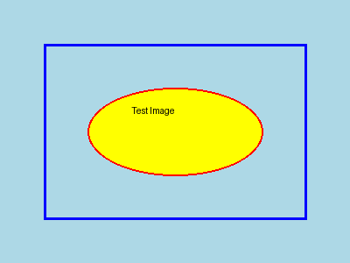
Test Presentation with Generated Image
This slide contains a generated test image.

Slide 2
Second Slide - Text Only

