Slide 1
Predicting Chronic Kidney Disease
A Machine Learning Approach to Hyper-Local Prediction of Chronic Disease

Slide 2
Can census data predict hyperlocal prevalence of chronic kidney disease?

Slide 3
Why Chronic Kidney Disease?
30 million Americans
$31 billion in annual treatment costs
89,000 deaths per year
Can be prevented and easily managed if caught in early stages
essential to find affordable and effective modes of prevention
Notes:
According to the National Kidney Foundation, 30 million Americans suffer from chronic kidney disease (CKD)
a life-threatening disease that impairs the kidneys
annual cost of treating kidney failure = $31 billion with 89,000 deaths per year
although CKD can be prevented and easily managed if caught in the early stages, it often goes unchecked until the disease has progressed to more advanced stages.
Early detection of CKD can help save money, save lives, and improve the livelihood and productivity of millions of Americans.

Slide 4
About the Data

Slide 5
Data Collection
500 Cities: Local Data for Better Living (Centers for Disease Control)
CSV with census-tract level data on chronic disease, poor health indicator, and preventative behavior rates
5-year American Community Survey (U.S. Census Bureau)
Pulled data on more than 256 demographic features from Census Bureau API
28,004 census tracts (observations) from 500 largest cities in the U.S.

Slide 6
Data Cleaning:
500 Cities
Limited to 1 target variable and 9 features:
7 prevention measures
2 unhealthy behaviors
Paired down to census tract-level data
Pivoted from long to wide data
Extracted Tract ID from UniqueID column
Converted to numeric and categorical (state and city) data types
Imputed missing data with the variable mean

Slide 7
Data Cleaning: American Community Survey
Dropped two empty columns
Converted negative numbers to NaN
Dropped all columns missing more than 80% of data
Brought number of features to 237
Imputed missing values with variable mean
Combined datasets on Tract IDs
Dropped all duplicate rows
Final dataset:
27,408 observations and 252 variables

Slide 8
Exploratory Data Analysis

Slide 9
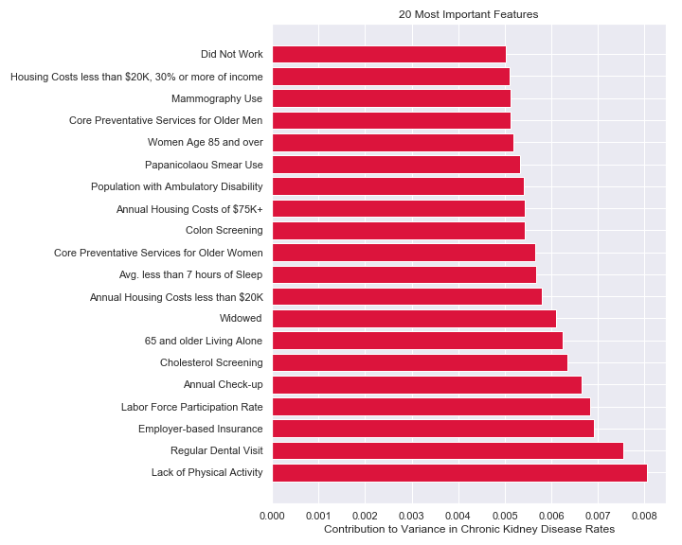
Extracting Important Features for Exploration

Slide 10
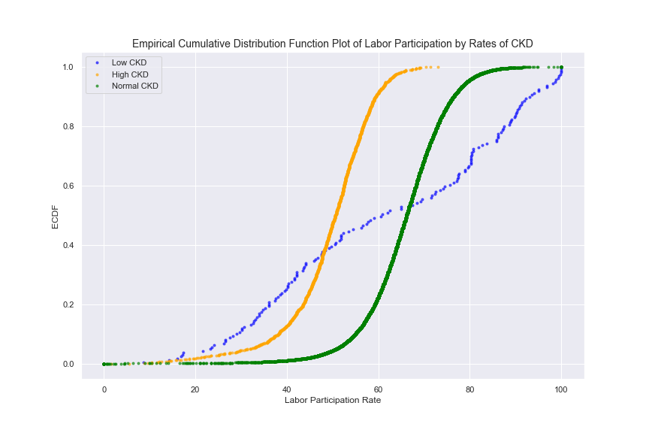
Labor Force Participation Rate and Chronic Kidney Disease

Slide 11
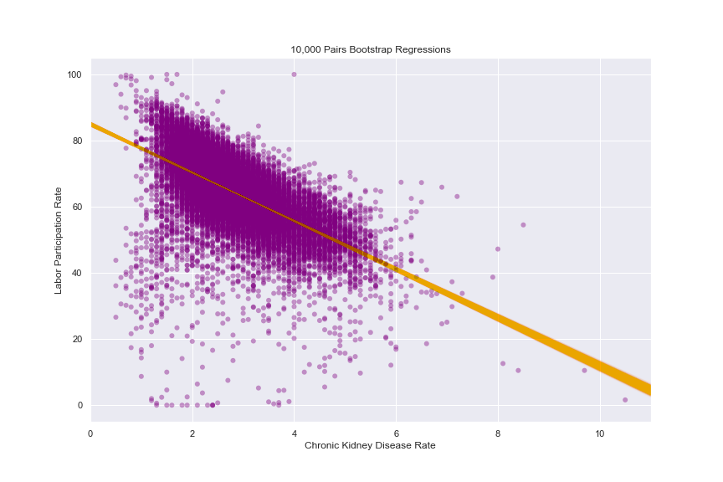
 | Mean CKD Rate | Mean Labor Participation Rate | Standard Error of Labor Participation
Low Rates of CKD | 0.939% | 61.62% | 25.18%
High Rates of CKD | 4.917% | 49.32% | 9.65%

Slide 12
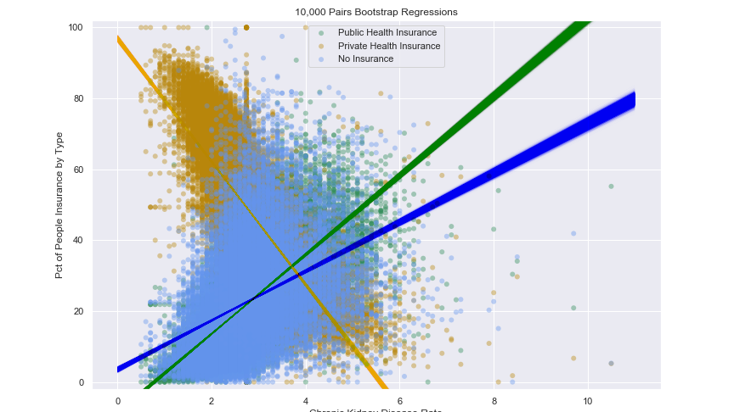
CKD and Types of Insurance

Slide 13
Comparing Rates of CKD Among Those with Public Insurance and Those with No Insurance
 | Sample Difference | 99% Confidence Interval | z-score | p-value
Difference of Mean Slope | 4.23 | (4.228,4.236) | 2751..27 | 0.0
Difference of Pearson r | 0.2814 | (0.281, 0.282) | 4285.0 | 0.0

Slide 14
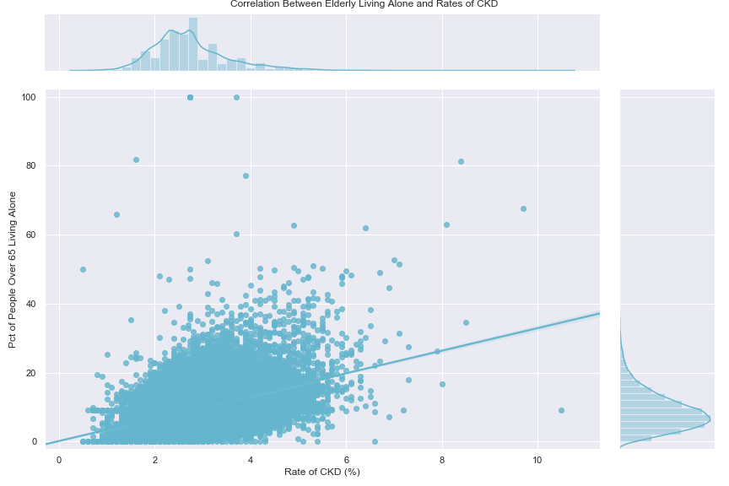
The Role of Seniors Living Alone

Slide 15
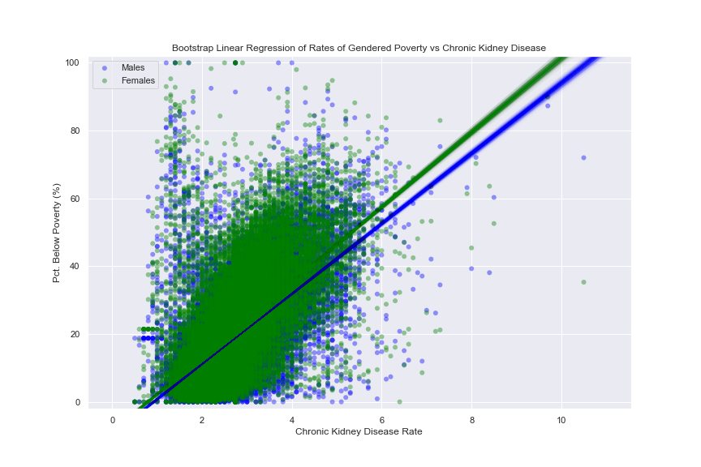
The Combined Impact of Poverty and Sex

