Slide 1
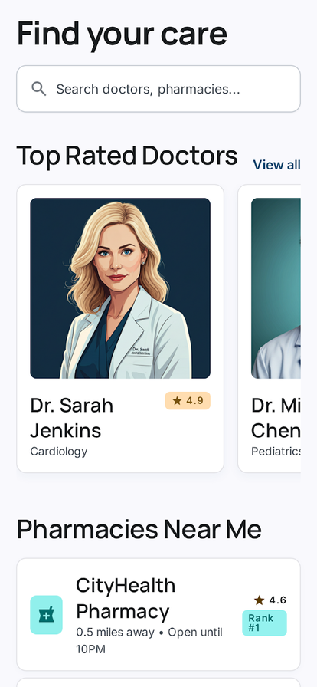
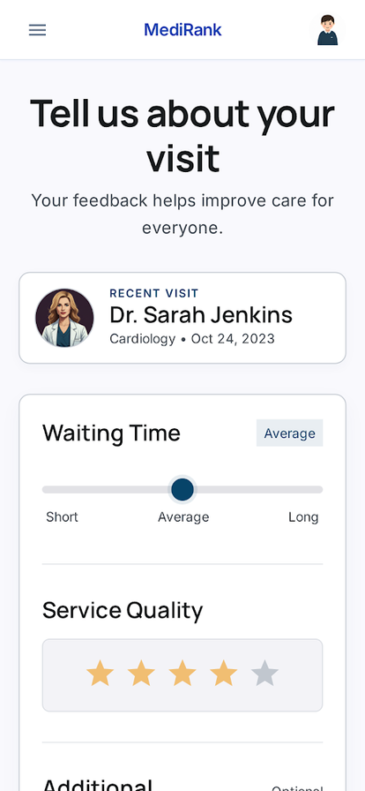
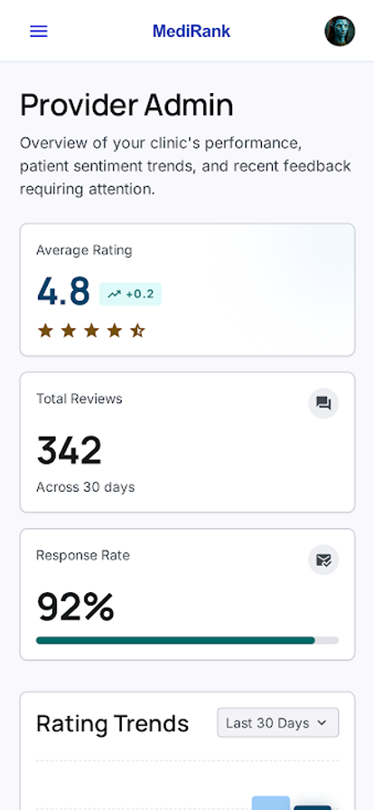
CMPE/ISE/SE 494 GRADUATION PROJECT
8541
Spring 2025-26
Dart lines in lib/
DRAPO
154
Patient-Centric Healthcare Review Platform
Dart tests
A Flutter + Firebase mobile app that turns post-visit feedback into structured provider discovery, role-aware workflows, and server-side weighted rankings.
78.75
Mean SUS score
Flutter 3.19+
Firebase Auth
Firestore
Cloud Functions v2
Provider state
DESIGN CHALLENGE
Healthcare reviews need more than a star average.
Problem
Method
Outcome
Single-star ratings flatten service quality and weaken trust.
Structure reviews, enforce deterministic IDs, aggregate server-side.
Ranked discovery with patient, provider, admin, and community flows.
SYSTEM WORKFLOW
Trust is built into the data path.
Patient App
Structured Review
search, bookmark, submit structured review
overall rating plus waiting time, service, hygiene, staff communication
Auth + Role Gate
Cloud Function Aggregation
patient / provider / admin navigation and permissions
recalculateProviderStats recomputes averageRating and rankingScore
Firestore Collections
Rules + Transactions
users, providers, reviews, community_doctors, community_reviews
locked score fields, immutable reviews, atomic community aggregation
AHP-INSPIRED RANKING
APP SURFACES
rankingScore = 0.4 * averageOverallRating + 0.6 * weightedQuestionnaireScore
Real project screen assets.
Staff communication
35%
Hygiene
25%
Service quality
25%
Waiting time
15%
Discovery
Review form
Dashboard
VALIDATION
Checked with tests and real task sessions.
154
2
78.1%
86.7%
6
Dart tests
JS tests
Coverage
Task completion
Participants
unit + widget + A/B
aggregation function
~92% effective
26/30 attempts
SUS + think-aloud
SUS score distribution
Mean SUS: 78.75 (B - Good)
P1
P2
P3
P4
P5
P6
Above industry average (68) and healthcare-app average (71.4). Next sprint: search affordance, bookmark label, emulator-backed integration coverage.
90
73
85
98
53
75
Sources: README.md, PRODUCT.md, DESIGN.md, TEST_REPORT.md, USABILITY_TEST.md, STUDY_GUIDE.md, functions/src/aggregation.js, firestore.rules, lib/services/firestore_service.dart

