Slide 1
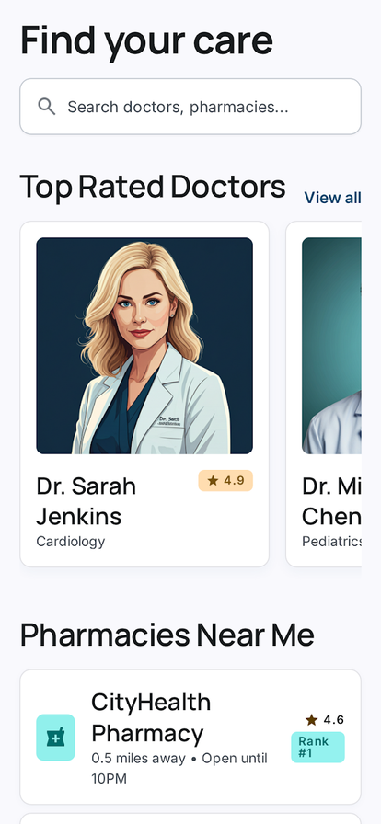
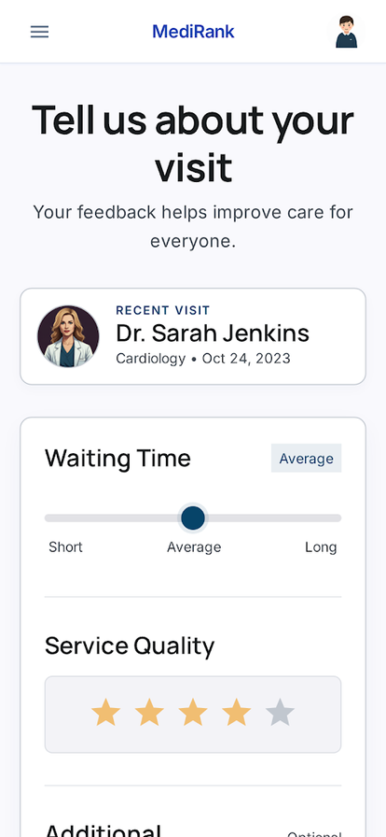
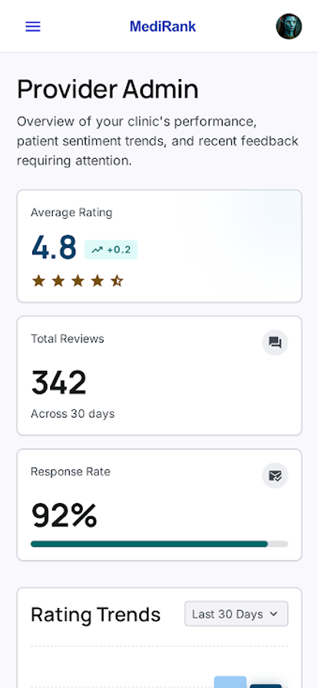
CMPE/ISE/SE 494 GRADUATION PROJECT
DESIGN CHALLENGE
PRODUCT SURFACES
Spring 2025-26
Healthcare reviews are useful only when the score is hard to fake and easy to understand.
A real mobile flow, not just a rating formula.
DRAPO
Problem: single-star ratings flatten service quality and invite weak trust signals.
Method: structure reviews, enforce one-review IDs, aggregate scores server-side.
Outcome: ranked discovery plus patient, provider, admin, and community flows.
Patient-Centric
Healthcare Review Platform
SYSTEM WORKFLOW
Trust is built into the data path, not just the interface.
Patient App
Auth + Role Gate
Firestore Writes
A Flutter + Firebase mobile application that turns post-visit feedback into structured provider discovery, role-aware workflows, and server-side weighted rankings.
search, bookmark, review
patient / provider / admin
users, providers, reviews, community_*
Structured Review
Cloud Function
Ranked Listing
overall rating + four service-quality criteria
recalculateProviderStats on review writes
rankingScore drives discovery
Patient discovery
Built for
Patients in Turkey seeking reliable healthcare care, plus doctors, pharmacies, and admins who need governed reputation workflows.
Structured review
Rules Lock Scores
Provider Replies
Community Transaction
Flutter 3.19+
Firebase Auth
Firestore
clients cannot edit averageRating, totalReviews, rankingScore
only providerReply + providerReplyAt may update reviews
off-app doctor aggregate + review write happen atomically
Cloud Functions v2
Provider state
Provider dashboard
AHP-INSPIRED RANKING
VALIDATION
Patient journey
rankingScore = 0.4 * averageOverallRating + 0.6 * weightedQuestionnaireScore
Find doctors/pharmacies, compare ranked
listings,
154
2
78.1%
8541
52
5
Dart tests
JS tests
coverage
Provider + admin control
Staff communication
35%
unit/widget/A-B
aggregation fn
~92% effective
Dart lines in lib/
Dart source files
Firestore collections
Hygiene
25%
SUS participant scores
Mean SUS 78.75 (B - Good)
86.7% task completion
6 participants
Providers reply and request practice changes;
admins
Service quality
25%
P1
P2
P3
P4
P5
P6
Waiting time
15%
Honest next sprint
90
73
85
98
53
75
Improve search affordance and bookmark labels;
add
No production usage or clinical claims are asserted; this poster presents the repository build and its measured evaluation artifacts.
Sources: README.md, PRODUCT.md, DESIGN.md, TEST_REPORT.md, USABILITY_TEST.md, STUDY_GUIDE.md, functions/src/aggregation.js, firestore.rules, lib/services/firestore_service.dart

