Slide 1
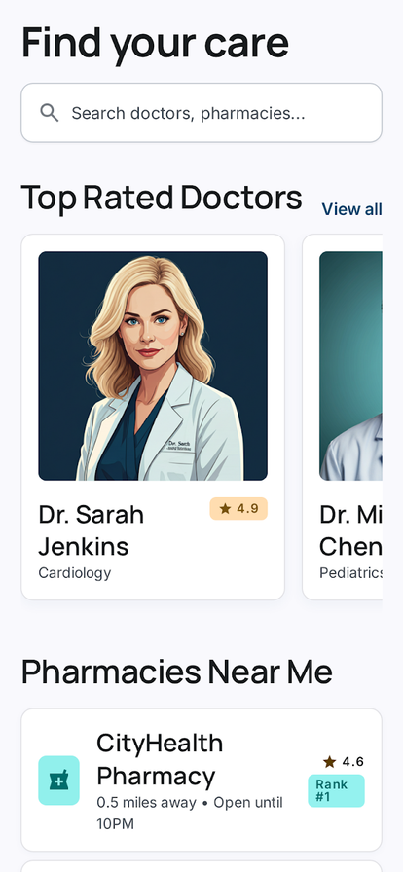
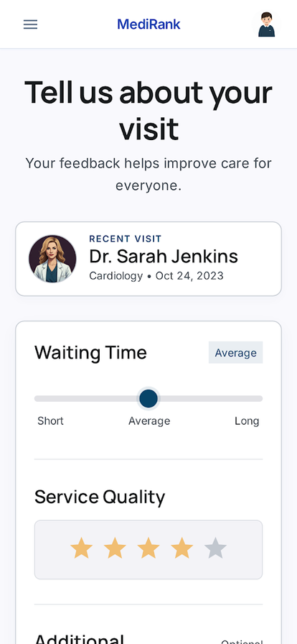
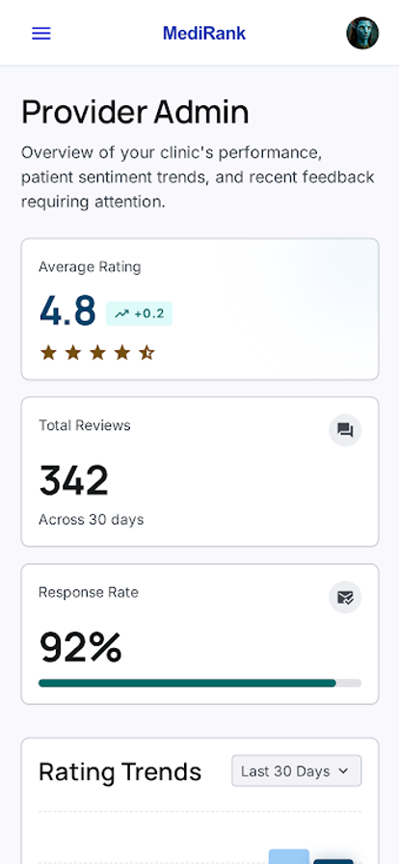
DRAPO
Patient-Centric Rating and Evaluation Platform for Healthcare Providers
CMPE/ISE/SE 494 Senior Project
Supervisor: Prof. Dr. Hürevren KILIÇ | Flutter + Firebase independent decision-support mobile app
Team
Design and Architecture
Interfaces
DRAPO Dev Team
Layered mobile architecture with server-side score integrity
Ahmed Nasser Haidar
20244710088
Ruşen Emir Ramazanoğlu
21243510122
Alireza Rahmani Ghahroudi
20243510082
Presentation Layer
Parnia Helchi
22243610087
Flutter UI: auth, discovery, provider profile, questionnaire
Omer Ahmed Awni Alobaida
20244710103
Aleyna Duru Koç
24244710045
Supervisor: Prof. Dr. Hürevren KILIÇ
Application Service Layer
Objective
Auth, provider search, review management, questionnaire processing
Reduce healthcare information asymmetry by turning real post-visit experiences into structured, comparable provider rankings for doctors, pharmacies, and clinics.
Business Logic Layer
Home / Discovery
Review Form
Dashboard
AHP-inspired ranking, validation engine, analytics dashboard
Project stance
Backend Cloud Infrastructure
Implemented mobile flows
DRAPO is not a hospital record system. It stores no diagnoses, prescriptions, or treatment histories; it focuses on non-clinical service quality.
Firebase Auth, Firestore, Storage, Cloud Functions
secure login, profile management, and role-aware navigation
Outcome: help patients choose with evidence while giving providers feedback they can act on.
search by name, specialty, provider category, and location
structured review form, star rating, anonymity option, analytics
Architecture views
Interface principle
Application Areas
Logical: Patient, Provider, Admin actors
Process: review write -> ranking trigger
Deployment: Flutter client + Firebase cloud
Simple, modern, mobile-first screens designed for low-friction provider discovery and guided feedback entry after a visit.
Patients
search, compare, save, and review providers
Privacy and trust constraints
Providers
monitor trends, strengths, and improvement areas
KVKK-aware data minimization, authenticated access, anonymous reviews, no clinical records, and backend-protected ranking updates.
Admins
moderate data and maintain provider quality
Methods/Tools
Conclusion
Service quality
measure waiting time, cleanliness, empathy, professionalism
Methodology + toolchain
DRAPO achieved its primary goal: a scalable patient-centered platform that combines mobile access, cloud backend infrastructure, and weighted service-quality evaluation.
Public value
support transparency, accountability, and SDG 3
Agile Scrum: 16 weeks / 9 sprints
Flutter 3.19+ / Dart 3.3+
patients gain clearer non-clinical comparison signals
Provider state management
Firebase Auth, Firestore, Storage
providers gain structured feedback for improvement
Project Evidence
Cloud Functions v2 for ranking updates
future: appointments, AI fraud detection, advanced analytics, larger provider database
Git/GitHub, VS Code, Cursor, antigravity
9
154
Firebase Spark Tier cost constraint
Scrum sprints
automated tests
AHP-inspired ranking method
78.75
0
Weighted score = sum(criteria weight x patient score)
30%
References
SUS mean
critical crashes
Communication quality
20%
Cleanliness
20%
Final Project Report — team, objectives,
metrics,
Performance summary from final report: provider search 1.2 sec, review submission <1 sec, screen transitions 0.8 sec, and 92% successful functional scenarios.
Professionalism
15%
Waiting time
15%
WHO (2023) — digital health transformation
context.
Empathy
Liu & Jiang (2021) — communication quality
and
Verification method
Al Awadh (2022) — multi-criteria
healthcare
154 automated tests across models, widgets, routes, and utility calculations
Fentaw (2020); Zarichuk (2023) —
cross-platform
Integration checks for authentication, cache failover, stream updates, and review writes
Valkamo (2025) — mHealth and real-time
mobile
UAT with 6 participants on Samsung Galaxy A54: T1/T2 100%, T3 83%, T5 67%
README.md / TEST_REPORT.md —
implementation
SUS mean 78.75; core flows tested for search, profile access, questionnaire, bookmarking
aggregation.js / firestore.rules —
weighted
Questionnaire captures communication, cleanliness, professionalism, waiting time, empathy, comments, and anonymous review preference.
2025-26 Spring | DRAPO Dev Team | Patient-centered healthcare service transparency through structured feedback and weighted rankings

