Slide 1

SOS Moderators
The All-In-One Moderator Co-Pilot for Reddit
Reddit Mod Tools & Migrated Apps Hackathon · May 2026
Category: Best New Mod Tool
Built by: Solomon Shasanmi

Slide 2

What Is SOS Moderators?
2 / 10
SOS Moderators is a moderation bot built natively on Devvit, Reddit's official developer platform.
Designed for every moderator — from the brand-new mod on day one to veteran teams running millions-member communities.
Works entirely inside Reddit. No external server. No OAuth setup. No developer maintenance required.
Installs in one click from the App Directory and is operational immediately with sensible out-of-the-box defaults.
Covers every stage of the moderation lifecycle:
▸ Prevention → Detection → Enforcement → Transparency → Recovery → Community Insight
The first Devvit app to integrate a data-grounded AI co-pilot (Coach) that answers plain-English questions about a specific subreddit's live data, with no API key required.

Slide 3

The Problem — The Moderation Crisis on Reddit
3 / 10
Reddit runs on billions of posts managed almost entirely by unpaid volunteer moderators.
The Attack Surface is Growing Fast:
▸ MASS REPORT campaigns clog modqueues and exhaust mod teams
▸ COORDINATED RAIDS flood feeds with off-topic content before mods can respond
▸ BAN EVASION networks use aged sockpuppet accounts to bypass bans repeatedly
▸ AI-generated SPAM floods create thousands of low-quality posts per hour
▸ REGEX EVASION (zero-width spaces, lookalike characters) defeats keyword filters
▸ Brigading, vote manipulation rings, and false-flag operations degrade COMMUNITY TRUST
The Human Cost is Real:
▸ Only 0.6% of communities provide removal explanations — silently removing legitimate users is the norm (Jhaver et al., CSCW 2019)
▸ The #1 mod time sink is leaving the queue to find user history and decision precedent (Bajpai & Chandrasekharan, CHI 2026)
▸ ~80% of Reddit traffic is mobile — sidebar rules are effectively invisible to most users (Juneja et al., Group 2020)
▸ Volunteer burnout is driven by constant toxic exposure and time pressure — not a lack of tools, but a lack of the right tools (UMich 2023)

Slide 4



Current Solutions — And Why They Fall Short
4 / 10
AutoModerator
▸ Powerful for exact-match keyword rules. Blind to context, trust history, and intent.
▸ Silent removals with no explanation. No recovery path. No predictive capability.
Toolbox
▸ Excellent UI helper for experienced mods. Adds no automation, no AI, no proactive detection.
▸ Requires mods to already know what they're doing — useless on day one.
Existing PRAW/Data API bots
▸ Strong at single tasks (spam removal, scheduling). Fragile, require developer maintenance.
▸ Not installable by non-technical mods. Community-specific — can't generalize to other subs.
Reddit native tools (Modqueue, Mod Notes, Reputation Filter, Crowd Control)
▸ Reactive by design. No predictive detection, no community analytics, no trust scoring.
▸ Crowd Control filters individual low-karma comments — cannot track escalation patterns across a thread chain.
What every existing solution misses:
▸ A unified system that prevents, detects, explains, recovers, and teaches — in a single one-click install.

Slide 5

Our Solution — One Install. Every Stage.
5 / 10
Prevention
▸ Posts caught and held in review. Author receives an instant PM naming the exact signal, the exact phrase, and the exact fix.
▸ Converts a removal event into an onboarding event. Jhaver et al. measured a 20.8% drop in repeat removals when explanations are provided.
Detection
▸ 9-signal SPAM SCORER, Levenshtein-based BAN EVASION DETECTION, coordinated inauthentic behavior (CIB) DETECTION, VOLUME SPIKE MONITORING.
Trust System (0–1000)
▸ Per-subreddit TRUST SCORE built from account age, karma (logarithmic), approval rate, positive signals, and penalties. Updates after every event.
▸ Feeds into SPAM SCORE as a discount multiplier — established contributors post freely; clear spam from TRUSTED USERS still gets caught.
Recovery
▸ First-time offenders get a 24-hour edit window. “!recheck” auto-rescores. If it passes, the post goes live with no mod action needed.
Shadow Audit Mode
▸ Test new SPAM KEYWORDS for 24 hours without enforcing them. Receive a modmail digest showing exactly what would have been caught.
▸ No existing mod tool in the ecosystem ships this pattern.
Coach — the AI co-pilot
▸ Ask plain-English questions. Get answers grounded in this subreddit's actual config, trust records, audit log, and stats. Works with zero API key.

Slide 6
SOS Moderators vs. Competitors
8 / 10
✓ We cover the basics
★ Only SOS Moderators
✓ Keyword / content filtering (AutoMod)
★ Trust score 0–1000
✓ Auto-remove & approve (AutoMod, PRAW)
★ Trust-as-multiplier spam scoring
✓ Banned domain blocking (AutoMod)
★ Trust decay (weekly, 90-day inactive floor)
✓ Report handling (AutoMod, PRAW)
★ First-time recovery + !recheck
✓ Ban evasion detection (PRAW)
★ Shadow Audit Mode
✓ Modmail command parsing (PRAW)
★ Signal-by-signal removal PMs
✓ Mod action log (Reddit native, Toolbox)
★ CIB detection (3+ reports in 5 min)
✓ Anti-raid gates (AutoMod partial)
★ Spike detection + !raid command
✓ Flair management (Reddit native, Toolbox)
★ AI flair auto-assign (15 categories)
✓ Appeal handling (PRAW partial)
★ Flair voting system
✓ Post volume monitoring (Reddit native)
★ Contribution leaderboard + weekly highlight
✓ Duplicate detection (AutoMod basic)
★ SOS Moderators Coach (AI co-pilot)
✓ Removal reason templates (Toolbox)
★ Quiet hours
✓ User history / mod notes (Toolbox)
★ Kill switch (pause all automation)
✓ Modqueue triage helpers (Toolbox)
★ 6-tab mod dashboard
✓ Ban with reason + message (Toolbox, PRAW)
★ Redis memory monitoring
★ Trust-weighted report scoring
★ Toxicity scoring on comments

Slide 7
How We Do It — The Technical Approach
6 / 10
Stack: TypeScript 5.4 on Devvit 0.12.23. Single dependency: @devvit/public-api. Fully typed end-to-end.
Event-driven pipeline
▸ PostSubmit → spam score → trust score → ban evasion → rate limiter → audit log → action + PM
▸ PostReport → CIB detection → trust-weighted report scoring
▸ ModMail → command parser (!recheck, !raid, !shadow-activate, !keyword add/remove/list)
▸ Kill switch checked first on every trigger — mods can pause all automation instantly.
Spam scoring: 9 additive signals (capped at 1.0). Trust discount multiplier applied after summing — not per-signal.
AI layer (heuristic-first, LLM optional)
▸ Flair classifier: 15 content categories, bigram detection, negation patterns, density bonus. Auto-applies at ≥80% confidence, suggests at 40–79%.
▸ Coach: 12 intent handlers backed by live Redis data. Free-form LLM path with 6-second hard timeout + automatic heuristic fallback.
7 scheduled background jobs: aggregate builder (15 min), spike detector (15 min), trust decay (weekly), flair vote tallier (hourly), weekly highlight, raid expiry, Redis monitor.
All Redis keys centralized in schema.ts — no raw string keys anywhere in the codebase.

Slide 8
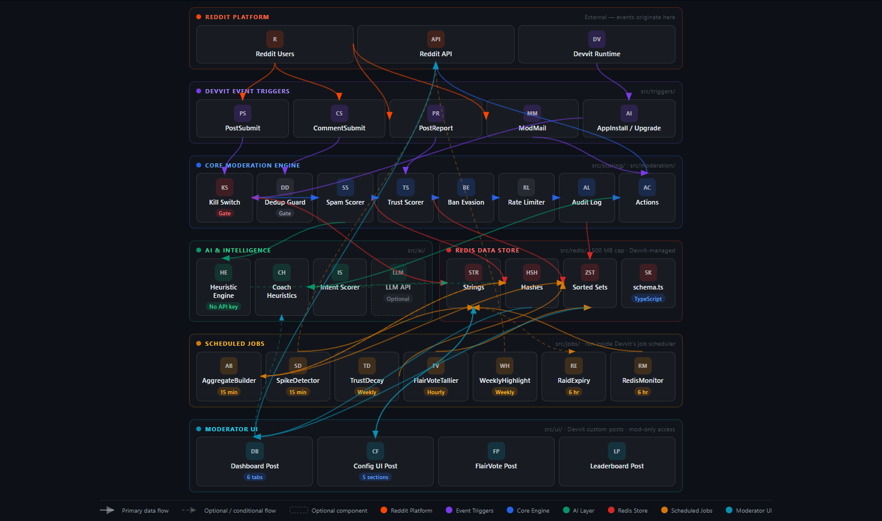
Architecture — 6 Layers, Clean Data Flow
7 / 10

Slide 9
Platform Constraints — What We Wanted, What We Built
9 / 10
We wanted to intercept posts before they go live.
▸ Devvit fires events after submission, not before.
▸ Built instant-catch soft-hold: the post is scored and quarantined in the same handler before any user can see it.
We wanted a free-text Q&A interface embedded directly in the dashboard.
▸ Devvit Blocks have no native text input component.
▸ Built form modals for free-text questions and 6 pre-populated chips that answer the most common queries without typing anything.
We wanted real-time LLM responses with no latency cap.
▸ Devvit handlers hard-timeout at ~10 seconds, making blocking API calls risky.
▸ Built a 6-second LLM hard-timeout with automatic fallback to the full heuristic layer — 12 intents always work, with zero API key required.
We wanted to store full post history, deep audit trails, and unlimited topic data.
▸ Redis is capped at 500 MB per app install.
▸ Built aggressive TTLs, rolling 7-day aggregates, and a monitor job that alerts mods at 80% and 90% usage before data is lost.
We wanted trust scores to follow users across all subreddits they post in.
▸ Redis is isolated per subreddit by platform design — no shared keyspace exists.
▸ Per-subreddit trust is the foundation. Cross-subreddit trust scoring is the primary post-launch milestone as adoption grows.

Slide 10
SOS Moderators — The Moderation Co-Pilot Reddit Needs
10 / 10
Reddit has over 100,000 active subreddits. Each is run by unpaid volunteers — and moderation burnout is the most predictable failure mode in community building.
SOS Moderators is the first moderation co-pilot: prevent violations, explain every removal, recover first-time offenders automatically, and answer plain-English questions about your subreddit's live data.
Backed by research:
▸ Jhaver et al. (CSCW 2019): removal explanations cut repeat violations by 20.8%. SOS Moderators delivers this for every flagged post, automatically, at zero cost to the mod.
No equivalent exists:
▸ AutoMod writes rules. Toolbox assists decisions. PRAW bots automate single tasks. SOS Moderators is the only tool that covers the full moderation lifecycle — and the only one with a data-grounded AI co-pilot that requires no API key.
Built to scale:
▸ Native Devvit app. No external server. No maintenance. One-click install. As more communities adopt SOS Moderators, a cross-subreddit trust network becomes possible — a reputation layer Reddit does not have today.
The return on installing SOS Moderators:
▸ Less time in the queue. More context on every decision. First-time users get a fair shot. Bad actors face a system that learns.
▸ Mods shouldn't need to be developers to run a healthy subreddit.
▸ Every subreddit deserves a co-pilot.

