Slide 1
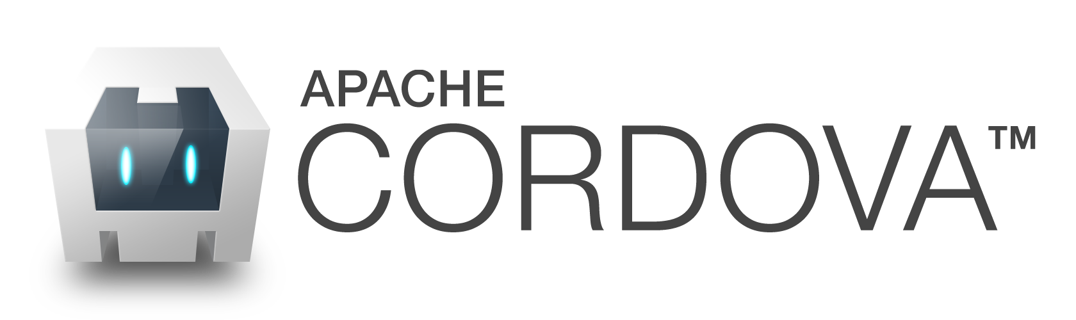
Mobile Application Develpoment Training

Slide 2
What is Cordova
Apache Cordova is a popular mobile application development framework. Cordova enables software programmers to build applications for mobile devices using CSS3, HTML5, and JavaScript instead of relying on platform-specific APIs like those in Android, iOS, or Windows Phone. It enables wrapping up of CSS, HTML, and JavaScript code depending upon the platform of the device. It extends the features of HTML and JavaScript to work with the device.

Slide 3
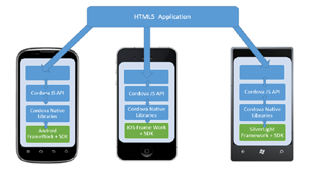
How does Cordova work
When you compile a Cordova application, it doesn’t actually take your HTML, CSS, and JavaScript code and automagically converts it into native code, specific to each platform.
Cordova acts as a container for the app that you write using web technologies. When the app is compiled, your code actually stays intact. The compiler just takes your code and makes it available to the web view for rendering.

Slide 4
What can you build with Cordova?
While you can build pretty much any kind of app with Cordova, there are some limits which we’ll talk about later.
Trip Case Trip Case is a travel app that guides you through every stage of your trip.
Fruit Salad Fruit Salad is a puzzle game similar to Bejewelled.
Health Tap Health Tap is the Stack Overflow for health questions.
Wikipedia The official Wikipedia app is built with Cordova.
They all communicate to a remote server to fetch data. That’s what Cordova is good at, fetching data from a server, presenting it to the user, and listening for and responding to input from the user.

Slide 5
Tools Needed
Cygwin
Node.js
Git
DynamoDb

Slide 6
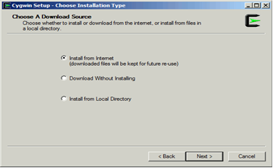
Install Cygwin Terminal.
Download setup.exez from www.cygwin.com
Run application from your local hard drive.
Chose next on first screen
Select "Install from Internet" and click next.

Slide 7
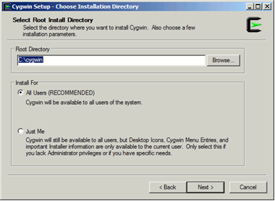
Install Cygwin Terminal
Enter preferred installation (Root) directory and click next.

Slide 8
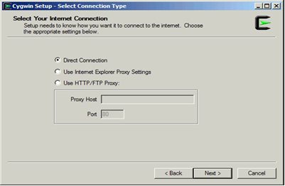
Install Cygwin Terminal
Select “Direct Connection” And click next.

Slide 9
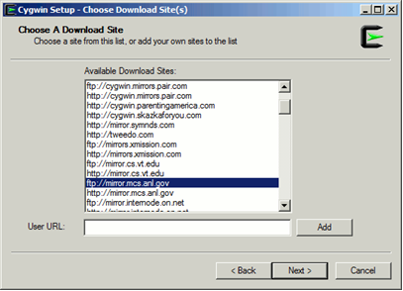
Install Cygwin Terminal
Select a download site and click next.
(Any site that you can connect to is fine. Some sites are more stable and/or faster than others. Try to pick one that works for you.)

Slide 10
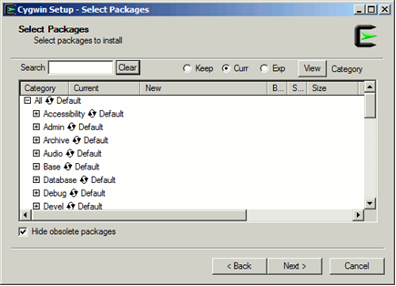
Install Cygwin Terminal
Select the packages you want to install and click next.
Packages you may want to install include: all of the packages
Once the installation is complete, click Finish and continue with the Setup section.
DO NOT RESTART AT THIS TIME!
Please note sometimes you may get a download incomplete and the setup application will return to step 8. Simply select another server and continue the installation process.

Slide 11
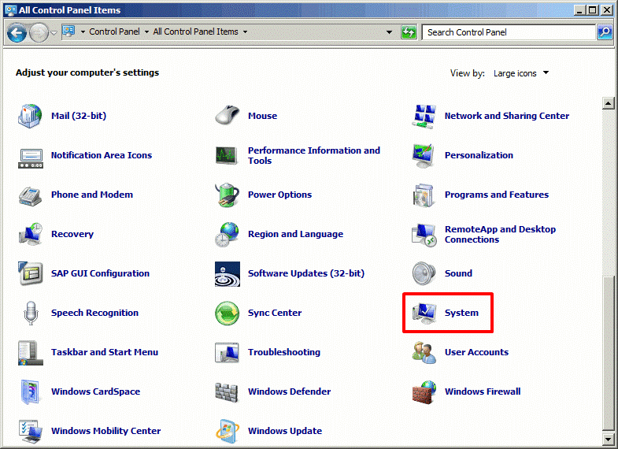
Setting Up Cygwin
Setup Windows Environment Variables: Open your System Control Panel: Select [start]->Control Panel->System

Slide 12
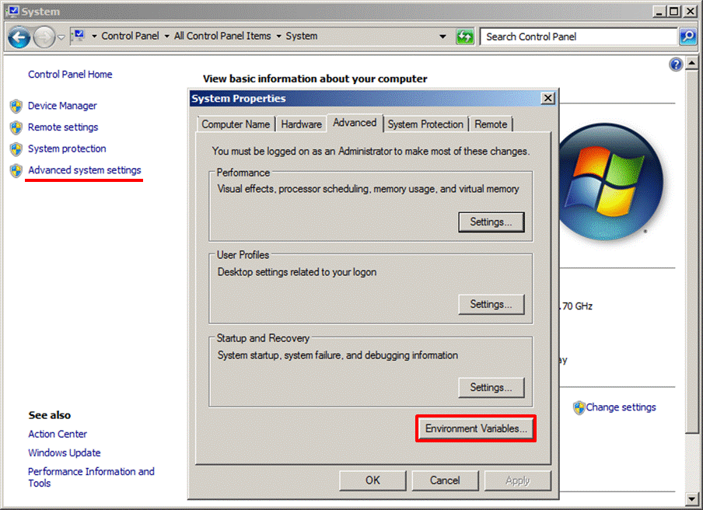
Setting Up Cygwin
Click on "Advanced System Settings", then select "Environmental Variables" under the "Advanced" tab of the "System Properties" Control Panel.

Slide 13
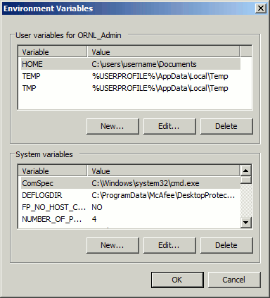
Setting Up Cygwin
In the Environmental variables window select new under "Variables for User" window
Edit "User Variable" as follows:
Variable name: HOME
Variable value: Path to where you want your home directory
e.g. C:\user\username\Documents

Slide 14
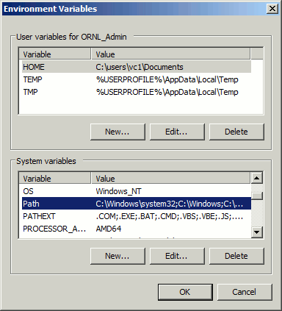
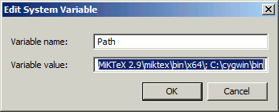
Setting Up Cygwin
In the Environmental variables window select Path under "System Variables" window.
Edit "System variable" as follows:
Append "; C:\cygwin\bin" to Variable value: (semicolon is very important)
Select "Ok" to close both "Environmental Variables" and "System Properties" windows.

Slide 15
Installing Node.js
Download the Windows installer from the Nodes.js® web site.
Run the installer (the .msi file you downloaded in the previous step.)
Follow the prompts in the installer (Accept the license agreement, click the NEXT button a bunch of times and accept the default installation settings).

Slide 16
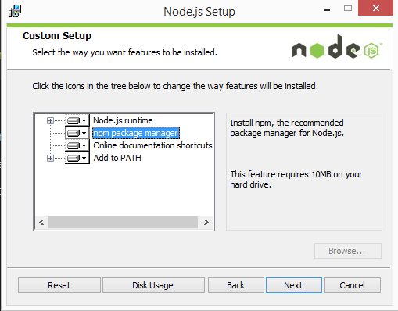
Installing Node.js
Restart your computer. You won’t be able to run Node.js® until you restart your computer.

Slide 17
Checking if Node.js is installed
Open Cygwin

Slide 18
Installing Git

