Slide 1
A CONTEXT-AWARE RECOMMENDATION SYSTEM FOR HOUSEHOLD SERVICE PROVIDERS USING ENSEMBLE LEARNING IN URBAN ENVIRONMENTS
164003 - Mbithi Keith Austine - ICS4E
Supervisor: Dr. Deperias Kerre
JULY 2026

Slide 2
BACKGROUND
Nairobi experiences some of the worst traffic congestion in Africa. During the evening rush, congestion reaches 98.8%.
BRAND
A service provider commuting 3 km across a congested corridor can take significantly longer than one traveling 6 km on a clear road, making pure distance-based recommendations completely ineffective.
CONTENT
PERFORMANCE
2

Slide 3
PROBLEM STATEMENT
WHAT IS HAPPENING
When someone in Nairobi needs a plumber, electrician, or cleaner, they open an app like Mama Fua, Fundis, or Kazi Konekt. Every single one of these platforms recommends providers using proximity and ratings only who is nearest and who has the best star rating
THE LIMITATIONS
Nairobi has some of the worst traffic congestion in Africa:
  A provider 3 km away across a congested corridor can take longer to arrive than one 6 km away on a clear road
  Road quality varies massively Karen and Westlands have good tarmac; Githurai, Dagoretti, and Embakasi have poor unpaved roads
  Most providers commute by matatu or motorcycle, making them extremely sensitive to road and traffic conditions
3

Slide 4
PROBLEM STATEMENT
THE CONSEQUENCE
Clients book a highly-rated, nearby provider who never shows up on time or gives substandard work because the platform had no idea about traffic conditions, road quality, or time of day. This erodes trust in the platforms and wastes everyone's time.
4

Slide 5
OBJECTIVES
THE GENERAL OBJECTIVE
To develop a web-based system that recommends providers using an ML-driven arrival reliability score factoring in traffic and historical performance.
THE SPECIFIC OBJECTIVES
  To identify the key factors that influence the reliability of household service providers in urban Nairobi, including traffic conditions, time of day, road quality, and past provider performance.
  To review existing Kenyan service-matching platforms and ML-based recommendation systems and identify gaps in contextual awareness and travel-time prediction.
  To develop a machine learning model that combines travel and provider-related factors to predict provider arrival reliability.
  To evaluate the model's performance against distance-based and rating-based recommendation approaches using RMSE and MAE metrics.
5

Slide 6
JUSTIFICATION
  Improves user experience by providing more reliable provider recommendations.
  Reduces the incidence of missed appointments, wasted waiting time, and the cost of rescheduling.
6

Slide 7
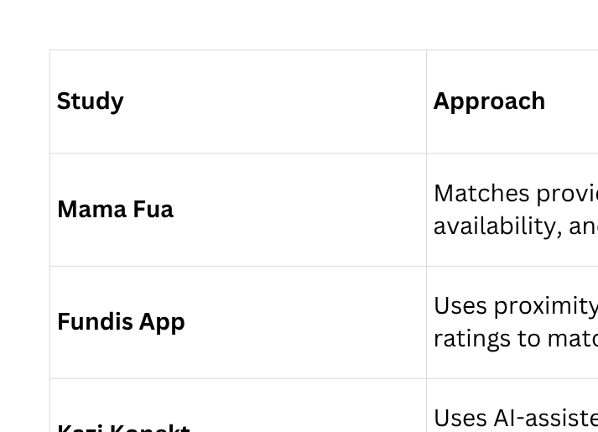
RELATED APPLICATIONS
7

Slide 8
RESEARCH GAP
THE CURRENT SYSTEMS :
  rely mainly on proximity, availability, and ratings;
  fail to account for traffic congestion, road quality, or time-of-day travel patterns;
  fail to predict provider arrival reliability.
THE LIMITATIONS :
Current Kenyan service-matching platforms lack a context-aware recommendation model that integrates : Traffic congestion, Time-of-day travel patterns, historical provider performance to predict provider arrival reliability.
THE PROPOSED SOLUTION:
Develop a context-aware recommendation system that uses ensemble learning to integrate traffic conditions, time-of-day patterns, and historical provider performance in order to predict provider arrival reliability and generate more dependable service provider recommendations.
8

Slide 9
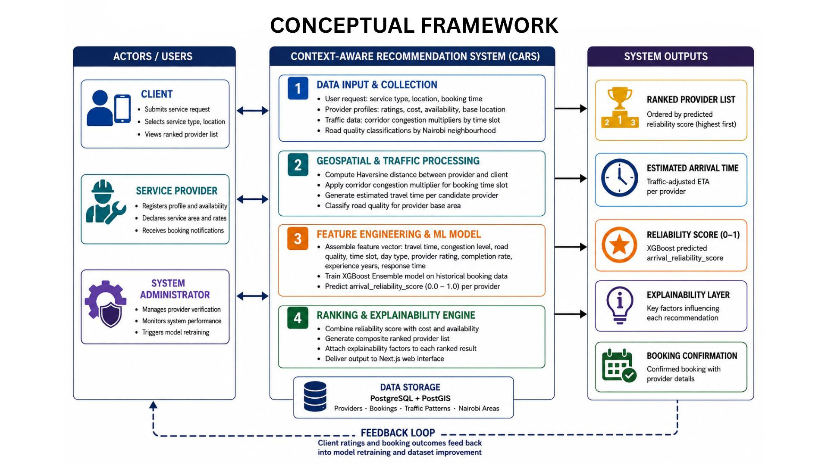
CONCEPTUAL FRAMEWORK
9

Slide 10
TECHNICAL IMPLEMENTATION STRATEGY
Data Collection
↓
Data Preprocessing
↓
Feature Engineering
↓
Model Training
↓
System Integration
↓
Recommendation Output
Synthetic Nairobi dataset using traffic, road quality, and provider data.
Clean, encode, normalize, and split data (80/20).
Generate travel time, congestion, road quality, provider performance features.
Train and validate using RMSE, MAE, and 5-fold cross-validation.
FastAPI + PostgreSQL backend with Next.js frontend.
Ranked providers, reliability score, ETA, and booking confirmation.
10

Slide 11
METHODOLOGY
THE SELECTED FRAMEWORKS :
CRISP-DM Framework: Utilized to govern the experimental design of the machine learning pipeline.
Agile Iterative Prototyping (Scrum): Utilized to build the web-based Interactive Decision Support System (IDSS) frontend and API layers.
WHY THIS FRAMEWORKS :
CRISP-DM (ML Alignment): Provides a structured approach for data preprocessing, feature engineering, and training the XGBoost model to compare its arrival reliability scores against traditional distance-only and rating-only baselines.
Agile Prototyping (Flexibility): Because the user interface behavior, ranking displays require repeated evaluation cycles and user feedback rather than rigid, upfront specifications.
11

Slide 12
EVALUATION METRICS
MACHINE LEARNING EVALUATION
  RMSE
  MAE
  5-Fold Cross Validation
  Baseline Comparison (Distance vs Rating vs XGBoost)
SYSTEM EVALUATION
  Unit Testing
  Integration Testing
  Functional Testing
VALIDATION
  80/20 Train-Test Split
  Unseen Test Set (No Data Leakage)
12

Slide 13
EVALUATION METRICS
SYSTEM - A web-based context-aware recommendation system for household service providers.
DELIVERABLES - XGBoost Recommendation Engine, Provider Ranking & Booking Module, Explainable Recommendations
CONTRIBUTIONS - Bridges the gap by integrating contextual traffic factors into household service recommendations.
USERS - Designed for household clients, service providers, and platform administrators.
IMPACT - Improves recommendation reliability, user trust, and service delivery efficiency.
SCOPE - Limited to household services within Nairobi as a web-based decision support system.
13

Slide 14
THANK YOU
QUESTIONS ?
164003 | Mbithi Keith Austine | ICS4E

