Slide 1

Color-based Image Segmentation using Parallel K-means Clustering
Gabriele Mirando
Advanced Computer Architecture
Computer Science and Multimedia
University of Pavia
A.Y. 2017/2018

Slide 2
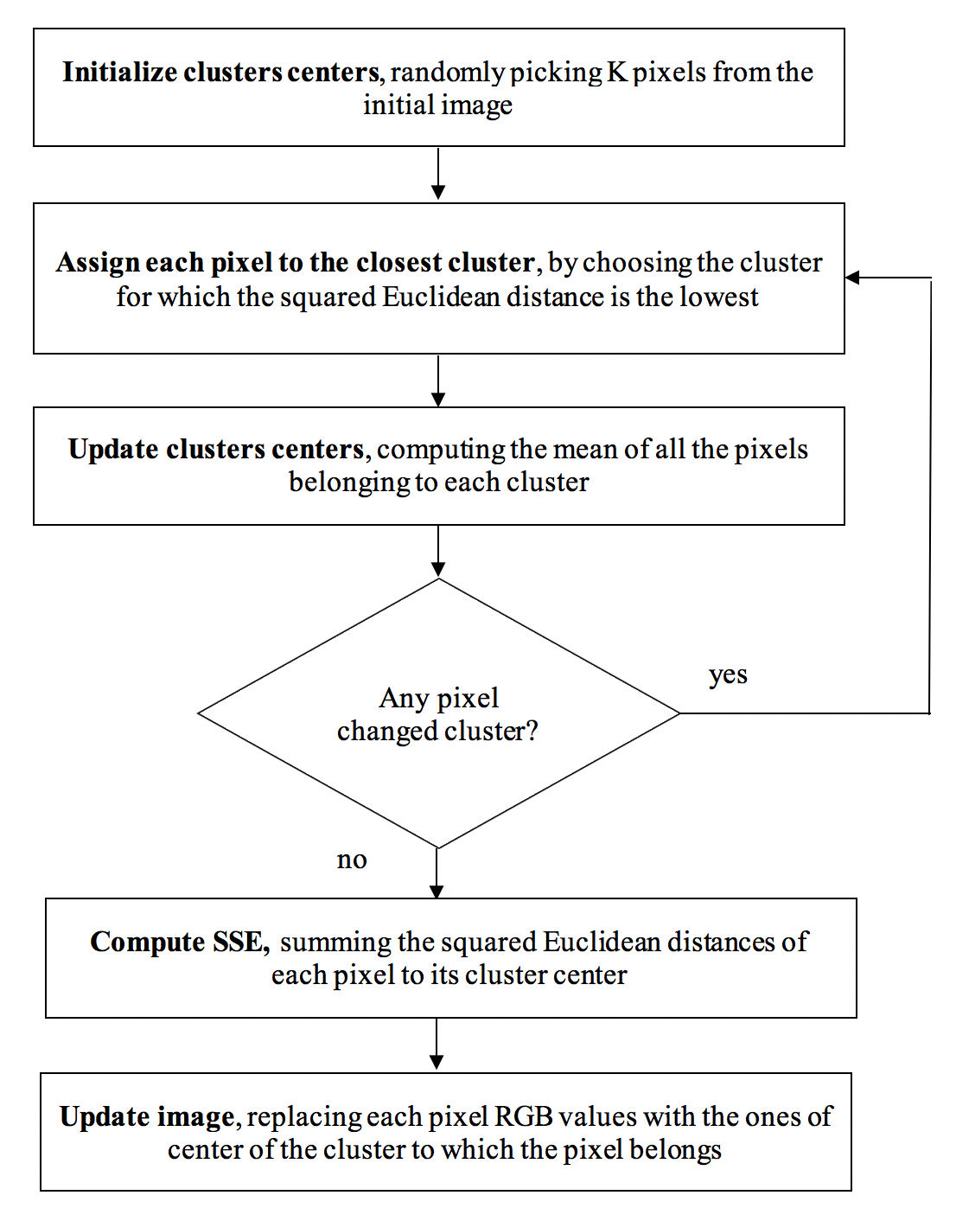
Analysis of the Serial Algorithm
Given a digital image and an integer number K, using the k-means clustering algorithm it is possible to divide the image pixels into K groups, such that pixels in the same group are similar in terms of color

Slide 3






Analysis of the Serial Algorithm
In the segmented image, K different regions of pixels of similar color are distinguishable
Original image
K = 4
K = 8
K = 16
K = 32
K = 64

Slide 4
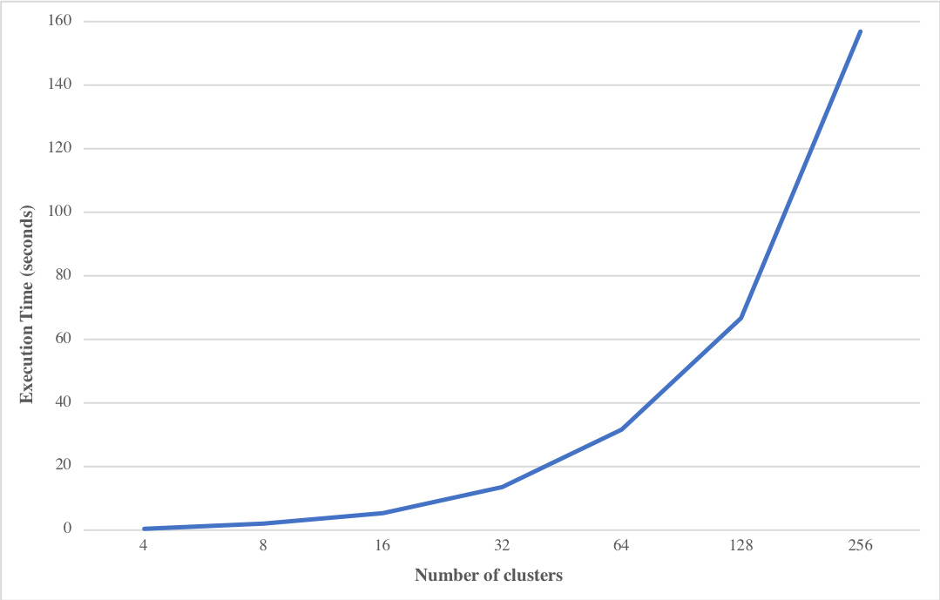
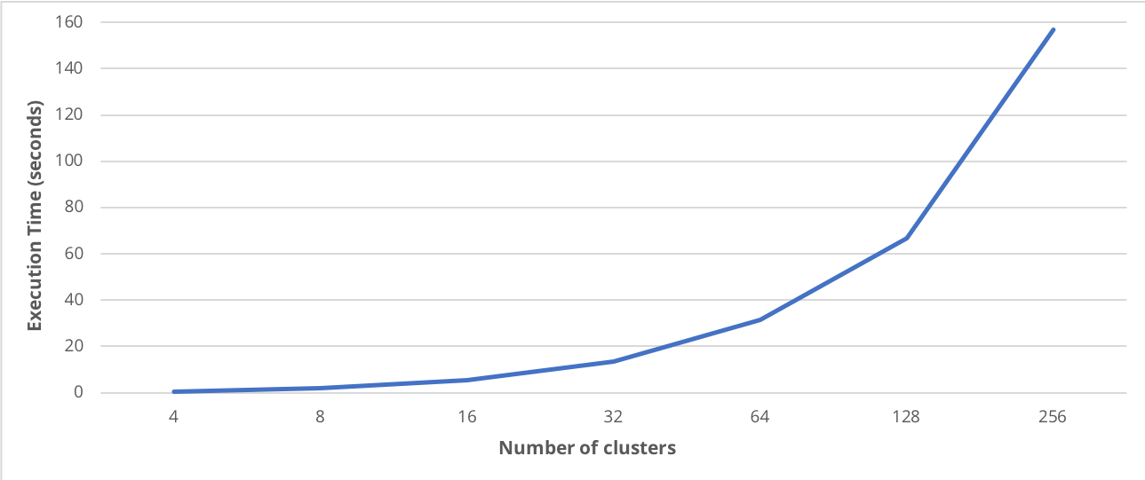
Analysis of the Serial Algorithm
Increasing the number of clusters K, the execution time of the algorithm increases …

Slide 5
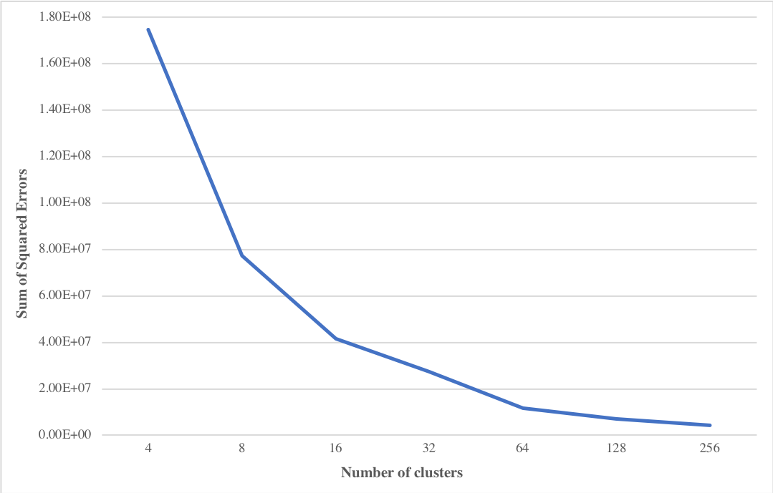
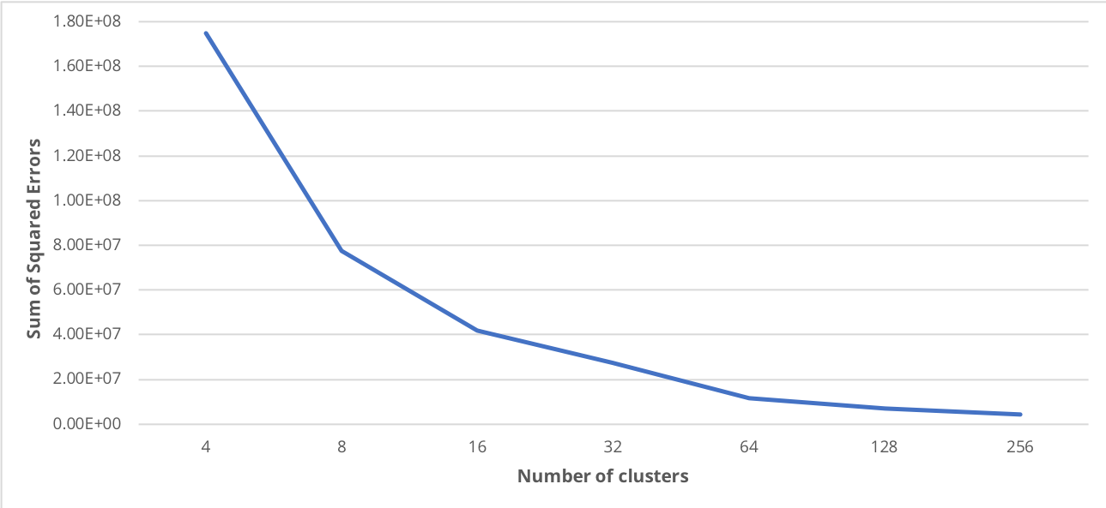
Analysis of the Serial Algorithm
… and the Sum of Squared Errors decreases

Slide 6
Study of the Available Parallelism
Using gprof it is possible to see the percentage of running time required by each step of k-means
 | K=4 | K=8 | K=16 | K=32 | K=64 | K=128 | K=256
init_centers | 0.0% | 0.0% | 0.0% | 0.0% | 0.0% | 0.0% | 0.0%
assign_pixels | 79.2% | 87.7% | 92.6% | 96.4% | 98.1% | 99.1% | 99.5%
update_centers | 18.9% | 12.3% | 7.3% | 3.6% | 1.9% | 0.9% | 0.5%
compute_sse | 0.0% | 0.0% | 0.0% | 0.0% | 0.0% | 0.0% | 0.0%
update_data | 1.9% | 0.0% | 0.1% | 0.0% | 0.0% | 0.0% | 0.0%

Slide 7
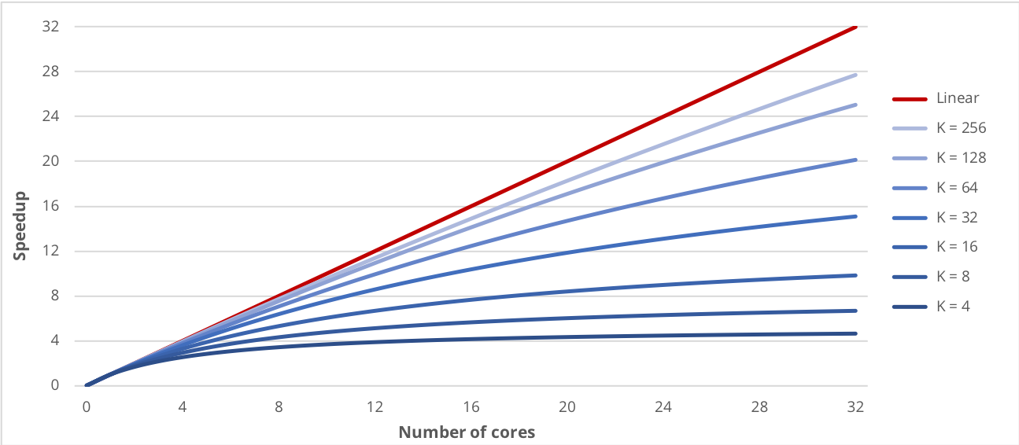
Study of the Available Parallelism
Amdahl’s Law estimates the speedup that can be reached just by parallelizing the pixels assignment

Slide 8
The parallel implementation
To parallelize the pixels assignment of each pixel to the closest cluster, a parallel for work-sharing construct is used
#pragma omp parallel for schedule(static) private(…)
for (px = 0; px < n_px; px++) {
…
}
The static approach is more effective because the work distribution across threads is well balanced

Slide 9
The parallel implementation
Updating the clusters centers from multiple threads leads to race conditions
#pragma omp parallel for private(…) reduction(+:centers[..],counts[..])
for (px = 0; px < n_px; px++) {
…
}
The reduction clause allows to protect the update operations of the clusters centers using an efficient synchronization technique

Slide 10
Performance on a Local Machine
The first machine utilized to test the performance of parallel implementation was equipped with an Intel Core i5@2.00GHz with 2 cores and 4 threads
Threads | K=4 | K=8 | K=16 | K=32 | K=64 | K=128 | K=256
2 | 1.612 | 1.753 | 1.797 | 1.819 | 1.847 | 1.857 | 1.858
3 | 1.912 | 1.929 | 1.943 | 1.955 | 1.966 | 1.983 | 2.000
4 | 2.062 | 2.098 | 2.120 | 2.148 | 2.198 | 2.207 | 2.210

Slide 11
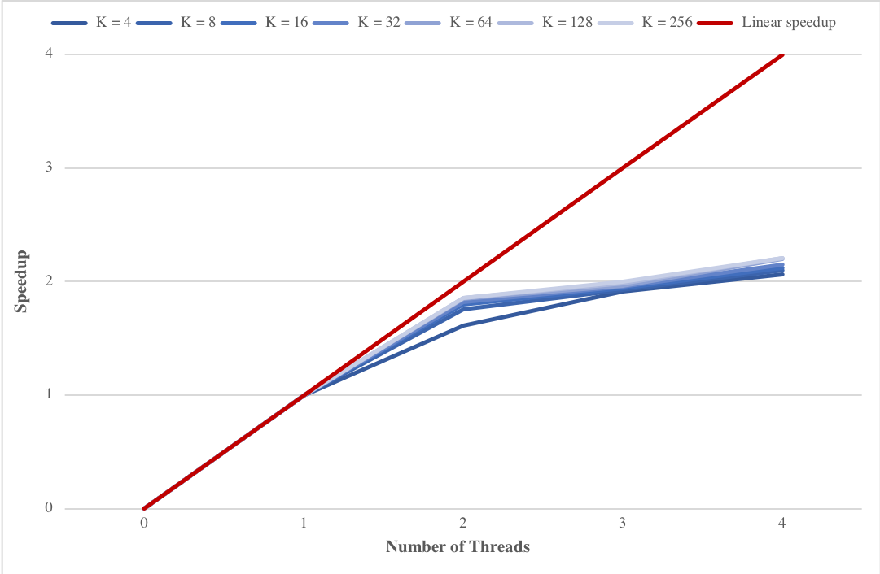
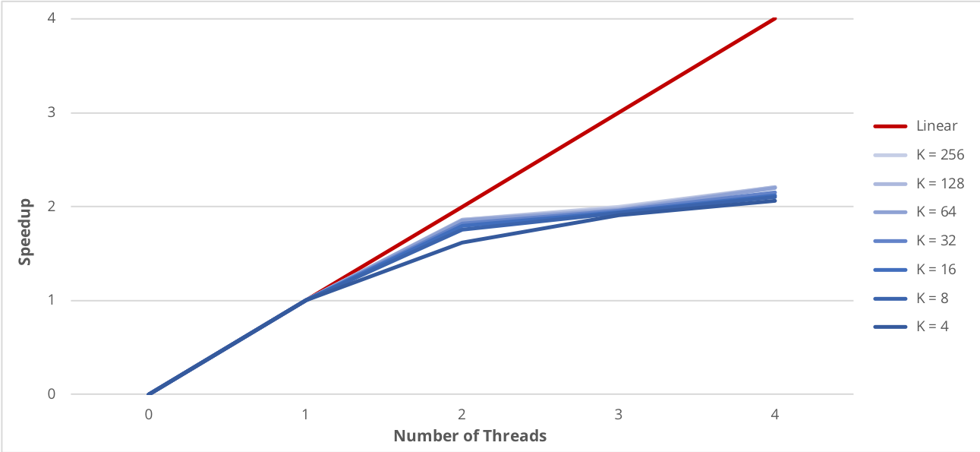
Performance on a Local Machine
The speedup is close to linear using 2 threads

Slide 12
Performance on a Local Machine
The percentage increase of the speedup obtained by parallelizing the centers update step is higher when a small number of cluster is specified
Threads | K=4 | K=8 | K=16 | K=32 | K=64 | K=128 | K=256
2 | 7.57% | 6.89% | 3.69% | 2.35% | 0.89% | 0.29% | 0.19%
3 | 9.54% | 8.61% | 3.43% | 1.47% | 0.82% | 0.42% | 0.38%
4 | 10.50% | 6.03% | 3.46% | 1.51% | 0.99% | 0.51% | 0.60%

Slide 13
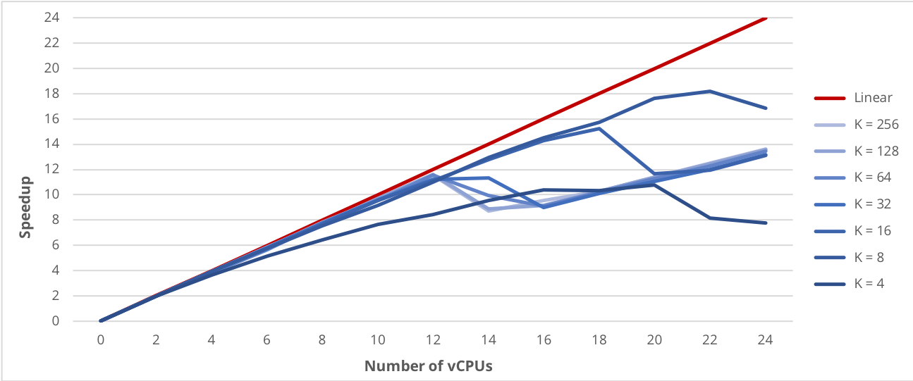
Performance on Google Cloud Platform
When increasing over 12 the number of vCPU, the speedup starts to have an irregular behavior

Slide 14
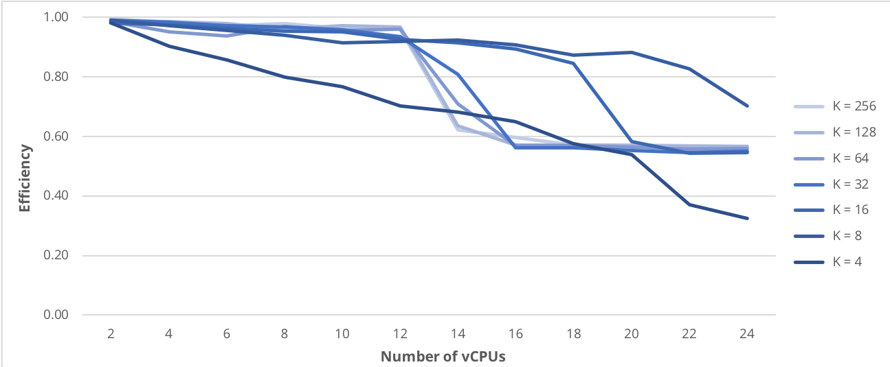
Performance on Google Cloud Platform
A drop in the efficiency of the parallel program is visible when more than twelve vCPU are used

Slide 15
Conclusions
Parallel Computing can be used to increase the performance of the k-means clustering algorithm
K-means algorithm is inherently characterized by an high level of data parallelism and so it is easy to obtain a remarkable speedup using OpenMP
Using a GPGPU programming API, like CUDA, would have made it possible to achieve an even better results

