Slide 1

Color-based Image Segmentation using Parallel K-means Clustering
Gabriele Mirando
Advanced Computer Architecture
Computer Science and Multimedia
University of Pavia
A.Y. 2017/2018

Slide 2
Analysis of the Serial Algorithm
K-means algorithm is the standard solution used in scientific and industrial applications to solve the clustering problem
Given a digital image and an integer number K, the k-means clustering algorithm can be used to partition the image pixels into K groups, in such a way that pixels in the same group are similar in terms of color
Notes:
Clustering is a very common problem in Data Analysis. It’s the task of partitioning a set of objects into groups, that are called clusters, in such a way that objects in the same cluster are more similar to each other than to those in other clusters. K-Means is the standard algorithm used to solve the Clustering problem
and has a wide range of applications. I chose Image Segmentation among K-means applications since it is one of the most relevant topics in Digital Image Analysis and Computer Vision. Image Segmentation is the task of dividing the image into its constituent objects. For this purpose, the K-means algorithm can be used to cluster the pixels of the image on the basis of their color.

Slide 3
Analysis of the Serial Algorithm
Clusters Initialization: K pixels are randomly picked from the initial image and set as clusters centers
Pixels Assignment: each pixel is assigned to its closest cluster, i.e. the cluster for which the squared Euclidean distance is the lowest
Centers Update: the clusters centers are updated by computing the mean of the pixels belonging to each cluster
Any pixel changed cluster?
yes
no
Image Update: the RGB values of each pixel of the initial image are replaced with the ones of their cluster center
Notes:
Color-based Image Segmentation using K-means Clustering
Given a digital image and an integer number K, using the k-means clustering algorithm it is possible to divide the image pixels into K clusters on the basis of the pixels color.
The steps of the algorithm are quite simple:
First step is the initialization of the clusters, K pixels are chosen from the image the cluster centers are initialized with the RGB values of those pixels.
Then there is the pixels assignment , where each pixel is assigned to the closest cluster. For each pixel, the squared Euclidean distance to every cluster center is computed and then the pixel is assigned to the cluster with the smaller distance.
After all the pixels have been assigned, the cluster centers are updated by computing the mean of the RGB values of each cluster.
If none of the pixels changed their cluster the algorithm has converged otherwise it goes back to the pixel assignment.
Finally the initial image is updated, each pixel RGB values are replaced with the ones of their cluster centers.

Slide 4

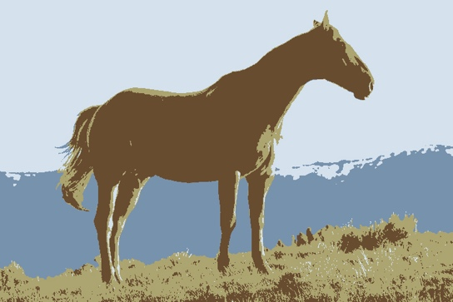
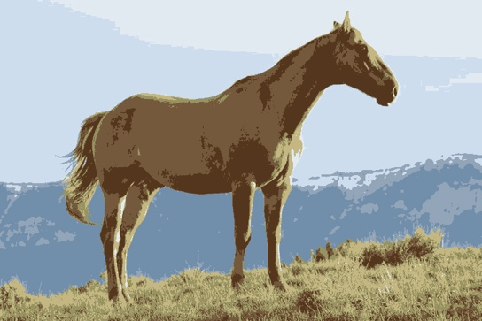

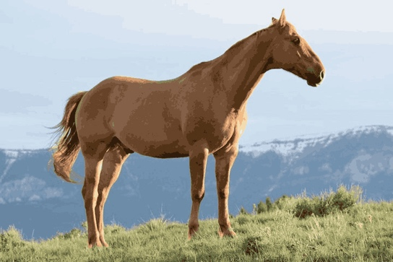

Analysis of the Serial Algorithm
A 640 × 360 JPEG test image has been segmented specifying an increasing number of clusters K
Original image
K = 4
K = 8
K = 16
K = 32
K = 64

Slide 5
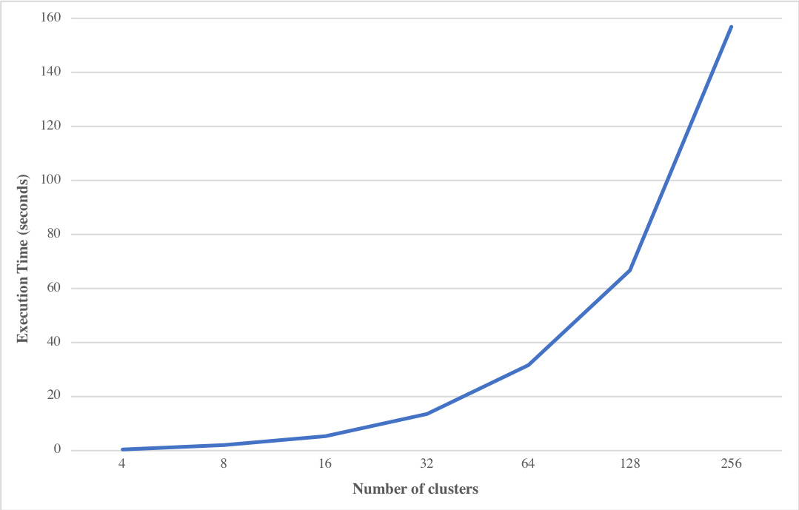
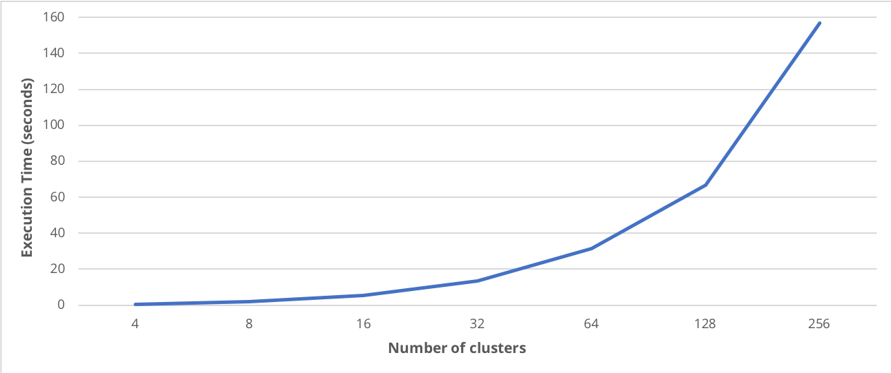
Analysis of the Serial Algorithm
When increasing the number of clusters K, the execution time of the program increases

Slide 6
Study of the Available Parallelism
Using gprof it was possible to assess the portion of running time required by each step of k-means segmentation algorithm
 | K=4 | K=8 | K=16 | K=32 | K=64 | K=128 | K=256
init_centers | 0.0% | 0.0% | 0.0% | 0.0% | 0.0% | 0.0% | 0.0%
assign_pixels | 79.2% | 87.7% | 92.6% | 96.4% | 98.1% | 99.1% | 99.5%
update_centers | 18.9% | 12.3% | 7.3% | 3.6% | 1.9% | 0.9% | 0.5%
update_data | 1.9% | 0.0% | 0.1% | 0.0% | 0.0% | 0.0% | 0.0%

Slide 7
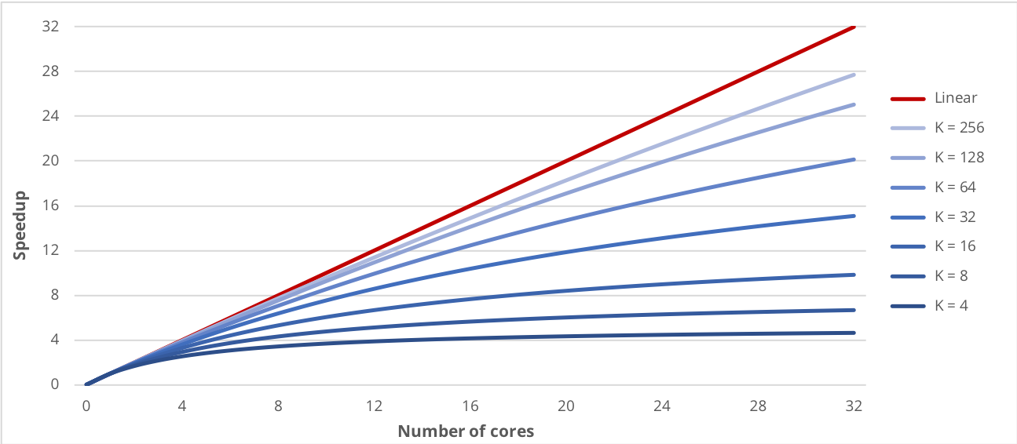
Study of the Available Parallelism
Amdahl’s Law was used to estimate the speedup obtainable by parallelizing the pixels assignment

Slide 8
Parallelizing the Pixels Assignment
To parallelize the assignment of each pixel to the closest cluster, a parallel for construct with a static scheduling technique has been adopted
#pragma omp parallel for schedule(static) private(…)
for (px = 0; px < n_px; px++) {
…
}
The static approach is more effective because the work distribution across threads is well balanced

Slide 9
Parallelizing the Centers Update
Updating the clusters centers from multiple threads can lead to race conditions
#pragma omp parallel for private(…) reduction(+:centers[..],counts[..])
for (px = 0; px < n_px; px++) {
…
}
The reduction clause allowed to protect the update computations of the clusters centers using an efficient synchronization technique

Slide 10
Performance on a Local Machine
The first machine utilized to test the performance of parallel implementation was equipped with an Intel Core i5@2.00GHz with 2 cores and 4 threads
Threads | K=4 | K=8 | K=16 | K=32 | K=64 | K=128 | K=256
2 | 1.612 | 1.753 | 1.797 | 1.819 | 1.847 | 1.857 | 1.858
3 | 1.912 | 1.929 | 1.943 | 1.955 | 1.966 | 1.983 | 2.000
4 | 2.062 | 2.098 | 2.120 | 2.148 | 2.198 | 2.207 | 2.210

Slide 11
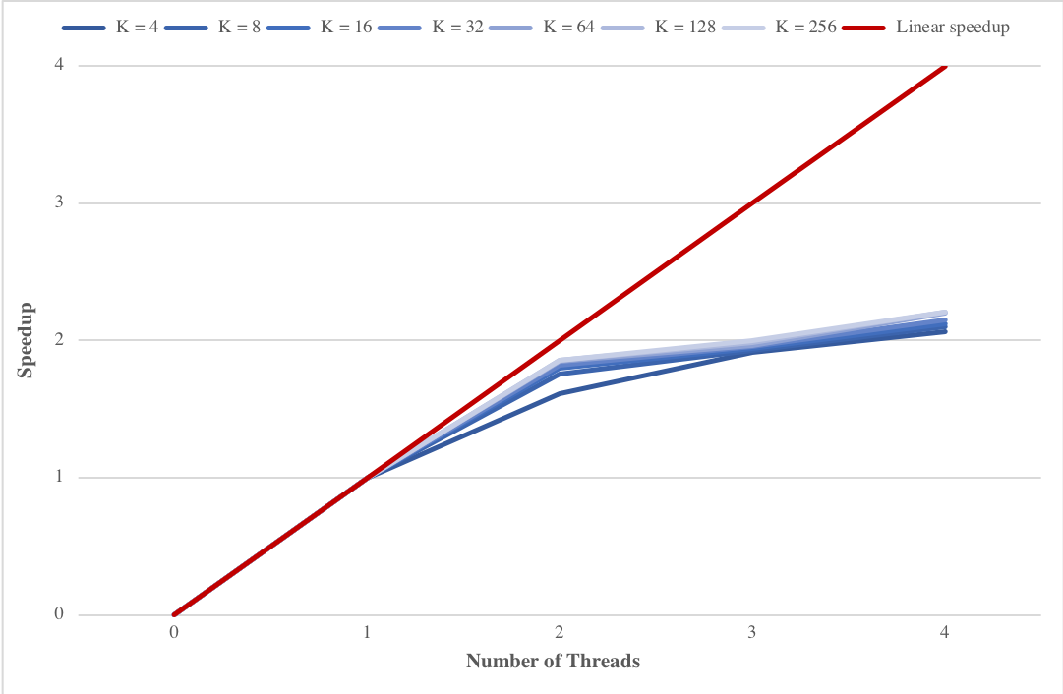
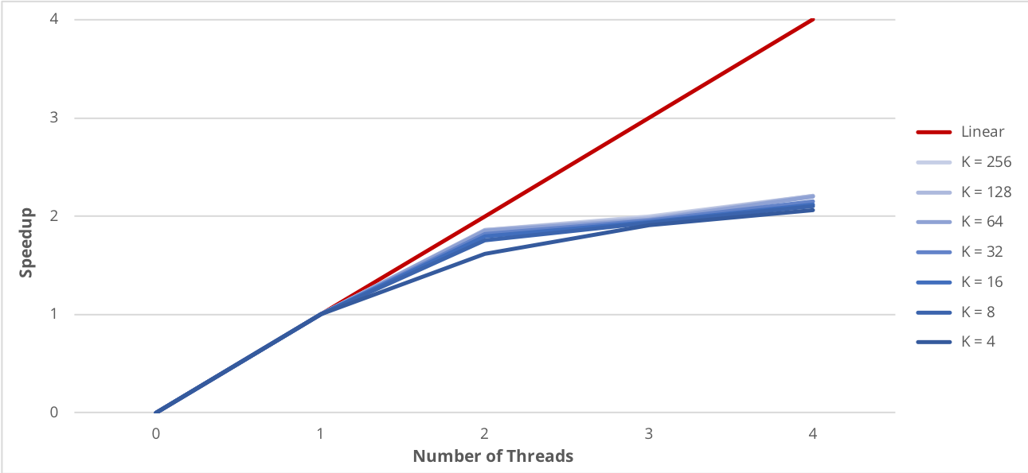
Performance on a Local Machine
The speedup is close to linear using 2 threads

Slide 12
Performance on a Local Machine
Parallelizing the centers update step produces an increase in the speedup that is higher when a smaller number of cluster is specified
Threads | K=4 | K=8 | K=16 | K=32 | K=64 | K=128 | K=256
2 | 7.57% | 6.89% | 3.69% | 2.35% | 0.89% | 0.29% | 0.19%
3 | 9.54% | 8.61% | 3.43% | 1.47% | 0.82% | 0.42% | 0.38%
4 | 10.50% | 6.03% | 3.46% | 1.51% | 0.99% | 0.51% | 0.60%

Slide 13
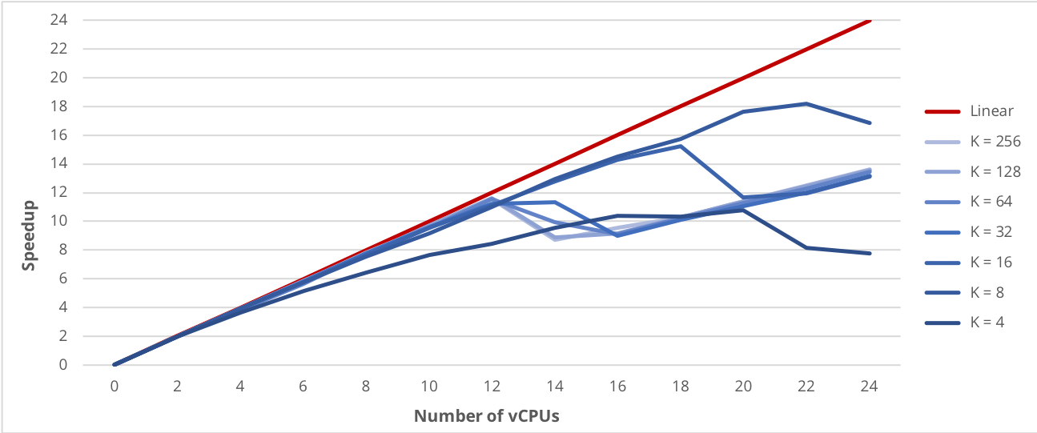
Performance on Google Cloud Platform
When increasing over 12 the number of vCPU, the speedup started to have an irregular behavior

Slide 14
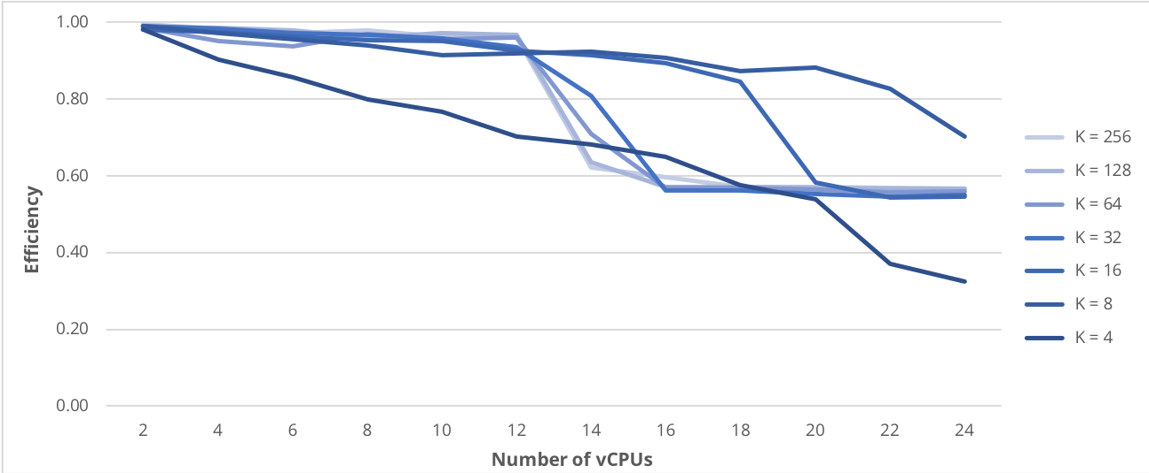
Performance on Google Cloud Platform
A drop in the efficiency of the parallel program is visible when more than twelve vCPU are used

Slide 15
Conclusions
Parallel Computing can be used to increase the performance of the k-means clustering algorithm
K-means algorithm is inherently characterized by an high level of data parallelism and so it is easy to obtain a remarkable speedup using OpenMP
Using a GPGPU programming API, like CUDA, would have made it possible to achieve an even better results

