Slide 1

Color-based Image Segmentation using Parallel K-means Clustering
Gabriele Mirando
Advanced Computer Architecture
Computer Science and Multimedia
University of Pavia
A.Y. 2017/2018

Slide 2
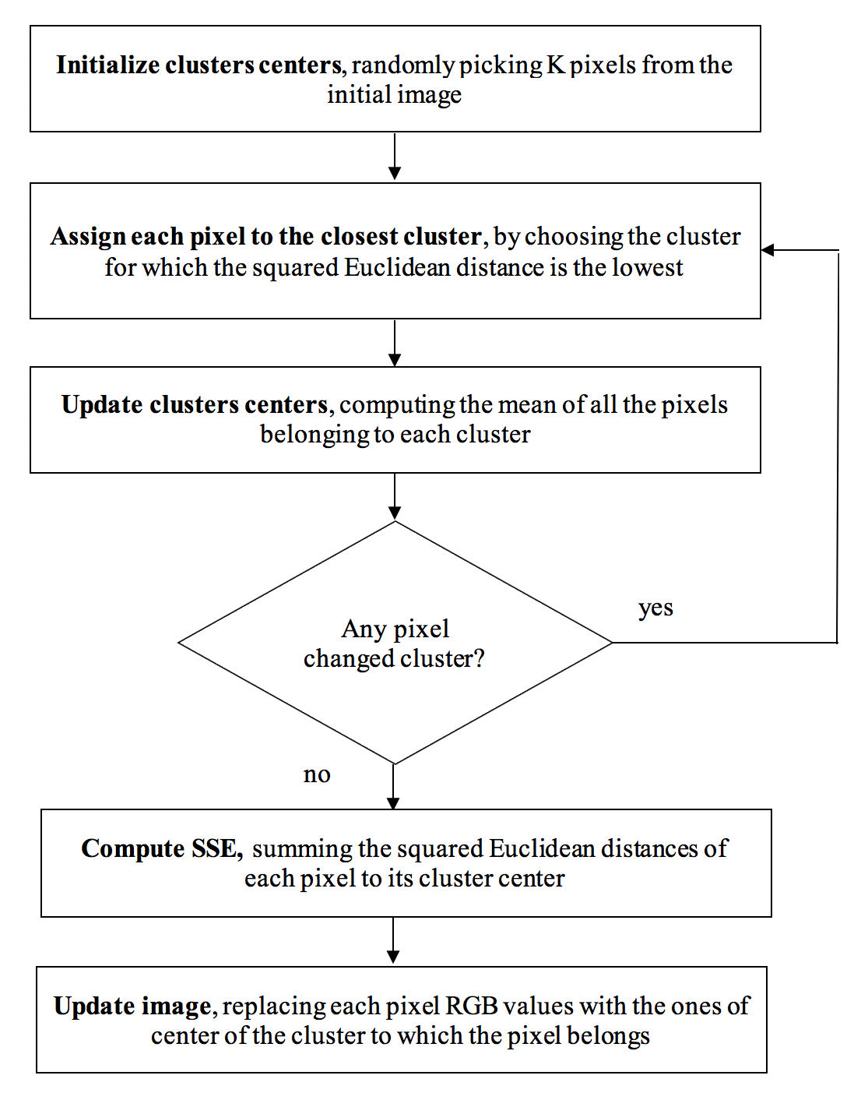
Analysis of the Serial Algorithm
Given a digital image and an integer number K, using the k-means clustering algorithm it is possible to divide the image pixels into K groups, such that pixels in the same group are similar in terms of color

Slide 3






Analysis of the Serial Algorithm
In the segmented image, K different regions of pixels of similar color are distinguishable
Original image
K = 4
K = 8
K = 16
K = 32
K = 64

Slide 4
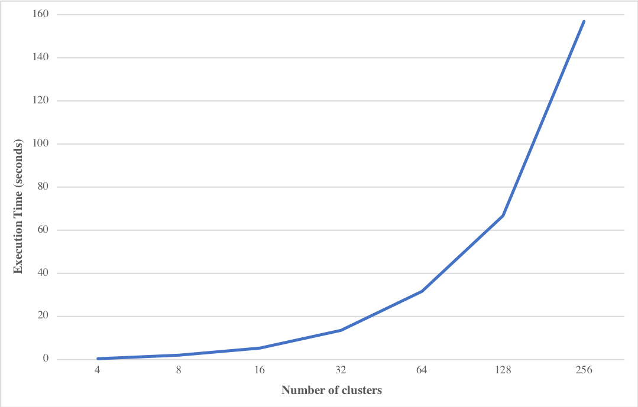
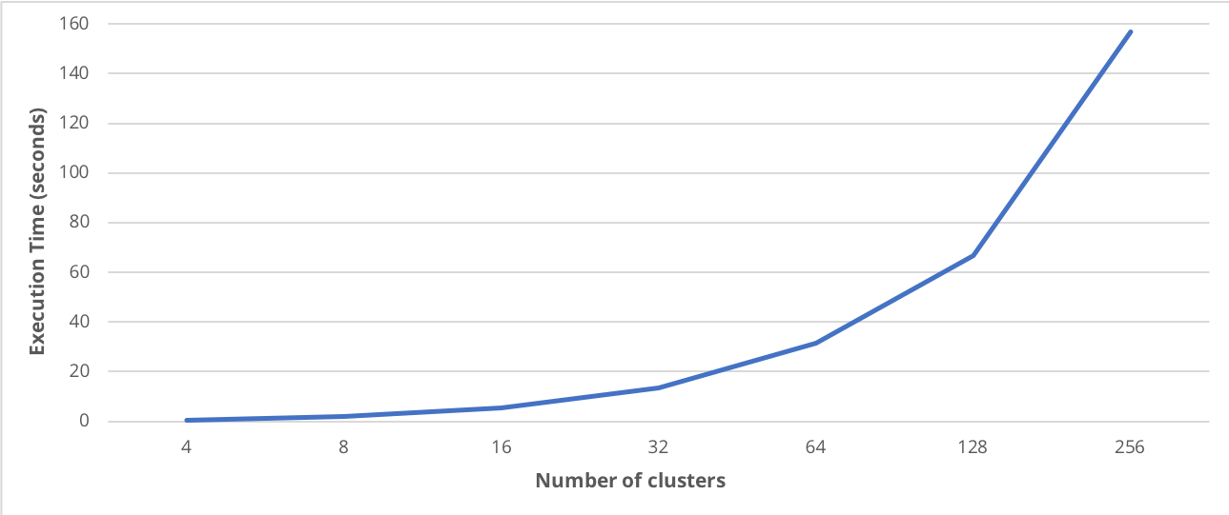
Analysis of the Serial Algorithm
Increasing the number of clusters K, the execution time increases …

Slide 5
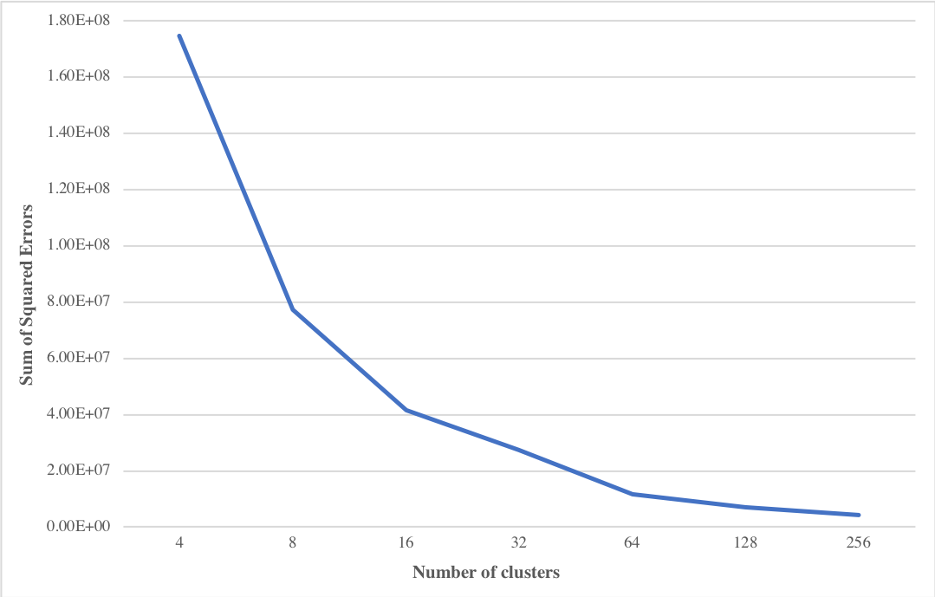
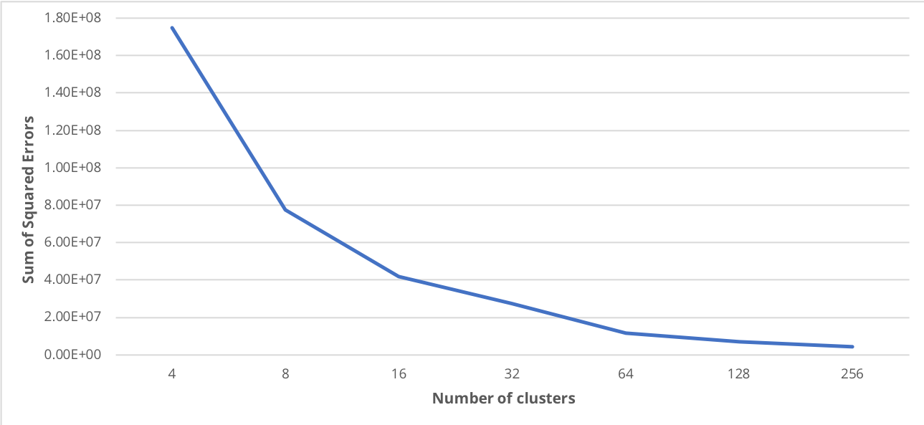
Analysis of the Serial Algorithm
… and the Sum of Squared Errors decreases.

Slide 6
Study of the Available Parallelism
Using gprof it is possible to see the percentage of running time required by each step
 | K=4 | K=8 | K=16 | K=32 | K=64 | K=128 | K=256
init_centers | 0.0% | 0.0% | 0.0% | 0.0% | 0.0% | 0.0% | 0.0%
assign_pixels | 79.2% | 87.7% | 92.6% | 96.4% | 98.1% | 99.1% | 99.5%
update_centers | 18.9% | 12.3% | 7.3% | 3.6% | 1.9% | 0.9% | 0.5%
compute_sse | 0.0% | 0.0% | 0.0% | 0.0% | 0.0% | 0.0% | 0.0%
update_data | 1.9% | 0.0% | 0.1% | 0.0% | 0.0% | 0.0% | 0.0%

Slide 7
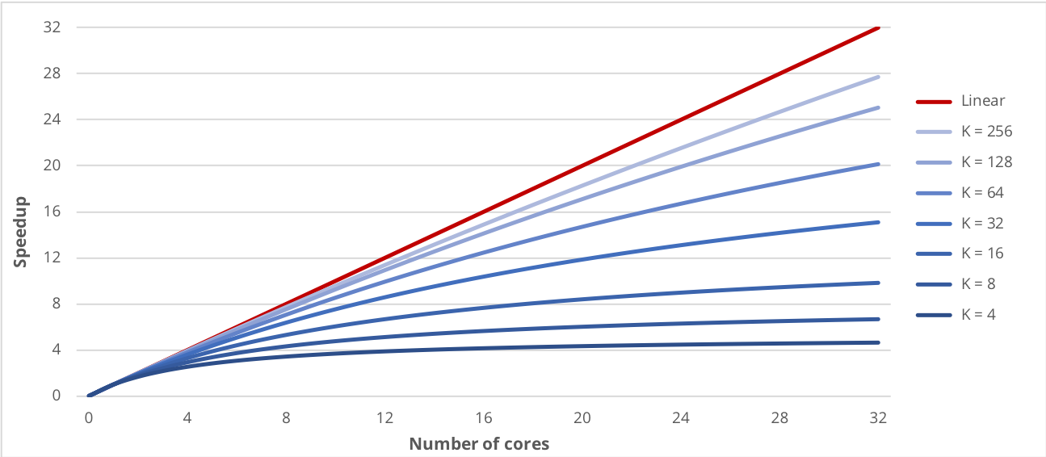
Study of the Available Parallelism
Amdahl’s Law estimates the speedup that can be reached just by parallelizing the pixels assignment

Slide 8
The parallel implementation
To parallelize the assignment of each pixel to the closest cluster, a parallel for work-sharing construct is used
#pragma omp parallel for schedule(static) private(…)
for (px = 0; px < n_px; px++) {
…
}
The static approach is used because the work distribution across threads is well balanced

Slide 9
The parallel implementation
Updating the clusters centers from multiple threads leads to race conditions
#pragma omp parallel for private(…) reduction(+:centers[..],counts[..])
for (px = 0; px < n_px; px++) {
…
}
The reduction clause allows to protect the update operations of the clusters centers using an efficient synchronization technique

Slide 10
Performance on a Local Machine
The first machine utilized to test the performance of parallel implementation was equipped with an Intel Core i5@2.00GHz with 2 cores and 4 threads
Threads | K=4 | K=8 | K=16 | K=32 | K=64 | K=128 | K=256
2 | 1.612 | 1.753 | 1.797 | 1.819 | 1.847 | 1.857 | 1.858
3 | 1.912 | 1.929 | 1.943 | 1.955 | 1.966 | 1.983 | 2.000
4 | 2.062 | 2.098 | 2.120 | 2.148 | 2.198 | 2.207 | 2.210

Slide 11
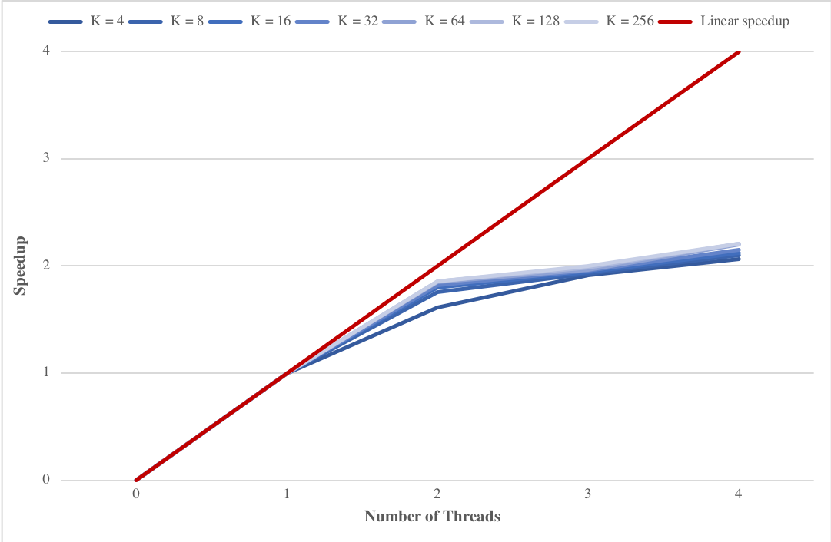
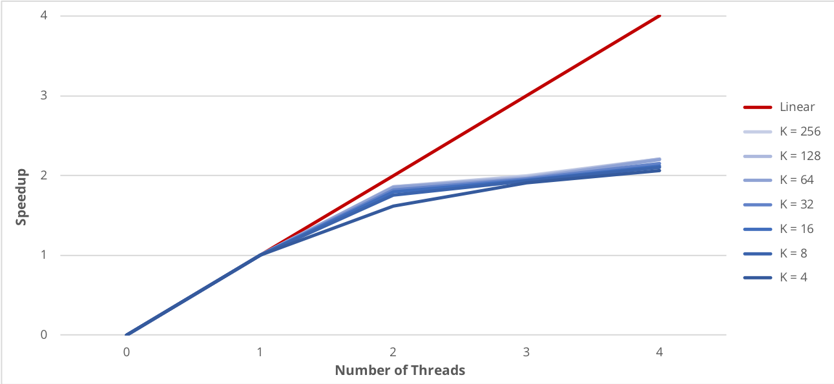
Performance on a Local Machine
The speedup is close to linear using 2 threads

Slide 12
Performance on a Local Machine
The percentage increase of the speedup obtained by parallelizing the centers update step is higher when a small number of cluster is specified
Threads | K=4 | K=8 | K=16 | K=32 | K=64 | K=128 | K=256
2 | 7.57% | 6.89% | 3.69% | 2.35% | 0.89% | 0.29% | 0.19%
3 | 9.54% | 8.61% | 3.43% | 1.47% | 0.82% | 0.42% | 0.38%
4 | 10.50% | 6.03% | 3.46% | 1.51% | 0.99% | 0.51% | 0.60%

Slide 13
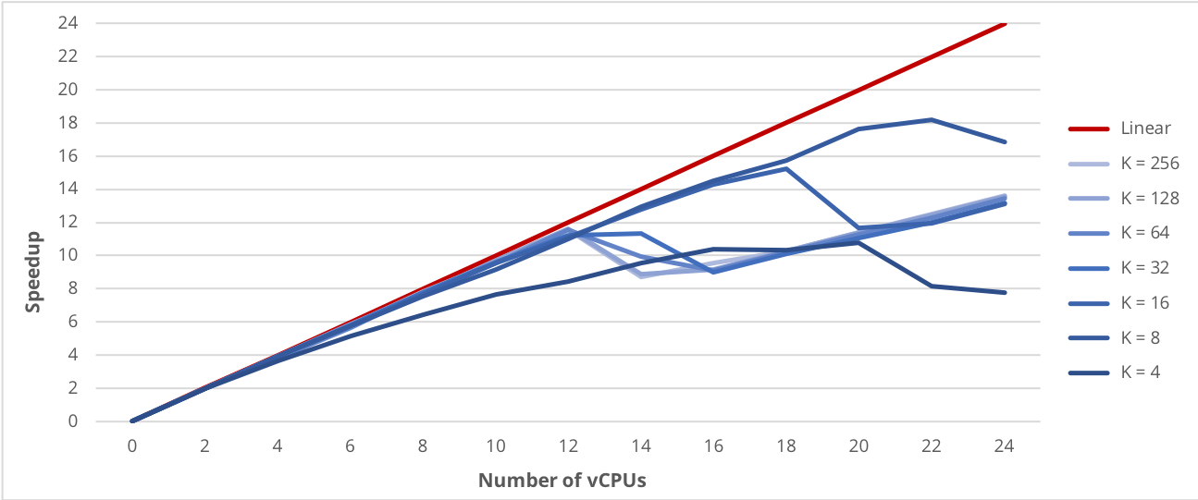
Performance on Google Cloud Platform
When increasing over 12 the number of vCPU, the speedup starts to have an irregular behavior

Slide 14
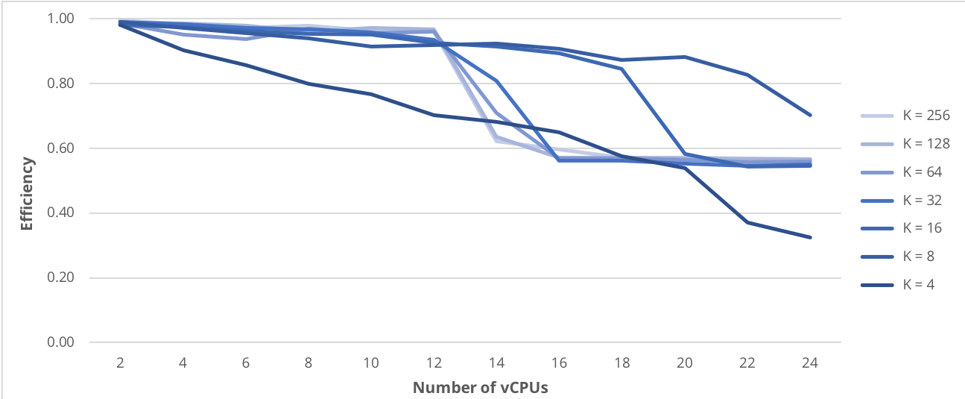
Performance on Google Cloud Platform
A drop in the efficiency of the parallel program is visible when more than twelve vCPU are used

Slide 15
Conclusions

