Slide 1
A Cost-Effective Predictive HR Analytics Framework for Sri Lankan SMEs
Using cloud-native serverless AI
Final Presentation and Viva | COM 4901
Theekshana Gimhan
Student ID 15002
Supervisor: Ms. Thanuja Irugalbandara
BSc (Hons) Management Information Systems | KIU University | September 2026
Notes:
Good morning. This project asked whether a Sri Lankan SME can run predictive HR analytics on a serverless budget, and whether attrition models built elsewhere transfer here. The headline answer to the second question is no, and that negative result is the contribution.

Slide 2
The problem
Firms with the turnover cost of a large employer and none of the analytics capacity
Commercial HR analytics is licensed per seat at enterprise scale. The fixed cost does not shrink with the firm.
AutoML platforms assume continuous, high-volume training data. A 30-person SME generates neither the volume nor the turnover events.
No published attrition model is fitted to Sri Lankan data, so practitioners are implicitly told to borrow one built elsewhere.
20-50
Employees in the target firm size
LKR 10,000
Monthly operational cost ceiling
That last assumption is what this project set out to test.
230
Real Sri Lankan records available anywhere
2
Notes:
The cost ceiling is not arbitrary - it is roughly what an SME of this size can absorb without board approval. The 230 figure matters most: that is the entire real Sri Lankan evidence base, and it is why borrowing looked attractive.

Slide 3
The gap in the literature
Transfer is assumed by one body of work and doubted by another. Almost nobody tests it.
A
What the ML literature assumes
B
What the shift literature predicts
Attrition studies train and validate on a single public dataset, most often IBM’s synthetic HR set, then name generalisation to other contexts as future work.
Dataset-shift theory and cross-cultural research both expect the relationship between predictors and turnover to change across labour markets — so transfer should degrade.
Two literatures disagree, and the disagreement has not been settled empirically for this region.
This project runs the test both of them defer.
3
Notes:
This is the framing that makes a negative result publishable rather than disappointing. Nobody had run the test for Sri Lanka, and the two relevant literatures make opposite predictions about what it would show.

Slide 4
Research questions
As stated in the interim report; Chapter 1 records how they evolved from the proposal
Which predictors matter for the Sri Lankan SME context, and how far do attrition patterns transfer from international data?
1
How far does a serverless architecture reduce operational cost, and can it stay within LKR 10,000 per month?
2
Can a hybrid of real international and calibrated synthetic data produce a usable classifier for a low-volume environment?
3
Each is answered in Chapter 6 in a single sentence first, then elaborated. Two of the three answers are negative.
4
Notes:
Flag early that two of three answers are negative, so the examiners are not waiting for a triumph slide that never comes.

Slide 5
Methodology
Design Science Research, six activities mapped to project phases
1
2
3
Problem identification
Define objectives
Design & development
SME cost and data constraints established from the Sri Lankan context
Five objectives, O1 to O5; three carry measurable pass criteria
HR platform, ML pipeline, inference service and Pulse Check
4
5
6
Demonstration
Evaluation
Communication
Deployed to Cloud Run and exercised end to end on live infrastructure
One script per question, each emitting a machine-readable report
This dissertation, the artefacts, and the reported negative results
5
Notes:
The point to stress is the evaluation activity: every number in Chapter 5 comes from a script written to attack a claim, not to illustrate one.

Slide 6
Data strategy
Weighted multi-source training, validated on held-out real Sri Lankan data
2,820
230
1,470
Training master
Sri Lankan validation
IBM benchmark
Saudi real 1,191 + Russian real 1,129 + calibrated synthetic 500
33 positive cases (14.3%). Never used in training, at any stage.
Published comparison only. Never mixed into training or validation.
The outcomes are not identically defined, and the design cannot separate the two effects.
!
The international sources record observed attrition. The Sri Lankan sample records turnover intention. Part of the transfer failure shown next is attributable to this label shift rather than to national context — which is declared throughout rather than hidden.
6
Notes:
Expect a question here. The honest answer is that label shift and national context are confounded by design, and separating them needs observed attrition data from a Sri Lankan employer - which is the first item of future work.

Slide 7
What was built
A production HR platform, a serverless inference service, and the capture mechanism that feeds it
Pulse Check
8 constructs
ML service
Risk + SHAP
16-item weekly
micro-survey
mean of items,
identical to training
FastAPI on Cloud Run,
scales to zero
probability, threshold,
per-request factors
Deployed, not prototyped
150
Inference is IAM-locked and authenticated, never public
Shipped to the product over an HTTP API boundary, not a merge
Employees never see their own risk score, by design
billable instance-seconds consumed by the inference service across four months.
7
Notes:
The 150 seconds figure is the architecture argument in one number: scale-to-zero means the model costs nothing while nobody is asking it anything.

Slide 8
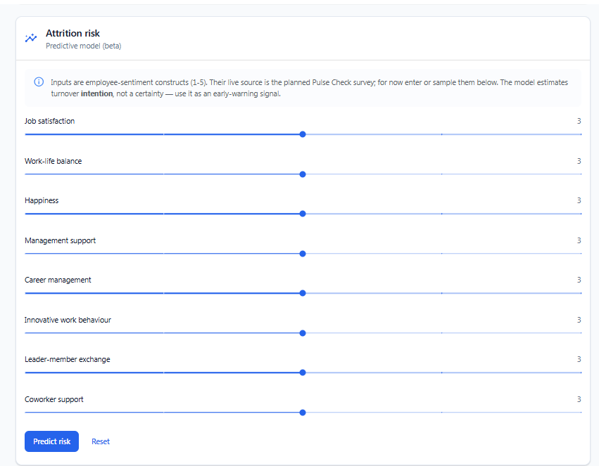
The system in use
Attrition risk on the employee detail page
1
Probability against a disclosed threshold
The operating point is shown, not hidden — a manager can see what the model was tuned to do.
2
Per-request SHAP contributions
Explanations are computed for this employee, not a global importance chart reused for everyone.
3
The caveat sits at the point of use
The card states that the model predicts turnover intention, where the decision is made — not in a manual.
8
Notes:
Demo hook. If time is short, skip the live demo and talk over this slide instead.

Slide 9
RQ1 — attrition patterns do not transfer
Both models evaluated against the same held-out Sri Lankan sample (n = 230, 33 positives)
0.641
Transfer model, ROC-AUC
4 shared features
0.937
Local model, ROC-AUC
8 psychometric constructs
A model carrying Saudi and Russian labour-market knowledge performs close to chance on Sri Lankan data, while one fitted to Sri Lankan constructs performs strongly.
9
Notes:
Be first to say the two figures are not like-for-like: transfer is genuine out-of-sample, local is cross-validated within the same 230 records. They answer different questions. Chapter 5 says this before any reader can raise it.

Slide 10
The transfer result is weaker than 0.64 suggests
Decomposing what the four shared features actually contribute
0.457
Age and gender together score below chance. They carry no transferable signal at all.
Whatever the transfer model achieves comes entirely from satisfaction items — which, on the Sri Lankan side, are self-reported in the same instrument as the outcome.
It is partly re-detecting same-source correlation, not transferring knowledge. This weakens my own headline — and it is reported that way.
10
Notes:
This slide exists because the audit found it. The interim report claimed age dominated the transfer model; that turned out to be an artefact of age being stored as four bracket midpoints with 88.7% of records at one value. Say so plainly if asked.

Slide 11
RQ3 — can synthetic data substitute for local data?
Six conditions, five seeds each, on the transfer arm
No.
0.526
Synthetic data alone — indistinguishable from chance
+0.032
Contribution of synthetic augmentation — inside seed noise
−0.007
Effect of the 2.0 / 0.5 weighting scheme — immaterial
The hybrid reaches F1 ≈ 0.29 against a target of 0.80. The usable classifier in this project came from local data alone — which is the central negative result, and more useful than a positive one.
11
Notes:
The weighting finding is the uncomfortable one: a scheme central to the data strategy turned out to do nothing measurable. Reporting it is the point.

Slide 12
RQ2 — operational cost
Measured per resource over four months and priced against published rates, under four scenarios
LKR 4,050
per month, on the most conservative of the four scenarios — roughly 2.5× inside the ceiling.
Compute is not the cost
The always-on database dominates
Container images are a hidden line item
All three services total about LKR 82 per month and fall inside the free tier.
At roughly 70% of spend, the one component that cannot scale to zero is the one that costs money.
LKR 1,140 per month of accumulated build artefacts — real, but removable with a retention policy.
12
Notes:
Concede the incompleteness before being asked: the comparison against a persistent always-on deployment was argued architecturally, not benchmarked. That is a genuine gap in the RQ2 answer.

Slide 13
Usability — what was found, and what was not
The planned SUS study did not run. A heuristic inspection was substituted and is reported as a substitution.
Neutral inputs on every construct return a HIGH risk band. The card explains what the number is, never what to do with it.
F1
There is no workforce risk view. The system’s primary question — who should I worry about? — has no interface.
F3
A first-time user is not told where to begin. No onboarding, no entry-point cue.
F13
Taken together, F1, F3 and F13 indicate that the barrier to this system being adopted is not its accuracy.
Two evaluators contributed and the split is declared: the author, and an AI assistant driving a scripted browser. F13 could only have come from the human one — an automated evaluator cannot feel lost.
13
Notes:
Declare the AI second evaluator before being asked. The defensible position: it gave systematic coverage and a screenshot per claim, it is not a usability expert, and the most valuable finding came from the human. All three statements are in section 5.10.

Slide 14
Limitations
Stated in Chapter 6 without softening, and summarised here the same way
Outcome
Common method
The Sri Lankan outcome is turnover intention, not observed departure. Every local claim is a claim about intention.
Predictors and outcome come from one self-report instrument. The design cannot quantify how much that inflates the result.
Sample size
Fairness
230 records, 33 positives, bootstrap interval [0.883, 0.982] — and drawn from startup professionals, not the SME population targeted.
Unvalidated for women and for employees over 25: two and six positive cases. The system should not run on real employees until that changes.
Objective O5
Compliance
Usability was inspected, not measured. The “above 80” SUS target is neither met nor refuted.
What is established is a compliant design, not a compliance result. No real employee data was ever processed.
14
Notes:
Do not rush this slide. Volunteering the limitations is what makes the positive claims credible, and examiners reward it.

Slide 15
Contributions
Four claims, in order of weight
1
Attrition models do not transfer across national contexts
2
A cost-viable serverless reference architecture
On shared demographic features: 0.937 local against 0.641 transfer, surviving leakage correction, estimator substitution and alternative binarisation.
Measured rather than estimated, with the finding that compute is not the cost — the always-on database is.
3
A working construct-capture mechanism
4
Negative and infeasible results reported, not suppressed
The Pulse Check produces the model’s own inputs inside the product, closing the gap between a model that scores well and one that can be operated.
The transfer failure, the immaterial weighting scheme, and the structural impossibility of fairness validation on this sample.
15
Notes:
Contribution one is the thesis. If only one thing is remembered from this presentation, it should be that borrowing an international attrition model does not work for this context.

Slide 16
Demonstration
Live on the deployed development environment
1
Sign in and open an employee
The HR platform — payroll, leave and attendance — is the system of record the predictions attach to.
2
Score attrition risk
Eight constructs produce a probability, a band, the disclosed threshold, and the SHAP factors behind that specific prediction.
3
Submit a Pulse Check
Sixteen Likert items become the eight constructs automatically, and the prediction is cached per employee per week.
4
Confirm the privacy boundary
The employee sees a confirmation and never a risk score. That is verified, not asserted.
If the first prediction takes about twenty seconds, that is the scale-to-zero decision made visible — the instance is cold. Warm responses run in half a second to one second. Keeping an instance always warm would break the cost result on the previous slide.
16
Notes:
Warm the service up immediately before the viva by making one prediction. If it is cold in front of the panel, do not apologise - explain it as the cost trade-off, which is exactly what it is.

Slide 17
Future work
Ordered by how much each would change the conclusions
1
Obtain observed attrition data from a partner SME
The single highest-value next step. It would dissolve the label-shift confound and let the local model be judged against departures rather than intentions.
2
Build the workforce risk view and an onboarding path
Both are additions rather than corrections, and the adoption literature says they matter more than accuracy does.
3
Run the usability study
The protocol is fully specified in §5.10 and directly executable with independent evaluators. It would close the one objective this work leaves open.
4
Validate fairness on an adequate sample
Subgroup performance should be a deployment precondition. Age and gender should also be dropped from the transfer model outright — removing them costs nothing.
5
Move the always-on database to a scale-to-zero tier
It is roughly 70% of operational spend, so it is the obvious next architectural target.
17
Notes:
If asked what I would do differently: collect Sri Lankan outcome data first and treat the international sources as a comparison rather than a substitute.

Slide 18
The most useful thing this project produced was not the strong model, but the weak one.
International attrition data cannot substitute for local data collection in this domain — and that is precisely the gap the project set out to examine.
Thank you — questions welcome
Theekshana Gimhan | 15002 | COM 4901
Notes:
Close on the reflection from section 6.5 rather than on a summary of findings - it is the sentence that frames every negative result in the deck as intentional.

