Slide 1


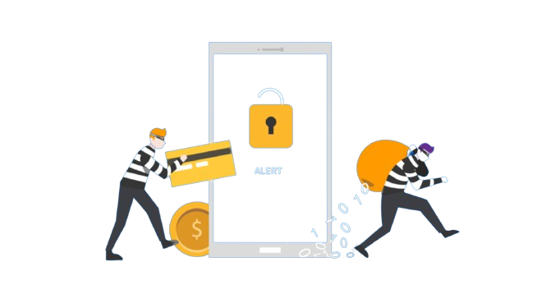
Phishing Attacks and Social Engineering
Phishing attacks and social engineering schemes pose a grave cybersecurity threat worldwide, threatening individuals and businesses by compromising their sensitive data. This report delves into the intricacies of malware and social engineering activities, elucidating how attackers trick and persuade victims into believing their lies.
IT22083678 SAHAN H.P.T

Slide 2
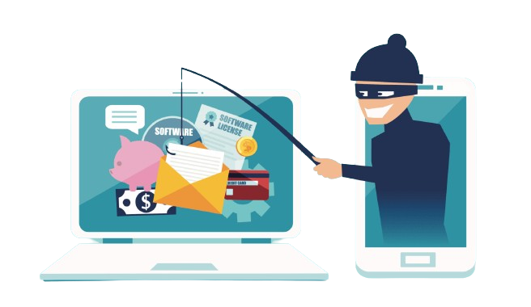
The Evolution of Phishing and Social Engineering Attacks
1
Early Phishing Attacks (1990s)
The earliest form of phishing attacks involved social engineering techniques that tricked vulnerable users into submitting private or sensitive information to fraudsters posing as trusted entities. These attacks typically came in the form of emails claiming to be from large companies or organizations, requesting the victim to confirm their personal or financial details.
2
Refinement and Expansion (Early 2000s)
The term "phishing" was coined in 1996, and the first recorded use of the term occurred in 1997. Phishing attacks became more widespread, with the complexity of the attacks increasing to target victims on online banking and e-commerce platforms.
3
Targeted Phishing and Spear Phishing (2009s)
Phishing strategies became more targeted, with the emergence of spear phishing attacks. Attackers invested significant time in researching their victims, crafting highly personalized and convincing emails that tricked users into providing their credentials.

Slide 3
The Types of Phishing Attacks and Social Engineering Techniques
Email Phishing
Spear Phishing
Smishing and Vishing
Email phishing is one of the most prevalent and widespread types of phishing attacks. Cybercriminals create fraudulent emails that appear to be from legitimate organizations, such as banks, online retailers, or service providers, in an attempt to trick victims into revealing sensitive information or clicking on malicious links.
Spear phishing is a targeted phishing attack that focuses on specific individuals or organizations. Attackers gather extensive information about the target, including their job, interests, and even personal details, to craft highly personalized and convincing phishing emails or messages.
Smishing, or SMS phishing, involves the use of text messages or SMS to trick victims into providing login credentials or visiting a malicious website. Vishing, or voice phishing, uses fake phone calls or voice messages to obtain sensitive information or trick victims into transferring funds.

Slide 4
Social Engineering Techniques: Exploiting Human Vulnerabilities
1
Trust and Authority Exploitation
2
Emotional Manipulation
Social engineering attacks leverage emotional triggers, such as panic, fascination, or a sense of urgency, to manipulate victims into taking the desired actions.
Phishers exploit the natural human tendency to trust authority figures or familiar entities, impersonating them to gain access to sensitive information or perform malicious actions.
3
Credential Reuse Vulnerability
4
Lack of Verification
Failing to thoroughly verify the authenticity of messages, websites, and requests can lead to victims inadvertently disclosing crucial information or falling for phishing scams.
The widespread practice of reusing the same passwords across multiple accounts makes it easier for attackers to breach several accounts with a single compromised credential.

Slide 5
The Impact of Phishing and Social Engineering
Financial Impact
Data Breaches and Privacy Violations
Phishing and social engineering schemes can result in significant financial losses, with criminals gaining the ability to drain accounts, commit identity theft, and cause operational disruptions that require costly response and recovery actions.
The disclosure of personal and corporate data through these attacks can lead to identity theft, financial fraud, and the compromise of sensitive intellectual property, causing severe damage to individuals and organizations.
Business Disruptions and Operational Impact
Reputational Damage
Successful phishing and social engineering attacks can result in reputational damage, causing consumers to lose trust in brands and leading to market share contraction, client loss, and declining brand value.
Malware, such as ransomware, can encrypt systems and halt production, sales, and service delivery, leading to significant productivity losses and even business failures. The disruption of critical infrastructure can also pose a threat to public health and safety.

Slide 6
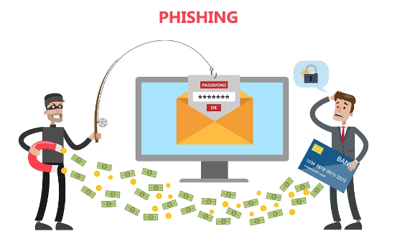
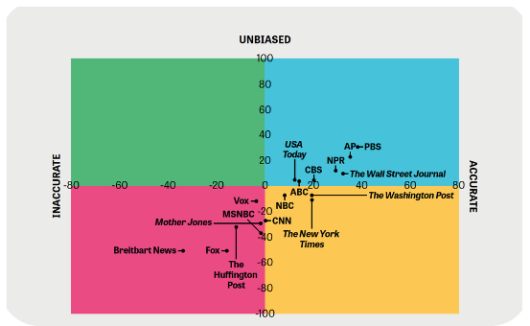
Emotional and Psychological Impacts
Trauma and Distress
Erosion of Trust
Victims of identity theft or the misuse of their personal data often experience severe emotional distress and trauma due to the violation of their privacy and the disruption to their lives.
Persistent phishing attacks and social engineering tactics can contribute to an environment of pervasive distrust, undermining the social cohesion that is essential for personal and professional interactions in the digital age.

Slide 7



Emerging Threats: AI-Powered Phishing and Social Engineering
Deepfakes
Automated Phishing Lures
Quantum Computing Threats
Advancements in AI and machine learning enable the creation of highly convincing deepfakes, which can be used to impersonate trusted individuals and launch even more sophisticated phishing and social engineering attacks.
AI-powered natural language generation can be used by attackers to produce personalized and tailored phishing emails and messages that are more difficult to detect and defend against.
The potential of quantum computing to break traditional encryption methods could enable new types of phishing attacks focused on decrypting sensitive data, even from encrypted systems.

Slide 8
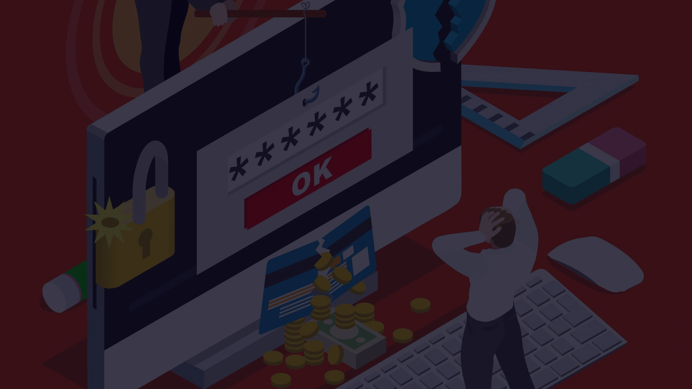



Combating the Evolving Threat
User Awareness Training
Advanced Detection and Response
Cybersecurity Culture
Comprehensive user education on the latest phishing and social engineering tactics is crucial to empower individuals to recognize and resist these attacks.
Implementing AI-powered phishing detection systems, along with robust incident response plans, can help organizations stay ahead of the evolving threat landscape.
Fostering a strong cybersecurity culture, where vigilance and proactive defense are ingrained in the organization, is essential for effectively combating the persistent threat of phishing and social engineering.

Slide 9


Thank You
IT22083678 SAHAN H.P.T

