Slide 1

SPORTS EVENT MANAGEMENT SYSTEM

Slide 2





S P O R T S E V E NT M A N A G E M E N T I N A SHELL
Sports&
Event microsevice
API Gateway
Admin
Authentication microservice
Player microservice
Participation microservice
2

Slide 3








REQUIREMENT ANALYSIS

Slide 4
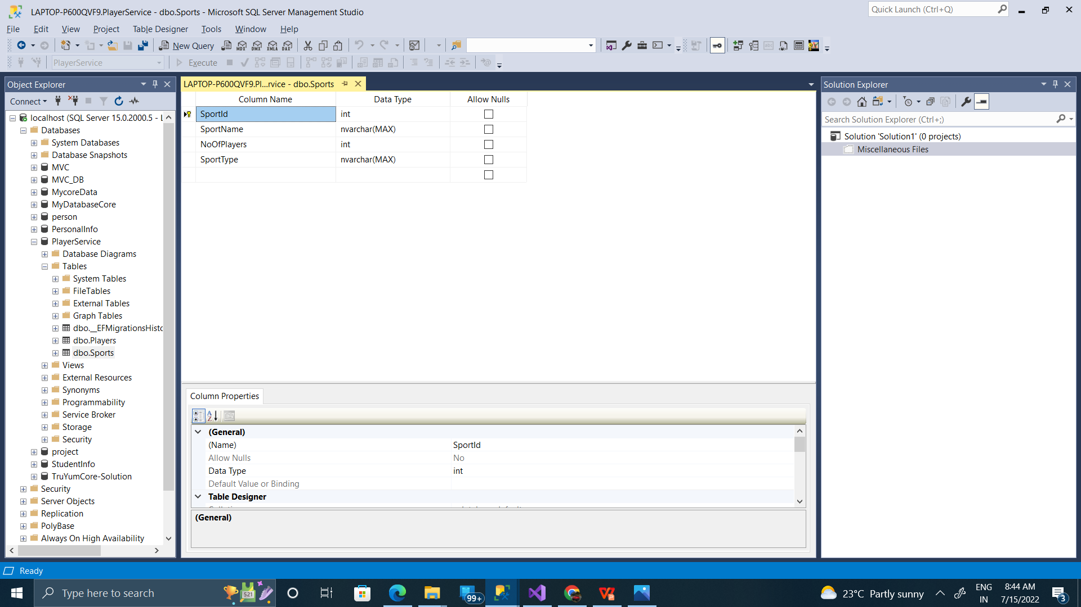
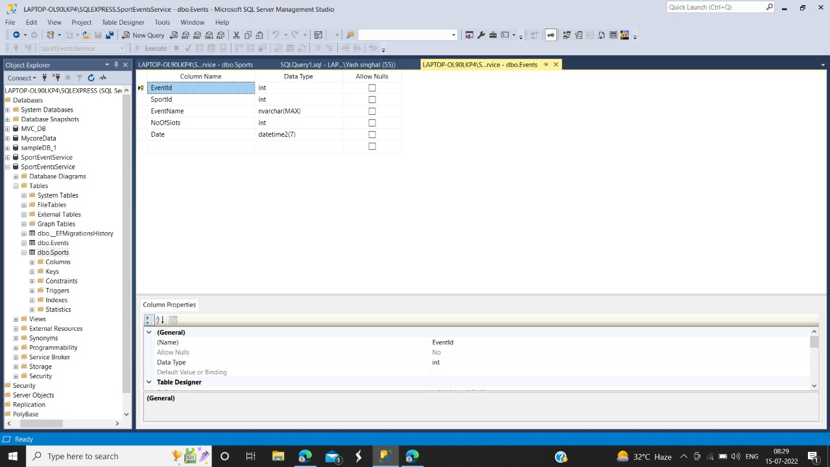
SQL TABLES
SPORTS TABLE
EVENT TABLE

Slide 5
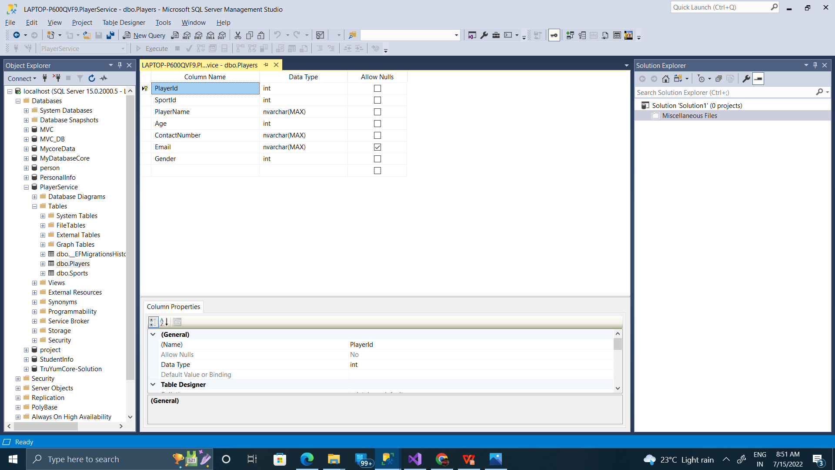
SQL TABLES (CONTINUED)
PLAYER TABLE
PARTICIPATION TABLE

Slide 6





DEVELOPMENT & DESIGNING
6

Slide 7







MICROSERVICES
Authorization microservice - to handle authentication of the admin
Sports & Event microservice - to perform sports & event related services
Player microservice - to perform player related services
Participation microservice - to perform operations
using sports event service and player service
7

Slide 8
Authorization MICROSERVICE

Slide 9




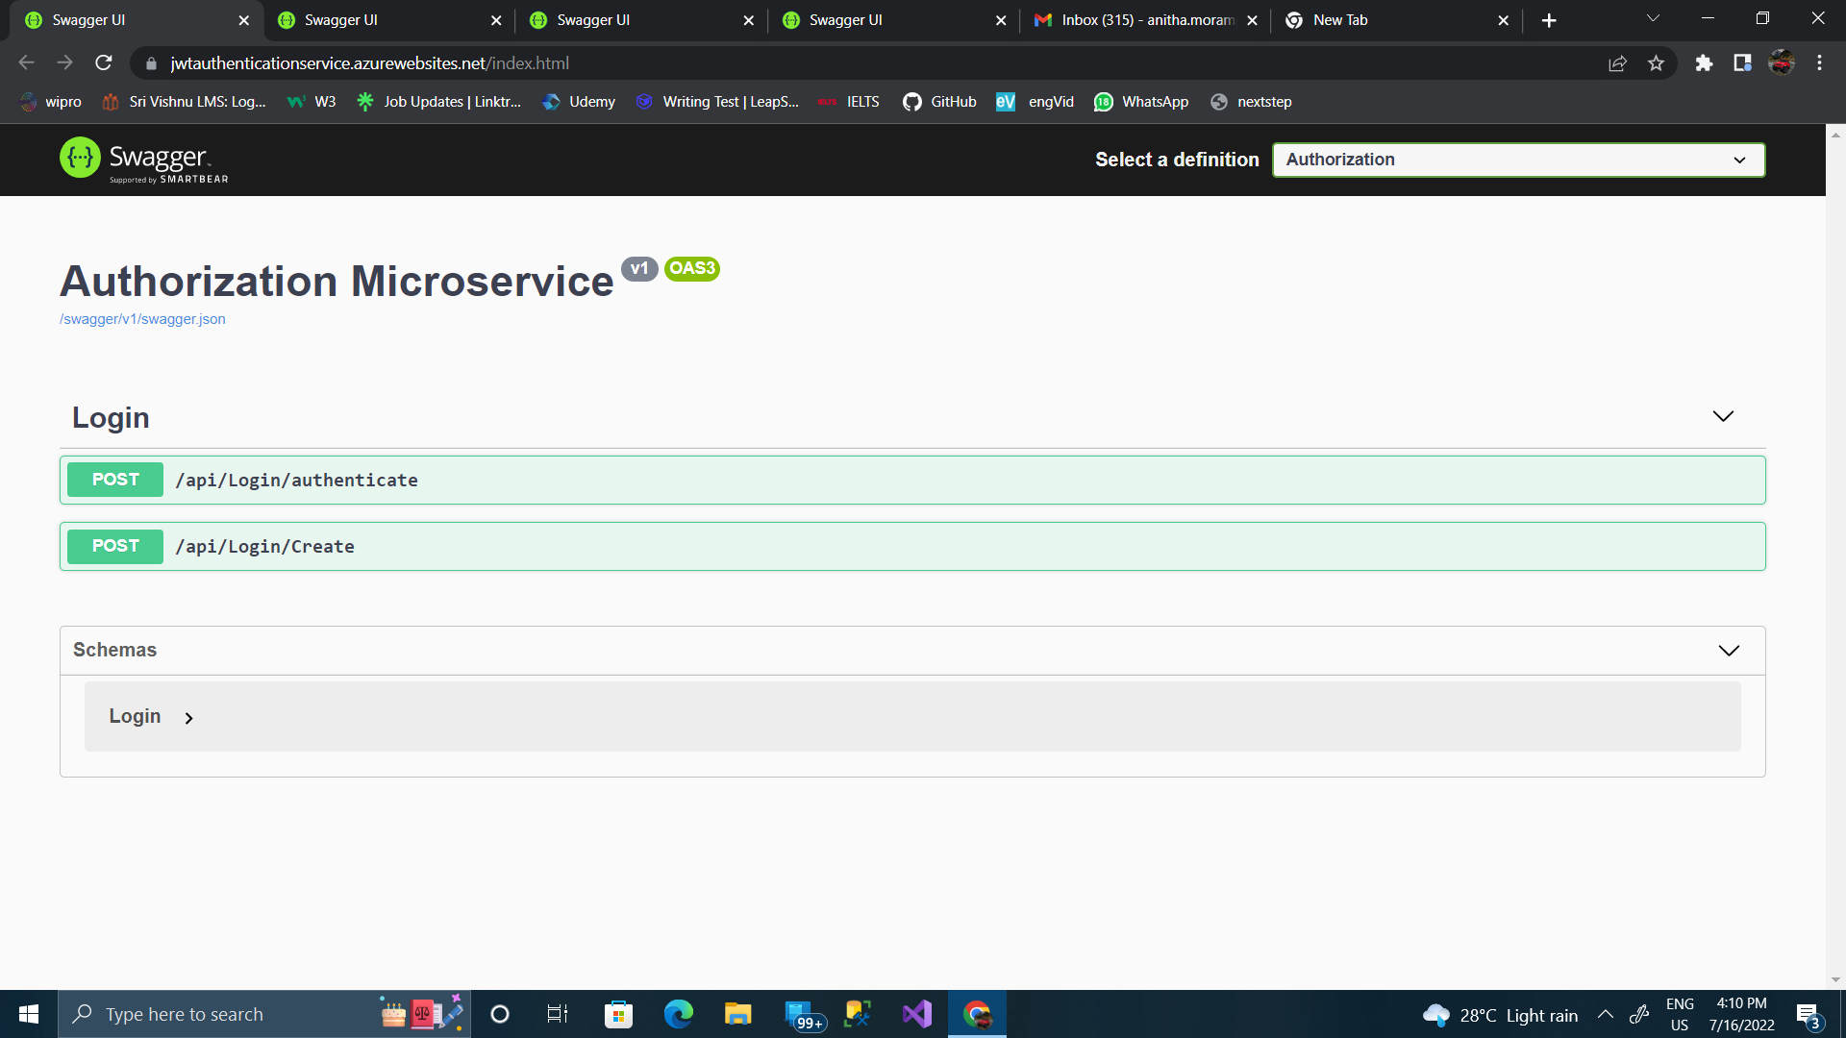
REST ENDPOINTS
/login - to log in the admin and generate jwt token
/validate - to validate the jwt token
11

Slide 10

Rest Controller (a gist)
One of the Post mappings of the rest controller (to login the user)
Rest controller calls the UserServiceImpl.java where all the necessary details are implemented

Slide 11
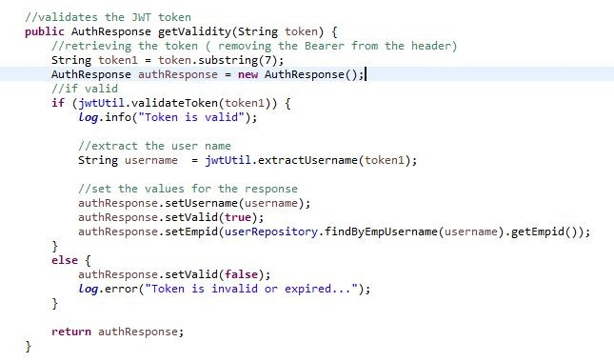
AUTH SERVICE

Slide 12
EXCEPTION HANDLING
Rest Exception handler - to handle all the
exceptions that occurs in the microservice with proper status code
UnauthorizedException - thrown when the user is invalid.
14

Slide 13
Sports & EVENT MICROSERVICE

Slide 14
REST ENDPOINTS
/Sports/GetAll – To view all sports’ details.
/Sports/GetSportByName/{SportName} – To View sport’s details searching by sport’s name
/Events/GetAll – To view all event’s details.
Events/GetByID/{EventID} - To View Event’s details searching by event’s ID.
Events/GetEventByName/{EventName} - To View Event’s details searching by Event’s name.
Events/PostEvent – To create Event according to the sports.
Events/Delete/{EventID} – To delete event using Event ID.

Slide 15
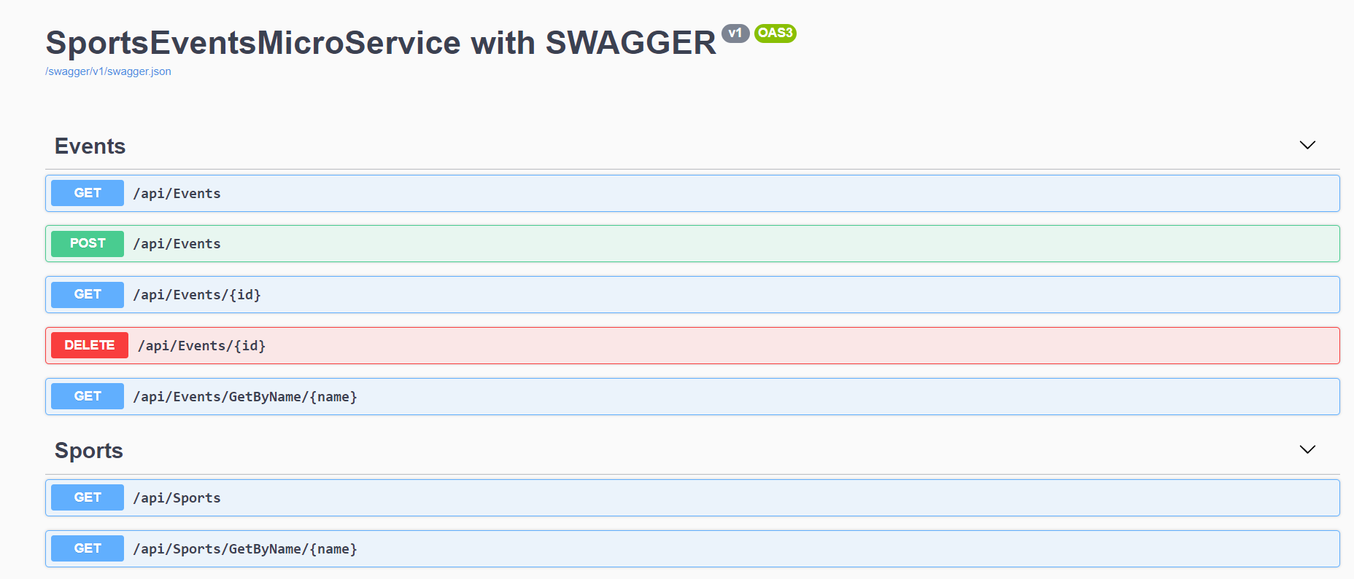
REST END POINTS CONT.

Slide 16
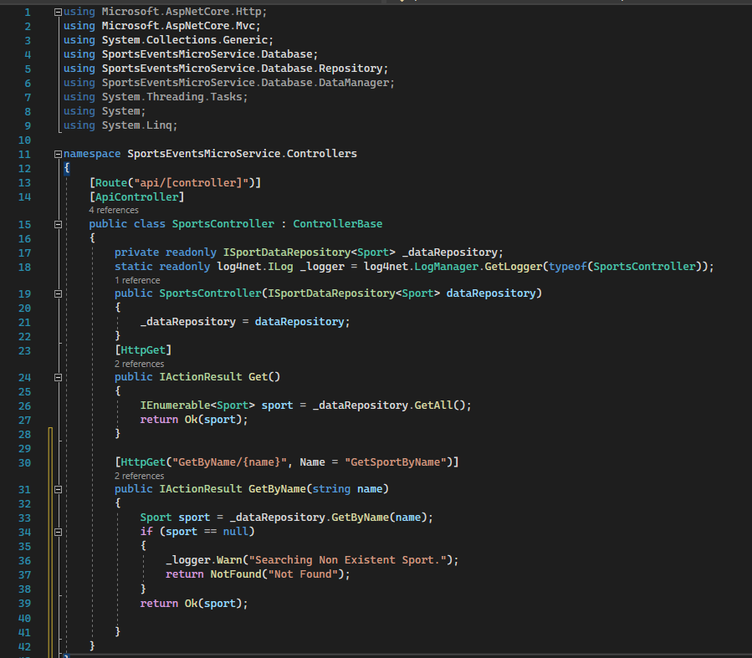
SPORT SERVICE

Slide 17
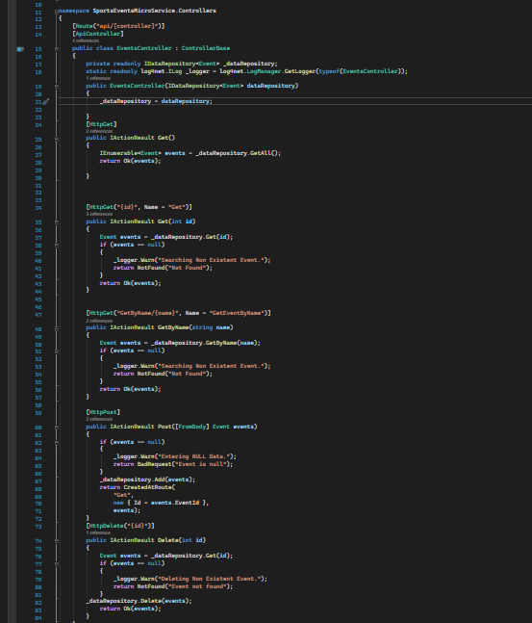
EVENT SERVICE

Slide 18
PLAYER MICROSERVICE

Slide 19
REST ENDPOINTS
/players/viewplayers/ - to view all the players details
/players/deleteplayers/{id} - to delete player through player id parameter
/players/addplayer/{id} - to add new player through existing sports id parameter
/player/addplayer - to add player through non existing sports id parameter
16

Slide 20
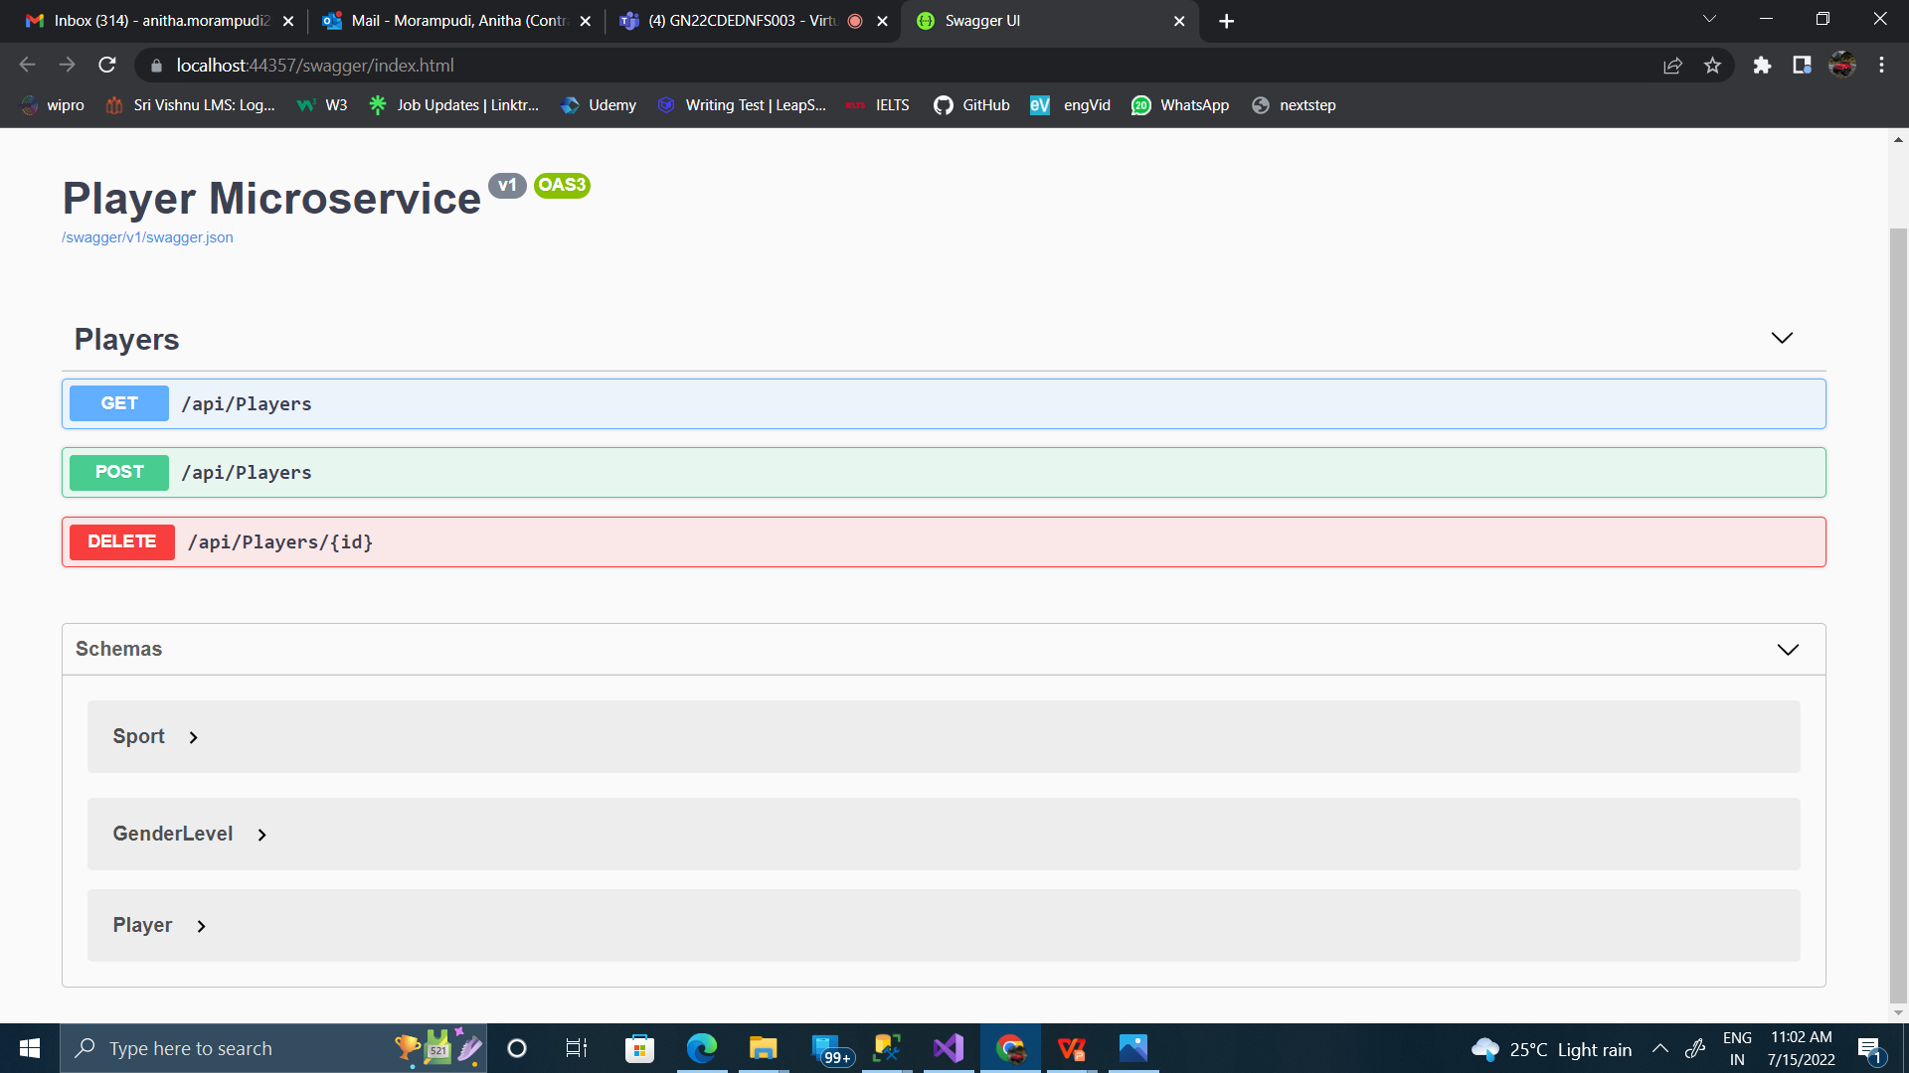
REST END POINTS CONT.

Slide 21
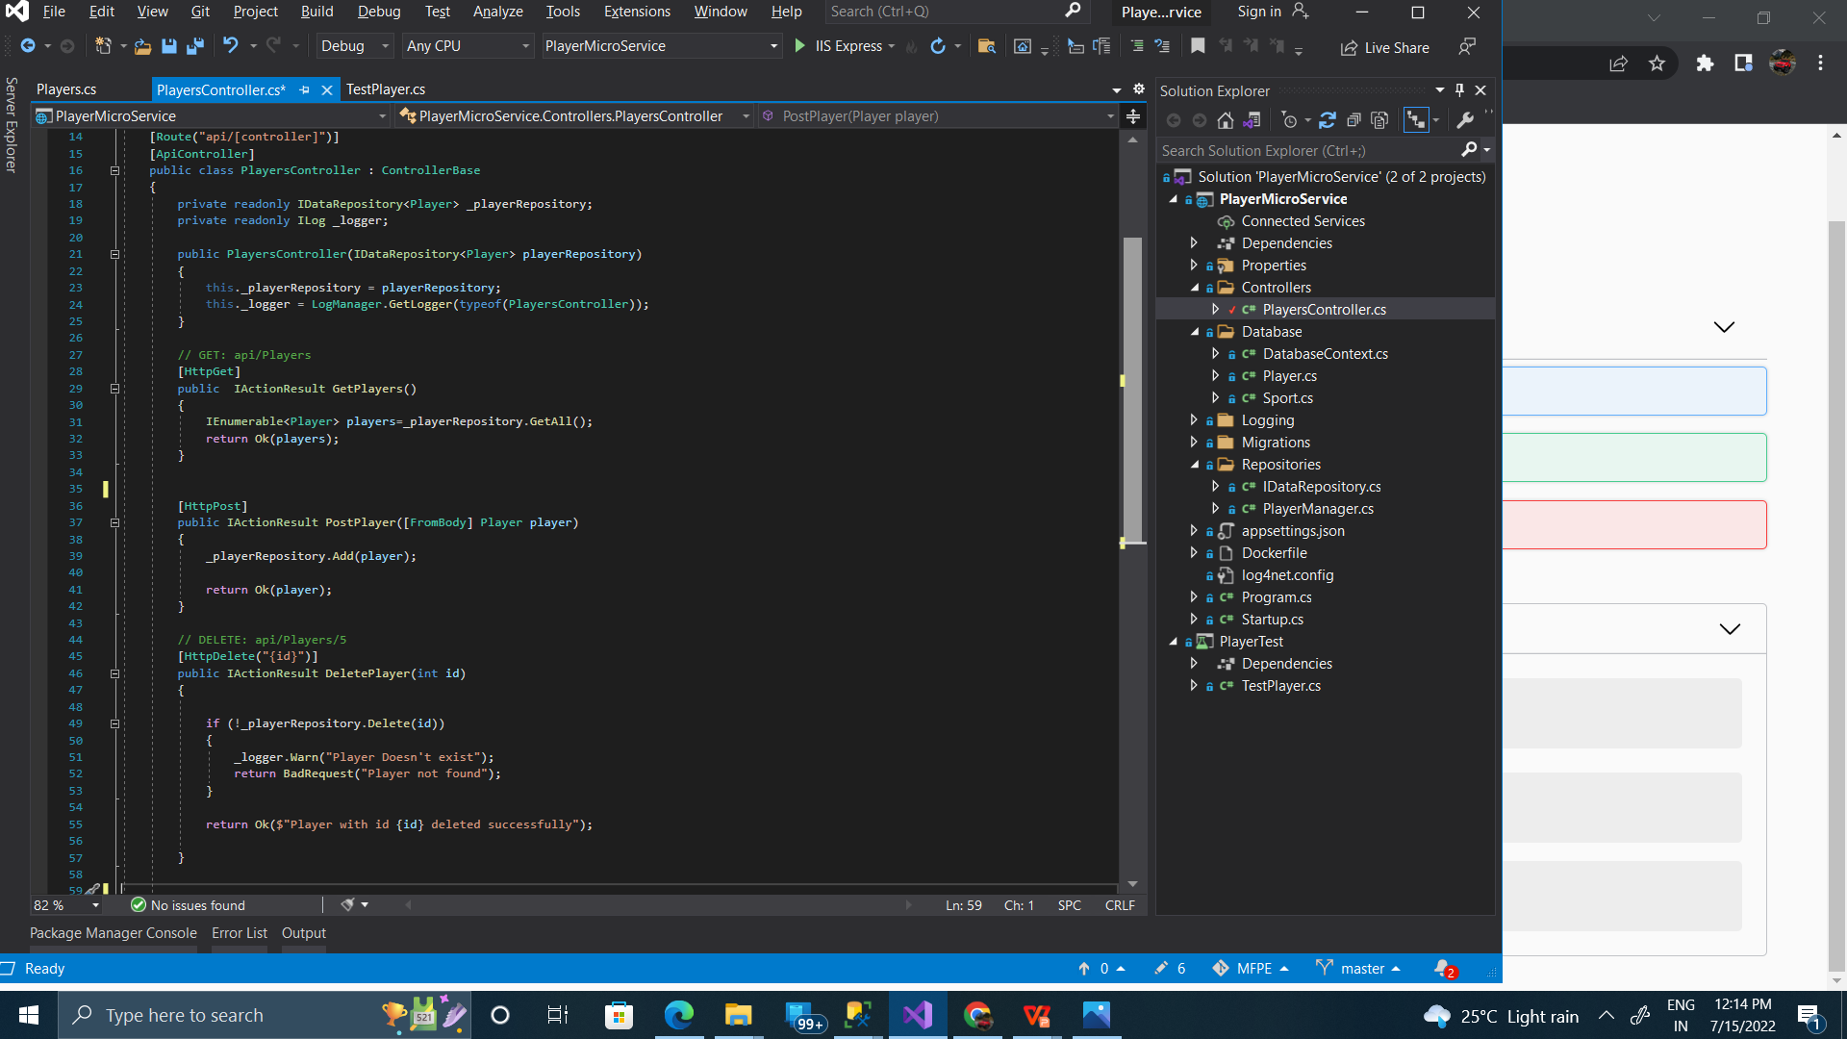
PLAYER SERVICE

Slide 22
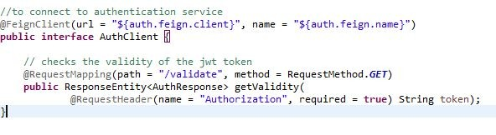
FEIGN CLIENTS
Auth client - to communicate with the authentication microservice
Offer client - to communicate with the offer microservice
Interface of AuthClient
20

Slide 23
PARTICIPATION MICROSERVICE

Slide 24
REST ENDPOINTS
/participation/addparticipation - to post a new
participation
/participation/getparticipation - to list all the participants
/participation/getApprovedParticipations - to list all the approved partipations
/participation/getDeclinedParticipations - to list all the declined participations
/participation/getPendingParticipations - to list all the pending participations
/participation/upadateParticipations/{id} - to know if Approved/declined successfully
22

Slide 25
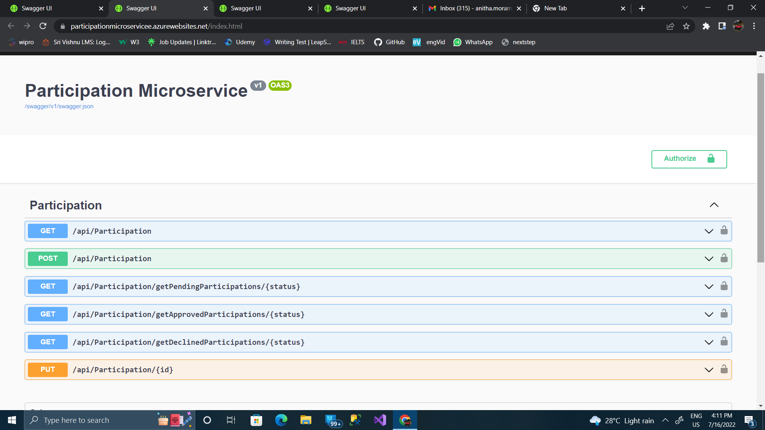
REST END POINTS CONT.

Slide 26
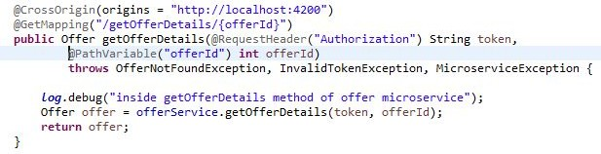
Rest Controller (a gist)
One of the Get mappings of the rest controller (to get the details of an offer by offer id)
Rest controller calls the offerService.java where all the necessary details are implemented

Slide 27
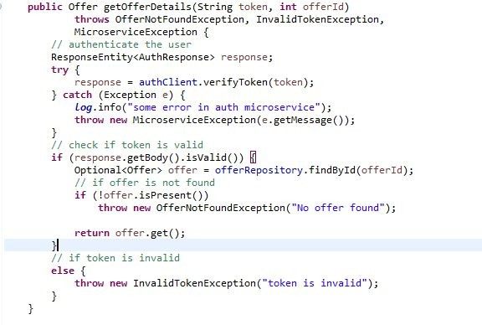
Participation SERVICE

Slide 28
EXCEPTION HANDLING
- Global Exception handler - to handle all the exceptions that occurs in
the microservice with proper status code
- EmployeeNotFoundException - thrown when no employee is found
╸
╸
╸
ImproperDateException - thrown when improper date is passed
InvalidTokenException - thrown when the jwt token is invalid
MicroserviceException - thrown when the communicated microservice is not working
- OfferNotFoundException - thrown when no offers are found
25

Slide 29
TESTING

Slide 30
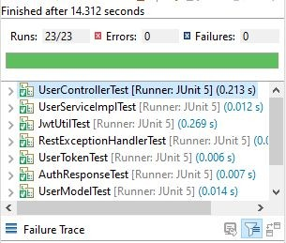
AUTH MICROSERVICE
AuthMicroserviceApplicationTests
UserControllerTest
RestExceptionHandlerTest
JwtUtilTest
ModelTests
UserServiceImplTest
There are 23 test cases and all of them pass successfully

Slide 31
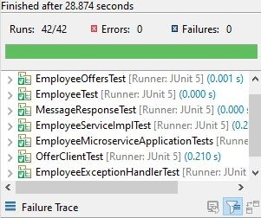
SPORTS MICROSERVICE
EmployeeMicroserviceApplicationTests
OfferClientTest
EmployeeControllerTest
EmployeeExceptionHandlerTest
ModelTests
EmployeeServiceImplTest
There are 42 test cases and all of them pass successfully

Slide 32
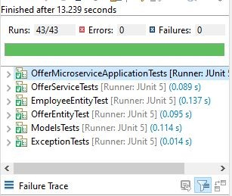
PLAYERMICROSERVICE
EmployeeEntityTests
ExceptionTests
OfferEntityTests
OfferServiceTests
ModelTests
There are 43 test cases and all of them pass successfully

Slide 33
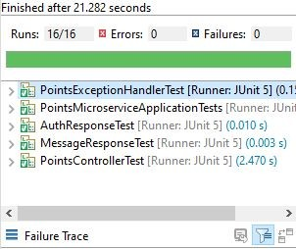
PARTICIPATION MICROSERVICE
PointsMicroserviceApplicationTest
PointsControllerTests
PointsExceptionHandlerTests
ModelTests
There are 16 test cases and all of them pass successfully

Slide 34









THANK YOU

