Slide 1

BADS7205 : Data Streaming
Assignment 1 : Group ONE
วิศราม ขำเกษม 6220412030
กอฟฟาร์ ลัดเลีย 6310412019
ธีธัช นาคเสนีย์ 6310412021

Slide 2

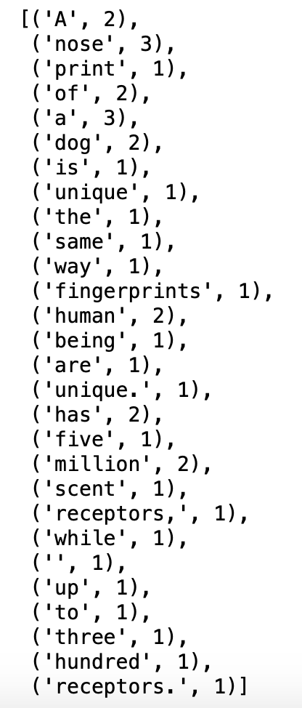

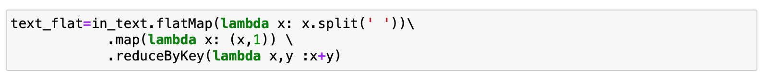
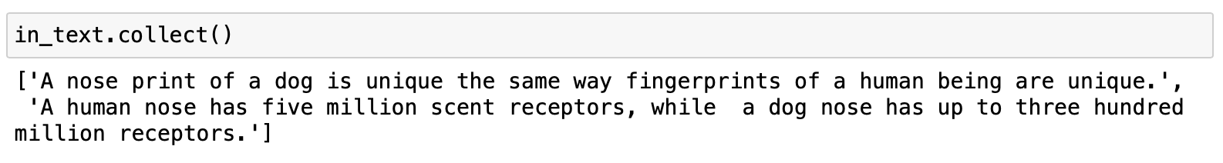
Solution Approach : Kafka Wordcount
Output
text_flat.collect()
Text Feed
Producer word partitioning
Compile wordcount
Consumer
1
1
1
2
10
5
1
1
1
1
1
7
1
11
9
12
. . . . . . . . . . . . . .
. . . . . . . . . . . . . .
. . . . . . . . . . . . . .
. . . . . . . . . . . . . .
3
17
8
6
23
1
1
1
1
1
27
1
15
12
3
Import findspark
findspark.init()
from pyspark.sql import SparkSession
spark = SparkSession.builder\
.master(“local”)\
.appName(‘word count’)\
.getOrCreate()
sc = spark.sparkContext
in_text = sc.textFile(‘/Users/macproretina13205/Desktop/text7205.txt’)

Slide 3
Solution Approach : TF-IDF
Text Feed
TF-IDF Weight Calculation
TF
Term Count
Term Frequency
Chapter 1
Chapter 1
The Boy Who Lived
A₁
B₁
Z₁
FA₁
FB₁
FZ₁
W A₁
3
12
……
15
3/n₁
12/n₁
……
15/n₁
TFA₁ x IDF A₁
Chapter 2
The Vanishing Glass
A₂
B₂
Z₂
FA₂
FB₂
FZ₂
18
13
……
1
18/n₂
13/n₂
……
1 /n₂
W Z₁
.
.
.
.
.
.
.
.
.
.
.
TFZ₁ x IDF Z₁
.
.
.
A₁₇
B₁₇
Z₁₇
FA₁₇
FB₁₇
FZ₁₇
20
4
……
17
20/n₁₇
4/n₁₇
……
17/n₁₇
IDF (t,D) = log |D| + 1 / DF(t,D) +1
Chapter 17
Chapter 1
Chapter 17
Chapter 17
Chapter 17
IDF A₁
IDF A₁₇
W A₁₇
LOG(17+1/A_{1C1-17} +1)
LOG(17+1/A_{17 C1-17} +1)
TFA₁₇ x IDF A₁₇
.
.
.
…
.
.
.
Chapter 17
The Man with Two Faces
IDF Z₁
IDF Z₁₇
W Z₁₇
LOG(17+1/Z_{1 C1-17} +1)
LOG(17+1/Z_{17 C1-17} +1)
TFZ₁₇ x IDF Z₁₇

Slide 4
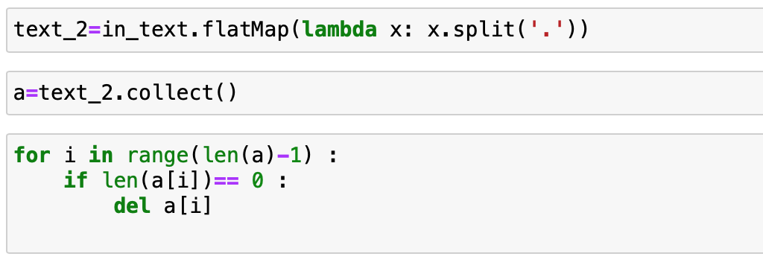
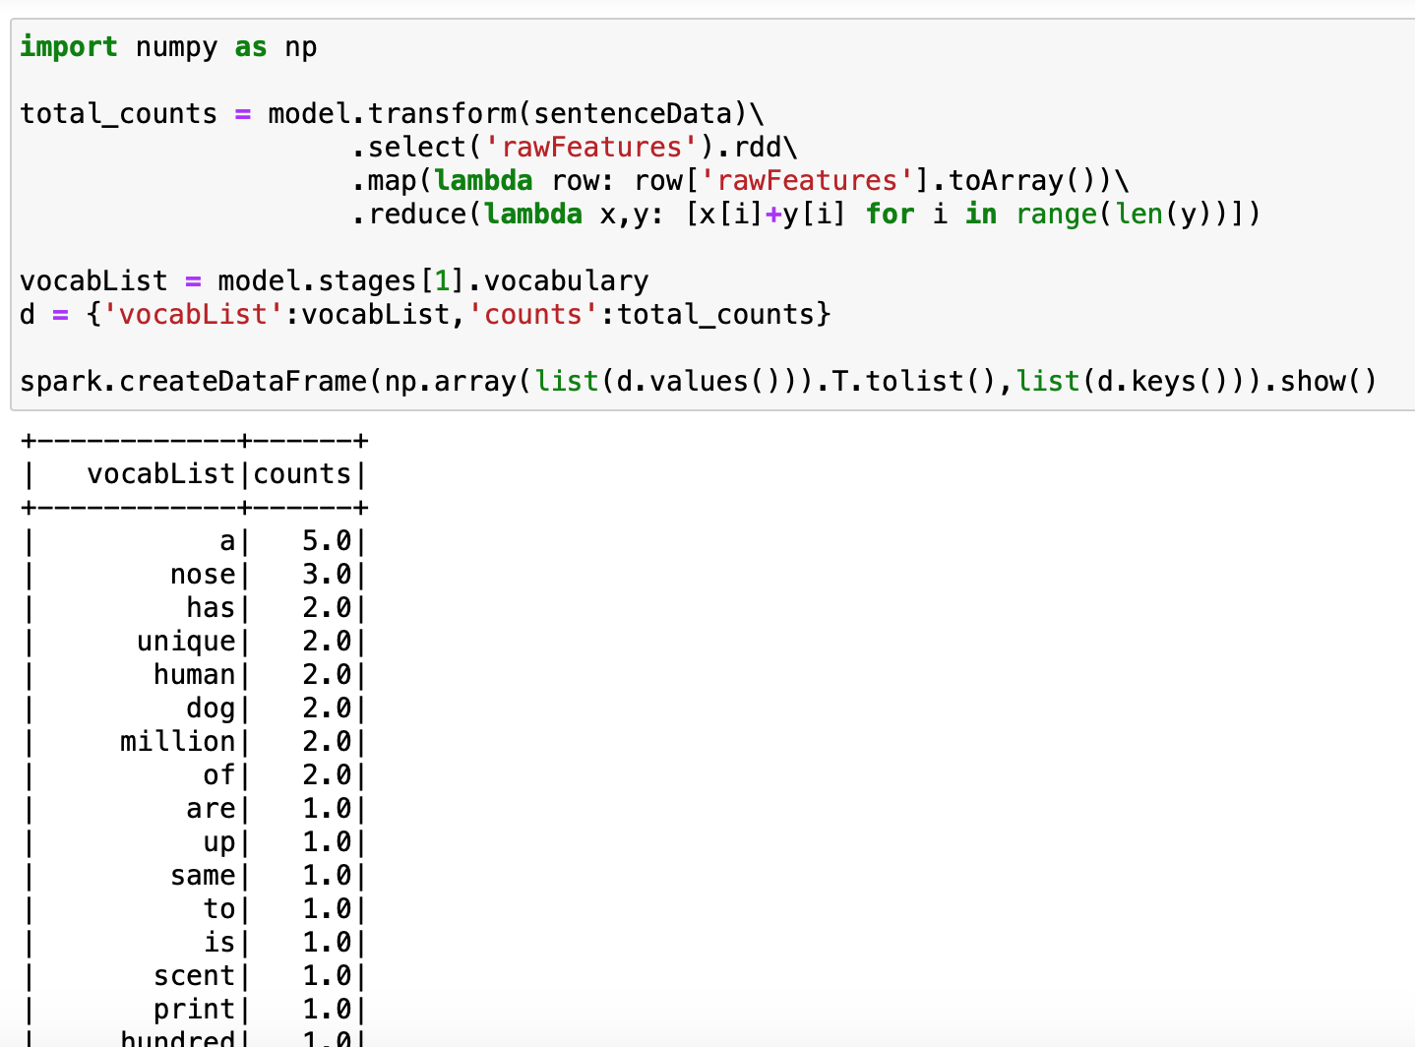
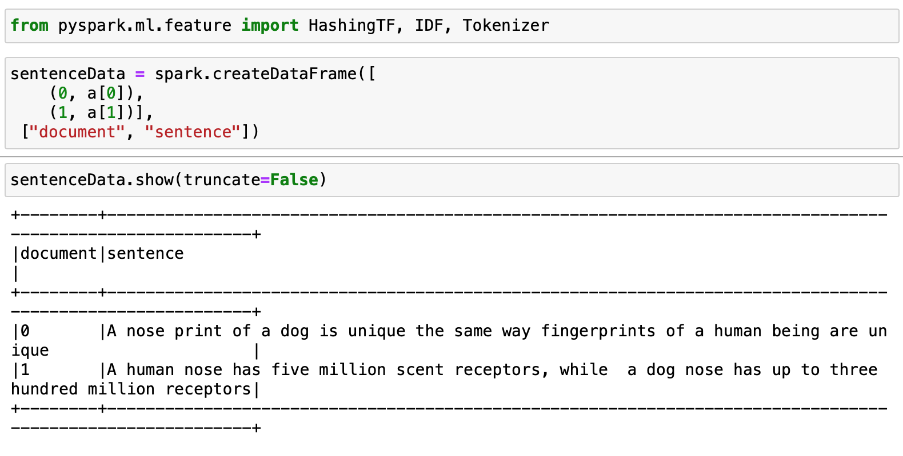
Solution Approach : TF-IDF
Text Feed
TF-IDF
Chapter 1
The Boy Who Lived
Chapter 2
The Vanishing Glass
.
.
.
.
.
Chapter 17
The Man with Two Faces

Slide 5
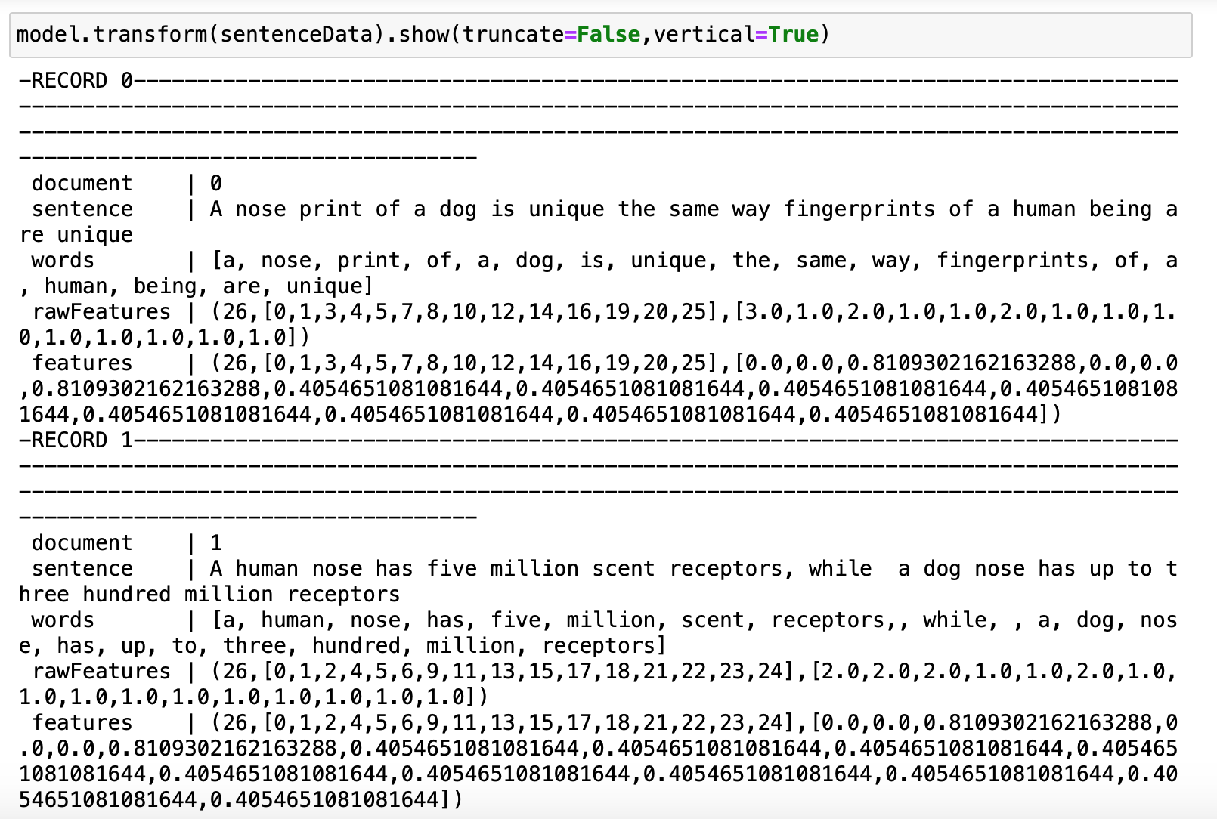
Solution Approach : TF-IDF
TF-IDF

