Slide 1

BADS7205 : Data Streaming
Offensive Word Detection
วิศราม ขำเกษม 6220412030
กอฟฟาร์ ลัดเลีย 6310412019
ธีธัช นาคเสนีย์ 6310412021

Slide 2




Project Overview : Offensive Word Detection
What we want to learn from this project
How we planned to make it happen
What we expected to see
Learn how to connect and manage social media data stream for analysis
Language processing model to classify offensive words
Use selenium tool to feed data to Spark Streaming to manage steaming input for consumer
Feed words to classification model to identify offensive or profanity words
Offensive words from the stream are correctly defined and tagged
Able to send out tagged word to other application for further processing
“End-to-end data stream analysis on word classification”
“Using collected data with Spark Streaming to feed word streaming to classification model”
“Correctly identify offensive words from incoming data stream and notify”

Slide 3

Solution Approach
Data file
Spark Streaming
Filtered output
Non-offensive
Hello
Hello
Good morning
Good morning
Bye
Transform and send data to ML pipeline
Prediction from ML Pipeline
Offensive
!@#%!@$
!@#%!@$
Bye
ML Pipeline
*!&@!^(@
*!&@!^(@
Tagged and Notify

Slide 4
Solution Approach
Pipeline
Stage 1
Stage 2
Stage 3
Stage 4
Cleaning data and
Remove Stop Words
Create Vector
Tokenize
LSTM
Load Data
Predicted Labels

Slide 5
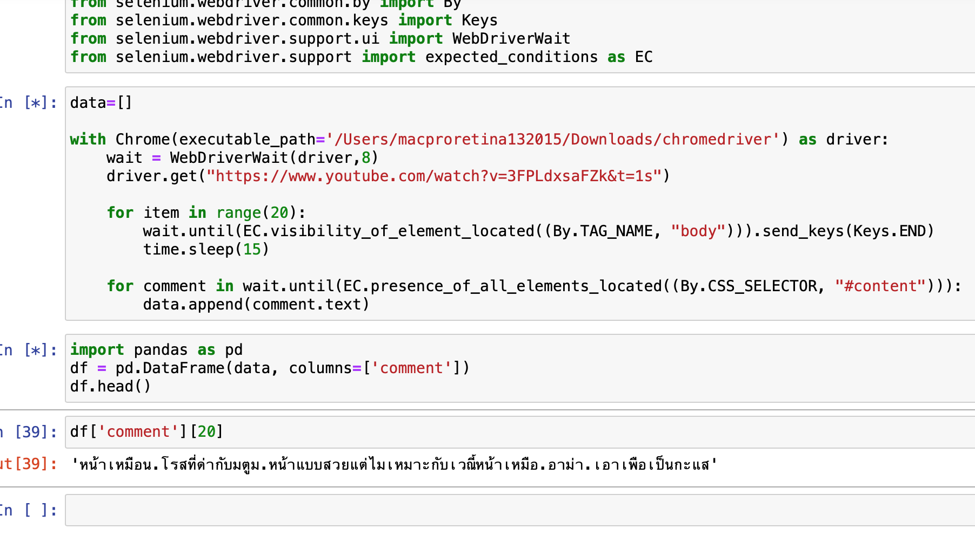
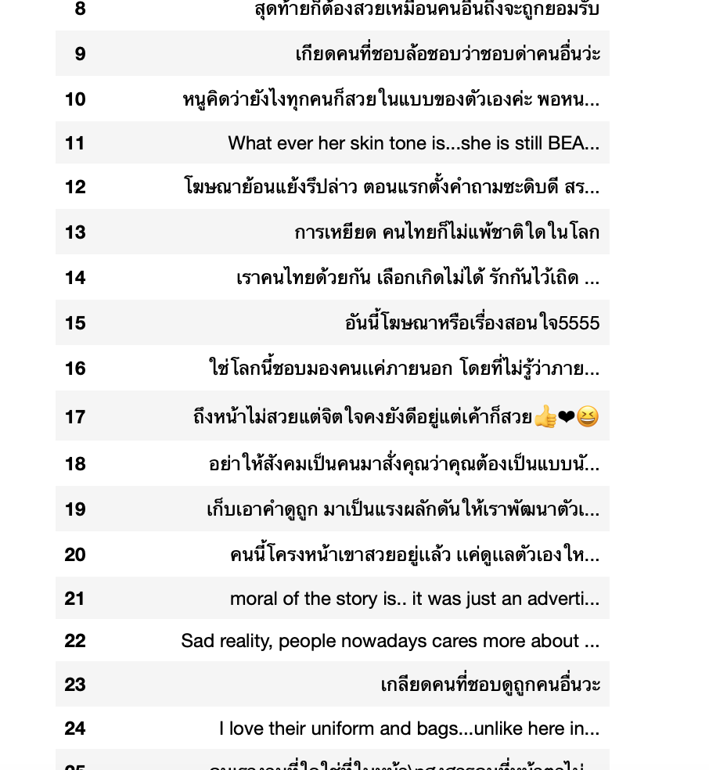
Dataset

Slide 6
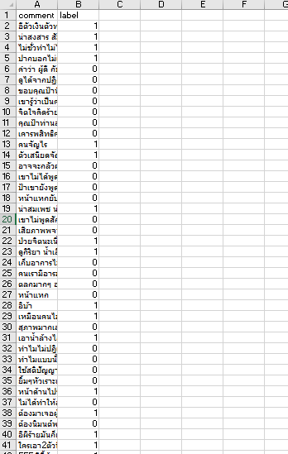
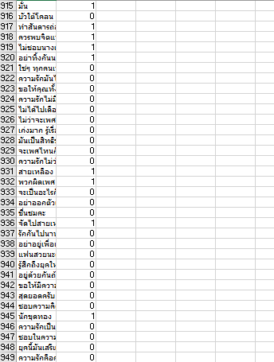
Bad word labeling
We labeled which message contained offensive word or not consisted of offensive word by using 2 vote out of 3 members’ judgement and get the labeled training data as below

Slide 7
Model

Slide 8
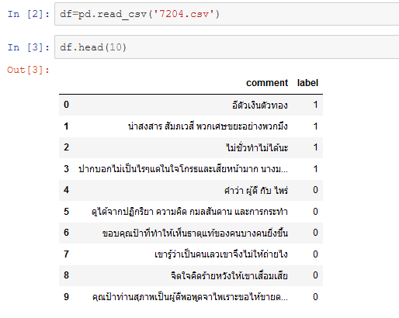

Slide 9
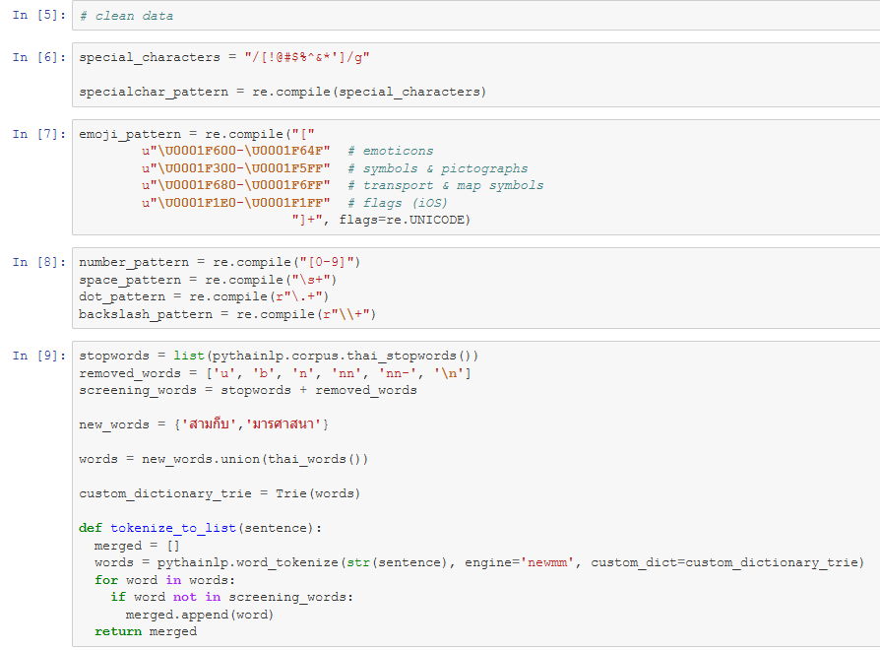

Slide 10
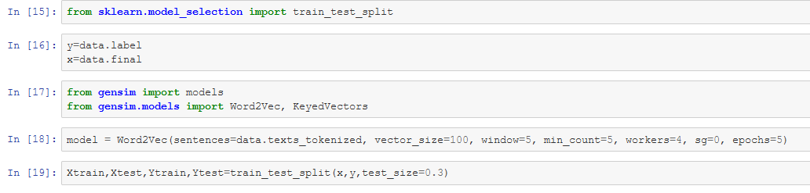

Slide 11
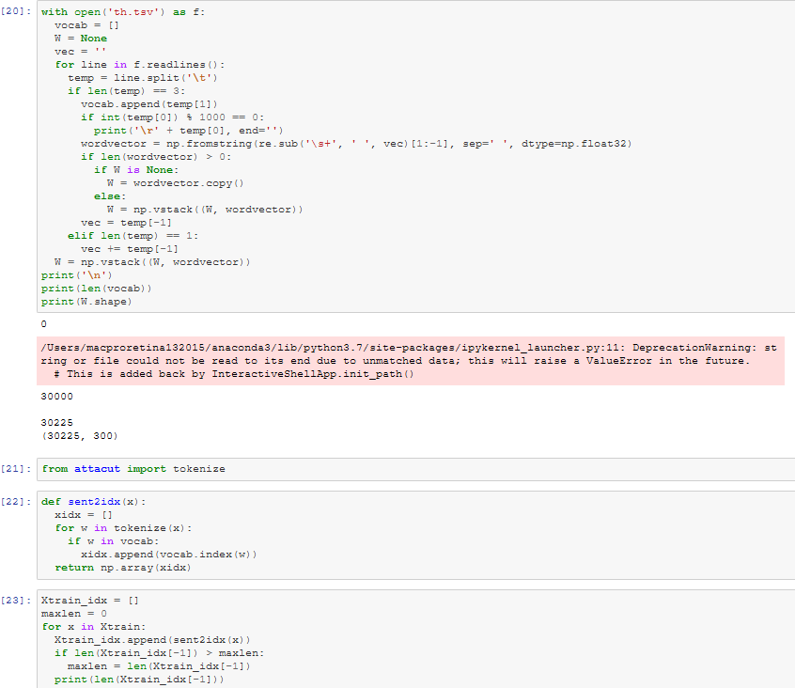

Slide 12
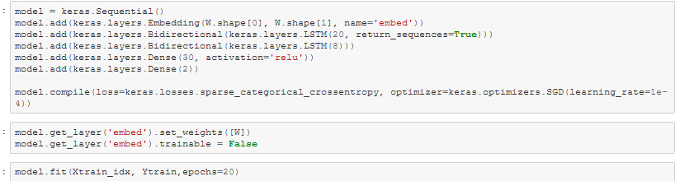

Slide 13
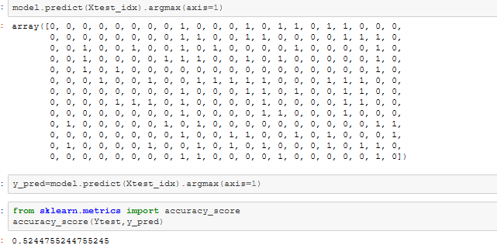

Slide 14
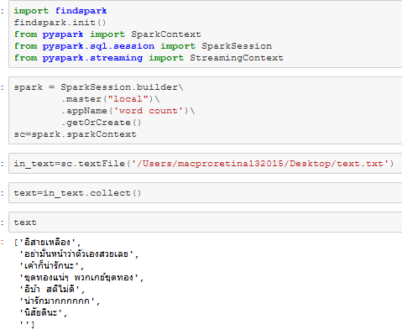
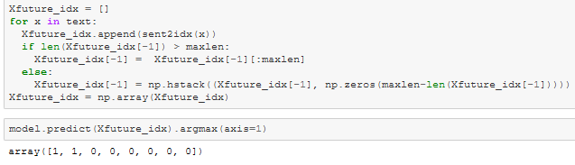
USE Pyspark

