Slide 2
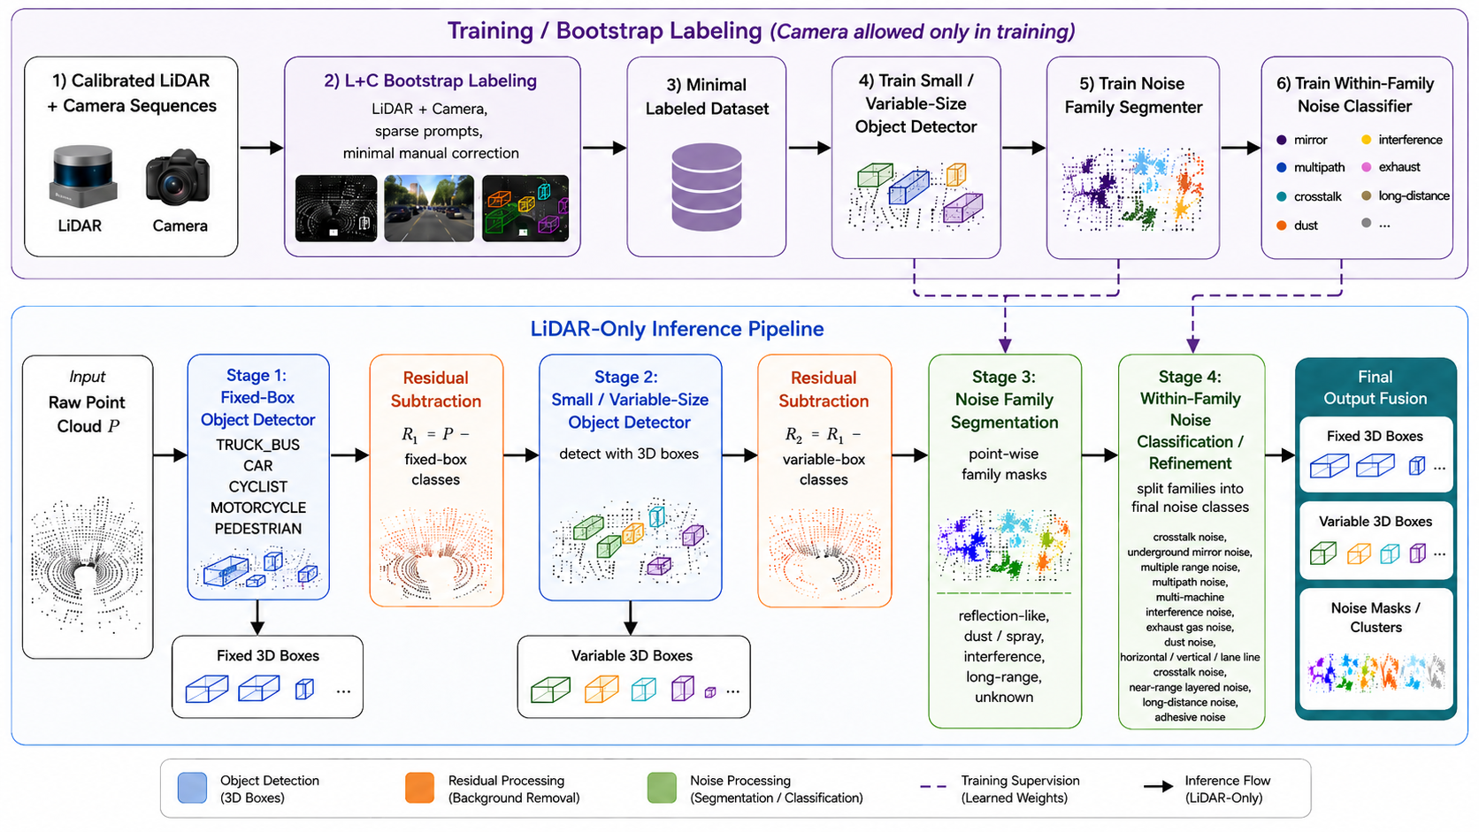
Draft of architecture
Notes:
Draft Pipeline Architecture
Since no labeled training dataset is available, the goal is to build a semi-automatic labeling pipeline with minimal manual correction.
During label generation, we use calibrated LiDAR and camera sequences. The final model must run on LiDAR only.
The main target is noise segmentation. To simplify it, we first remove explained physical objects from the point cloud:
fixed-size objects: cars, trucks/buses, pedestrians, cyclists, motorcycles;
variable-size objects: traffic signs, cones, roadblocks, tires, road studs, bars.
Noise segmentation is then applied to the residual point cloud, reducing confusion between real objects and LiDAR artifacts.

Slide 3
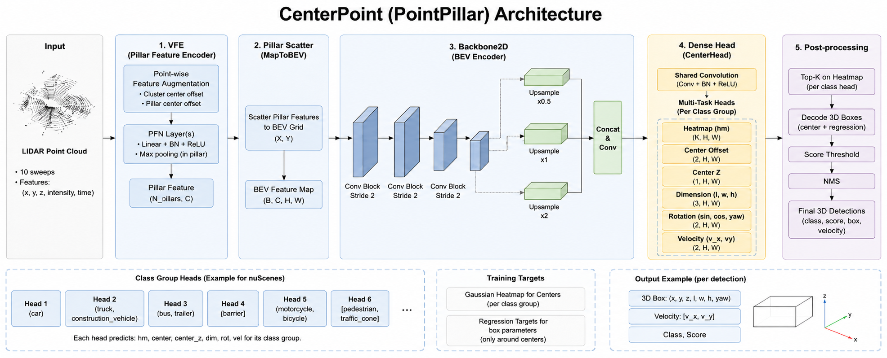
VRU Detection with Fixed-Size Boxes
Figure adapted from : Lang et al., PointPillars: Fast Encoders for Object Detection from Point Clouds, arXiv:1812.05784, 2018. DOI: 10.48550/arXiv.1812.05784.
Notes:
For VRU segmentation, we use a baseline CenterPoint model with a PointPillar encoder trained on the nuScenes dataset.
1. VFE / Pillar Feature Encoder:
Converts raw LiDAR points into pillar-wise features. For each point, the encoder augments the input with geometric offsets, such as the offset from the mean point inside the pillar and the offset from the pillar center.
2. Pillar Scatter:
Projects sparse pillar features onto a dense BEV feature map.
3. 2D BEV Backbone:
Processes the BEV feature map with convolutional blocks to extract multi-scale spatial features and increase the receptive field.
4. Dense Head / CenterHead:
Predicts object-center heatmaps and regression maps for box parameters: center offset, height, size, rotation, and velocity.
5. Post-processing:
Decodes the predicted centers and regression outputs into final 3D detections, followed by score thresholding and NMS(Non-Maximum Suppression – preprocessing that remove box dupl).

Slide 4
Results on our data
FIG

Slide 5
Results on our data
FIG

Slide 6
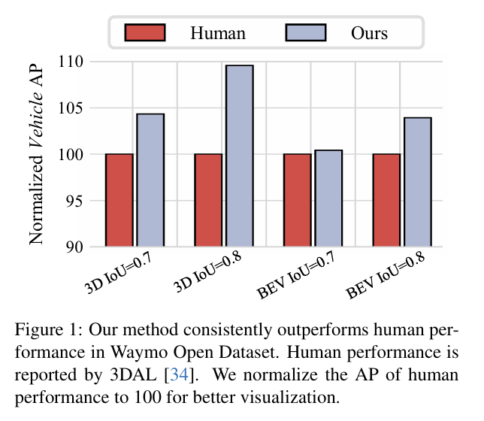
Planned Improvement: Offline LiDAR 3D Detection
Frame-level detectors may miss objects in sparse or occluded frames.
CTRL proposes an offline, track-centric detection strategy: once an object is confidently detected, temporal context is used to recover missed boxes and refine detections across the sequence.
This can improve VRU recall and produce more stable object boxes before downstream noise segmentation.
Figure adapted from: Fan et al., Once Detected, Never Lost: Surpassing Human Performance in Offline LiDAR based 3D Object Detection, arXiv:2304.12315, 2023. DOI: 10.48550/arXiv.2304.12315.
Notes:
This slide shows the first planned improvement for fixed-size object detection.
Our current baseline uses frame-level LiDAR detectors such as CenterPoint or PointPillars. These models can miss objects in difficult frames, especially VRUs with few points or partial occlusion.
To improve this, we plan to investigate a CTRL-like offline detector. It uses the full temporal sequence: initial detections are linked into tracks, and bidirectional temporal context helps recover missed boxes and refine detections.
This should improve VRU recall and produce cleaner residual point clouds for downstream noise segmentation.

Slide 7
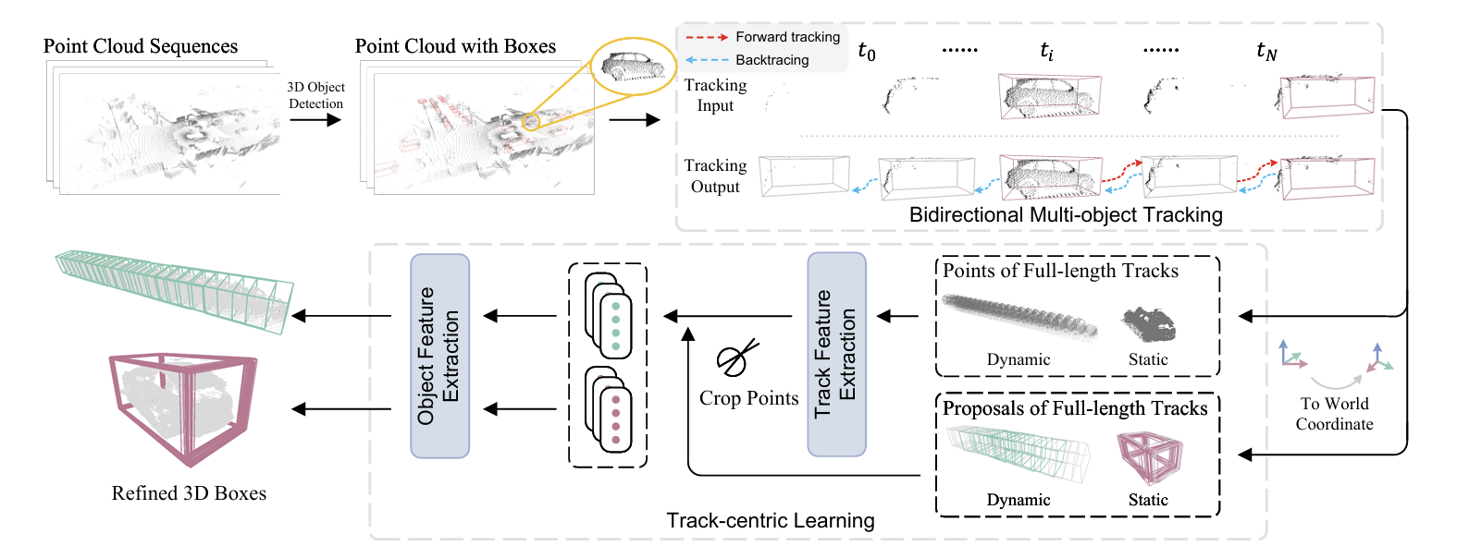
CTRL-like Offline Detector: Once Detected, Never Lost
CTRL uses a base detector to generate initial boxes, links them into tracks with bidirectional tracking, and refines them using track-centric learning.
Figure adapted from: Fan et al., Once Detected, Never Lost: Surpassing Human Performance in Offline LiDAR based 3D Object Detection, arXiv:2304.12315, 2023. DOI: 10.48550/arXiv.2304.12315.
Notes:
This slide shows the overall CTRL architecture.
CTRL first uses a base 3D detector to generate initial detections. These detections are then linked into object tracks. The important part is bidirectional tracking: the method extends tracks both forward and backward in time, so an object detected in one frame can be recovered in neighboring frames.
After that, CTRL applies track-centric refinement. Instead of refining boxes frame by frame, it uses the full object track as temporal context. This helps recover missed detections and makes the final boxes more stable across the sequence.

Slide 8
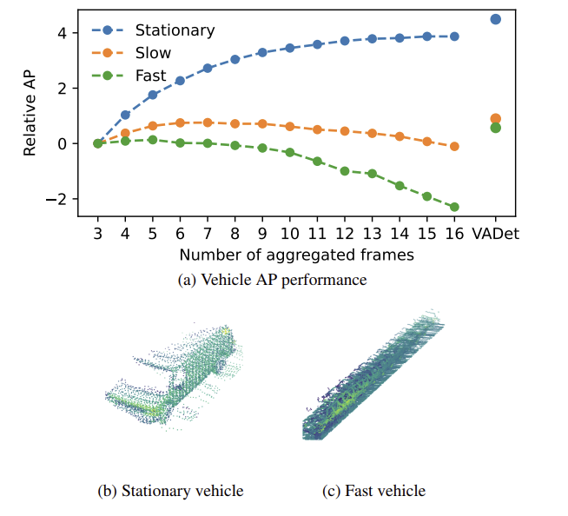
Planned Improvement: Variable Temporal Aggregation
Standard multi-frame LiDAR detectors use the same temporal window for all objects
However, different objects require different amounts of temporal context:
• sparse / distant objects may benefit from more frames
• fast-moving objects may be degraded by excessive aggregation
VADet proposes object-level variable aggregation instead of fixed scene-level aggregation.
Fixed aggregation has different effects for stationary, slow, and fast objects. VADet selects the temporal window adaptively.
Figure adapted from: Huang et al., VADet: Multi-frame LiDAR 3D Object Detection using Variable Aggregation, arXiv:2411.13186, 2024. DOI: 10.48550/arXiv.2411.13186.
Notes:
This slide introduces the motivation behind VADet.
Most multi-frame LiDAR detectors aggregate a fixed number of past frames for the whole scene. However, this is not always optimal. A distant or sparse object may need more frames to collect enough points, while a fast-moving object can become blurred if too many frames are aggregated.
VADet addresses this by choosing the aggregation window adaptively for each object, instead of using the same number of frames everywhere.

Slide 9
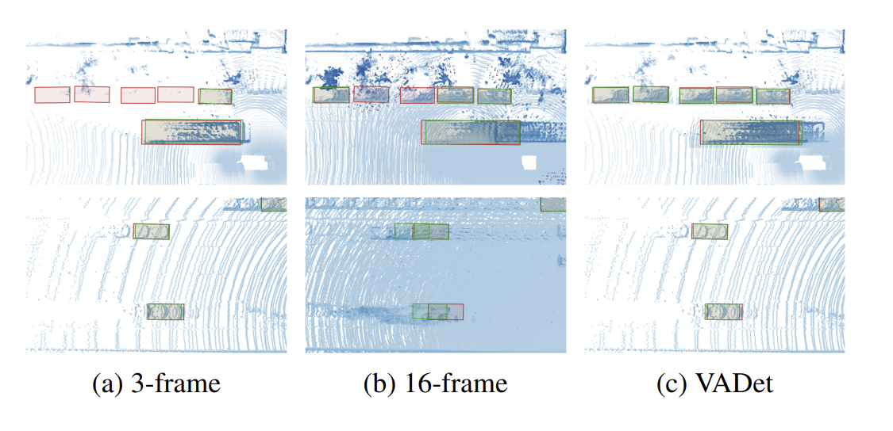
VADet: Object-Level Adaptive Aggregation
VADet performs aggregation at the object level. Instead of aggregating the full scene with a fixed number of frames, it estimates object properties and selects a suitable temporal window for each object. The aggregated object-level features are then passed to the 3D detector.
Qualitative results comparing 3-frame and 16-frame fixed aggregation with VADet. Red and green bounding boxes are ground truth and predictions, respectively
Figure adapted from: Huang et al., VADet: Multi-frame LiDAR 3D Object Detection using Variable Aggregation, arXiv:2411.13186, 2024. DOI: 10.48550/arXiv.2411.13186.
Notes:
This slide shows the VADet framework.
The key idea is to move from scene-level fixed aggregation to object-level adaptive aggregation. VADet estimates object-specific properties, such as speed and point density, and then selects how many frames should be used for that object.
This makes the detector more flexible: it can use more temporal context when the object is sparse, and avoid excessive aggregation when the object is fast or already well observed.

Slide 10
Proposed Integration: VADet-style Aggregation before CTRL-like Refinement
VADet and CTRL-like detection are complementary.
VADet can improve initial detections by selecting an adaptive temporal window per object.
CTRL-like offline refinement can then link detections into tracks, recover missed boxes, and improve temporal consistency.
Expected benefit:
better VRU recall and cleaner residual point clouds before noise segmentation.

Slide 11
Variable-Size Object Detection
TABEL
Goal: create a training dataset with minimal manual labeling.
During dataset generation, both camera and LiDAR are available.
The final inference model must use LiDAR only.
Proposed bootstrap labeling:
• use SAM3 / SAM4D-like models to segment objects in camera frames
• project masks into LiDAR using C-L calibration
• extract corresponding 3D point clusters
• fit variable-size 3D boxes
• manually correct only uncertain cases
Notes:
For variable-size objects, we want to avoid fully manual annotation.
The idea is to use camera and LiDAR together only during dataset creation. SAM3 or SAM4D-like models can segment objects in the image, and then we transfer these masks into the LiDAR point cloud using calibration.
After that, we extract object point clusters, fit variable-size 3D boxes, and manually correct only low-confidence cases. The final trained model will still be LiDAR-only.

Slide 12
Some FIGS from SAM4D and maybe SAM3

Slide 13
Camera-LiDAR Calibration for Label Transfer
If calibration is inaccurate:
• image masks are projected to wrong LiDAR points
• object clusters become noisy
• variable-size boxes become unreliable
Current calibration plan:
• use targetless automatic calibration as a first step (SuperGlue Scene-based methods)
• inspect projection quality visually
Notes:
The quality of pseudo-labels strongly depends on Camera–LiDAR calibration.
If the calibration is slightly wrong, image masks will be transferred to incorrect LiDAR points, and this will create noisy training labels.
So before generating labels, we need to validate extrinsic calibration, camera intrinsics, and time synchronization. Targetless calibration can be used as a first step, but if the projection quality is not good enough, manual or target-based refinement may be required.
Provide some frame from SuperGlue in blanding mode.
– problems
maybe need camera recalibrate ( create new intrinsic )
If it’s available maybe need manual with data extrinsic calibrate
maybe problem with time sinc not with calibration, but in another dataset for example Waymo-4DSeg not a problem with calibaration L+C somehowe they overcome this

Slide 14
Camera-LiDAR Calibration for Label Transfer
SuperGlue is scene-base method was used for calibration, it’s provide better result then, manual calibration.
FIG
Notes:
Maybe using target base method provide better calibration

Slide 15
Training a LiDAR-only Model from Generated Labels
Generated pseudo-labels will be used to train a LiDAR-only model. Possible architecture: • point / voxel segmentation backbone ( like PTv3 or LitePT) • semantic head for variable-size object classes • instance clustering over predicted object points • simple adaptive 3D box fitting
Why segmentation-based detection? Variable-size objects are often small, thin, sparse, and geometrically diverse. Output: • class label • variable-size 3D box • confidence score
Notes:
After pseudo-label generation and manual correction, we use the resulting dataset to train a LiDAR-only model.
For these classes, a standard fixed-size detector may not be optimal, because objects like cones, signs, bars, road studs, and tires have different sizes and sparse LiDAR returns.
A better option may be a segmentation-based pipeline: first detect object points, then cluster them into instances, and finally fit adaptive 3D boxes. This model will later remove real small objects before the noise segmentation stage.

Slide 16
Noise Segmentation: Residual Cloud Processing
Input: residual point cloud after removing known physical objects.
Goal: detect LiDAR artifacts that do not correspond to real objects.
Proposed first step:
• remove fixed-size objects and variable-size objects
• keep unexplained residual points
• extract noise candidates using simple geometric and temporal cues
• segment candidates into coarse noise families
Noise families:
• crosstalk / interference
• reflection / range ambiguity
• dust / exhaust
• distance / layered artifacts
• adhesive(mix pixel ?) / attached noise
• unknown artifact
PUT A TABLE WITH CLASSES HERE
Notes:
For noise segmentation, we first work with the residual point cloud. This means that fixed-size objects and variable-size physical objects are already removed.
The remaining points are not automatically noise, but they are much easier to analyze. We then extract noise candidates using simple cues such as local density, range-image structure, temporal instability, distance to objects, and intensity.
Instead of directly predicting all 14 noise classes, we first segment points into broader noise families. This should make the problem more stable and reduce confusion between similar noise types.

Slide 17
From Noise Families to Final Noise Classes
Direct 14-class noise segmentation may be challenging due to class similarity and limited labeled data. Proposed hierarchy: 1. Family-level point segmentation 2. Cluster extraction inside each family 3. Cluster-level classification into final noise classes Model idea: • point / voxel segmentation backbone for coarse families (PTv3, LitePT) • connected components or DBSCAN for clustering • cluster features for fine-grained classification Cluster features: • shape and size • local density • intensity statistics • range and ring pattern • temporal stability • distance to objects / ground
Notes:
At this stage, we do not yet know whether direct 14-class noise segmentation will work well. However, because some noise classes are visually similar and we have limited labeled data, we propose to start with a hierarchical approach.
First, the model predicts coarse noise families. Then, points inside each family are clustered, and each cluster is classified into one of the final noise classes.
This gives us a more controllable baseline and allows manual correction of uncertain clusters.

