Slide 1
Kyk Paint
Ultimate Surveillance in a Can

Slide 2
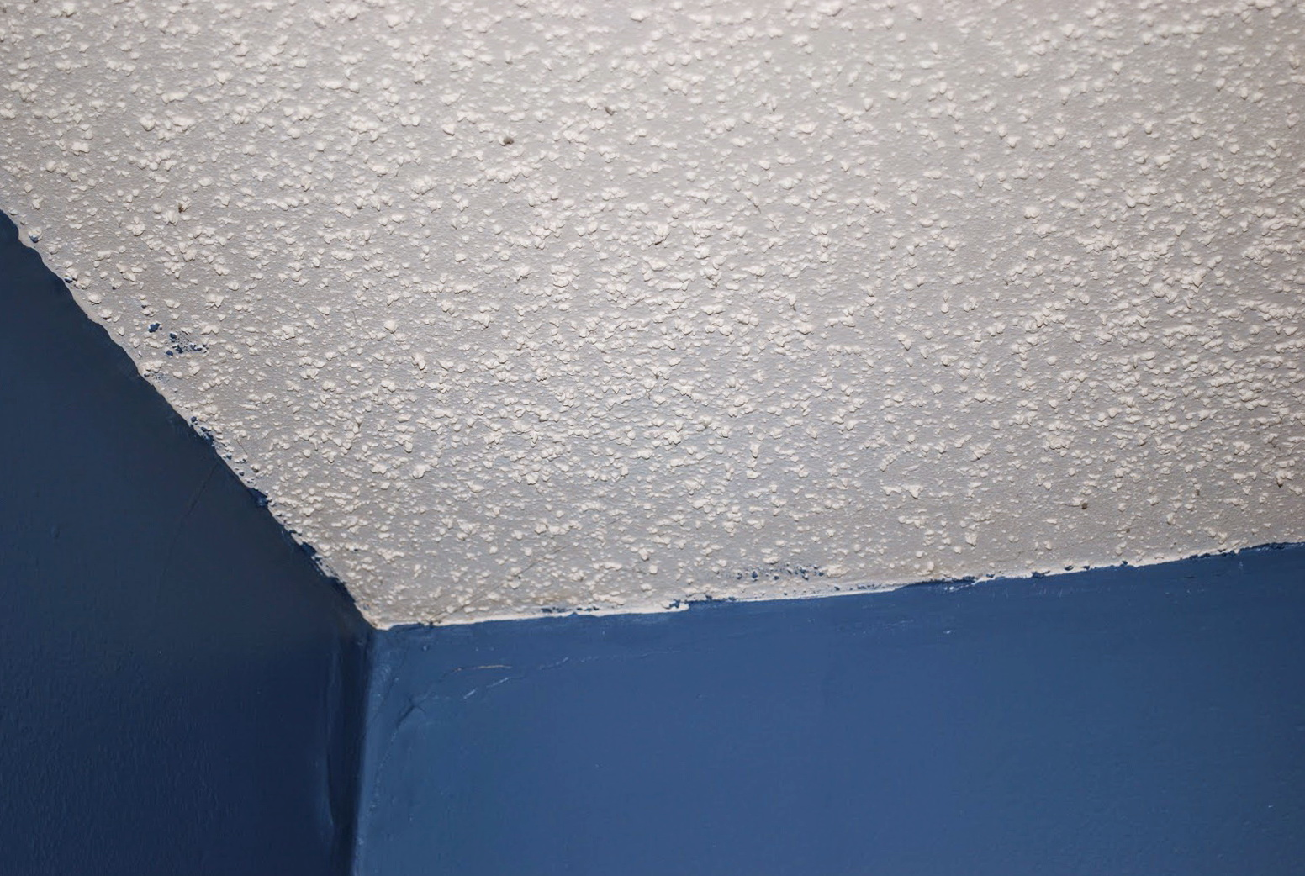

Slide 3
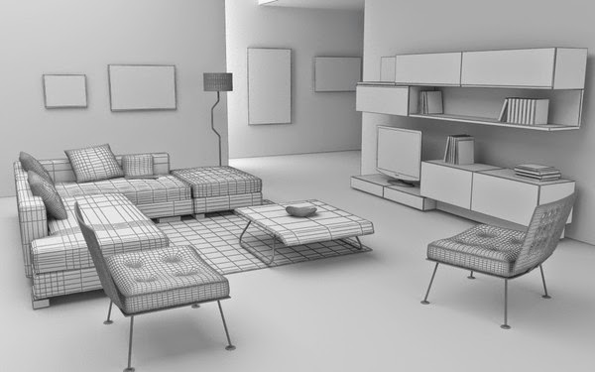

Slide 4
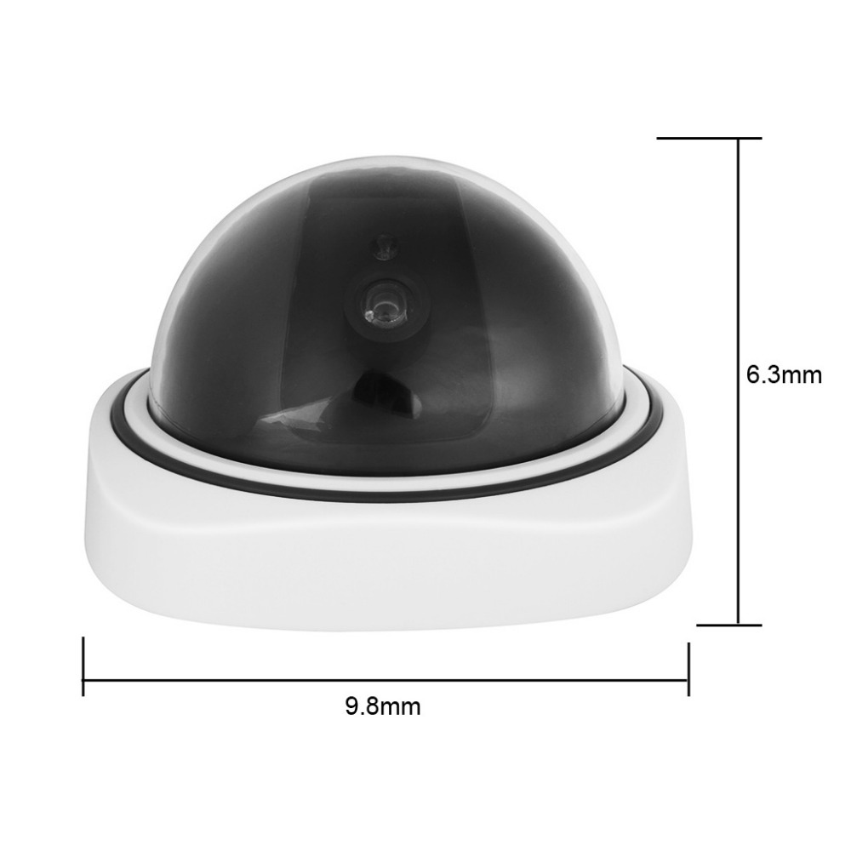

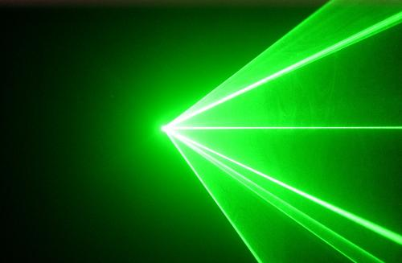
wireless power provided by base station
Superposition of low energy
10 ZHz radiation transmits data to camera
focused ultraviolet electromagnetic radiation emitters
30 EHz radiation shown in visible spectrum

Slide 5


