Slide 1
OrionFleet Logistics
Business Analytics & Profit Leakage Assessment
Prepared for: Executive Leadership Team Deliverable Package: Code, Dashboard, Analysis Report & Insights

Slide 2
1. Financial Performance & Key Metrics
• Total Net Billed Revenue: ₹4,13,47,142.30 across 2,200 transactions.
• Total Profit Margin Generated: ₹1,96,93,134.06 (~47.6% overall gross margin).
• Uncollected Cash Exposure: ₹88,41,780.27 (21.38% of total revenue tied up in pending, failed, or refunded states).
• Customer Base Breakdown: 1,001 total accounts (813 Active, 128 At Risk, 60 Churned).
• Annual Recurring Revenue Exposure: Over ₹1.16 Crores in contract value associated with At Risk or Churned accounts.

Slide 3
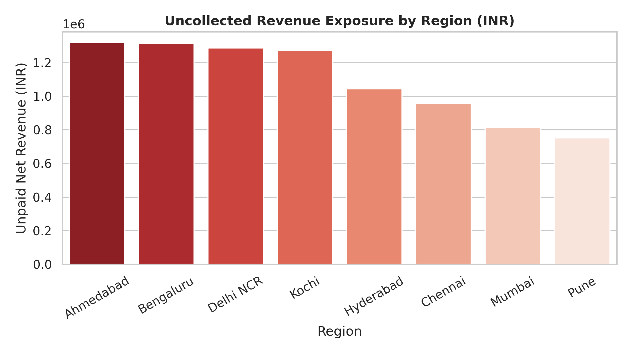
2. Uncollected Revenue & Regional Risk Areas
• Key Uncollected Metrics:
- Failed Payments: ₹32.01 Lakhs
- Pending Transactions: ₹43.45 Lakhs
- Refunded Revenue: ₹12.95 Lakhs
• Top Risk Regions:
- Ahmedabad: ₹13.17 Lakhs unpaid
- Bengaluru: ₹13.14 Lakhs unpaid
- Delhi NCR: ₹12.86 Lakhs unpaid
• Strategic Action:
Establish regional collection protocols and automated payment retry mechanism.

Slide 4
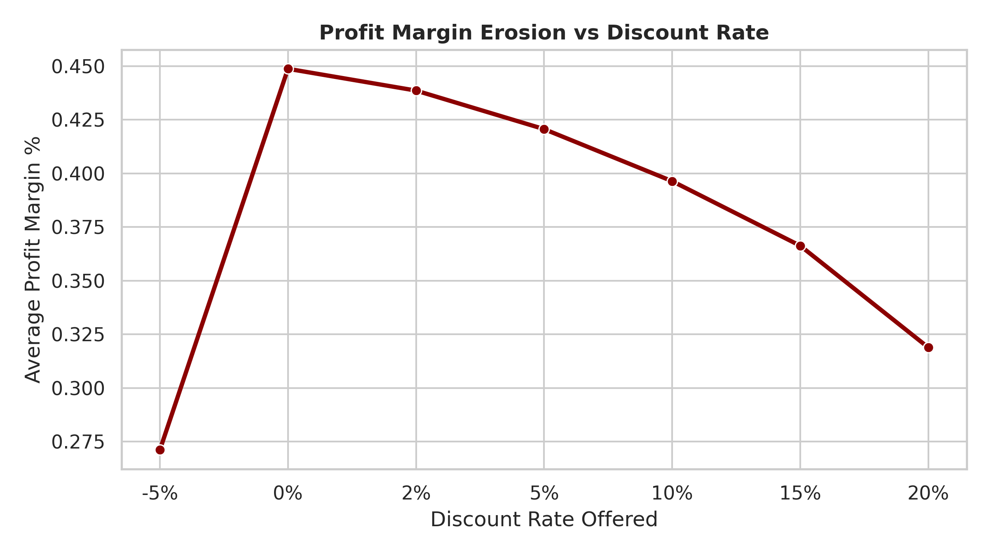
3. Discount Over-Extension & Margin Erosion
• Revenue Lost to Discounts: ₹19,58,612.30
• Profit Margin Progression:
- 0% Discount: 44.8% Margin
- 10% Discount: 39.6% Margin
- 20% Discount: 31.8% Margin
• Negative-Margin Deals:
- Exactly 67 transactions were executed at a net financial loss (₹36,105.26 direct loss).
- Cause: 100% of negative sales occurred at 15% or 20% discount rates.
• Recommendation: Enforce a strict 10% discount cap across all sales channels.

Slide 5
4. Evidence-Based Strategic Recommendations
1. Cap Maximum Discounts at 10%:
Eliminate sales rep authorization for 15%+ discounts to prevent negative-margin sales.
2. Automate Credit & Payment Recovery:
Implement automated payment retry workflows and prioritize collection teams in Ahmedabad and Bengaluru.
3. Proactive Account Health Interventions:
Mobilize Customer Success teams for the 128 'At Risk' clients to protect ₹78.3 Lakhs in contract value.
4. Operational Support Streamlining:
Reduce ticket resolution times for high-priority installation issues to safeguard client satisfaction.

