Slide 1

Lead_Scoring_Case_Study
By
Thejus VS and PremKumar

Slide 2
Problem Statement
X Education is an organization which provides online course to Industry professionals. The company markets its Courses on several websites and search engines like Google.
X Education wants to select most promising leads that can be converted to paying customers.
Although X education gets a lot of leads, its lead conversion rate is very poor, where in the company wants a higher lead conversion. Leads come through numerous mode like email, advertisements on websites, google search etc.
The company has had 30% conversion rate through the whole process of turning lead into customers by approaching those leads which are to be found having interest in taking the course. The implementation process of lead generating are not efficient in helping conversion.

Slide 3
Business Goal
The company requires a model to be built for selecting most promising leads.
Lead score to be given to each leads such that it indicates how promising the lead could be. The higher the lead score
the more promising the lead to get converted, the lower it is the lesser the chances of conversion
The model to be built in lead conversion rate around 80% or more.

Slide 4
Strategy
Import data
Data Cleaning and Preparation for further analysis
Exploratory data analysis for figuring out most helpful attributes for conversion
Scaling features Preparing Categorical and Numerical variable analysis
Prepare the data for model building
KDE Mean square transformation
Finding Outliers
Dummy variable Creation
Test the model on train set
Looking at the Correlations
Model Building
Model Evaluation
Precision-Recall View
Precision and and Recall Trade Off
Making Prediction on the Test set
Summary

Slide 5
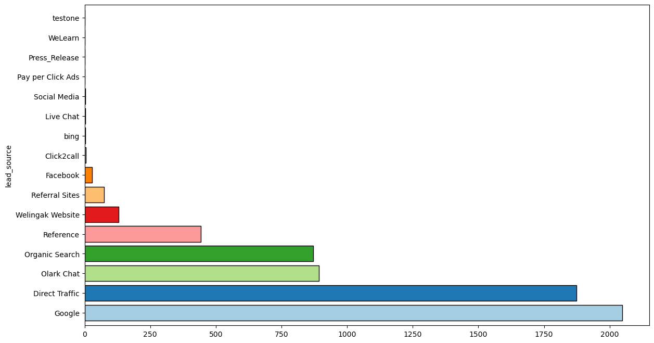
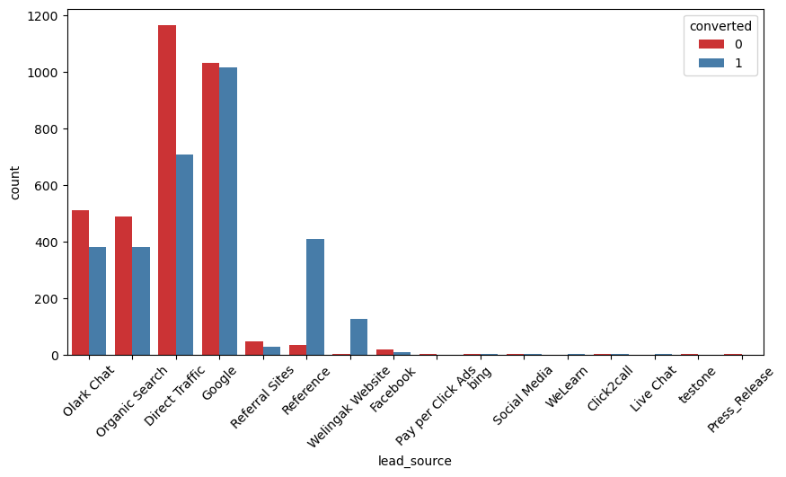
Exploratory Data Analysis
Lead Source VS Converted
Google search has had high conversion compared to other modes. Behind that Welligak website Direct Traffic and Olark chat modes are also in contribution.

Slide 6
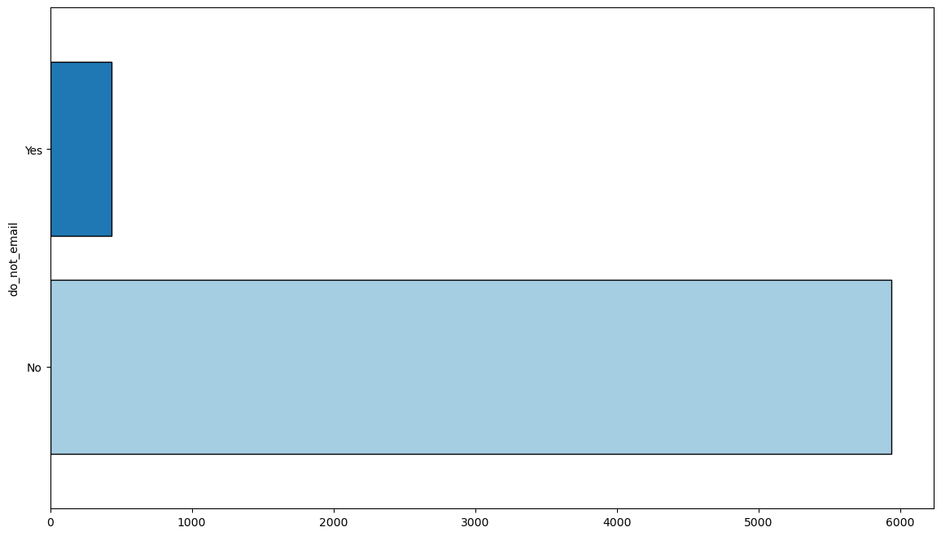
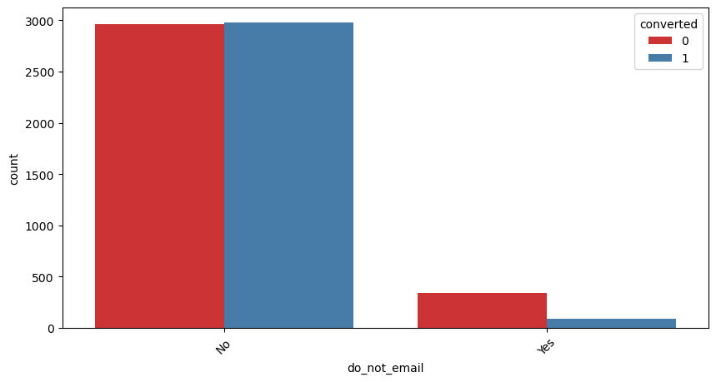
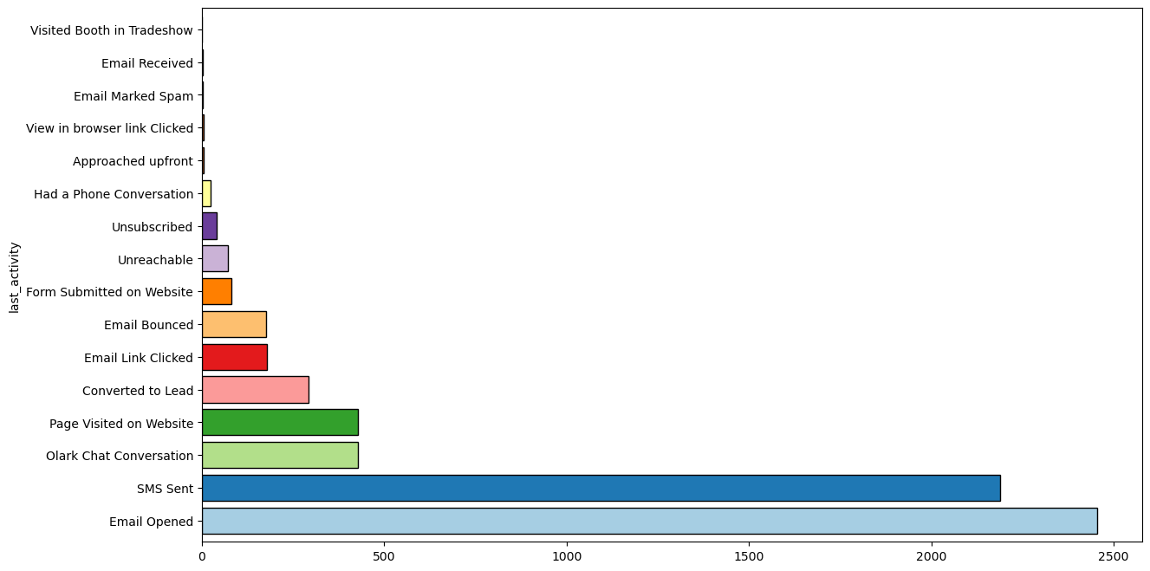
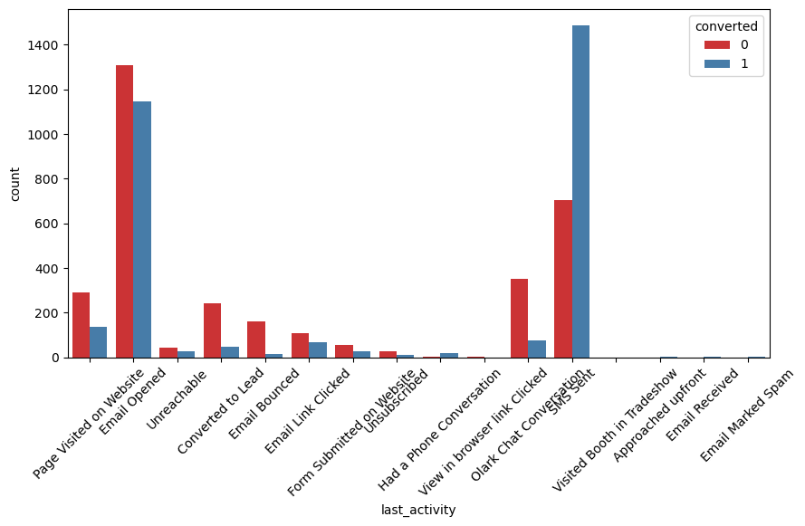
Do Not Email VS Converted
Most leads do not prefer to be informed through Email modes.
Last activity VS Converted
The chance are in higher for conversion to those Email opened and SMS sent.

Slide 7
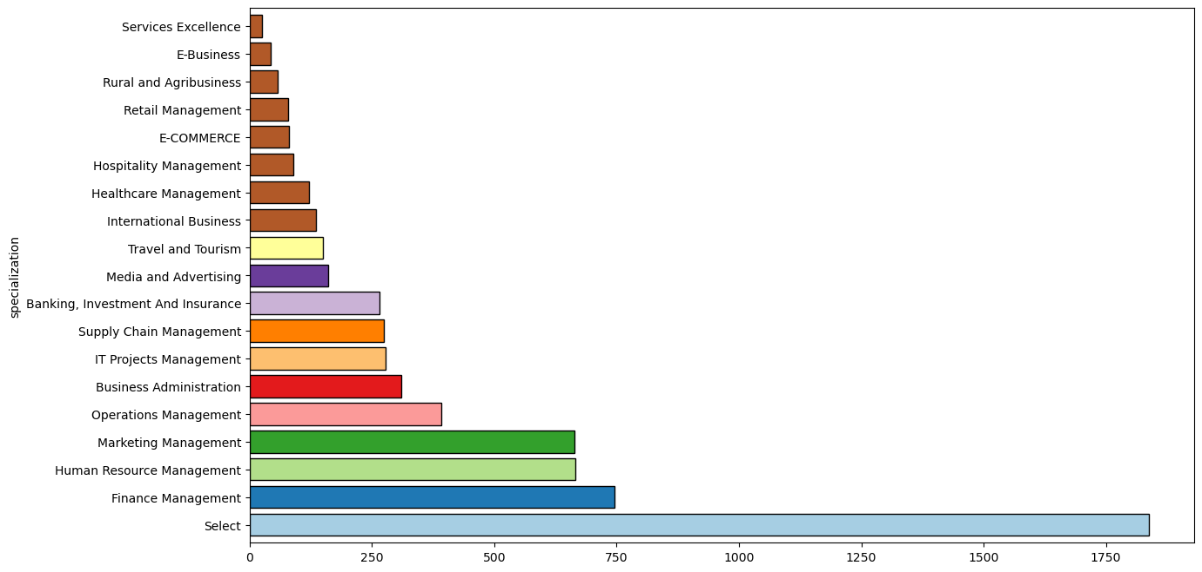
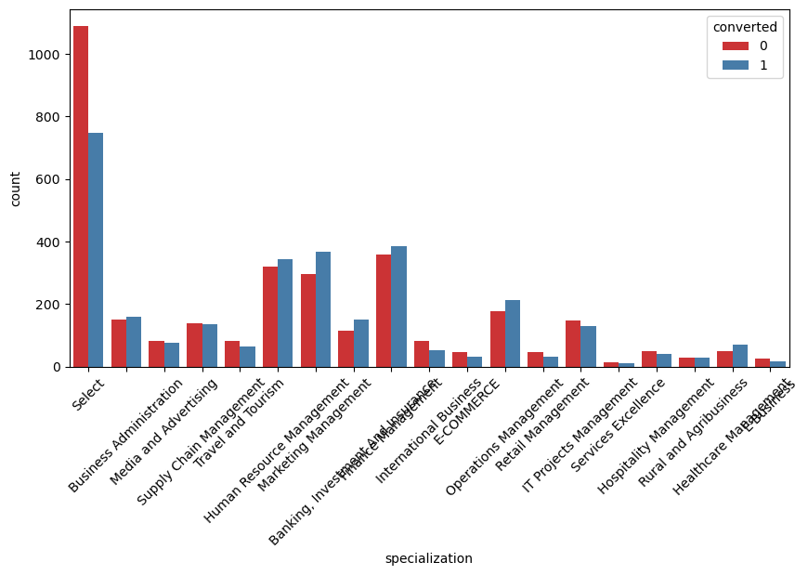
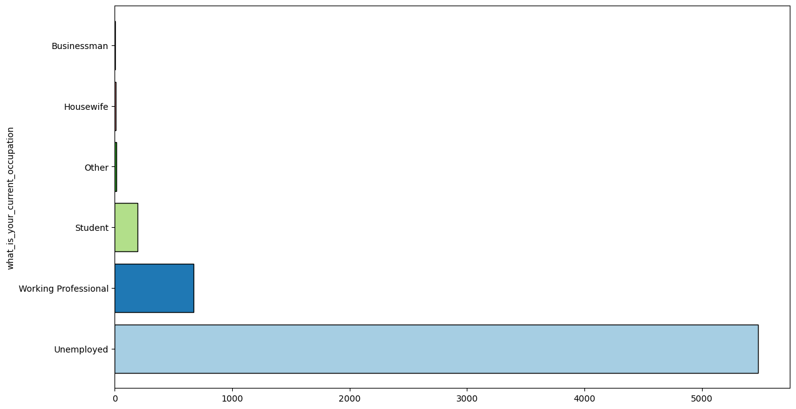
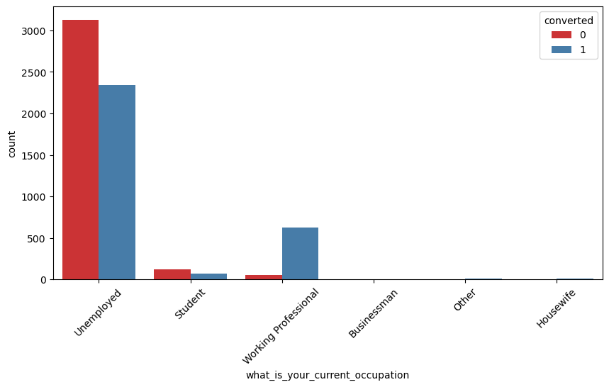
Specialization VS Converted
Most leads prefers Finance Management , Human Resource Management and Marketing Management
What is your current Occupation VS Converted
Those are Working professional having higher conversion that rest of the categories. Unemployed having comparatively more Conversion and leads that off Students.

Slide 8
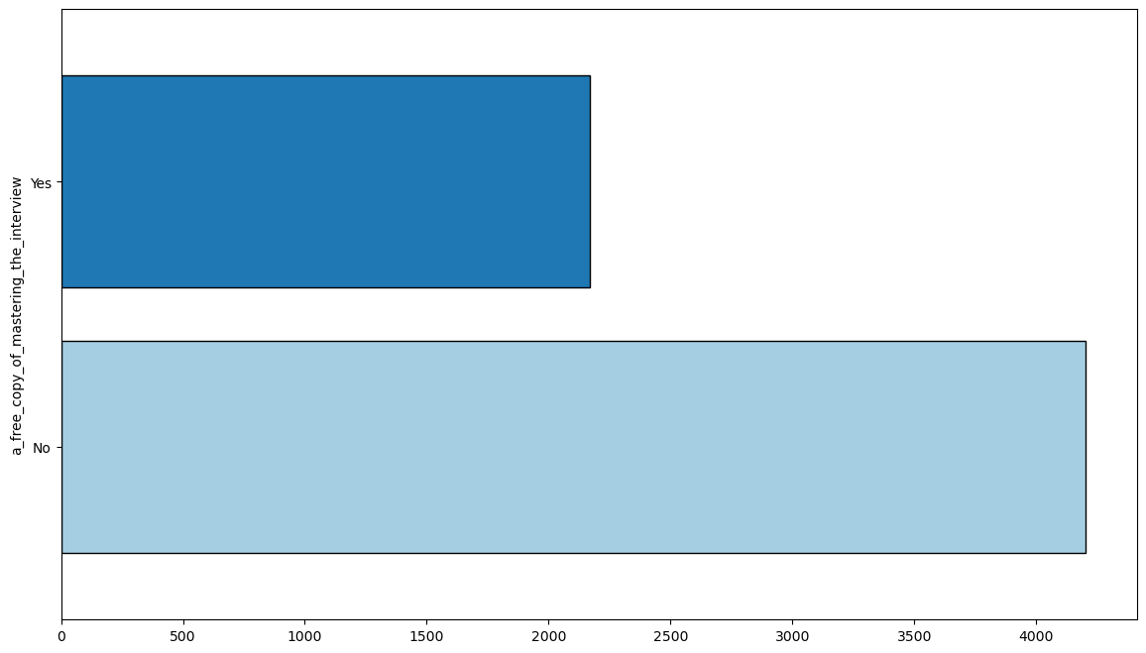
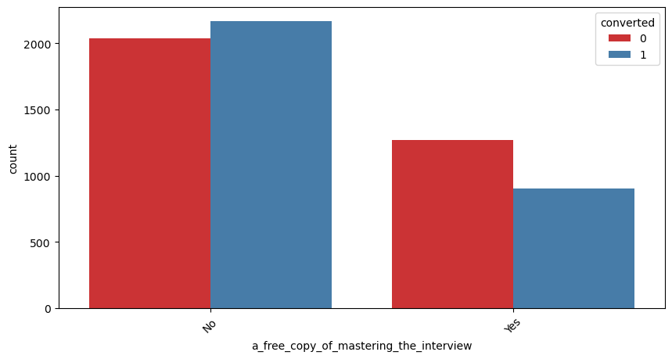
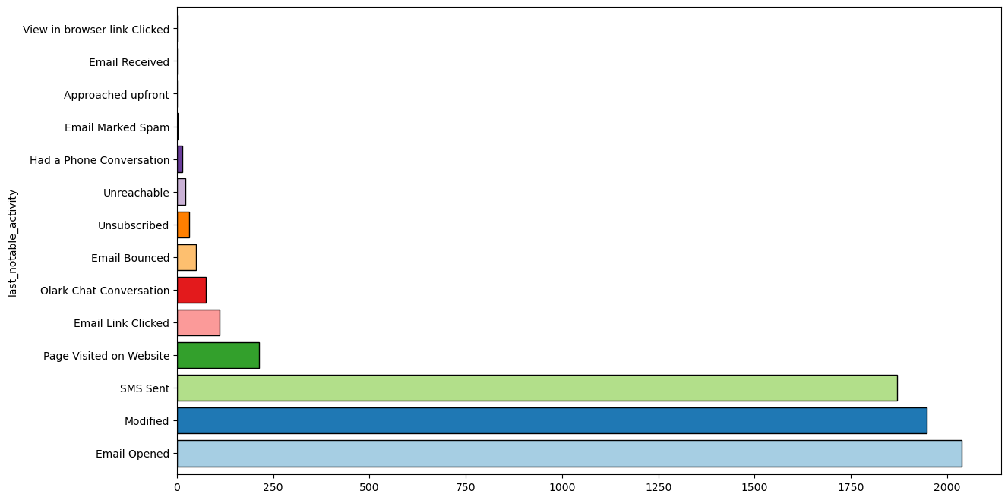
A Free Copy Of Mastering The Interview VS Converted
A free copy of mastering the interview had lesser preference and not shows as important to a lead conversion.
The Last Notable activity VS Converted
The people who opened Email , modified and SMS sent having
Higher chance of being a promising lead.

Slide 9
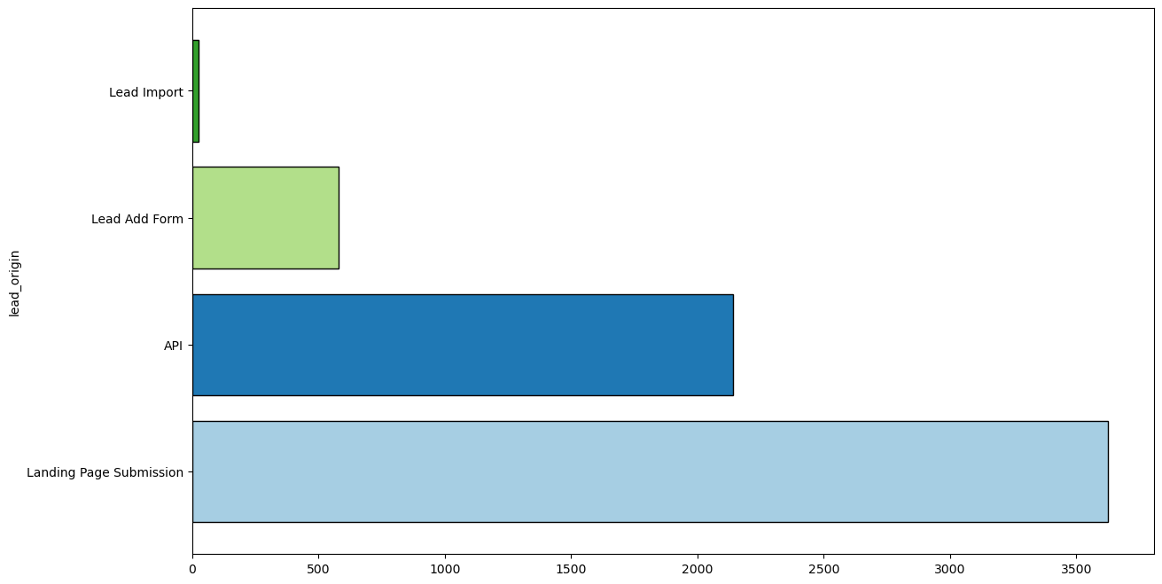
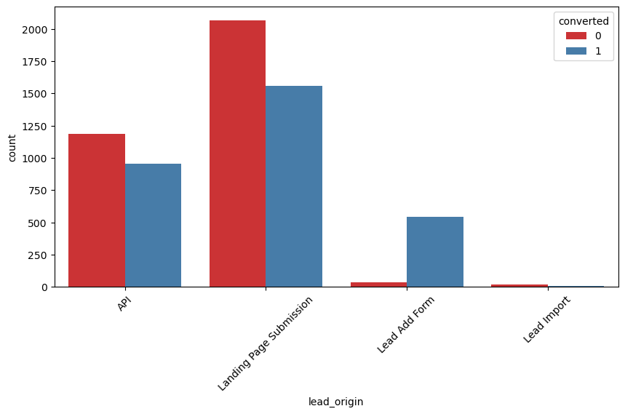
Lead Origin VS Converted The conversion rate is high in Lead Add form, whereas other likes, submission page and API have more numbers but also, they have less attractive say ‘NO’ more number of times

Slide 10
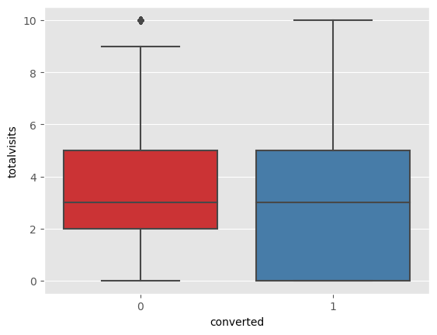
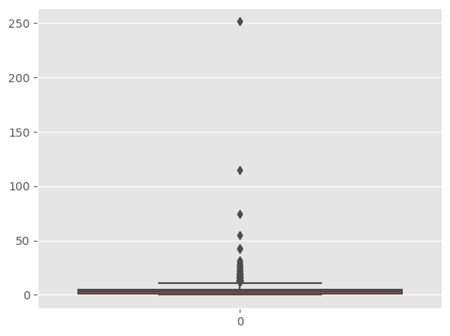
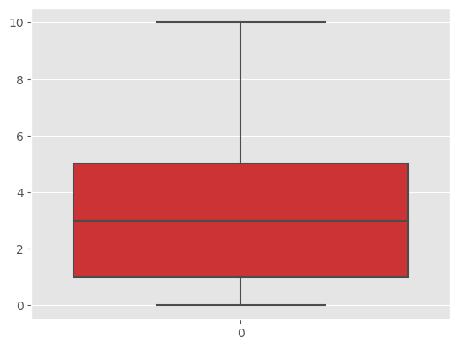
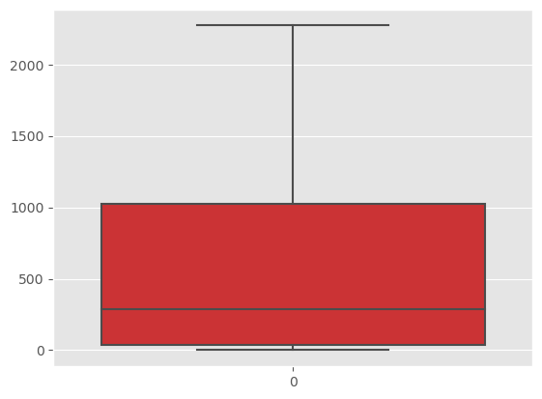
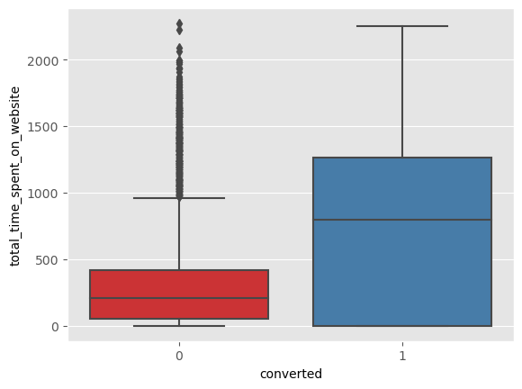
Outlier Treatment
Total Visit
Total time spent on website

Slide 11
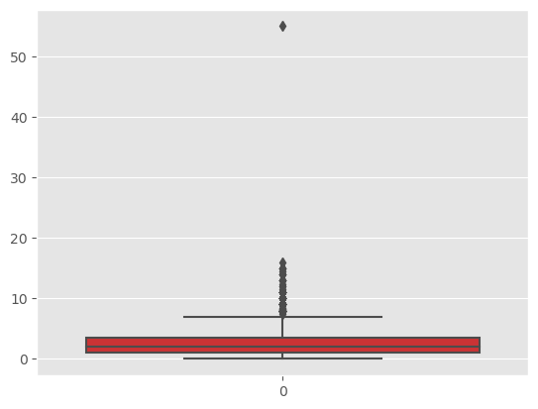
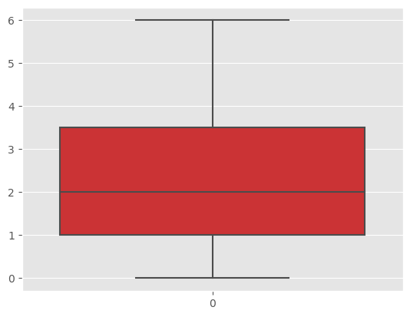
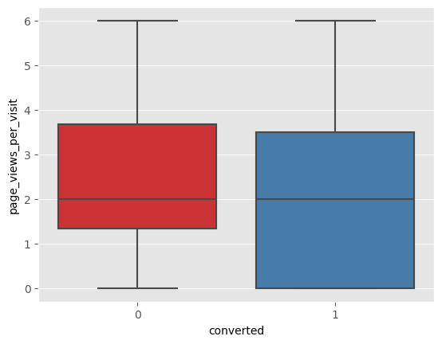
The plots represent before and after outliers' treatment for each of the variables totalvisit, total time spend on website and page views per visit against convert variable . Though outliers in Total time spend on website shows valid values, this will misclassify the outcomes consequently create problems when making inference with wrong model. Logestic regression heavily influenced by outliers. Those data having heavily with outliers cap it to 95% value of analysis
Page views per visit

Slide 12
Model Building
Splitting Into Train and Test Set Data.
Scale variables in train set.
Build the first model.
USE RFE to eliminate less relevant variables.
Build next model.
Eliminate variables for all the existing columns.
Predict using train set.
Create Confusion metrics
Precision and recall analysis on test prediction.

Slide 13
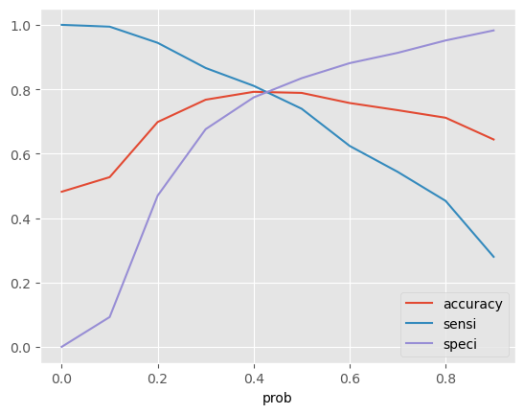
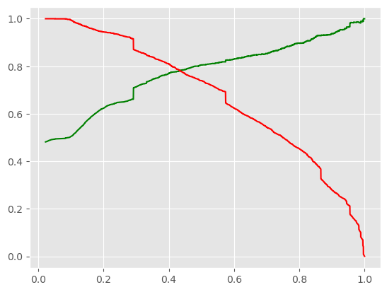
Model Evaluation
Accuracy Sensitivity and Specificity
79.00 % Accuracy
79.43% Sensitivity
78.67% Specificity
can see that around 0.42, you get the optimal values of the three metrics. So , choose 0.42 as our cutoff now.
1819 493
442 1707
Precision and Recall
78.40% Precision
78.36% Recall

Slide 14
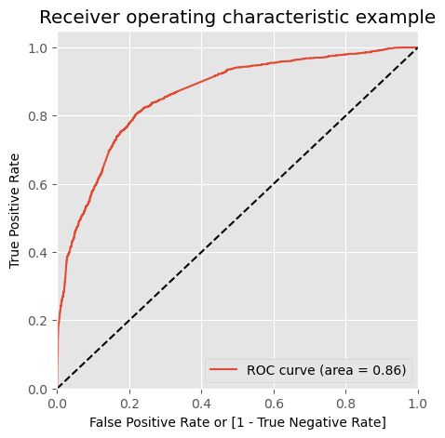
Finding Optimal Cut-Off
ROC CURVE
The area under the curve of the ROC is 0.86 which is quite good. So we seem to have a good model.

Slide 15
Conclusion
EDA:
The people spending higher time(totalvisit) than average time are promising leads ‘(Total Time Spent on Website' , 'Page Views Per Visit’ ), so targeting them and approaching them can be helpful in conversions.
Target those from google ,Direct traffic and Olark chat, Organic search are great internet tools to get promising lead contact.
SMS messages have a high impact on lead conversion.
Working professional conversion is significantly higher as comparing to students. Whereas unemployed people as they prefer to take course but less chances and slighter chance to become a prospective lead.
Need to follow up those prospective leads who come through Lead Add form and consider those landed on the submission page and API.
Logistic Regression Model:
The model shows high close to 79% accuracy.
The Threshold has been selected from Accuracy, Sensitivity, Specificity measures and precision, recall curves.
The model shows 78.40% Sensitivity and 78.80% Specificity.
The model finds promising leads and leads that have less chance of getting converted.
Overall, this model proves to be accurate.

