Slide 1
STUDENT ENROLMENT SYSTEM
NAME - T. D. R. MALLAWAARACHCHI
STUDENT NO. - E115257
REG. NO. - 00066815
BATCH - GAM/DITEC/2021-IN3-171

Slide 2
STUDENT ENROLMENT SYSTEM is an application for a small sports unit that can be used to,
Enrol new students
Calculate their monthly fees
Delete an existing student’s information
from the system.

Slide 3
This application helps staff members to manage their student’s information in a more efficient way compared to systems that are not computerized.

Slide 4
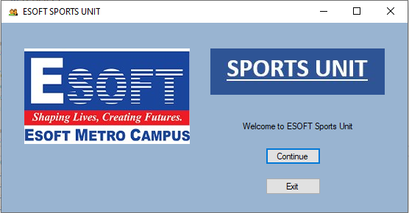
The application has a nice user interface for the home page

Slide 5
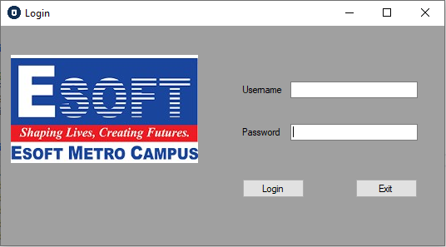
Login page

Slide 6
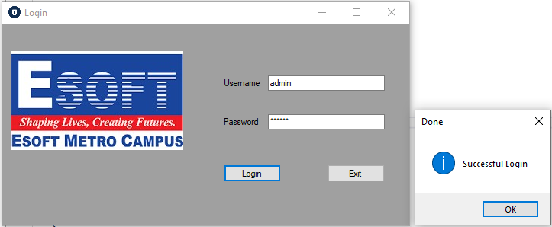
When the user successfully logged in, the system will display a message

Slide 7
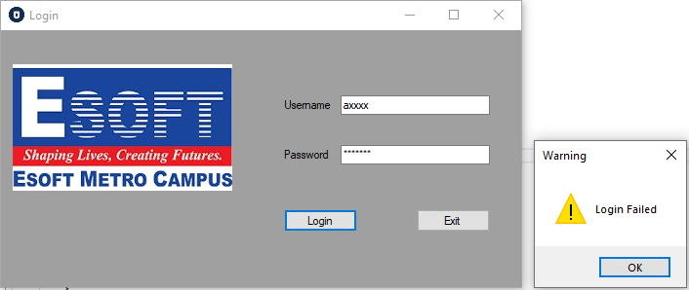
Warning message when the user enters invalid credentials

Slide 8
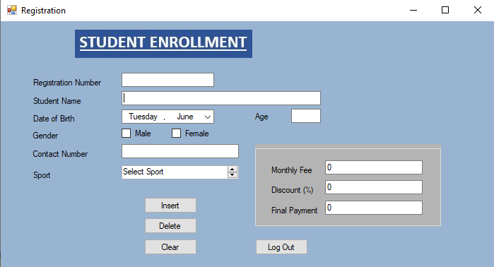
Registration number should be an integer value
If the user types an already existing registration number then the system will disable the ‘Insert’ button
‘Delete’ button will be disabled if the user enters an already existing registration number
‘Clear’ button will clear all the data displayed in the form
Registration form

Slide 9
Age will be automatically calculated when the user selects the date of birth
If the age is below 18, the system will prompt an error message when the user clicks the Insert button
Contact number cannot exceed the maximum of 10 numeric characters
Registration form

Slide 10
The monthly fee will be displayed automatically when the user selects the sport
Final payment will be calculated and displayed according to the discount entered by the user
User should complete all the data before selecting the Insert option
Registration form

Slide 11
After clicking the ‘Insert’ button, filled data will be stored in the database
‘Log out’ button will redirect user to the login page
Registration form

Slide 12
Future Enhancement
Access for the other members in the management to view sports details
Access for students to log and view their details
Edit students’ details
Summary of payments
Sending emails through the system

Slide 13
Thank You!

