Slide 1
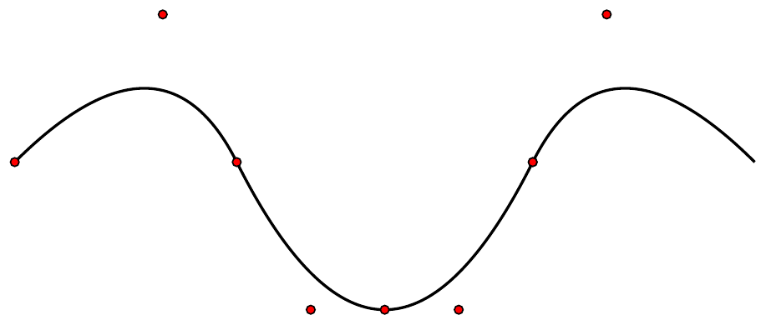
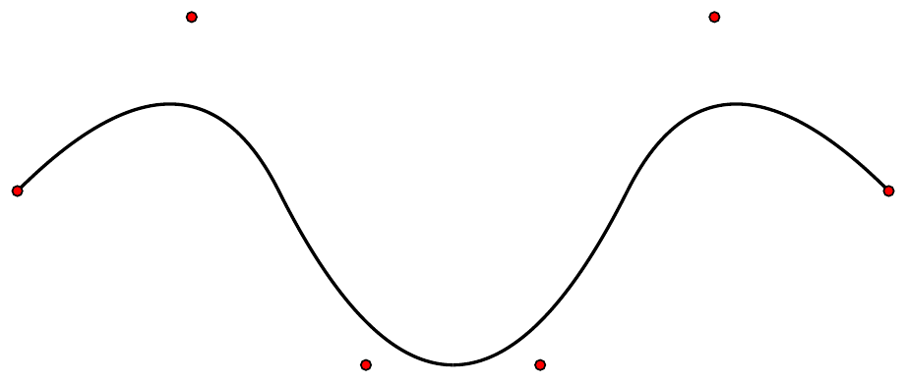
Name : Thejaka Jayasinghe
Student ID: 5225BG08
Question 1
quadratic B-spline curve
Order elevation to cubic

Slide 2
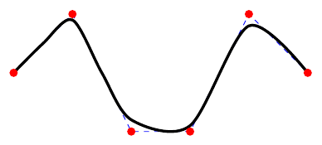
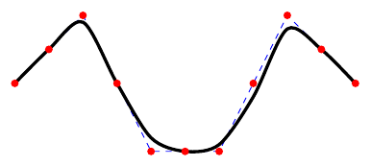
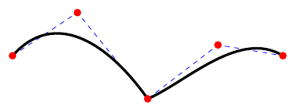
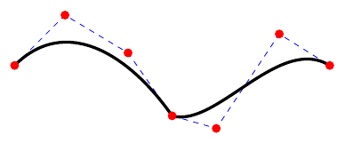
Question 2
1. Quartic Bspline curve
2. Knot refinement
3. Order reduction
Bezier extraction

