Slide 1

Life Expectancy Prediction
Tomson George (C0857730)
Praveen Mahaulpatha (C0860583)
R. B. C. M. W. Thulana Vimukthi Abeywardana (C0861333)
Big Data Fundamentals - Data Storage Networking
CBD 2214
Kritika Buttan

Slide 2
Content
Project Overview
Data Identification
Data Cleansing
Model Fitting, Prediction and Validation
Conclusion

Slide 3
1. Project Overview
Project Purpose | : Predict the life expectancy of a person, given a few parameters of their characteristics
IDE | : Jupyter Notebook
Python Version | : Python 3.9
Machine Learning Technique | : Supervised Learning
Model | : Linear Regression
Dataset Source | : Kaggle
Predictor Variables | : 18
Response Variable | : 1 (Life expectancy in years)
Libraries | : Pandas / Numpy / matplotlib / seaborn / sklearn

Slide 4

2. Data Identification

Slide 5
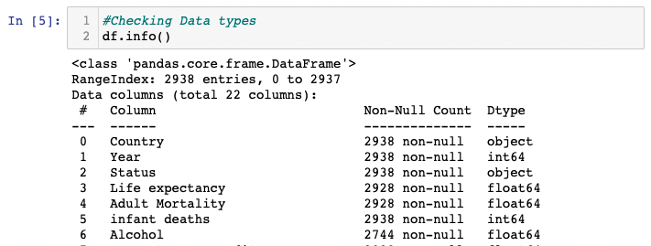
2.1 Understand available Data Types of Features
Functions Used: “info()”
Conclusion: 2 integers , 2 strings, 18 floats
Output:

Slide 6

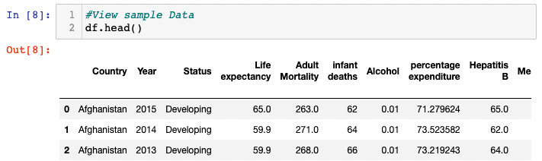
2.2 Viewing sample data of the dataset
Functions Used: “head() / tail() / shape”
Conclusion: Dataset has 2938 rows and 22 columns and seems to be having different ranges
Output:

Slide 7
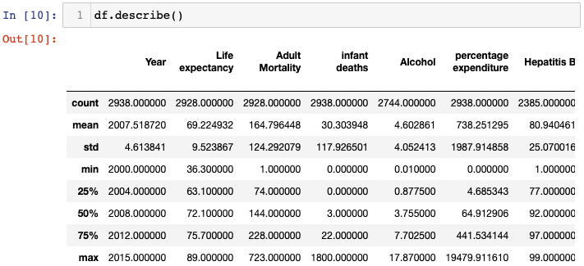
2.3 Descriptive Statistics
Functions Used: “describe()”
Conclusion: Dataset has missing values and understandings of other metrics
Output:

Slide 8
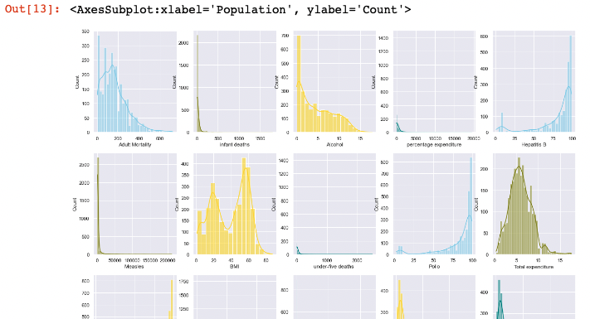
2.4 Data Distribution
Functions Used: “histplot()”
Conclusion: Having skewed and normally distributed data. Outliers exists.
Output:

Slide 9
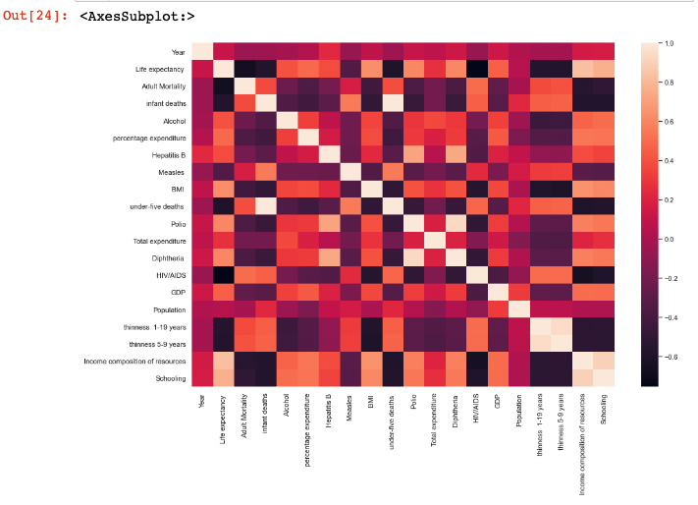
2.5 Correlation
Functions Used: “corr() / heatmap()”
Conclusion: Correlation between features exits which allows to work on them separately for model creations
Output:

Slide 10

3. Data Cleansing

Slide 11
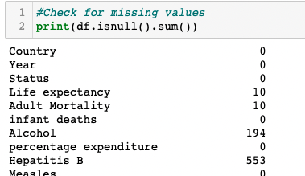
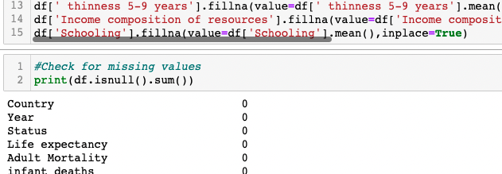
3.1 Missing value correction
Functions Used: “isnull() / fillna() / mean()”
Conclusion: missing values were identified and filled with the mean of correspondent feature
Output:

Slide 12
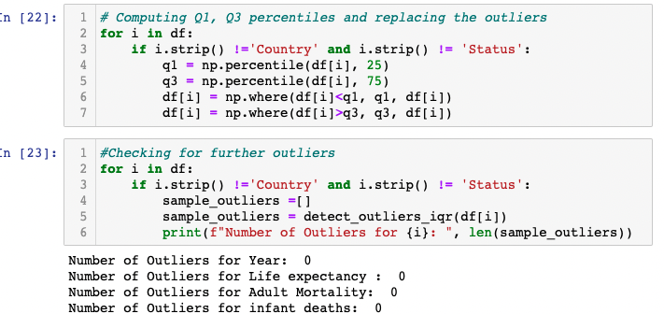
3.2 Dealing Outliers
Method: Replace outliers with closest 1st or 3rd interquartile
Functions Used: “percentile() / where()”
Conclusion: Data points that are outside the 1st and 3rd quartile were considered outliers.
Output:

Slide 13
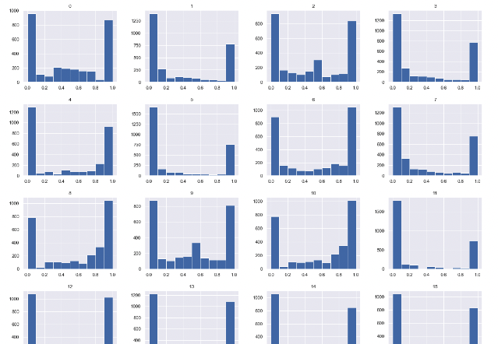
3.3 Normalization
Method: Min Max Normalization
Functions Used: “MinMaxScaler() / transform()”
Conclusion: Data will fit a range between 0 and 1. Increases the accuracy of the model.
Output:
Note:
Most significant impact is on non-linear models

Slide 14

4. Model fitting, Prediction and Validation

Slide 15
4.1 Data Splitting
Functions Used: “train_test_split()”
Method: 75% testing and 25% training dataset.
Code:

Slide 16
4.2 Model Fit
Functions Used: “fit()”
Method: Fitting the training dataset for the Linear Regression model
Code:

Slide 17
4.3 Prediction
Functions Used: “predict()”
Method: Predicting an outcome using test dataset
Code:

Slide 18
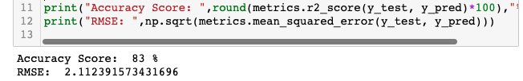
4.4 Validation
Functions Used: “r2_score() / mean_squared_error()”
Method: Validation through accuracy score and mean squared error
Output:

Slide 19
5. Conclusion
The linear model we fitted predicts with 83% accuracy
Improvement in Accuracy can be done by further cleansing the dataset and using alternative supervised learning models
Further analysis on correlated data to identify patterns should be carried out

