Slide 1

Hazardous Meteorite Prediction
Praveen Mahaulpatha (C0860583)
Data Science and Machine Learning
AML 1114
Debashish Roy

Slide 2
Content
Project Overview
Data Identification
Data Cleansing
Model Fitting, Prediction and Validation
Conclusion

Slide 3
1. Project Overview
Project Purpose | : Predicting whether a Meteorite is hazardous or not using meteorite characteristics.
IDE | : Jupyter Notebook
Python Version | : Python 3.9
Machine Learning Technique | : Supervised Learning
Models | : Classification
Dataset Source | : Kaggle
Predictor Variables | : 34
Response Variable | : 1 (Hazardous / Non-Hazardous)
Libraries | : Pandas / Numpy / matplotlib / seaborn / sklearn

Slide 4

2. Data Identification

Slide 5
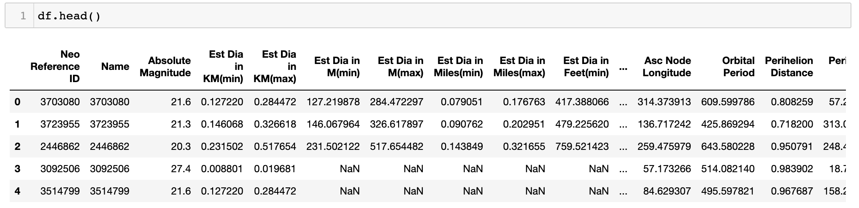
2.1 Viewing sample data of the dataset
Functions Used: “shape / head() / tail()”
Conclusion: Dataset has 2938 rows and 22 columns and seems to be having different ranges
Output:

Slide 6
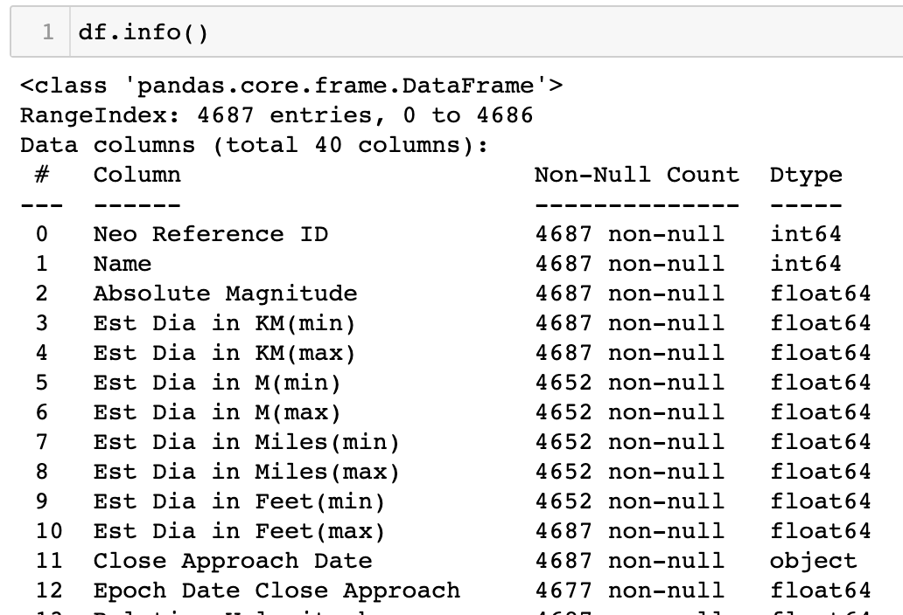
2.2 Understand available Data Types of Features
Functions Used: “info()”
Conclusion: 5 integers , 4 strings, 30 floats, 1 bool
Output:

Slide 7
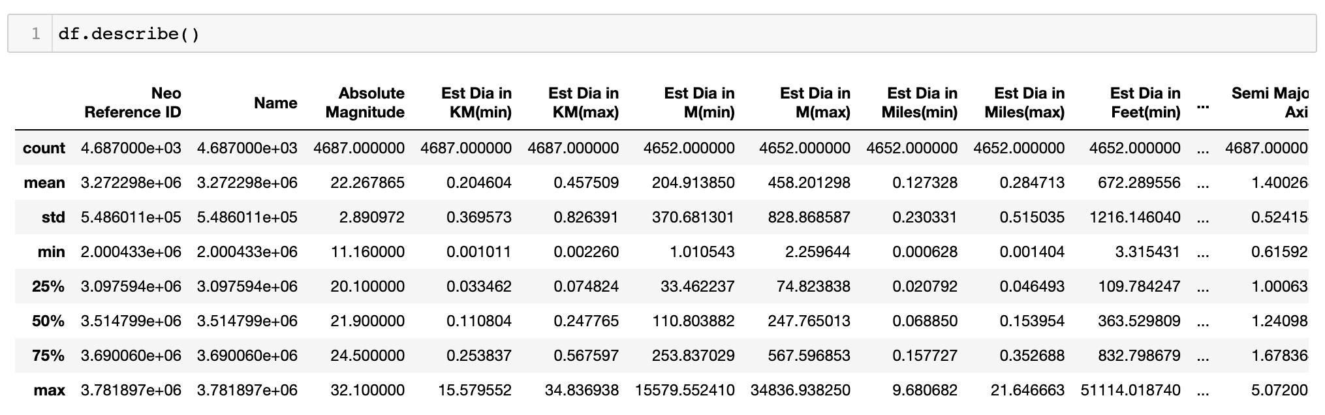
2.3 Descriptive Statistics
Functions Used: “describe()”
Conclusion: Dataset has missing values and understandings of other metrics
Output:

Slide 8
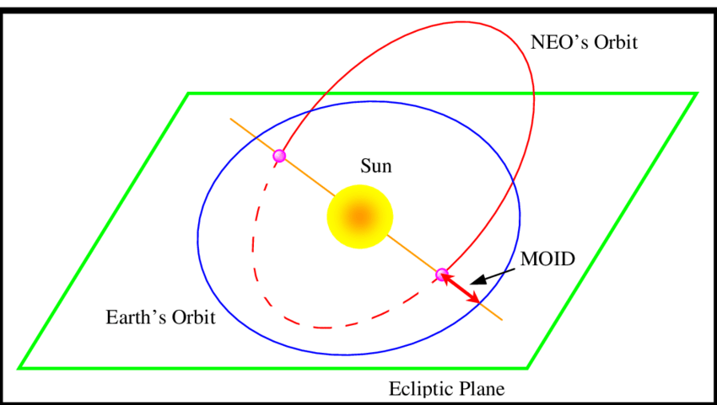
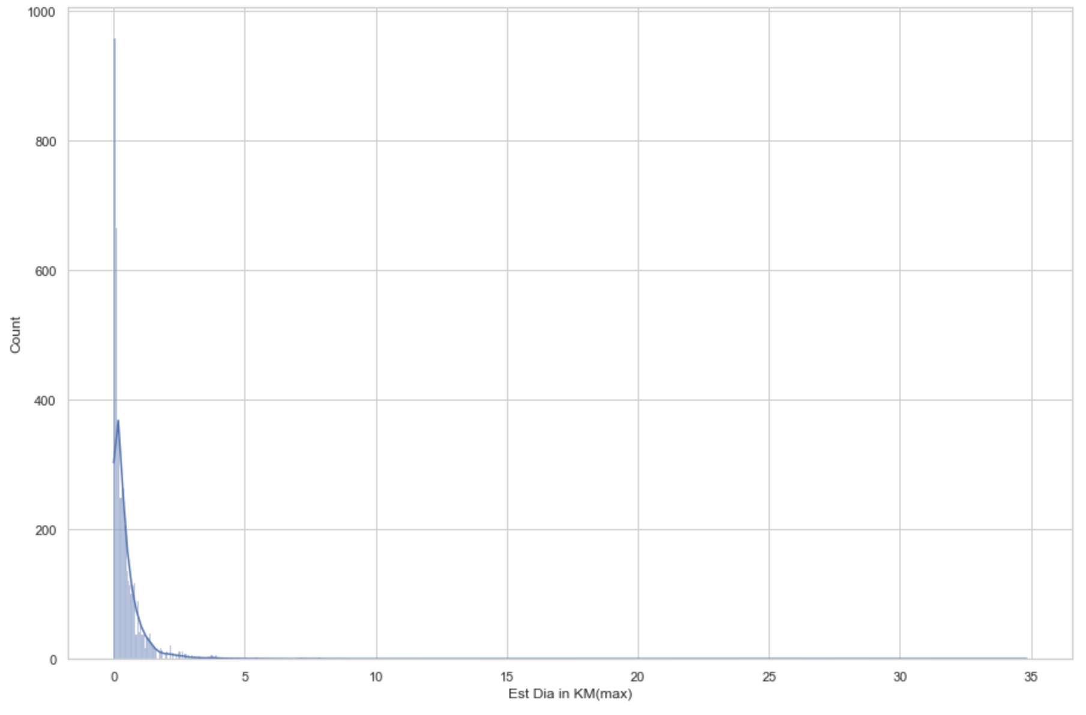
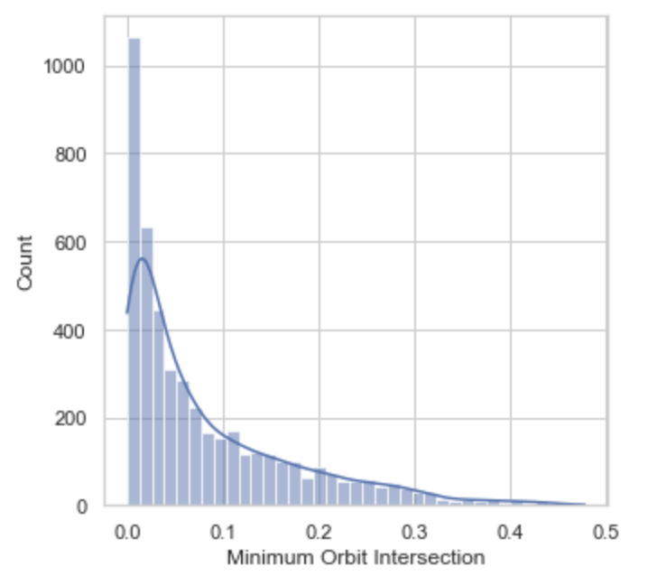
2.4 Data Distribution
Functions Used: “histplot()
Conclusion: Having right skewed data for most significant features.
Output:

Slide 9
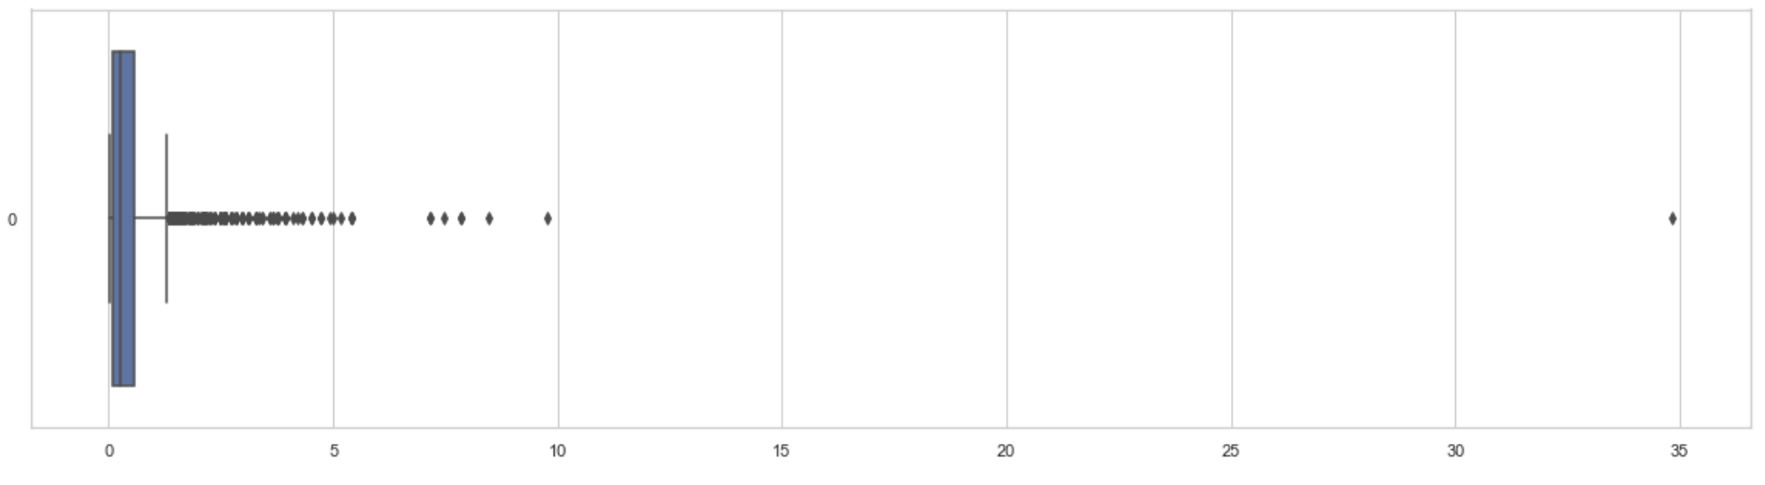
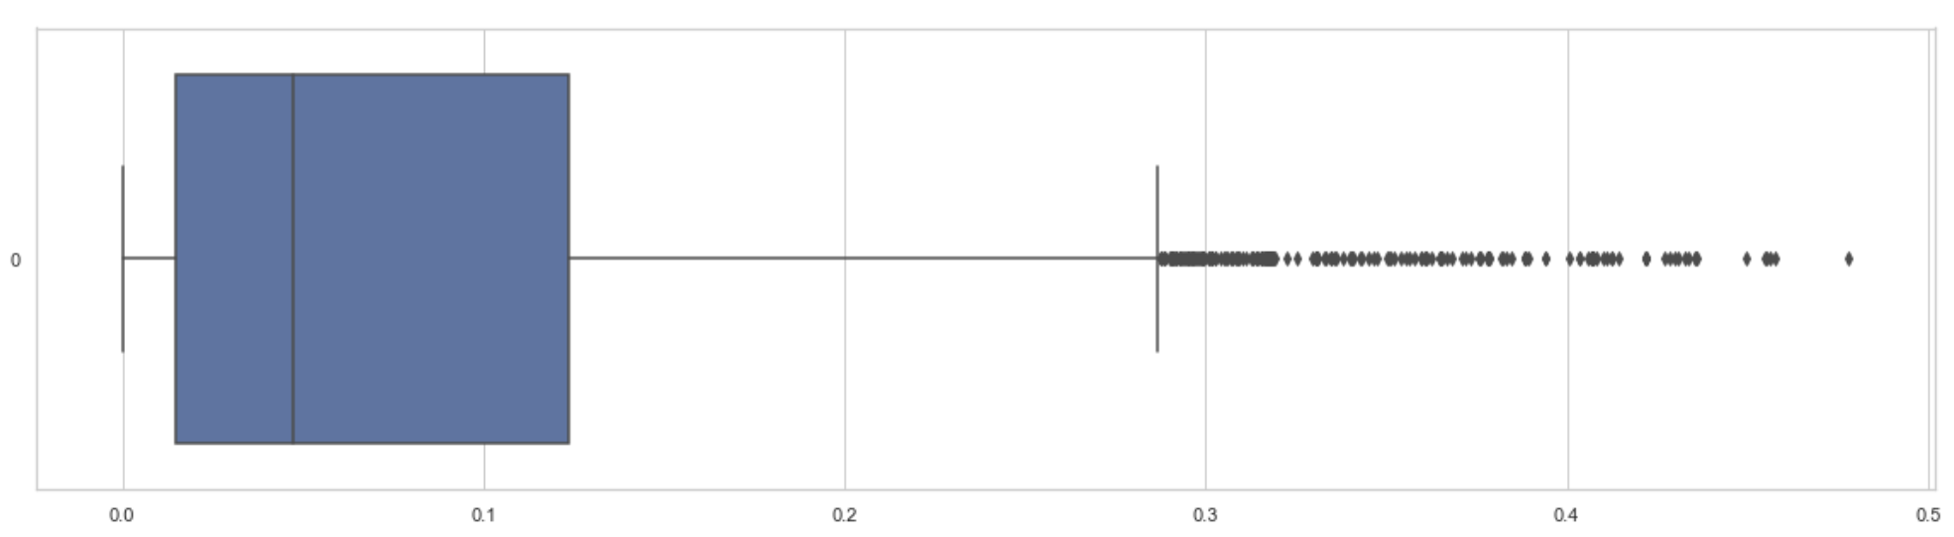
2.4 Data Distribution Cont.
Functions Used: “Boxplot()
Conclusion: Having outliers.
Output:
Estimated Max Diameter
Minimum Orbit Intersection

Slide 10
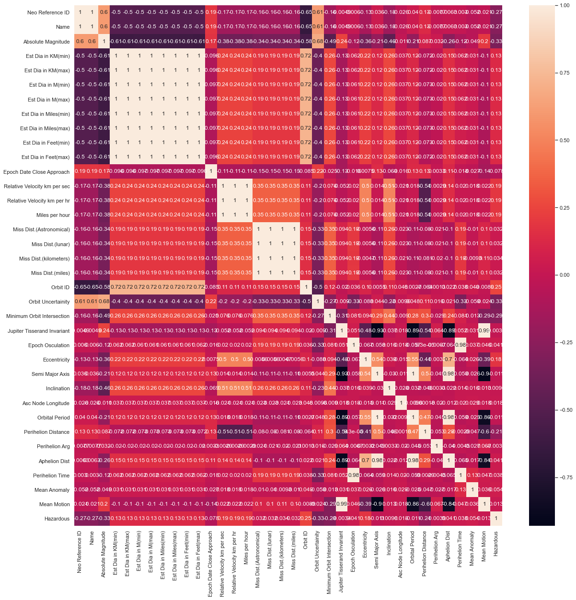
2.5 Correlation
Functions Used: “corr() / heatmap()”
Conclusion: Correlation between features exits which allows working on them separately for model creations
Output:

Slide 11

3. Data Cleansing

Slide 12
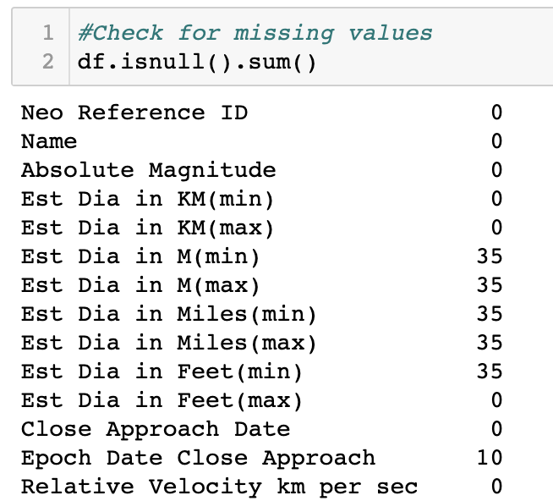

3.1 Missing value correction - Removal
Functions Used: “isnull() / dropna()
Conclusion: missing values were identified and removed from the dataframe.
Output:

Slide 13

3.2 Missing value correction – Mean Imputation
Functions Used: “fillna() / mean()
Conclusion: missing values were identified and imputed with correspondent mean value.
Output:

Slide 14
3.3 Further Steps
Outlier Detection and imputation
Normalization
Duplicate Data Cleansing

Slide 15

4. Model fitting, Prediction and Validation

Slide 16
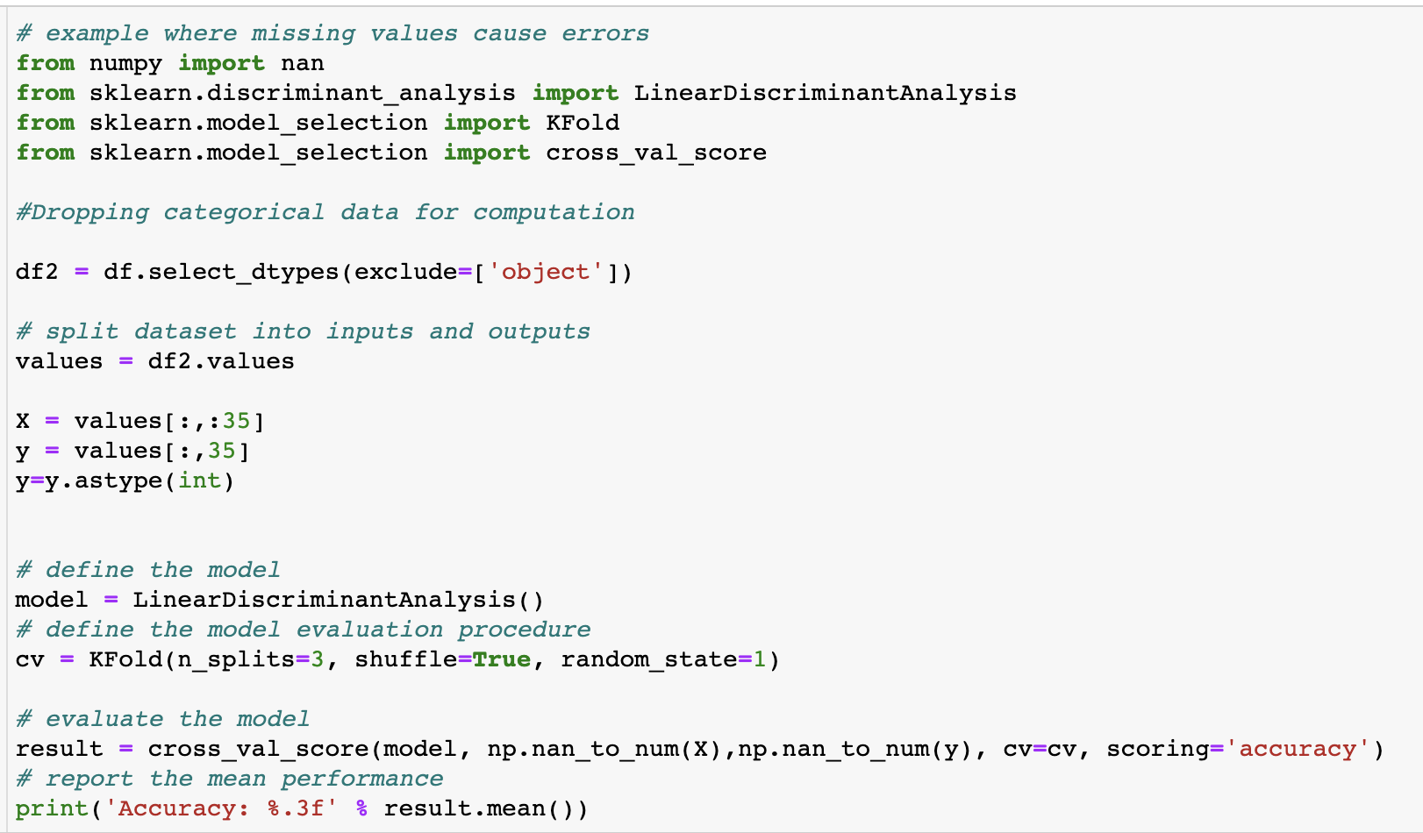
4.1 Fitting Missing value non supporting Model
Model Used: “Linear Discriminant Analysis()”
Code:

Slide 17
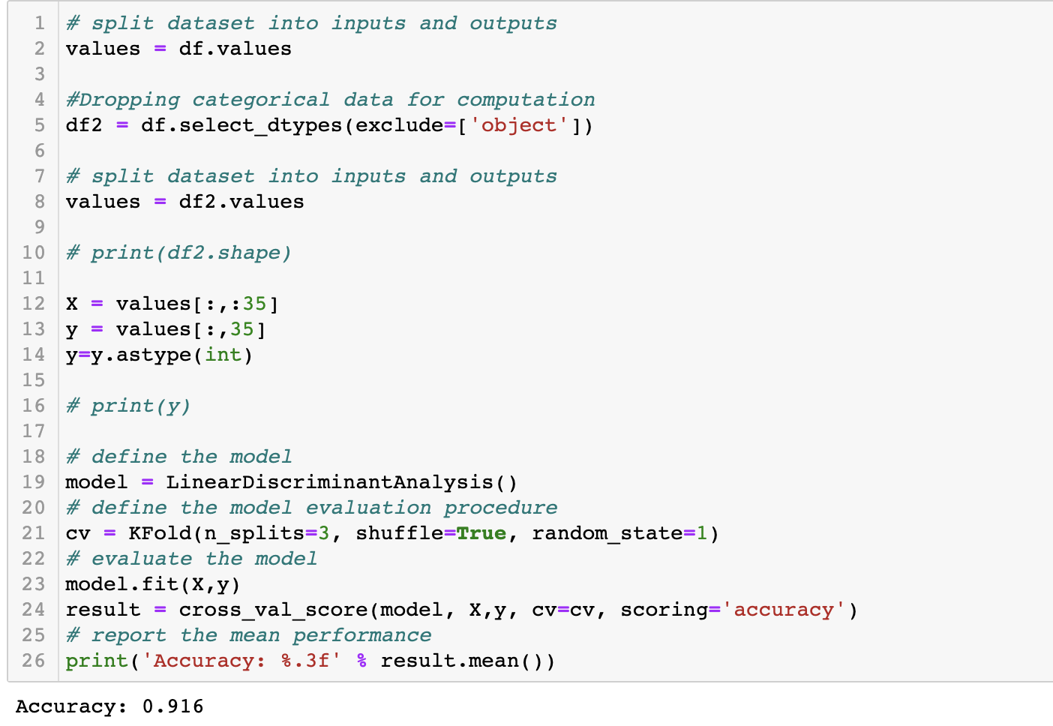
4.2 Fitting after Removing null values
Model Used: “Linear Discriminant Analysis()”
Code:

Slide 18
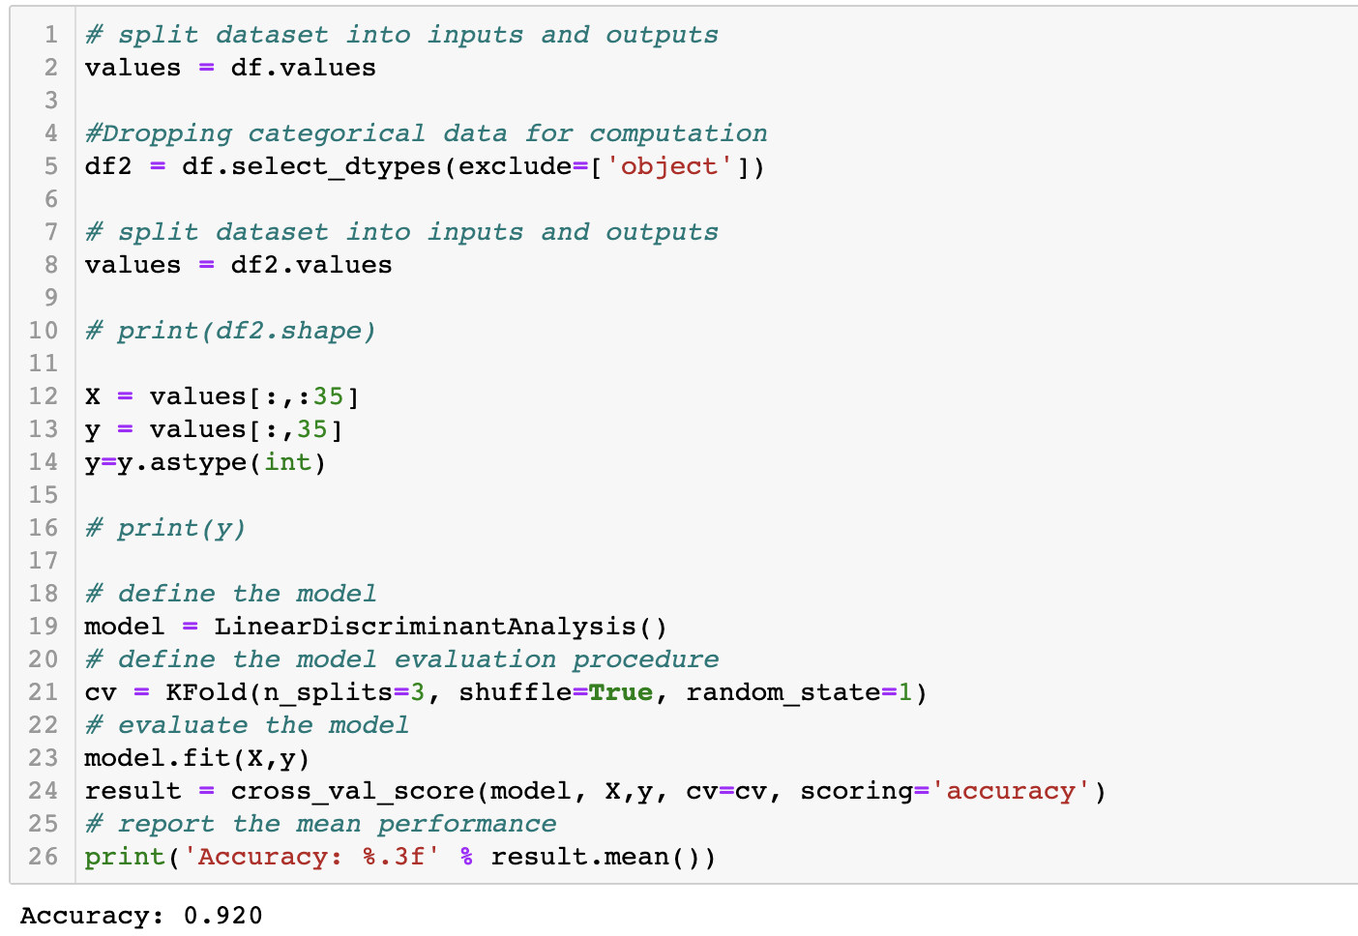
4.3 Fitting after Imputing Null Values
Model Used: “Linear Discriminant Analysis()”
Code:

Slide 19
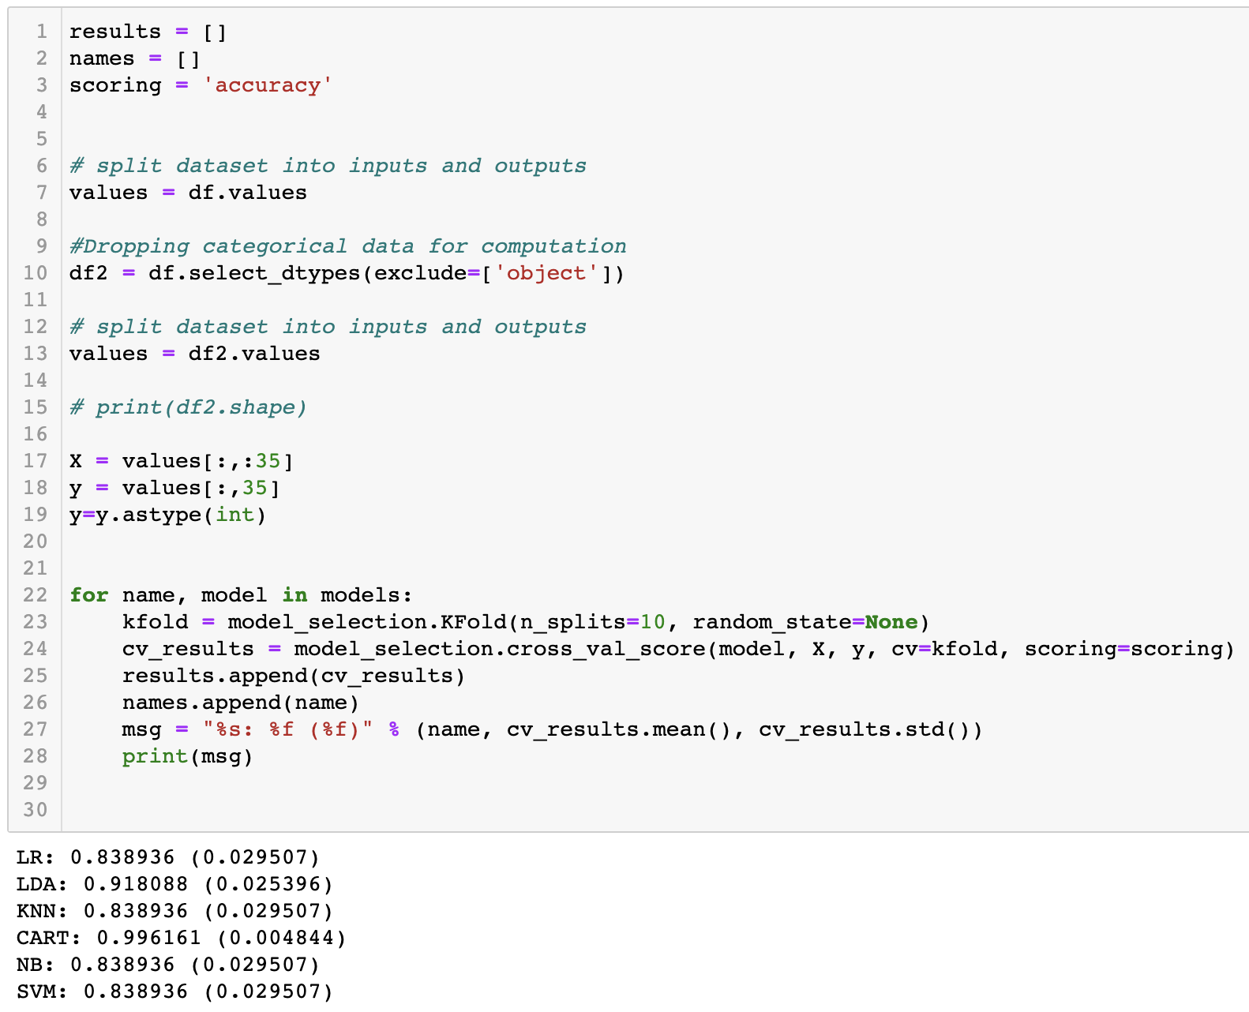
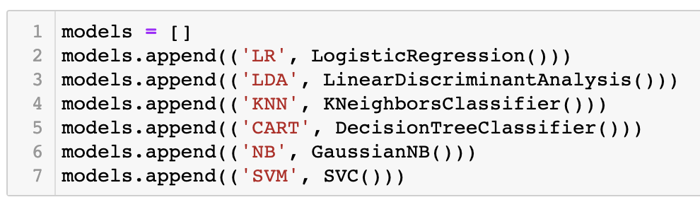
4.4 Comparing fitting other models
Functions Used: “cross_val_score()”
Code:

Slide 20
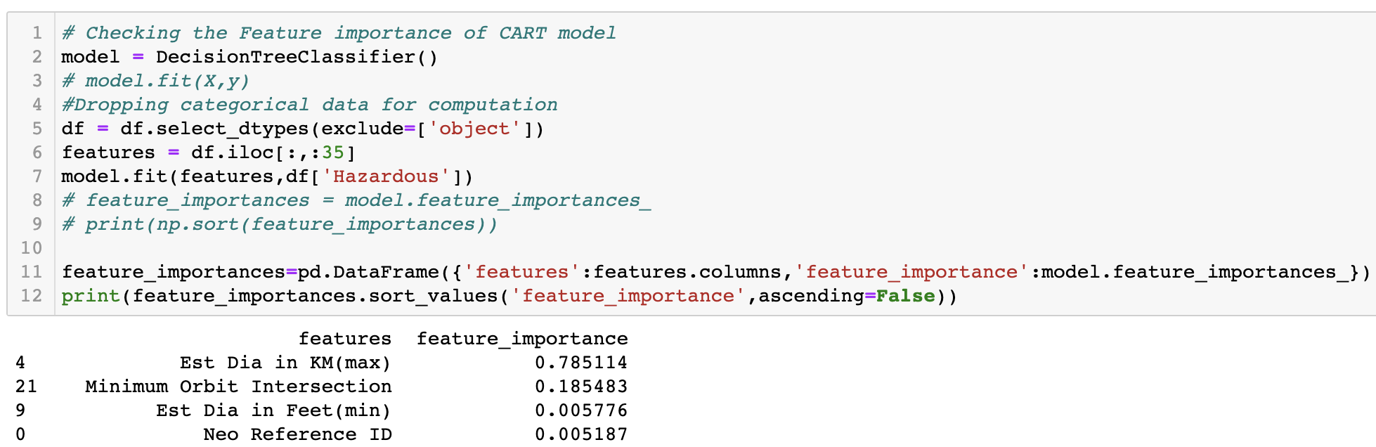
4.5 Feature Importance
Functions Used: “feature_importances_
Code:

Slide 21
5. Conclusion
The best model with highest accuracy is Decision Tree Classifier (99.6%)
Most significant features were as below
Maximum Diameter – 78%
Minimum Orbit Intersection – 18%
Further analysis on correlated data to identify patterns should be carried out

