Slide 1


KONGU ENGINEERING COLLEGE
PERUNDURAI ERODE-638060
ARTIFICIAL INTELLIGENCE AND DATA
SCIENCE
Java micro project
CAR RENTAL MANAGEMENT
SYSTEM
THEJASRINI M
23ADR178
AIDS-C

Slide 2

PROBLEM DESCRIPTION
The primary objective of the Car Rental Management System in Java is to develop a comprehensive and
efficient software solution that facilitates the seamless management of a car rental business. This system
aims to automate and streamline various operations involved in the rental process, ensuring enhanced
customer satisfaction, operational efficiency, and effective resource utilization. The system is designed
to support administrators, staff, and customers by providing a user-friendly interface and robust
functionalities for managing car rentals.
SCOPE
User Management:
Admin Functions: Add, update, delete, list, rent, and return cars.
Car Management:
It handles car details like add, update, delete the ID, make, model, year, price.
Inventory Management::
List/Search Cars: Show cars based on criteria like status and attributes.

Slide 3
OBJECTIVE
1)Centralized Car Management:
2)Customer Satisfaction
3)Data Security and Integrity
4)Real-Time Updates:
5)User-Friendly Interface:

Slide 4
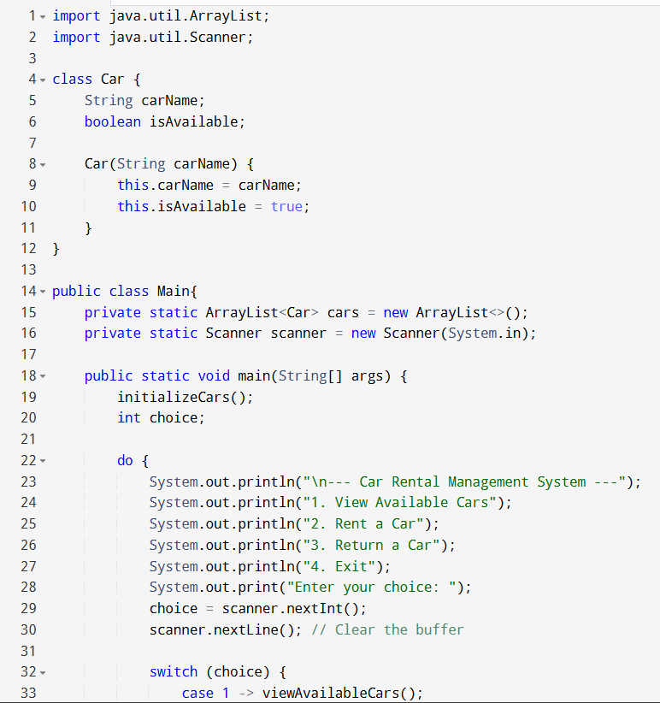
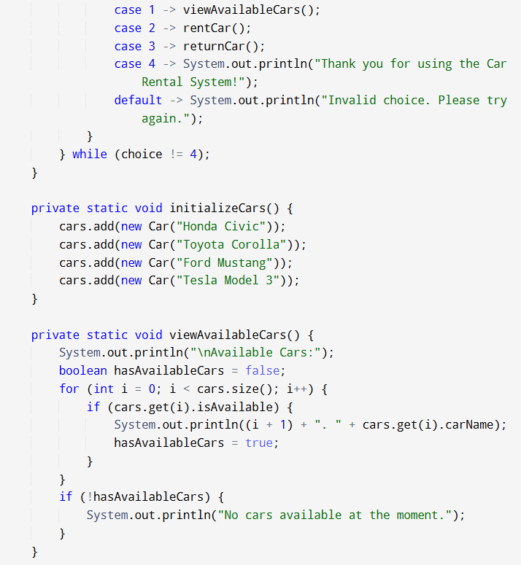
PROGRAME
car class
Main class

Slide 5
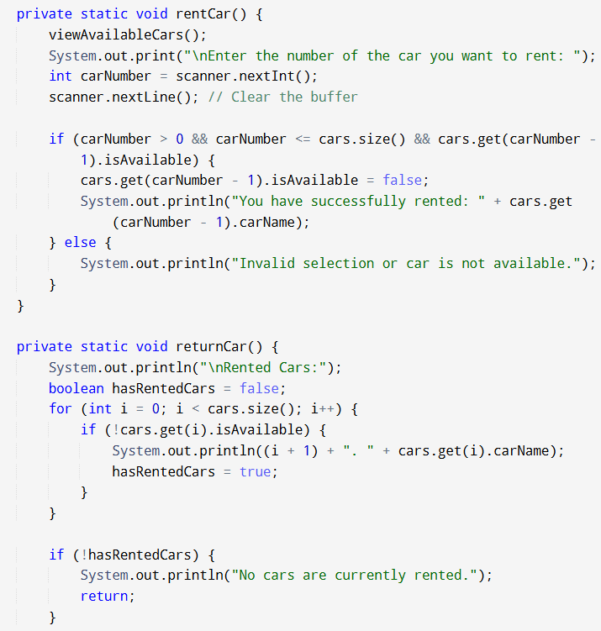
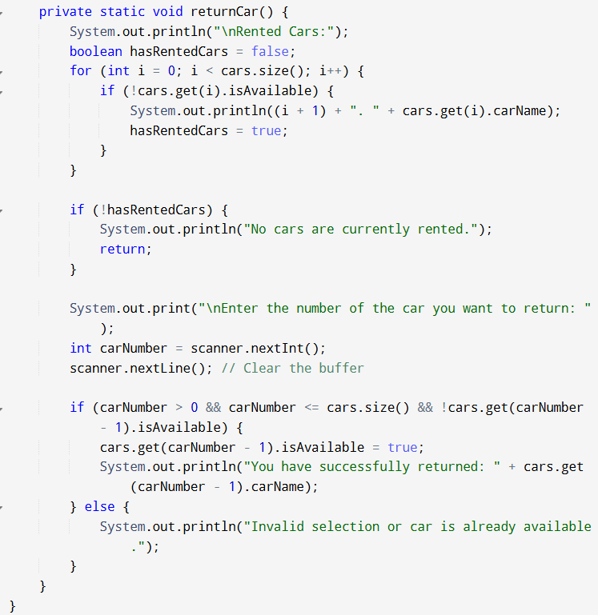

Slide 6
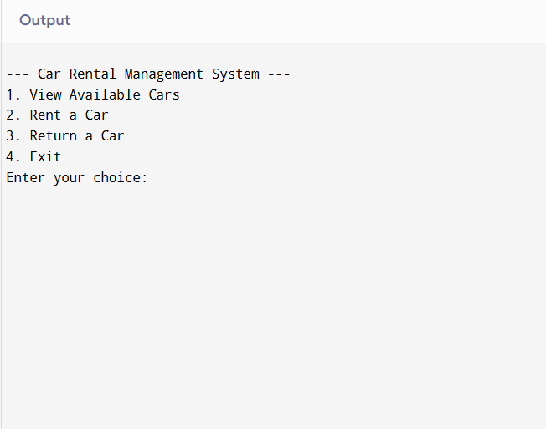
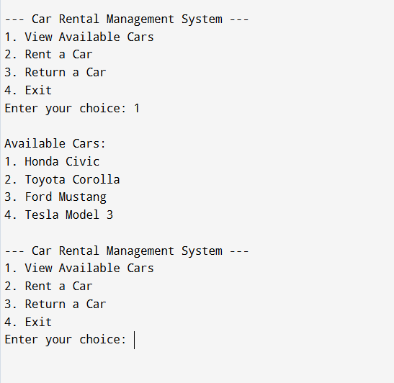
OUTPUT

Slide 7
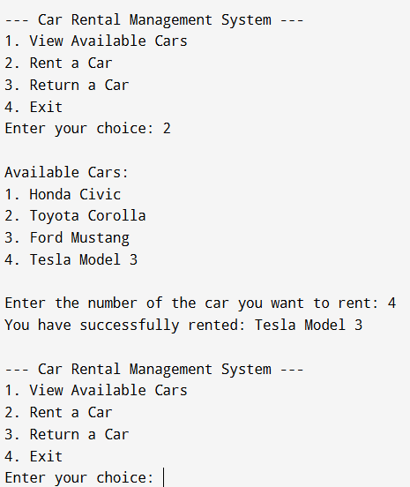
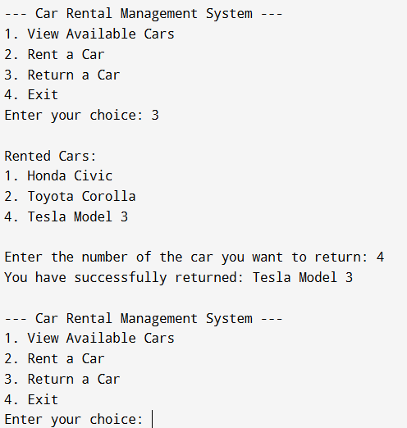

Slide 8
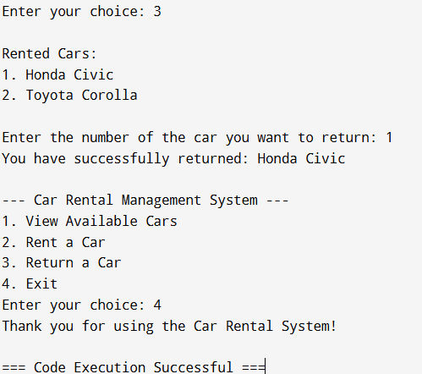

Slide 9
Problem Description:
A car rental service wants to automate its management process to improve efficiency and customer experience. The system should allow customers to view available cars, rent a car, and return a car. The goal is to design a simple Java program that manages these functionalities in a console-based environment.
CAR CLASS
Purpose: Represents the details of a single car in the system.
Attributes:
CarName (String): Stores the name of the car.
IsAvailable (boolean): Indicates whether the car is available for rent.
Methods:
Car(String carName): Constructor to initialize a car object with its name and sets isAvailable to true.

Slide 10
Main Class
Purpose: Contains the main logic for the car rental system, including menu navigation, renting, returning cars, and managing the car list.
Attributes:
cars (ArrayList<Car>): Stores the list of all cars in the system.
scanner (Scanner): Used to get user input from the console.
Methods:
main(String[] args): The entry point of the program. Initializes the car list. and Displays a menu for the user to interact with the system.
initializeCars(): Adds predefined cars to the list.
viewAvailableCars(): Displays all cars currently available for rent.
rentCar(): Allows the user to rent an available car by selecting it from the list.
returnCar(): Allows the user to return a rented car, making it available again.

Slide 11
THANK
YOU

