Slide 1
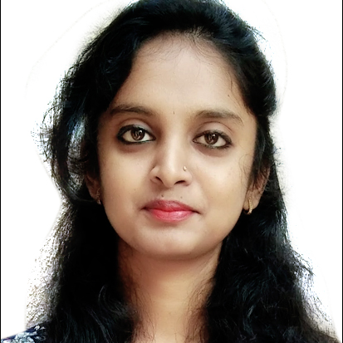


Thejaswini M
Analyst/Software Engineer
Bachelor of Engineering
Electronics and Communicaton :
2017 – 2021
Skills Basic Java
C++,C sharp
Sql
Database:
SQL database
Additional Details:
Leadership
Quick Learner
Team management
Areas of intrest and hobbies:
Listening to music
Bangalore
thejaswini.a.m@@capgemini.com
9113293772
A4
Ready to learn new technologies and implement them to further improve my knowledge.
Eager to work in a team of dedicated people and serve a key role in the enhancement and development of the project.
I have working knowledge on Csharp, . NET, SQL,HTML and CSS on an intermediate level.
Completed Microsoft Azure Fundamentals-AZ900 certification..
Completed java ,sql course at Pentagon Space in Bangalore.
Completed .net and csharp training.

