Slide 1

HOMEMAKER
PRESENTED BY
Thejesh 221701503
Naveen Raj 221701501

Slide 2
Abtract
Homemaker is a simple platform that helps homemakers sell their homemade products like food, clothes, jewelry, and more. It gives women a space to showcase their skills and lets customers easily find and buy unique, handmade items. The website has features like profiles for sellers, product listings, reviews, secure payments, and delivery options using gig workers from services like Rapido, Zomato, and Swiggy. Homemaker makes the buying and selling process easy, builds trust, and supports local talent.

Slide 3
INTRODUCTION
Homemade products are special and creative, but many homemakers struggle to find customers. Homemaker solves this problem by connecting homemakers with buyers, helping them turn their hobbies into income. Whether it’s custom cakes, handmade jewelry, or tailored clothing, the website makes it simple for customers to find and order these products.
Homemaker offers features like product customization, secure payments, and delivery through gig workers. It aims to create a supportive marketplace that helps small businesses and gives customers access to high-quality, handmade products.

Slide 4
Objective
Provide a digital marketplace for homemakers to sell their products.
Empower women entrepreneurs by giving them a platform to grow their businesses.
Offer a seamless experience for customers to sell and buy homemade goods.
Integrate secure payment options for safe transactions.
Partner with gig workers for fast and efficient delivery.
Create a supportive community that values handmade products.

Slide 5
Methodology
By merging elements of Swiggy, Zomato, and Etsy, Homemaker provides a specialized platform where homemakers can sell food, clothing, jewelry, and more while ensuring efficient delivery and secure transactions.
Using Tools:
Mern Stack
Mongo DB database
Node JS Server

Slide 6
Literature Survey
"Homely Store" (2023, India) – A college project that focused on homemade product sales with WhatsApp-based ordering.
"CraftHub" (2022, USA) – A student-led project that built an e-commerce platform for handmade crafts.
"MaaKaKhana" (2022, India) – A college project aimed at providing home-cooked meals with Swiggy API integration.
"FreshPlate" (2021, UK) – A student startup connecting local chefs with customers.
"SellItEasy" (2021, India) – A college project that helped small businesses sell through WhatsApp.
"WomenMarket" (2020, USA) – A marketplace app specifically for women entrepreneurs.
"CraftNearMe" (2020, Canada) – A project that focused on hyperlocal handmade goods.
"LocalArtisans" (2019, Germany) – A student-built app for supporting local artisans.

Slide 7
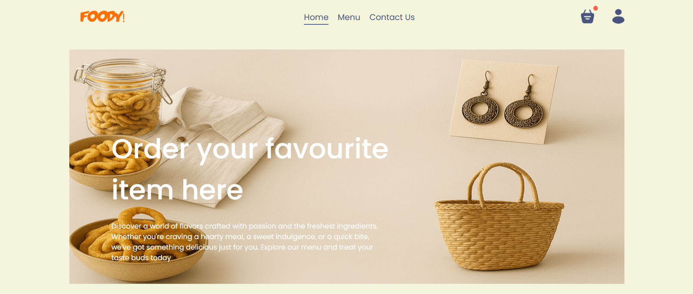
Home Page

Slide 8

Explore Menu page

Slide 9
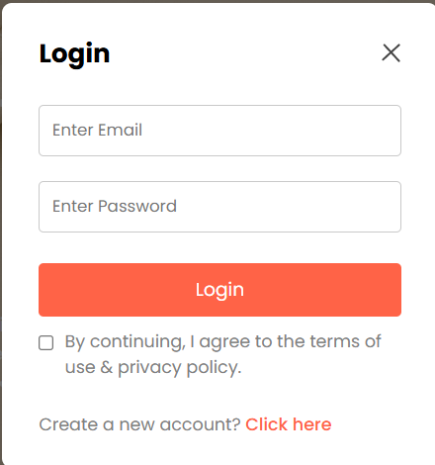
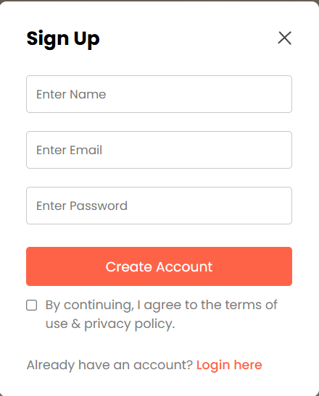
Login & Register page

Slide 10
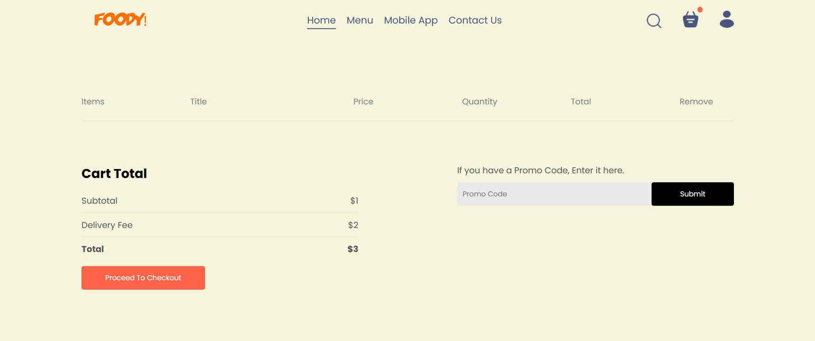
Cart Page

Slide 11
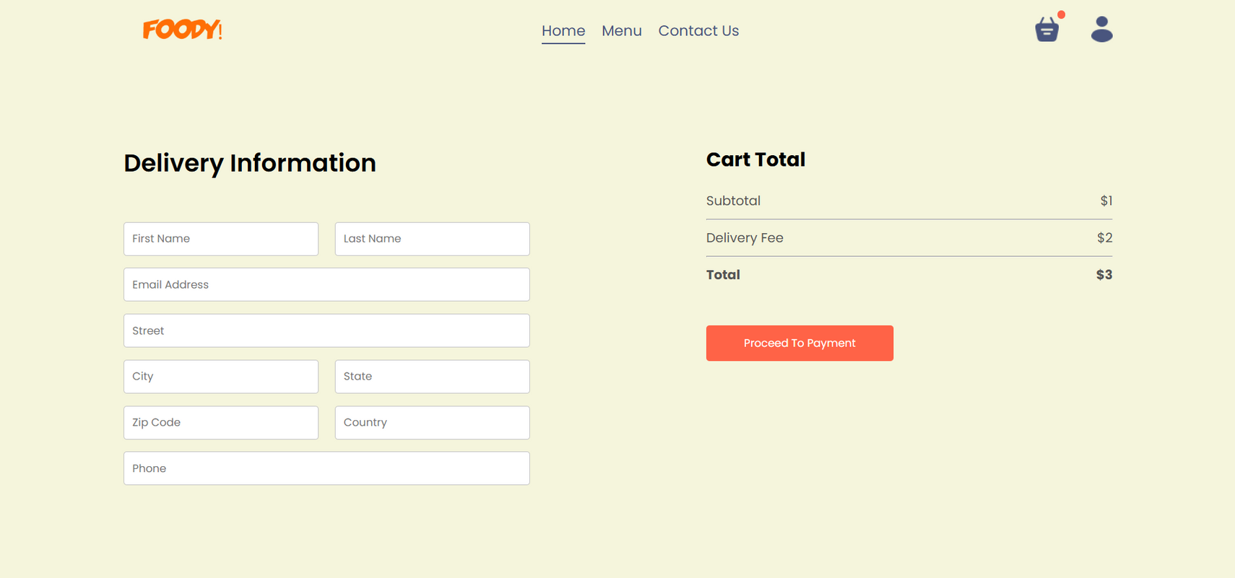
Order Page

Slide 12
Thank you very much!
PRESENTED BY
Thejesh 221701503
Naveen Raj 221701501

Slide 13
Link
https://github.com/Thejesh16/HomeMaker-e-commerce-website.git

