Slide 1
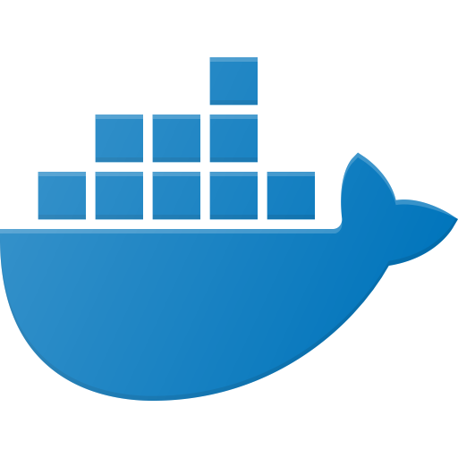
docker

Slide 2
What is Docker?
Open platform for developing, shipping, and running applications
Set of PaaS products that uses OS-level virtualization to deliver software
Container technology that allows a developer to package & ship an application with required dependencies
Light-weight as compared to the traditional VM based approach

Slide 3
Why use Docker?
Enables separation of your applications with your infrastructure
Fast, consistent delivery of your applications
Responsive deployment and scaling
Avoids “works on my machine” syndrome
Provides linux/windows platforms to play with on completely different operating systems
Notes:
Docker enables you to separate your applications from your infrastructure so you can deliver software quickly. With Docker, you can manage your infrastructure in the same ways you manage your applications.
Fast, consistent delivery of your applications - Docker streamlines the development lifecycle by allowing developers to work in standardized environments using local containers which provide your applications and services.
Responsive deployment and scaling - Docker containers can run on a developer’s local laptop, on physical or virtual machines in a data center, on cloud providers, or in a mixture of environments.

Slide 4
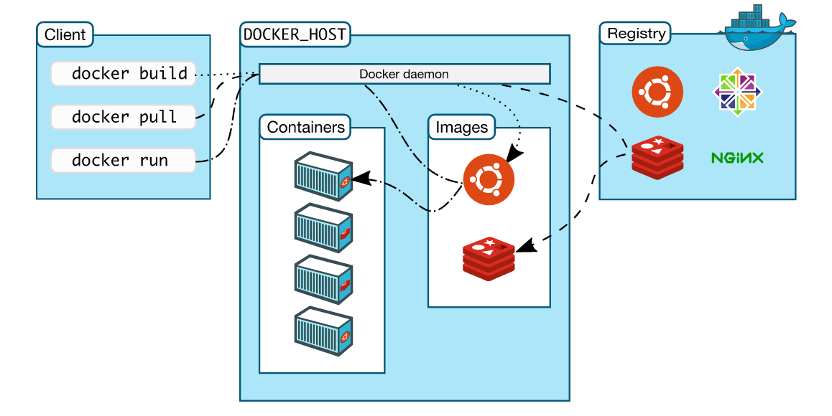
Docker Architecture
Notes:
Docker uses a client-server architecture
The Docker client talks to the Docker daemon, which does the heavy lifting of building, running, and distributing your Docker containers.
The Docker client and daemon can run on the same system, or you can connect a Docker client to a remote Docker daemon.
The Docker client and daemon communicate using a REST API, over UNIX sockets or a network interface.

Slide 5
Docker Image
Read-only template that contains a set of instructions for creating a container
Provides a convenient way to package applications and preconfigure server environment
Starting point for anyone using Docker for the first time
Built using a series of intermediate image layers using the docker build command
Images are shared by storing them in a public/private registry (ex: docker hub, gcr.io etc.)
Notes:
Docker enables you to separate your applications from your infrastructure so you can deliver software quickly. With Docker, you can manage your infrastructure in the same ways you manage your applications.
Fast, consistent delivery of your applications - Docker streamlines the development lifecycle by allowing developers to work in standardized environments using local containers which provide your applications and services.
Responsive deployment and scaling - Docker containers can run on a developer’s local laptop, on physical or virtual machines in a data center, on cloud providers, or in a mixture of environments.

Slide 6
Docker Container
Standard unit of software that packages code and its dependencies
Can be seen as - an instance of an image
Runs on Docker Engine
Independent of the machine infrastructure
Light-weight - Share the machine’s OS kernel for more than one application
docker run --name=react_app ubuntu:latest
Containerized Applications
React JS
Node JS
mySQL
EMS
Spring
Docker
Host Operating System
Infrastructure

Slide 7
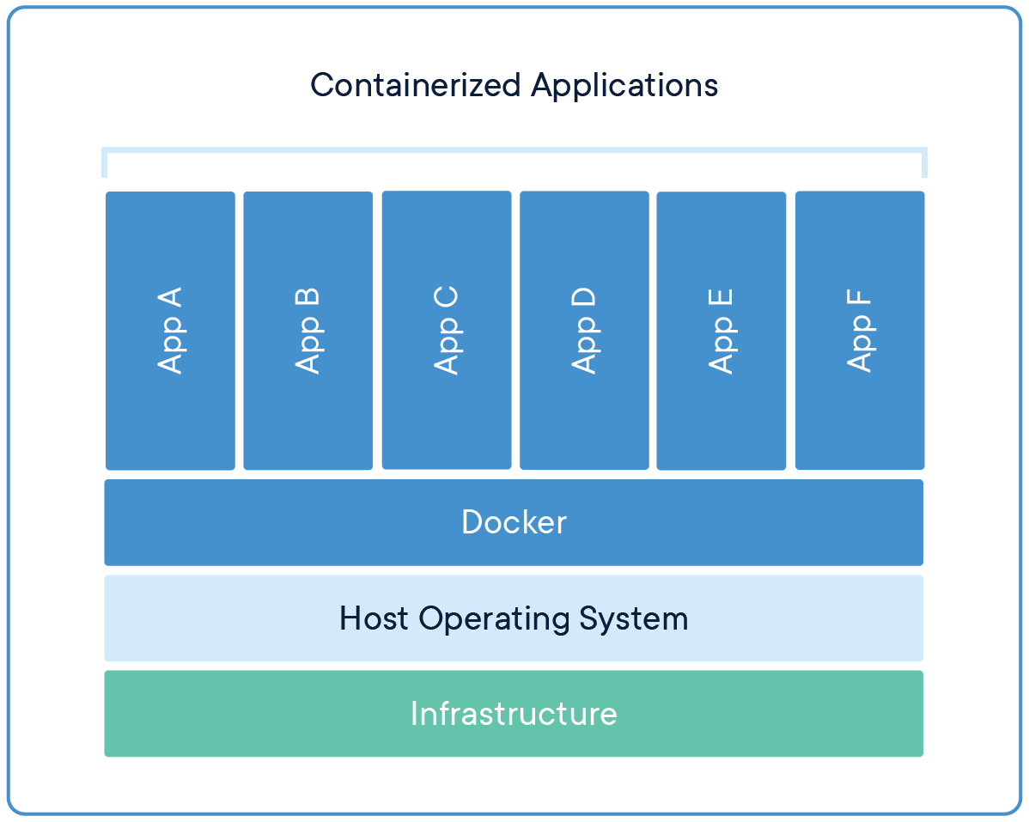
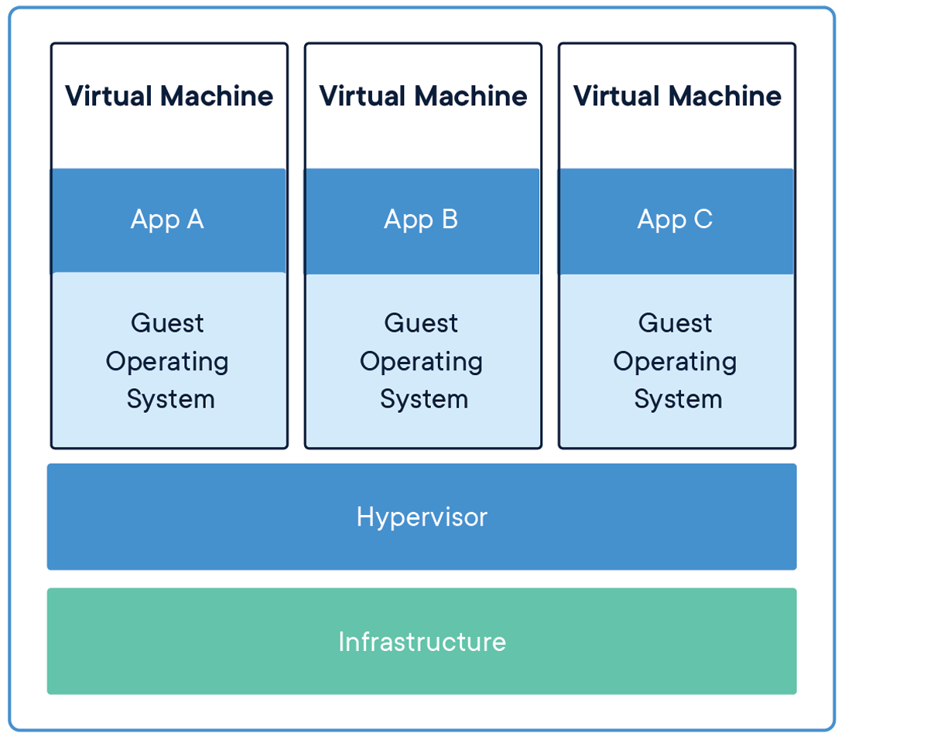
Docker Containers vs Virtual Machines

Slide 8
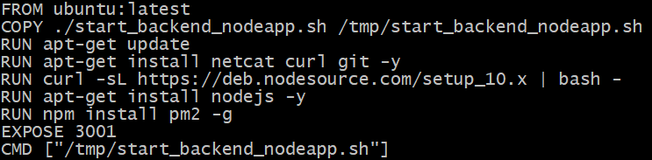
Dockerfile
Instruction set to assemble a docker image
Light-weight file to maintain a consistent runtime environment
Contains commands on how the image shall be initialized when the container starts
May have references to scripts to initiate right during the image build process

Slide 9
Volumes
Provides a way to persist and/or share data amongst different containers
Saved in the docker host file system /var/lib/docker/volumes
Provides a way of sharing the local file system with the docker container when it starts
Volumes can be mapped while creating a container through docker run or docker-compose
Command to create volume: docker volume create <volume_name>

Slide 10
Networks & Ports
Provides a way to manage network connections/access between multiple containers
Docker networking subsystem is pluggable using drivers: bridge, host, overlay, macvlan, none
docker run -p 8080:3000 <image_name>:<tag_name>
Containers
App A
App B
App C
FrontEnd
App E
App F
App G
App A
App B
App C
BackendEnd
App E
App F
App G

Slide 11
Docker Commands

Slide 12
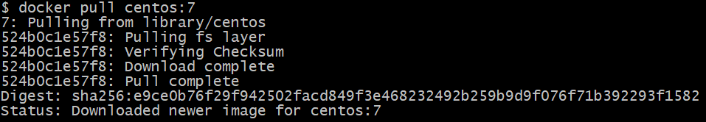
docker pull
Downloads an image from a public or private docker registry (Ex: docker hub)
Syntax: docker pull <image_name>:<tag_name>
image_name: Specifies the image to be pulled from docker hub repository.
tag_name: Specifies the version of the image to be downloaded. Optional. If not provided, latest will be considered as default.

Slide 13
docker run
Creates a container from the specified docker image
Syntax: docker run --name=<container_name> <image_name>:<tag_name>
container_name: Specify a custom container name
image_name: Specifies the image to be pulled from docker hub repository.
tag_name: Specifies the version of the image to be downloaded. Optional. If not provided, latest will be considered as default.

Slide 14
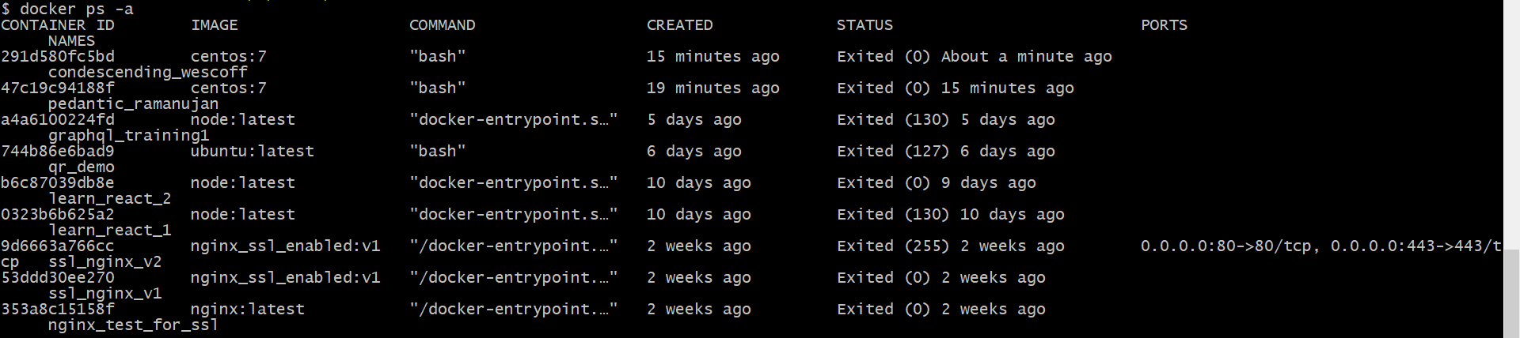
docker ps
Lists the running containers on the host machine
Syntax: docker ps
-a flag displays all containers (including stopped and exited ones)

Slide 15
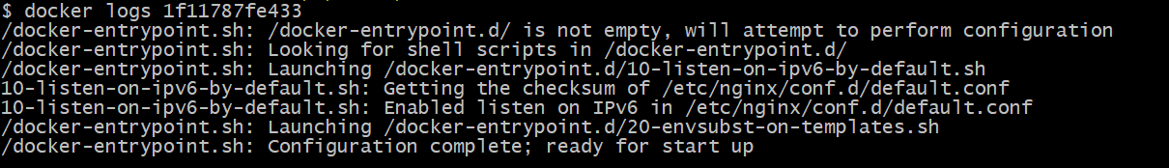
docker logs
Displays the logs from a container
Syntax: docker logs <container_name>
container_name: Specifies the container name for which to display the logs

Slide 16

docker stop
Stops a running container.
Syntax: docker stop <container_name>
container_name: Specifies the container name for which to display the logs
Note: Similarly, we have docker start that will allow us to start one or more stopped containers.

Slide 17
docker rm
Removes a stopped container
Syntax: docker rm <container_name>
container_name: Specifies the container name to be removed.

Slide 18
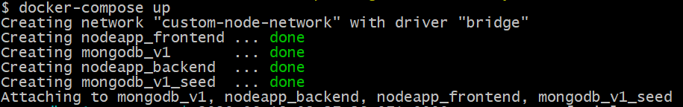
docker-compose
Tool for defining and running multi-container Docker applications
Uses YAML file to define the container configurations
Provides a way to start or stop all the containers in a single command
Use docker-compose up to start all the containers
Use docker-compose down to stop and remove all the containers

Slide 19
THANK YOU

