Slide 1
IMPLEMENTATION OF BLOCKCHAIN TECHNOLOGY IN LAND REGISTRATION PROCESS
By K.THEJESH

Slide 2
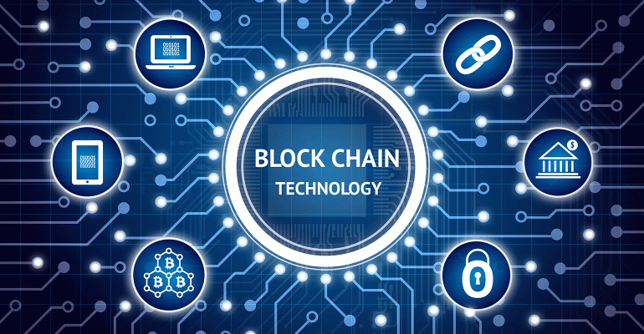

Slide 3
Contents
Abstract
Introduction
Literature Survey
Scope and Objectives
Discussion on the topic
Implementation
Merits and Demerits
Applications
References

Slide 4
Abstract
Blockchain is a ledger of transactions that is shared across a network of users and individually verified by each participant.
The transaction costs for real estate in Canada includes title search fees, land transfer fees, and notary fees.
The blockchain technology will impact the transaction costs, transaction times and fraud deterrence in this market.

Slide 5
Introduction
Blockchain is a digitized, distributed and secure ledger that guarentees immutable transactions and solves the trust problem when two parties exchange the value.
It is "an open, distributed ledger that can record transactions between two parties efficiently and in a verifiable and permanent way".

Slide 6
Contd…
The Canadian Real Estate market has been growing significantly as a proportion of total Canadian GDP (Argitis 2016).
This data implies that improvements in transaction costs could have a significant effect on housing affordability for Canadian citizens.

Slide 7
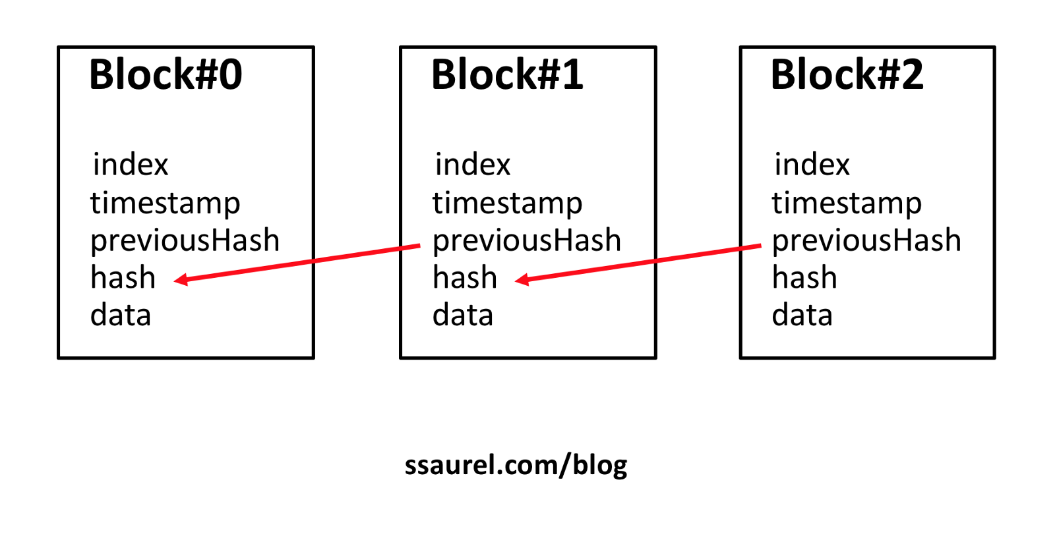

Slide 8
Literature Survey
Iansiti, M., and Lakhani K.R. 2017. "The Truth About Blockchain." Harvard Business Review, January-February Edition: 118-127.
Blockchain Technology at the heart of bitcoin and other virtual currencies, blockchain is an open, distributed ledger that can record transactions in a verifiable and permanent way.
With blockchain, we can imagine a world in which contracts are embedded in digital code and stored in transparent, shared databases, where they are protected from deletion, tampering, and revision.

Slide 9
Literature Survey
2. Malik, S., and Foxcroft, T. 2016. “Real estate agents caught breaking the rules on Marketplace's hidden camera”. CBC News. November 3.
An investigation by CBC Marketplace reveals some real estate agents are breaking the rules in an effort to double their sales commission.
The agent may reveal the exact amount of a competing buyer's bid.
Real estate agents may be involved in some fraudulent activities that may cause damage to the income of the government.

Slide 10
Literature Survey
3. Mizrahi, A. 2015. "A blockchain-based property ownership registry." ChromaWay Corporate Website. Accessed February 9, 2017.
For any kind of a property like real estate, cars and art it is important to have accurate records which identify the current owner and provide a proof that he is indeed the owner.
A blockchain ­based property ownership recording system eliminates most potential failures and attacks through transparency and use of cryptographic primitives for authentication.

Slide 11
Scope and Objectives
Scope
To increase the income of the government by reducing fraudulent activities in the Real Estate sector.
To reduce the fraud and registration costs in the Real Estate sector.
To track real-world asset ownership.
Objectives
To reduce the costs in land registration .
To resolve disputes.
To make sure ownership is correctly transferred to a new owner after sale.
To prevent sales fraud.

Slide 12
Discussion on the topic
Real estate is a uniquely good target for blockchain technology because it has a complex transaction process.
Blockchain can be enabled to improve the transparency a system enabling regulators to catch and prevent fraudulent behavior.
The architecture of blockchain also enables the creation of an immutable record which can be trusted not to be modified or lost, something which is not possible with traditional electronic or paper records.

Slide 13
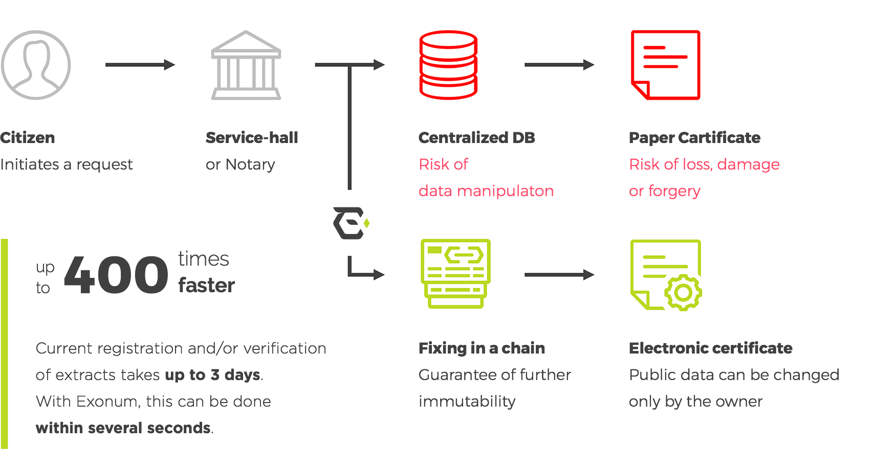

Slide 14
Implementation
In Canada, real estate fraud can come in many forms. Title fraud usually occurs when a criminal pretends to be the legitimate owner of a property.
A criminal may also sell a property they do not own, though this is a rarer form of title fraud.
Blockchain systems could likely be designed to help reduce frauds by providing greater transparency to title ownership records and the bidding process.

Slide 15
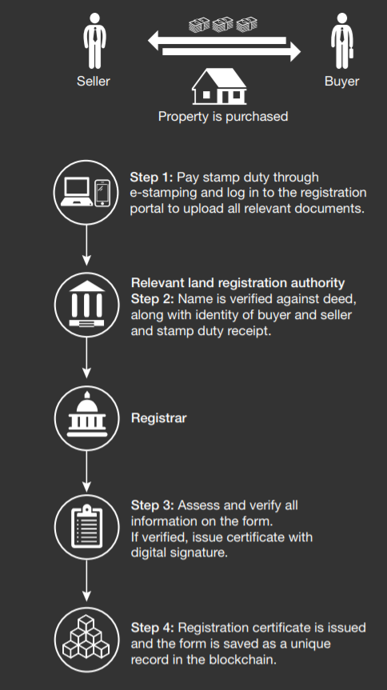

Slide 16
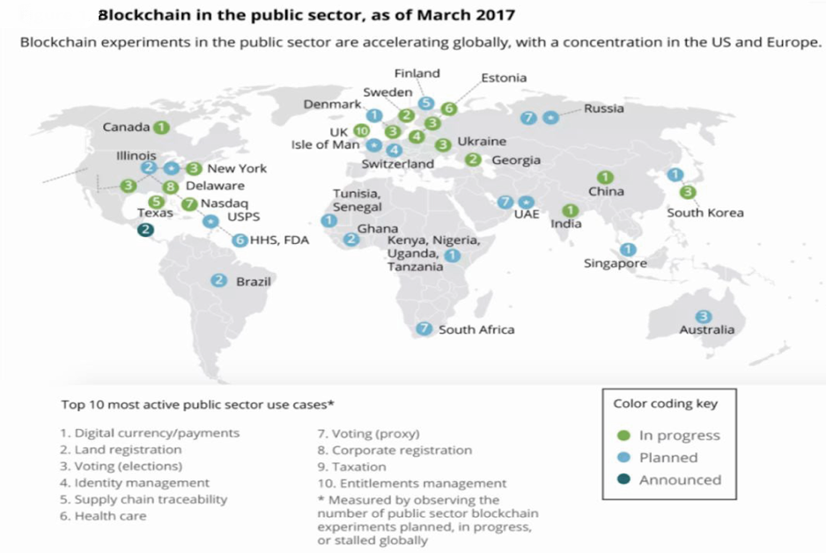

Slide 17
Merits
Intermediaries are not required.
Only pertinent information is shared, rest remains encrypted and inaccessible.
Mistakes are easily verifiable.
Information is secured using cryptography.
Data is stored over a democratized network.

Slide 18
Demerits
Difficulty of development.
Your decentralized application (Dapp) should not depend upon the API of centralized applications.
Difficulties with updating and eliminating errors.
Blockchain, by nature, employs strict logic that doesn’t allow redesign without loss of benefits.

Slide 19
Applications
We can develop electronic voting system using this model.
We can extend this to the transparent bidding process to perform it in an efficient way.

Slide 20
Conclusion
Blockchain technology could have a significant effect on transaction costs, transaction times and fraud deterrence in land registration.
The techniques and solutions will also later be applied to other markets outside of Canada with similar real estate systems in place.

Slide 21
References
[1] Argitis, T. 2016. "Canada’s economy is growing at the slowest pace in 60 years and the only thing holding us up is housing." Financial Post, August 2.
[2] Global Property Guide. 2016. “Buying Property In Canada”. November 24.
[3] Iansiti, M., and Lakhani K.R. 2017. "The Truth About Blockchain." Harvard Business Review, January-February Edition: 118-127.
[4] Malik, S., and Foxcroft, T. 2016. “Real estate agents caught breaking the rules on Marketplace's hidden camera”.
[5] Morrison, A. 2016. “Blockchain and smart contract automation”. PwC Technology Forecast.

Slide 22
Thank You

