Slide 1
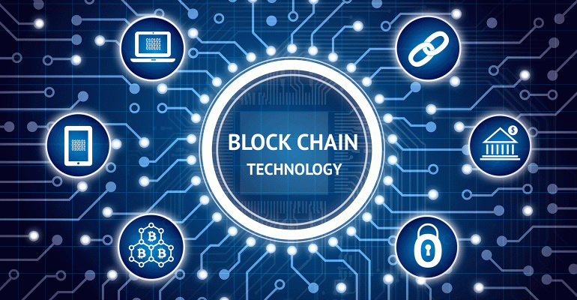
Presentation by
K.THEJESH

Slide 2
CONTENTS:
Introduction
History
Key characteristics
Blockchain in action
Future of Blockchain
Bitcoin
Advantages of bitcoin
Disadvantages of bitcoin
Future scope
Conclusion

Slide 3
Introduction
Originally block chain, is a continuously growing list of records, called blocks, which are linked and secured using cryptography. Each block typically contains a cryptographic hash of the previous block, a timestamp, and transaction data. By design, a blockchain is resistant to modification of the data.
(or)
Blockchain is a digitized, distributed and secure ledger that guarentees immutable transactions and solves the trust problem when two parties exchange the value. Cryptocurrencies like Bitcoin rely on blockchain to conduct transactions.

Slide 4
It is "an open, distributed ledger that can record transactions between two parties efficiently and in a verifiable and permanent way". For use as a distributed ledger, a blockchain is typically managed by a peer-to-peer(P2P) network collectively adhering to a protocol for inter-node communication and validating new blocks.

Slide 5
History
The first blockchain was conceptualized by a person (or group of people) known as Satoshi Nakamoto in 2008.
In August 2014, the bitcoin blockchain file size, containing records of all transactions that have occurred on the network, reached 20 GB (gigabytes). In January 2015, the size had grown to almost 30 GB, and from January 2016 to January 2017, the bitcoin blockchain grew from 50 GB to 100 GB in size.

Slide 6
Key Characteristics
Consensus: For a transaction to be valid, all participants
must agree on its validity.
Provenance: Participants know where the asset came from and how its ownership has changed over time.
Immutability: No participant can tamper with transaction after it’s been recorded to the ledger. If a transaction is in error, a new transaction must be used to reverse the errorand both transactions are then visible.
Finality: A single, shared ledger provides one place to go to determine the ownership of an asset or the completion of a transaction.

Slide 7
Key Benifits
Time saving
Cost saving
Tighter security
Enhanced privacy
Improved auditability

Slide 8
Blockchain In Action
Trade finance
Cross-border transactions
Insurance
Government
The Government of India is fighting land fraud with the help of a blockchain. Andhra Pradesh became the first state in India to adopt blockchain technology in government.
Supply chain management
Healthcare
Internet of things(IOT)

Slide 9
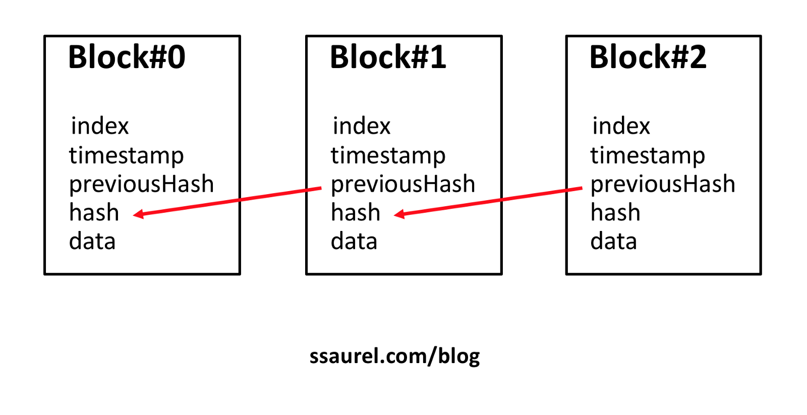

Slide 10
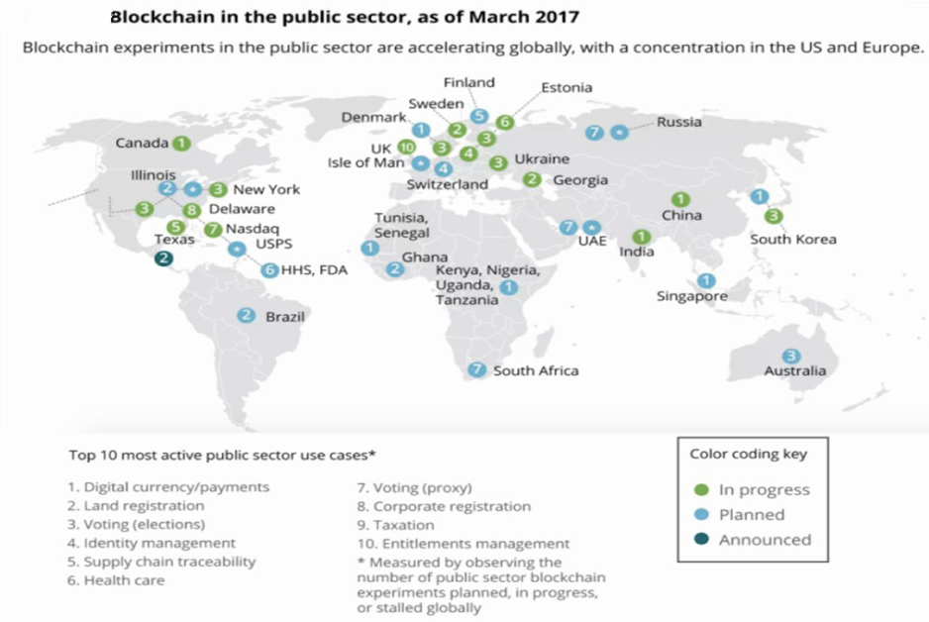

Slide 11
Future of Blockchain
Electronic voting.
Healthcare
Eradicating online fraud.

Slide 12

Bitcoin

Slide 13
Bitcoin
Bitcoin is a cryptocurrency, innovative network and a new form of electronic cash.
It is the first decentralized digital currency.
The system was designed to work without a central bank or singal administrator.
It is an open source P2P money.
1 Bitcoin equals 423,250.29 Indian Rupees.

Slide 14
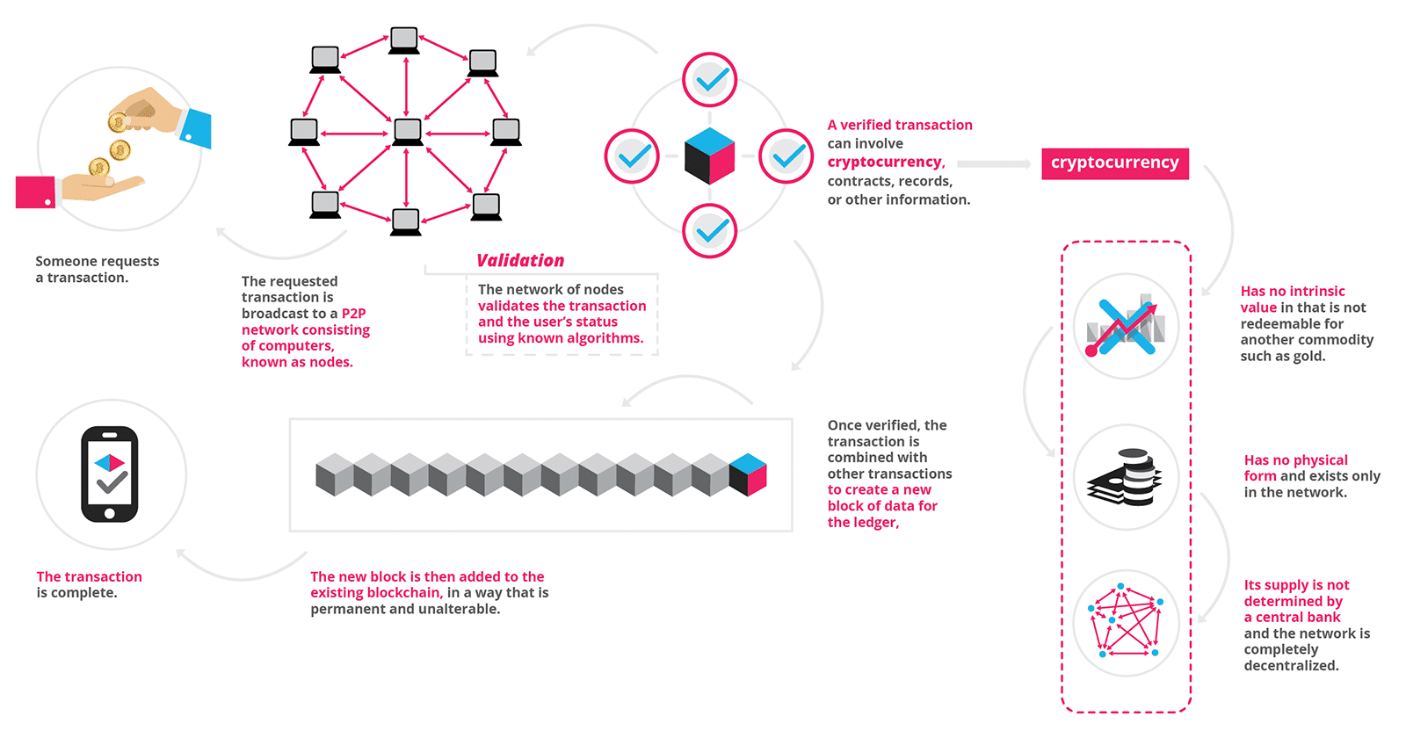

Slide 15
Advantages of bitcoin
Freedom in Payment
Control and Security
Information is Transparent
Very Low Fees
Fewer Risks for Merchants

Slide 16
DISADVANTAGES OF BITCOIN
Lack of Awareness & Understanding
Risk and Volatility
Still Developing
Extending its I plementation in the black market.
Ristrictions on Bitcoin by governments.

Slide 17
CONCLUSION
The “blockchain” is a new technology that has its implementation in a wider space . It has its application in various applications for safer asset transfer, but at the same time it has some drawbacks which has to be overcomed.

Slide 18
THANKYOU

