Slide 1


Jenkins

Slide 2

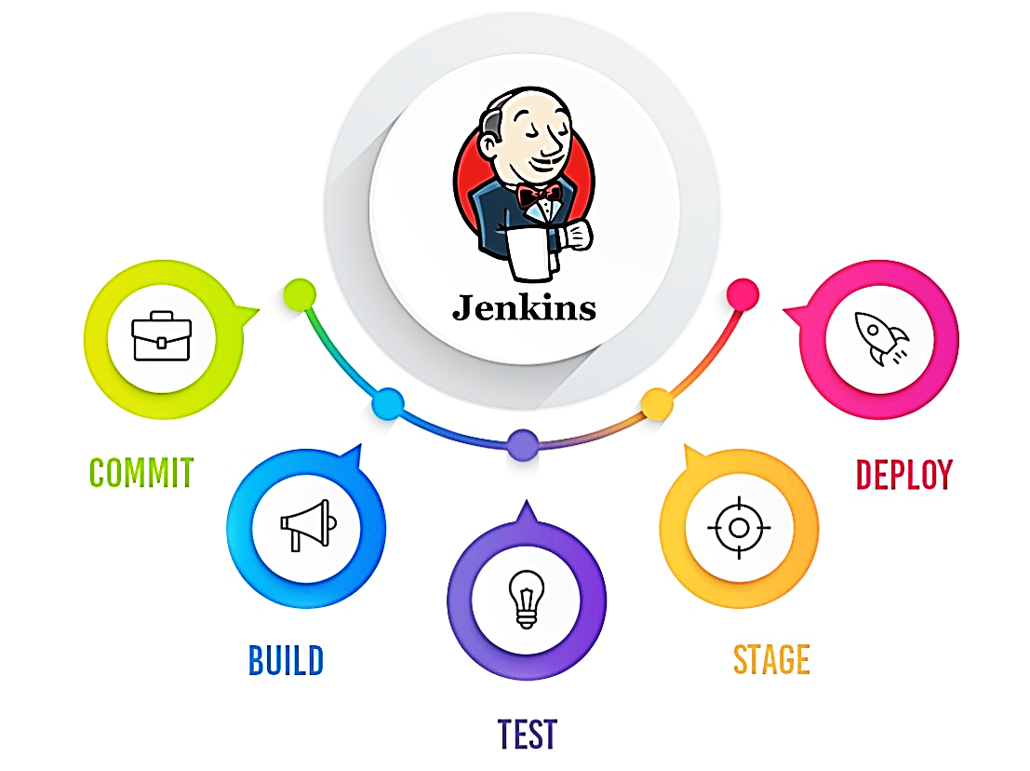

What is Jenkins

Slide 3
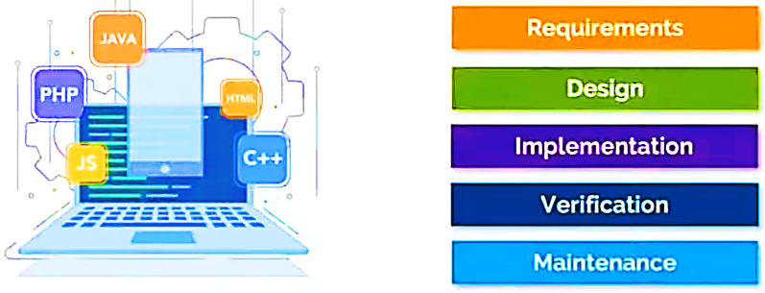
Phases in Software Development Life Cycle

Slide 4
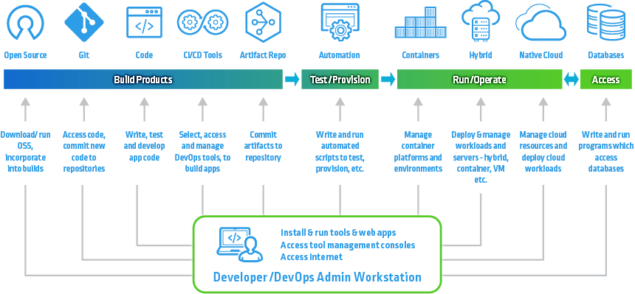
Modern Software Development Life Cycle

Slide 5
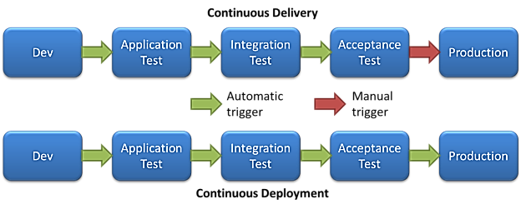
Phases in CI CD pipelines

Slide 6
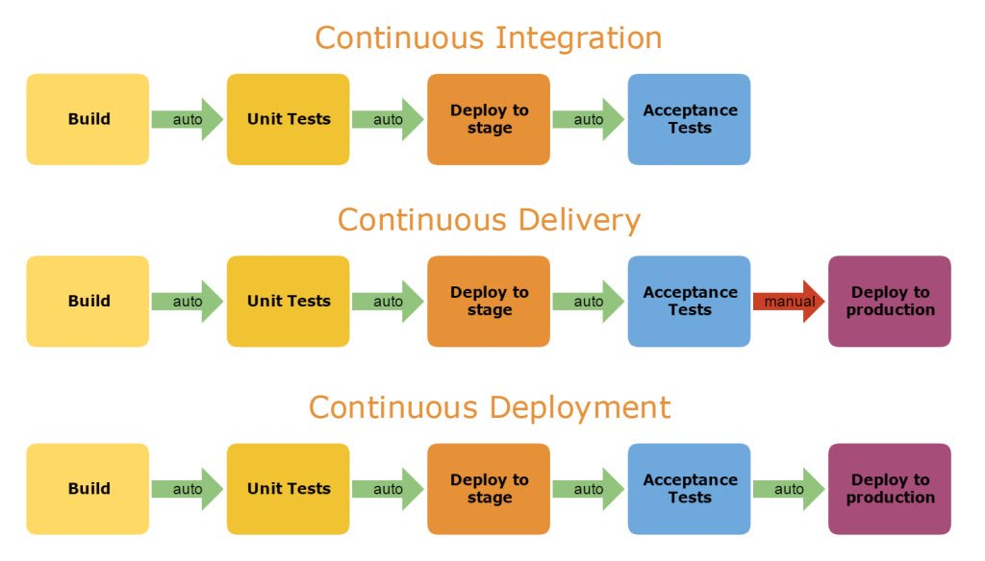
Phases in CI, CD, CD pipelines

Slide 7
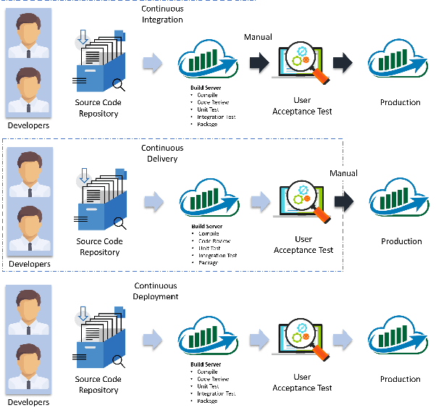
Phases in CI CD pipelines

Slide 8
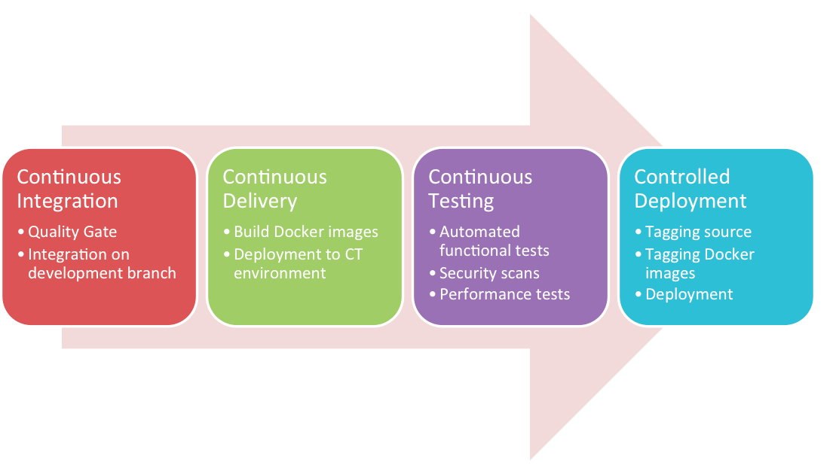
Phases in CI CD pipelines

Slide 9
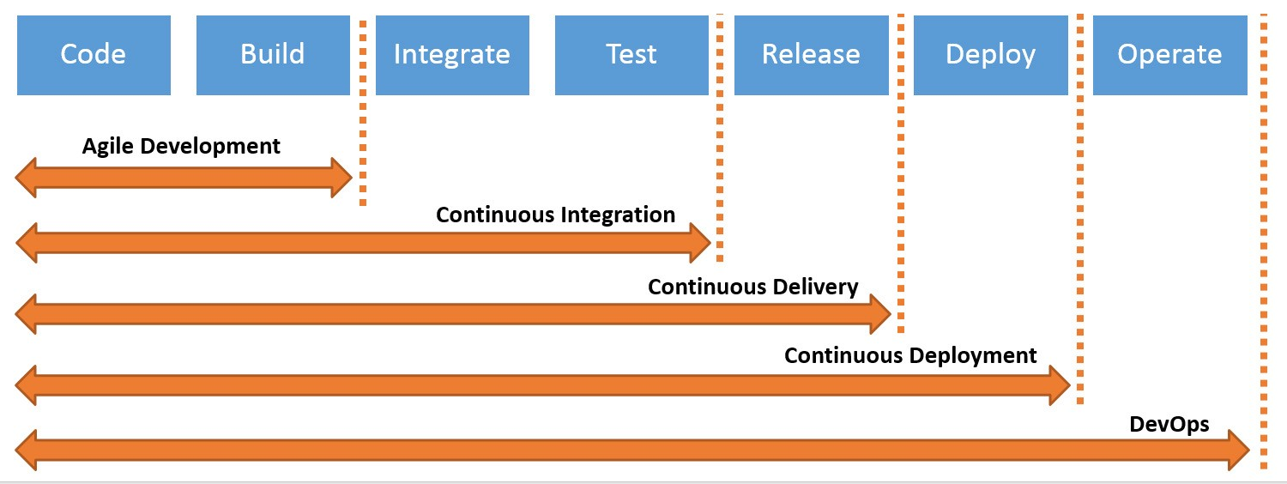
Phases of automation form Agile to DevOps

Slide 10
What is Jenkins
Jenkins is an open sourced automation server that is written in Java and has 1500+ inbuilt plugins for continuous integration and delivery
All of these plugins are also written in Java
Popular plugins are Maven 2 Project, Git, HTML Publisher, Amazon EC2, etc.
Jenkins automates the various phases of software development life cycle such as building, testing, releasing and deploying, thus facilitating continuous integration and continuous delivery
Jenkins enables organizations to accelerate their software development and delivery process with automation.

Slide 11
Need of Jenkins
In Agile based software development projects the developers need to integrate code into a shared repository at regular intervals. This development practice is known as Continuous Integration (CI)
Whenever a new code commit occurs, a build activity is triggered
The build activity pulls the code and builds it to remove the problem of finding later occurrences of issues in the build lifecycle.
Jenkins automates the process of building, testing, and delivery
Jenkins is a server typically installed with the built-in Java servlet container/application server (Jetty)
A continuous integration pipeline is a set of sequential or parallel jobs; these jobs are designed to perform a set of tasks that are configured using the GUI interface of Jenkins.

Slide 12
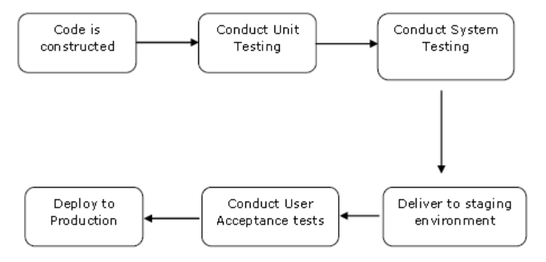
Work Flow of Jenkins

Slide 13
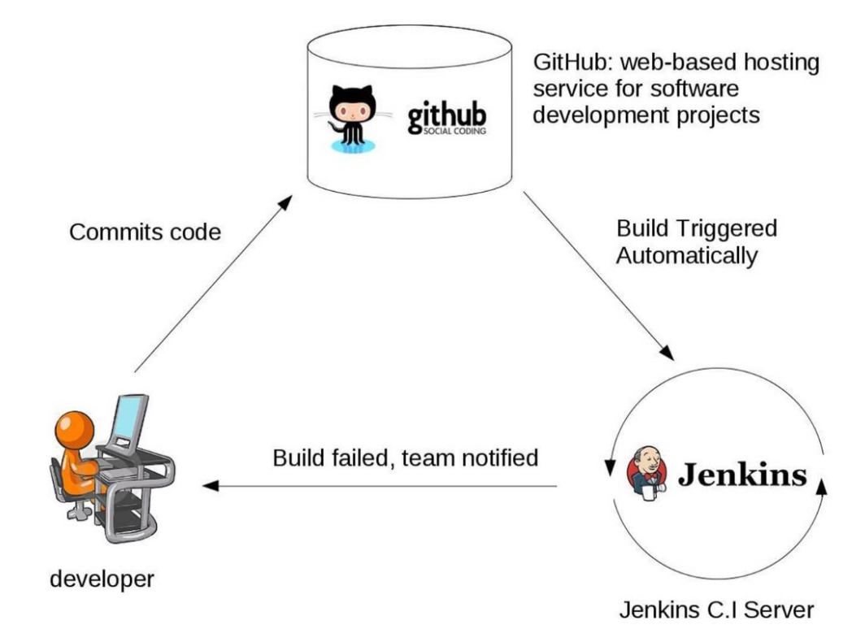

Slide 14
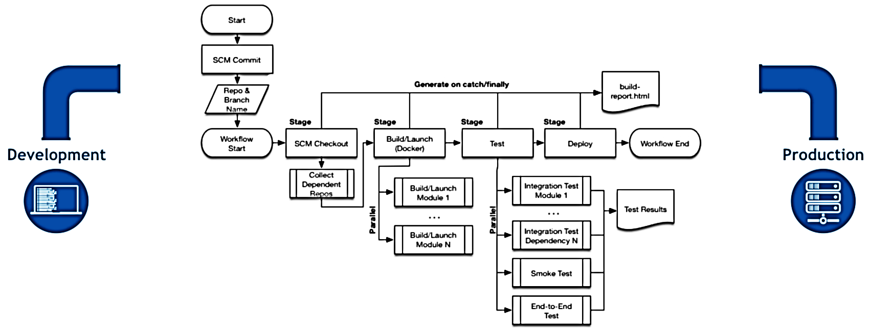
Work Flow of Jenkins

Slide 15
Plugins for Git
GitHub plugin: integrates Jenkins jobs with GitHub repositories for triggering builds and reporting commit status
GitHub Authentication plugin: uses GitHub as the authentication provider for your Jenkins instance
Git plugin: use Git repositories as the source of code for a Jenkins job
GitHub SQS plugin: trigger builds via the GitHub SQS (AWS) service hook
GitHub Issues plugin: create a GitHub issue whenever your build fails, and automatically close it once the build starts passing again.

Slide 16
Plugins for Docker
Docker plugin: dynamically provision agents with Docker
Docker Pipeline plugin: build and use Docker containers in Pipelines
Kubernetes plugin: dynamically allocate and schedule Docker agents on a Kubernetes cluster
Docker build step plugin: add Docker commands as build steps
CloudBees Docker Hub Notification plugin: allows Jenkins to receive webhooks from hub.docker.com to drive pipelines based on Docker in Jenkins.

Slide 17
Plugins for pipelines
Pipeline plugin: allows creating Pipeline scripts for defining build/test/deploy stages of a delivery pipeline
Pipeline Utility Steps plugin: provides a number of additional, useful, steps to the Pipeline DSL
Job DSL plugin: creates a DSL to orchestrate job creation

Slide 18
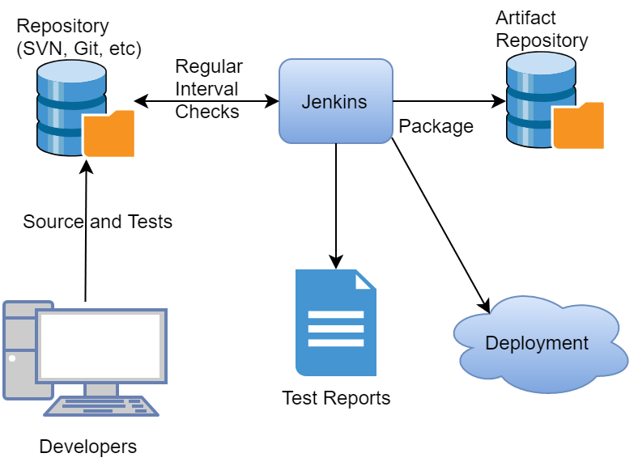
Jenkins work flow

Slide 19
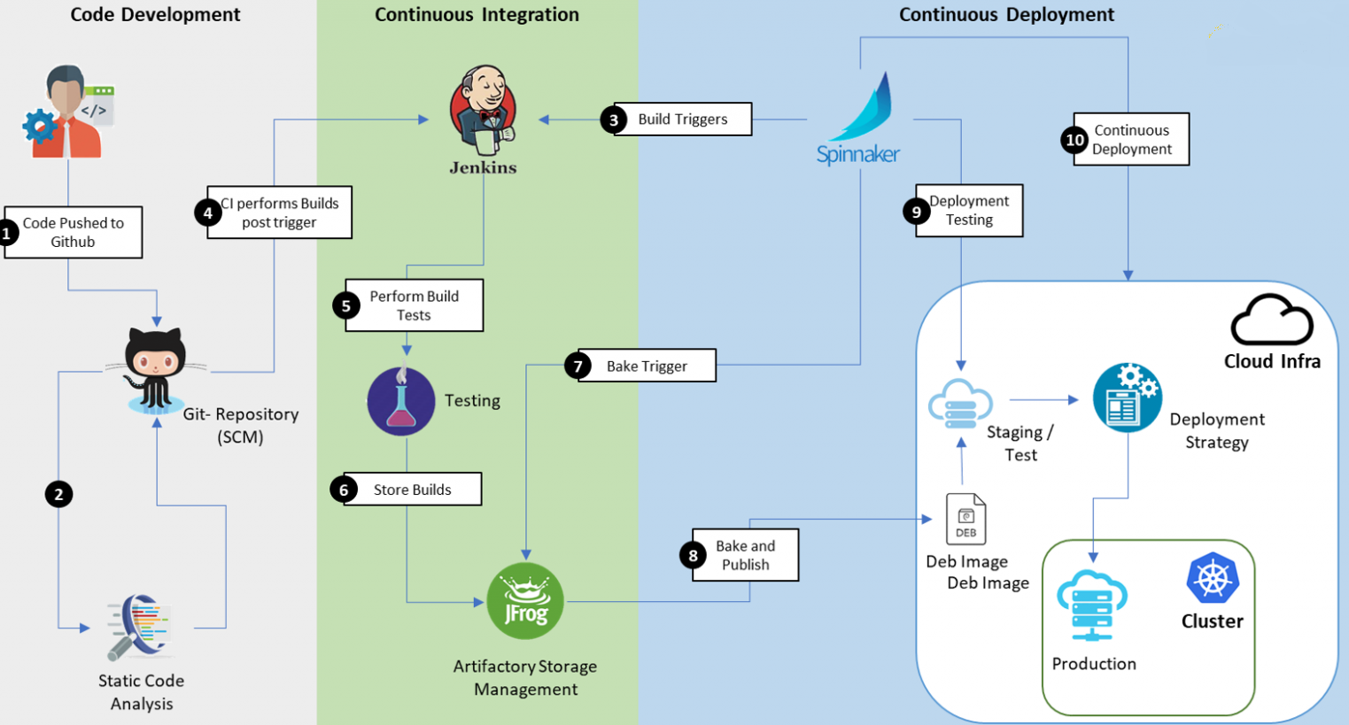
CI & CD

Slide 20
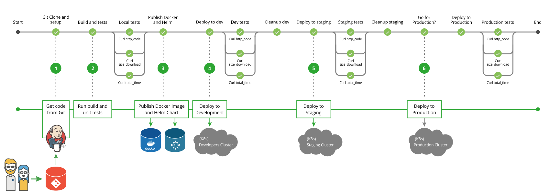

Slide 21
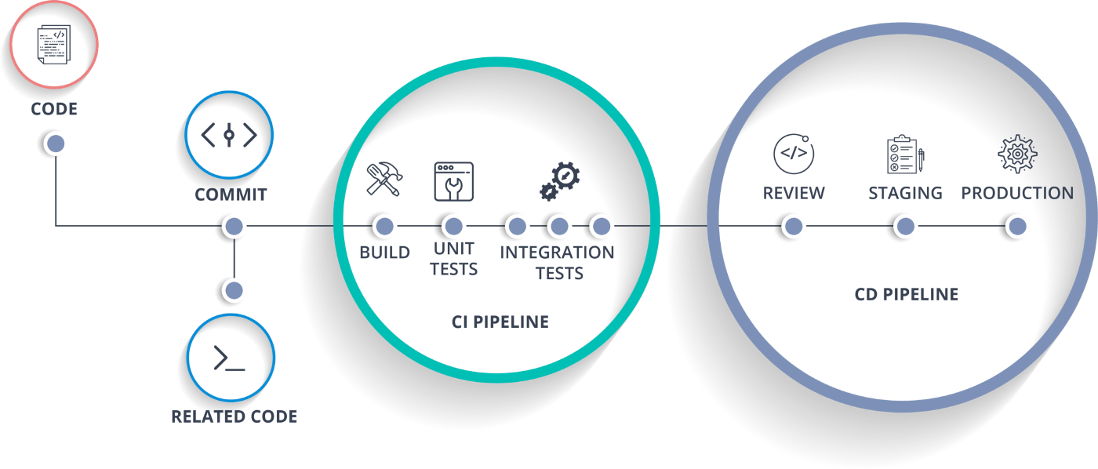
Continuous Development, Integration & Deployment

Slide 22
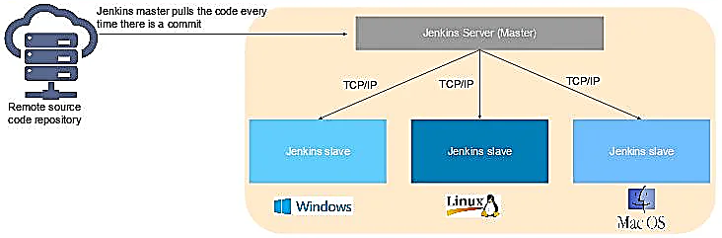
Jenkins Master & Slave architecture

Slide 23
Continuous Integration
Continuous Integration, also know as CI, is a cornerstone of modern software development.
CI infrastructure streamlines the development process right up to deployment, help detect and fix bugs faster, provide a useful project dashboard for both developers and non-developers, and ultimately, help teams deliver more real business value to the end user.
Continuous Integration radically alters the way teams think about the whole development process.
It has the potential to enable and trigger a series of incremental process improvements, going from a simple scheduled automated build right through to continuous delivery into production.

