Slide 1
Real-Time Heart Rate Monitoring System with PIC Microcontroller and Pulse Sensor -Thejesvinii -Sindhu S U

Slide 2
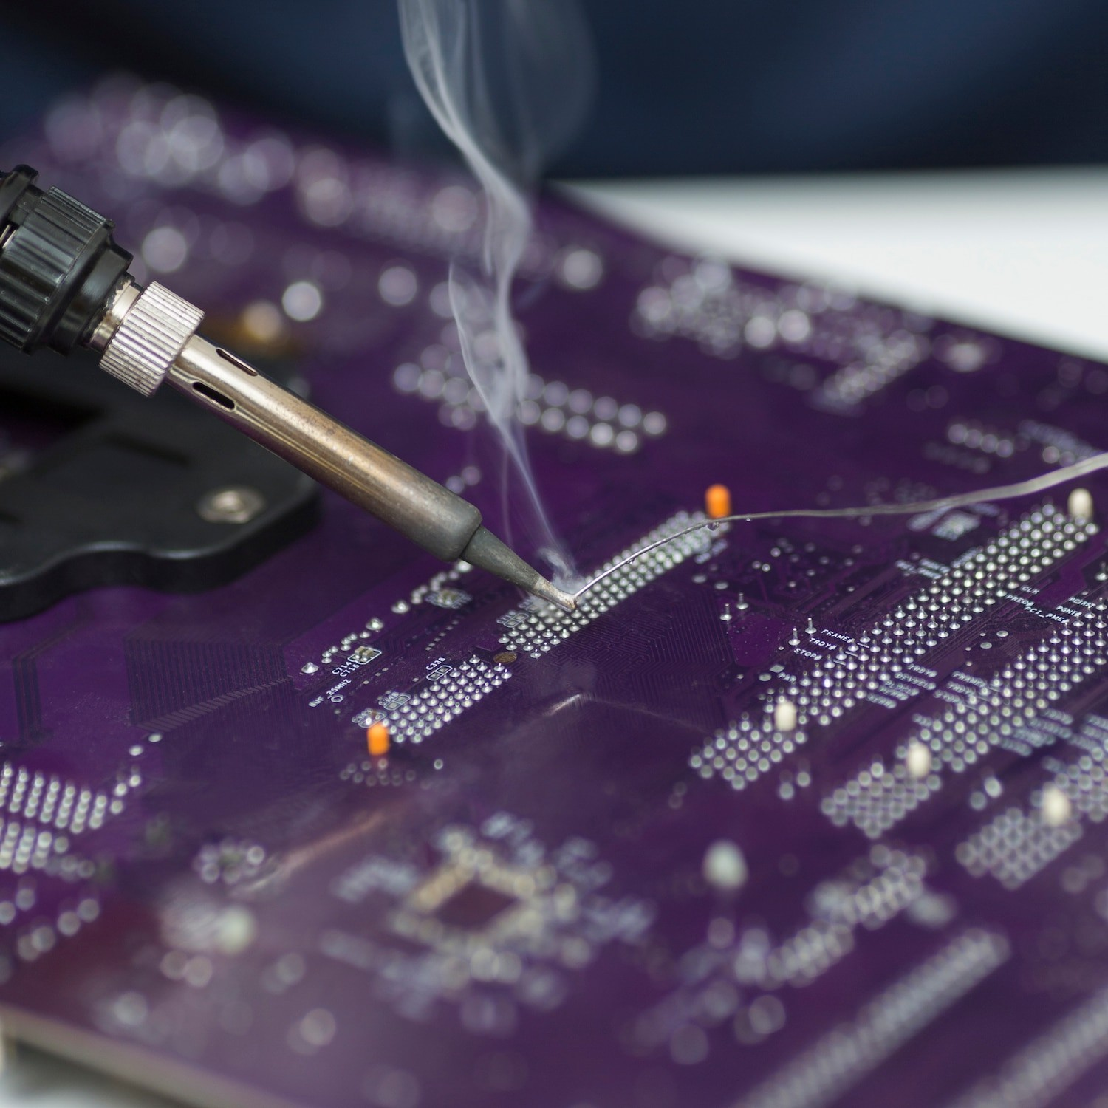

Introduction
This presentation discusses the implementation of a Real-Time Heart Rate Monitoring System using a PIC microcontroller and a . The system provides continuous heart rate monitoring, making it suitable for medical and ﬁtness applications.

Slide 3

The is a versatile and widely used microcontroller in embedded systems. It provides the processing power and I/O capabilities required for real-time heart rate monitoring. The microcontroller is programmed to process the sensor data and display the heart rate.

Slide 4
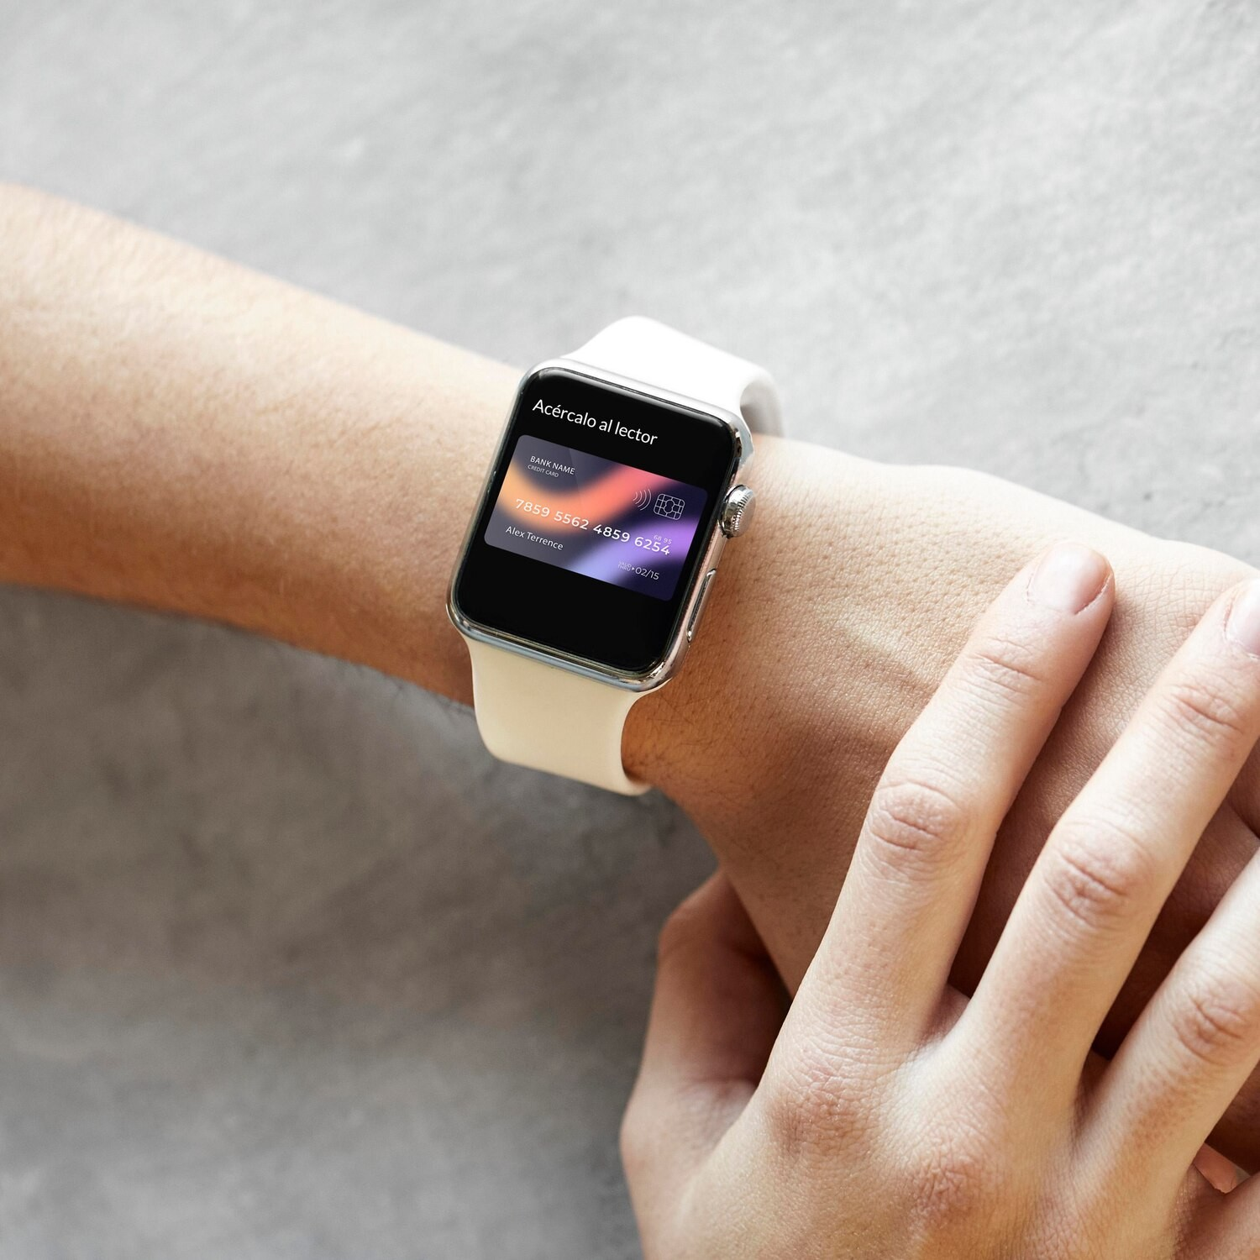

Pulse Sensor
The is a non-invasive sensor that detects changes in blood volume. It is commonly used for measuring heart rate and provides reliable and accurate data.
The sensor is easily integrated into the monitoring system, making it suitable for real-time applications.

Slide 5
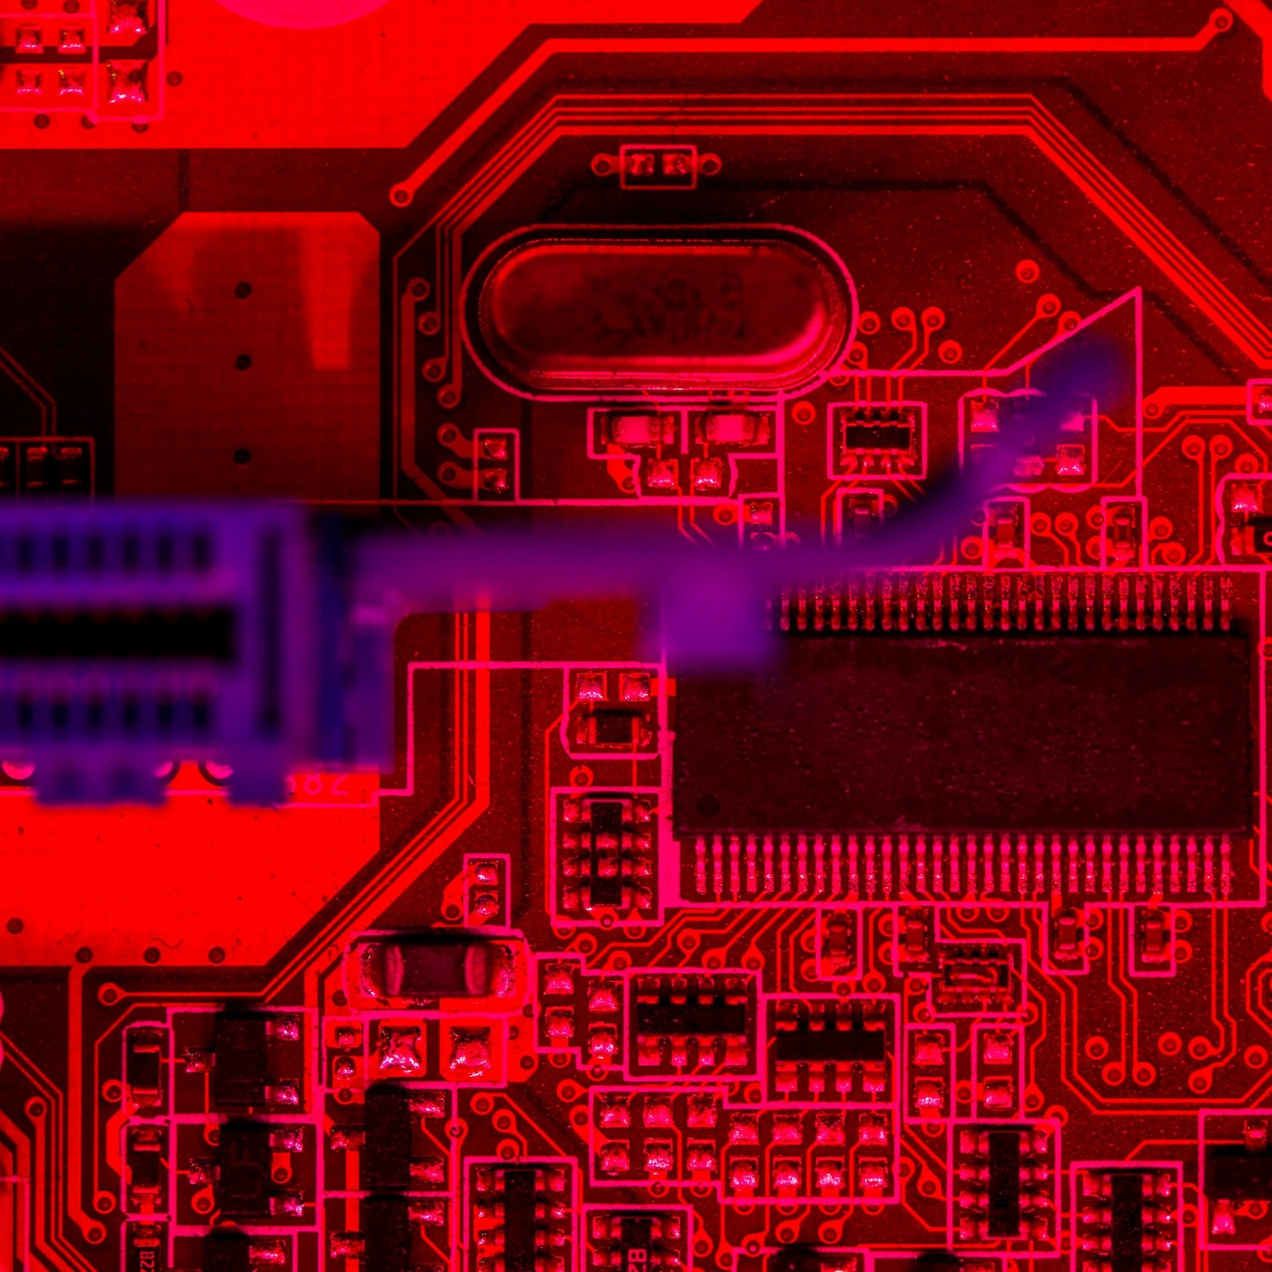

System Architecture
The
consists of the PIC microcontroller, Pulse Sensor, and a monitoring display.
The sensor detects the pulse signal, which is processed by the microcontroller. The calculated heart rate is then displayed in real-time on the monitoring display.

Slide 6
Required Components
PIC16F877A microcontroller
20 Mhz Crystal
33pF capacitor 2 pcs
4.7k resistor 1 pcs
16x2 Character LCD
10K pot for contrast control of the LCD
SEN-11574 Pulse sensor
Velcro strap
5V Power adapter
Breadboard and hookup wires

Slide 7
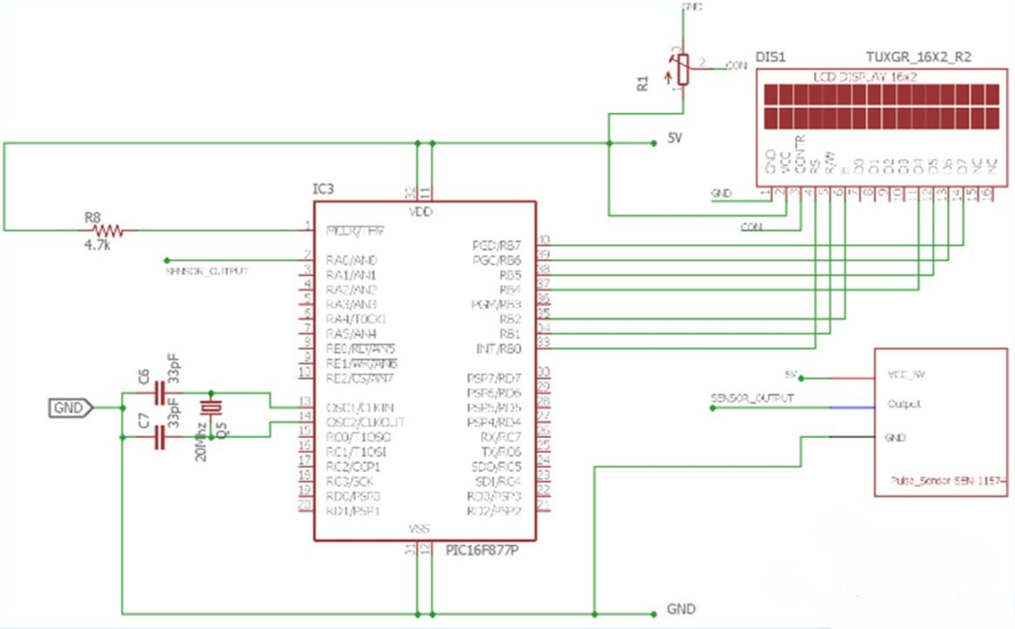
Schematic

Slide 8
Code flow Case 1: Read the ADC Case 2: Calculate the Heart Beat Case 3: Show the heartbeat on LCD

Slide 9
void main() {
system_init();
main_state = READ_ADC;
while (1) {
switch (main_state) {
case READ_ADC:
{
adc_value = ADC_Read(0); // 0 is the channel number
main_state = CALCULATE_HEART_BEAT;
break;
}
case CALCULATE_HEART_BEAT:
{
calculate_heart_beat(adc_value);
main_state = SHOW_HEART_BEAT;
break;
}
case SHOW_HEART_BEAT:
{
if (QS == true) { // A Heartbeat Was Found
// BPM and IBI have been Determined
// Quantified Self "QS" true when Arduino finds a heartbeat
QS = false; // reset the Quantified Self flag for next time

Slide 10
// 0.9 used for getting better data. actually should not be used
BPM = BPM * 0.9;
lcd_com(0x80);
lcd_puts("BPM:- ");
lcd_print_number(BPM);
lcd_com(0xC0);
}
}
main_state = IDLE;
break;
case IDLE:
{
break;
}
default:
{
}
}

Slide 11
void system_init(void){ TRISB = 0x00; lcd_init(); // This will initialize the lcd TMR0_Initialize(); TMR0_StartTimer(); INTERRUPT_GlobalInterruptEnable(); INTERRUPT_PeripheralInterruptEnable(); ADC_Init();}
void timer_isr() { main_state = READ_ADC; }
void interrupt INTERRUPT_InterruptManager (void) { // interrupt handler if(INTCONbits.TMR0IE == 1 && INTCONbits.TMR0IF == 1) { TMR0_ISR(); } }

Slide 12
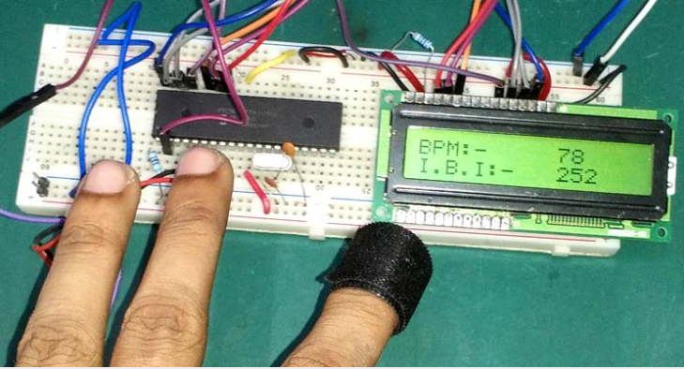

Slide 13
The processes the analog signal from the Pulse Sensor using signal conditioning techniques. The processed data is then converted to digital format for heart rate calculation. The calculated heart rate is continuously updated and displayed in real-time.

Slide 14
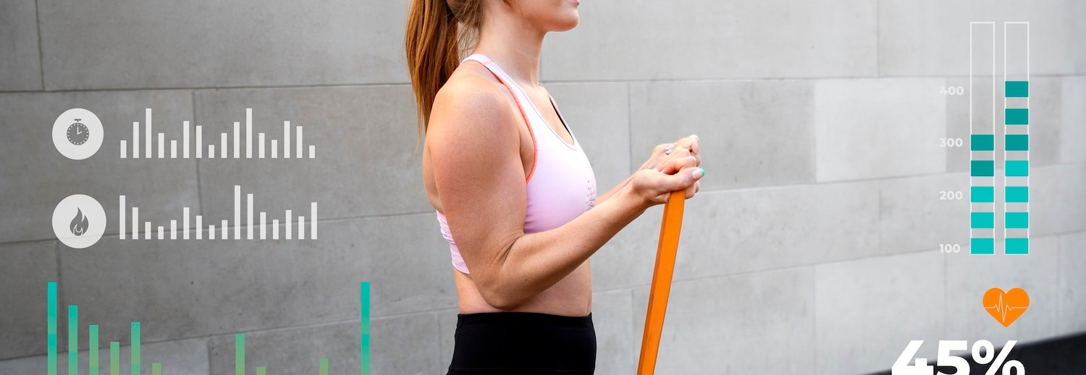
The system provides , allowing users to track their heart rate continuously. This feature is beneﬁcial for medical professionals, athletes, and ﬁtness enthusiasts. The real-time display enables immediate feedback and intervention if necessary.

Slide 15
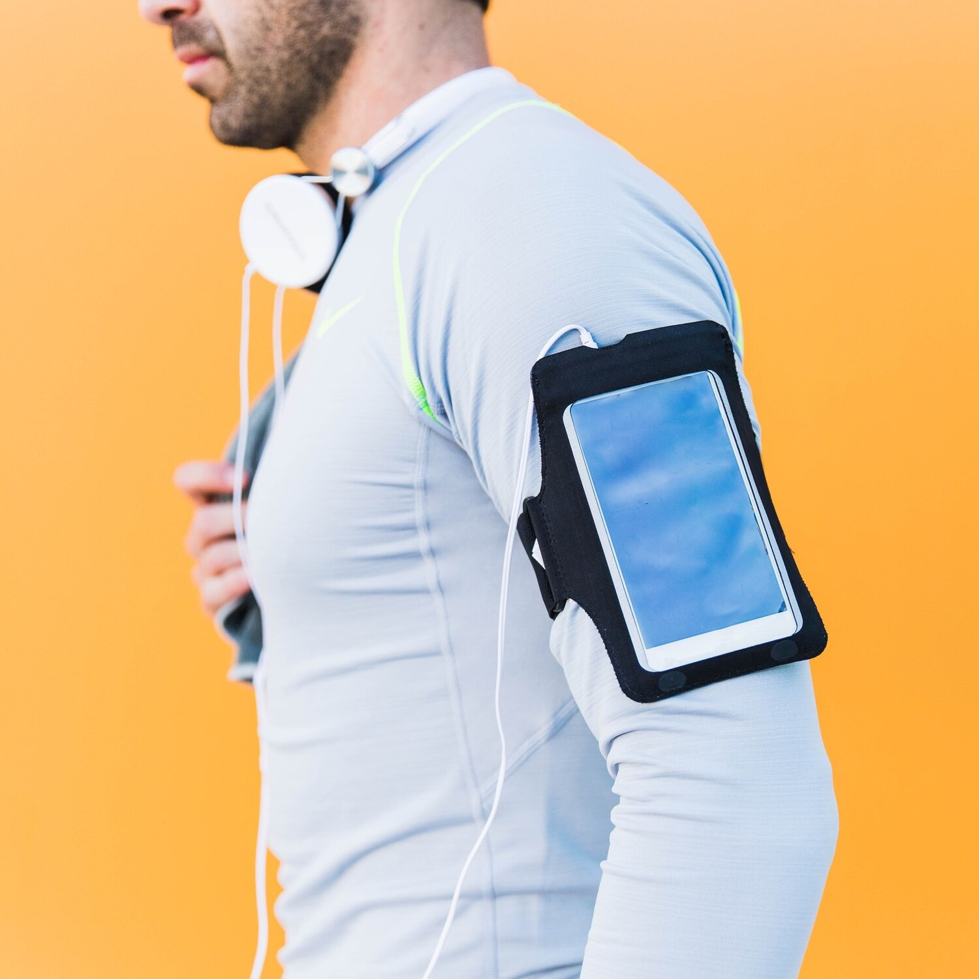
Applications
The
has diverse applications in healthcare, sports, and wellness. It can be used for patient monitoring in hospitals, ﬁtness tracking in sports, and personal health management. The system's versatility and accuracy make it suitable for various use cases.

Slide 16
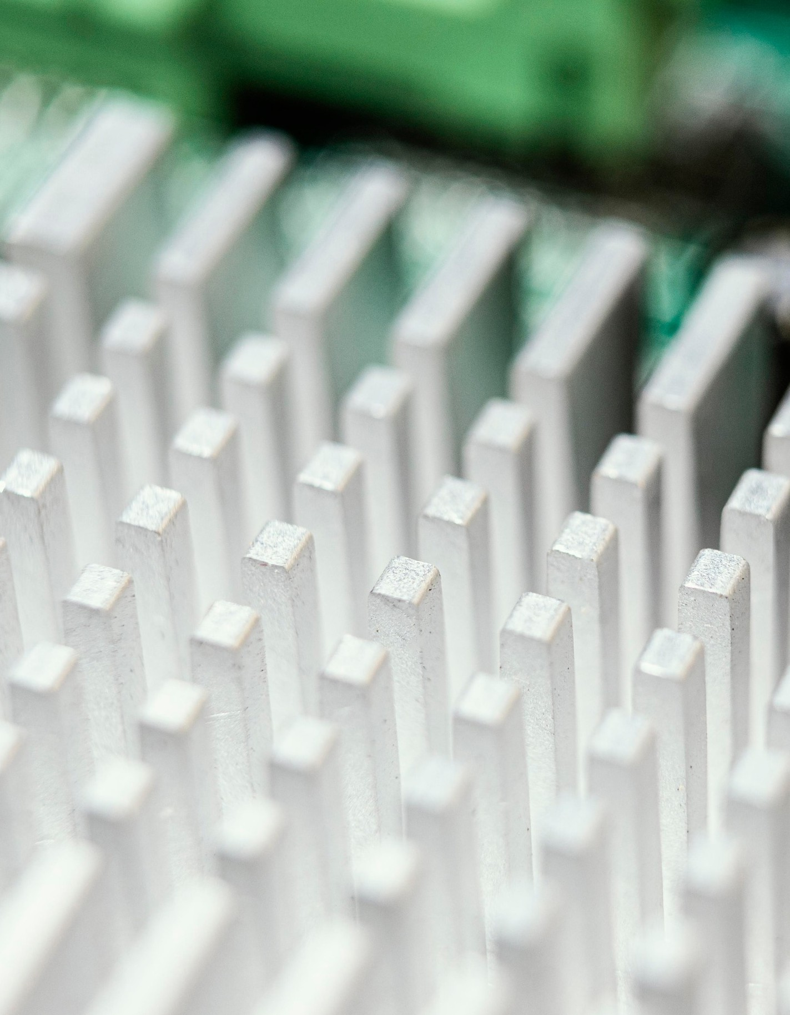
Challenges and Solutions
Implementing a real-time heart rate monitoring system poses challenges such as signal noise and accuracy. Solutions include signal ﬁltering techniques and calibration to ensure accurate heart rate measurements. The system's performance can be optimized through careful design and implementation.

Slide 17

Future Enhancements
Future enhancements to the system may include wireless connectivity for data transmission, integration with mobile applications for remote monitoring, and advanced data analytics for health insights. These enhancements aim to further improve the system's usability and effectiveness.

Slide 18

Conclusion
The implementation of a
using a PIC microcontroller and Pulse Sensor offers continuous and accurate heart rate monitoring. The system's applications in healthcare, sports, and wellness demonstrate its signiﬁcance in promoting health and well-being.

Slide 19
Thank You

