Slide 1

Peltier-Based Thermoelectric Cooler using PWM Controller and IoT Web Interface
M. Thejeswara Reddy – CB.SC.U4AIE24129
V. Noothan – CB.SC.U4AIE24129

Slide 2
INTRODUCTION :
Temperature control is essential in various industrial and domestic applications.
This project focuses on developing a Peltier-based thermoelectric cooler monitered by an ESP32.
The system uses a DS18B20 sensor to monitor the ambient temperature.
A MOSFET switch is used to control the Peltier module, and a PWM controller allows manual adjustment of
the cooling intensity.
This project demonstrates a practical application of IoT and temperature regulation using
microcontroller-based automation.
Additionally, the system includes an HTML-based IoT interface for remote monitoring and control.

Slide 3
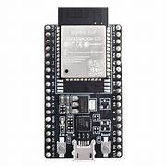
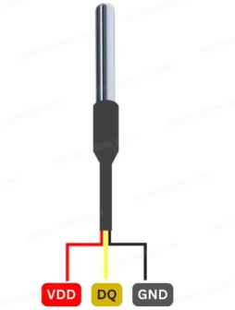
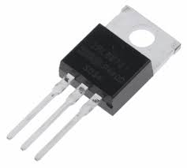
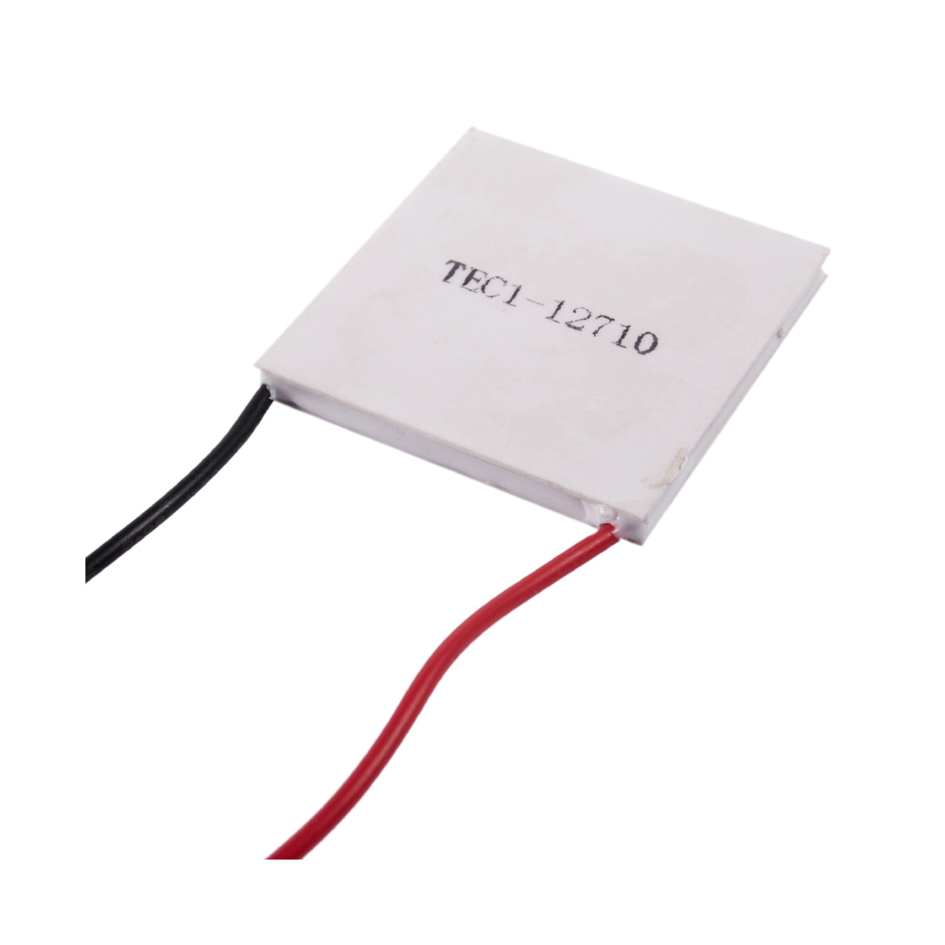

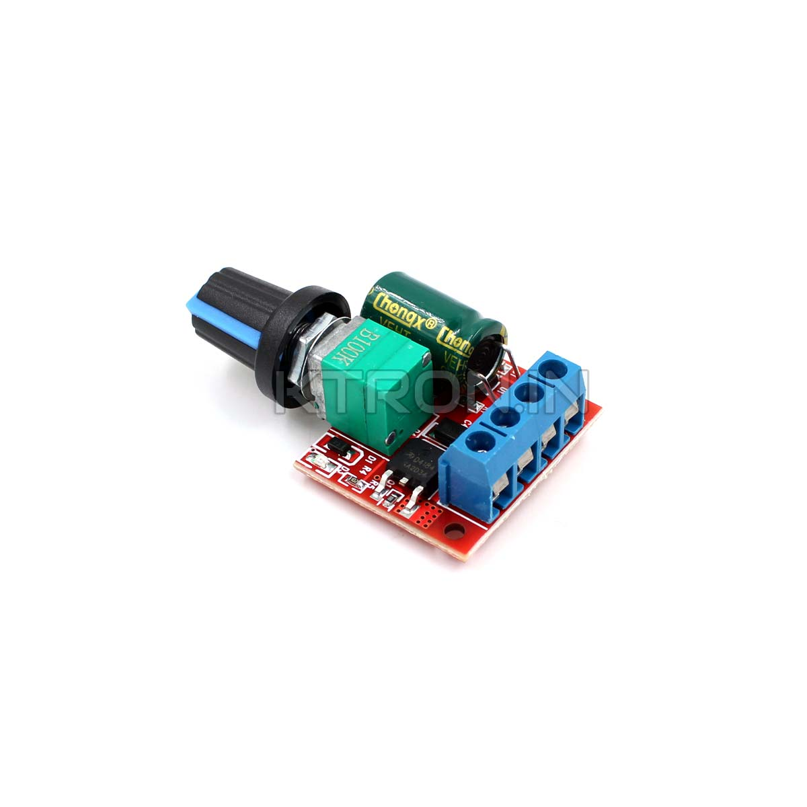

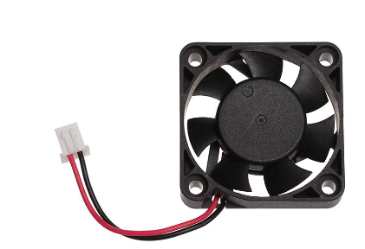
CIRCUIT CONNECTIONS
GND
3.3V
10K Resistor
VCC
DATA
SOURCE
GND
GATE
GPIO 4
GPIO 14
- VE
GND
DRAIN
V +
V +
V-
V-
M -
M +

Slide 4
Objectives :
To design and develop a Peltier-based thermoelectric cooling system controlled by an ESP32.To monitor real-time
temperature using a DS18B20 sensor . To automate the cooling process when the temperature exceeds 50°C using a
MOSFET . To regulate the cooling intensity manually using a PWM controller . To ensure continuous operation of the
cooling system until it is manually stopped . To enhance system efficiency by adding a fan for heat
dissipation . To create a stable and efficient temperature regulation system for real-time applications.

Slide 5
What is the Peltier Effect?
The Peltier Effect is a thermoelectric phenomenon where heat is absorbed or released when an electric current passes through a junction of two different conductors.
In our project, the Peltier module uses this effect to create a temperature difference, allowing for active cooling.

Slide 6
Working of a Peltier Module
A typical Peltier module (TEC1-12706) has two ceramic plates with thermoelectric materials in between. When DC current is applied, one side becomes hot and the other cold.
The cold side is used for cooling the desired area, while the hot side is dissipated using a heat sink and fan.

Slide 7
METHODOLOGY
Component Selection and Setup:
Selected ESP32-WROOM-32D for its Wi-Fi capability and low power consumption.
Used a DS18B20 sensor for its reliability in measuring temperature.
Chose a TEC1-12706 Peltier module for its high cooling efficiency.
Used an IRLZ44N MOSFET for switching because of its high current handling capacity.
Integrated a PWM controller to adjust the cooling intensity based on real-time needs.
System Configuration:
Configured ESP32 GPIO pins to handle input from the DS18B20 sensor.
Defined control logic in Arduino IDE to trigger the MOSFET when the temperature exceeds the threshold.
Tuned the PWM controller’s duty cycle to control the voltage applied to the Peltier module.

Slide 8
Algorithm and Logic Flow:
System starts in monitoring mode.
DS18B20 sends real-time temperature and humidity data to the ESP32.
If temperature > 50°C → ESP32 sends a HIGH signal to the MOSFET gate.
MOSFET switches ON → Current flows to the Peltier module via the PWM controller.
Peltier starts cooling → Cooling intensity adjusted manually using the PWM controller.
Peltier continues working even if the temperature drops.
System runs continuously once triggered.
Safety measures:
We are using a heat sink on the Peltier module to improve heat dissipation and even a fan to ensure proper heat dissipation.
We are using N-channel MOSFET (IRLZ44N) to ensure that the Peltier module gets correct current from the esp32.

Slide 9
IoT Interface Overview
An HTML/JavaScript-based web interface is created for real-time temperature monitoring.
The ESP32 hosts a webpage via Wi-Fi, displaying live temperature data read from the DS18B20 sensor.
This enables remote observation of the system.

Slide 10
Advantages of the System
- Compact and efficient cooling
- Manual control of intensity via PWM
- Real-time temperature feedback
- Integration with IoT for remote monitoring
- No harmful gases or mechanical parts

Slide 11
Results
The system successfully detects temperature using the DS18B20 sensor.
The PWM controller effectively adjusts the cooling intensity.
The HTML-based web interface displays real-time temperature data.
The addition of a fan significantly improved heat dissipation efficiency.

Slide 12
Future Enhancements
- Add temperature data logging using SD card or cloud
- Mobile app integration for enhanced accessibility
- Automatic intensity adjustment based on environment
- Solar power integration for eco-friendly operation

Slide 13
Conclusion
This project successfully demonstrates the implementation of a Peltier-based thermoelectric cooling system with IoT capabilities. By integrating an ESP32, DS18B20 sensor, MOSFET, and a manual PWM controller, the system achieves efficient temperature regulation. The HTML-based interface further enhances usability by enabling remote monitoring. Future enhancements could make this system even more intelligent and sustainable.

Slide 14
THANK YOU

