Slide 1

ELECTRICAL AND ELECTRONICS ENGINEERING & USER INTERFACE
Peltier-Based Thermoelectric Cooler using PWM controller
Team-16
Team Members
1.Thejeswara Reddy – CB.SC.U4AIE24129
2.V.Noothan – CB.SC.U4AIE24156

Slide 2
INTRODUCTION
Temperature control is essential in various industrial and domestic applications.
This project focuses on developing a Peltier-based thermoelectric cooler controlled by an ESP32.
The system uses a DHT11 sensor to monitor the ambient temperature.
When the temperature exceeds a set threshold, the ESP32 will activate the cooling system.
A MOSFET switch is used to control the Peltier module, and a PWM controller allows manual adjustment of
the cooling intensity.
This project demonstrates a practical application of IoT and temperature regulation using
microcontroller-based automation.

Slide 3
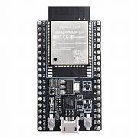
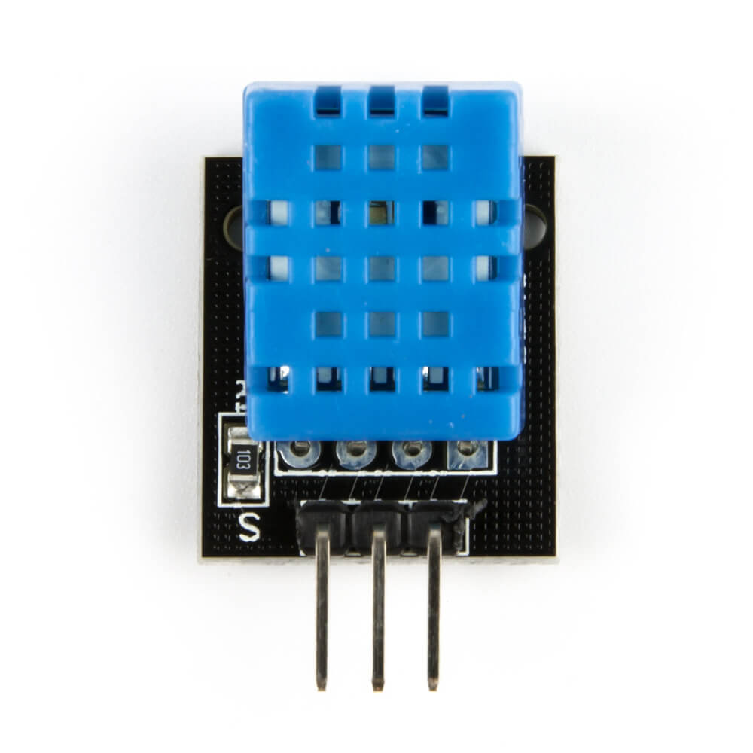
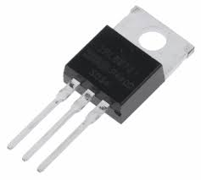
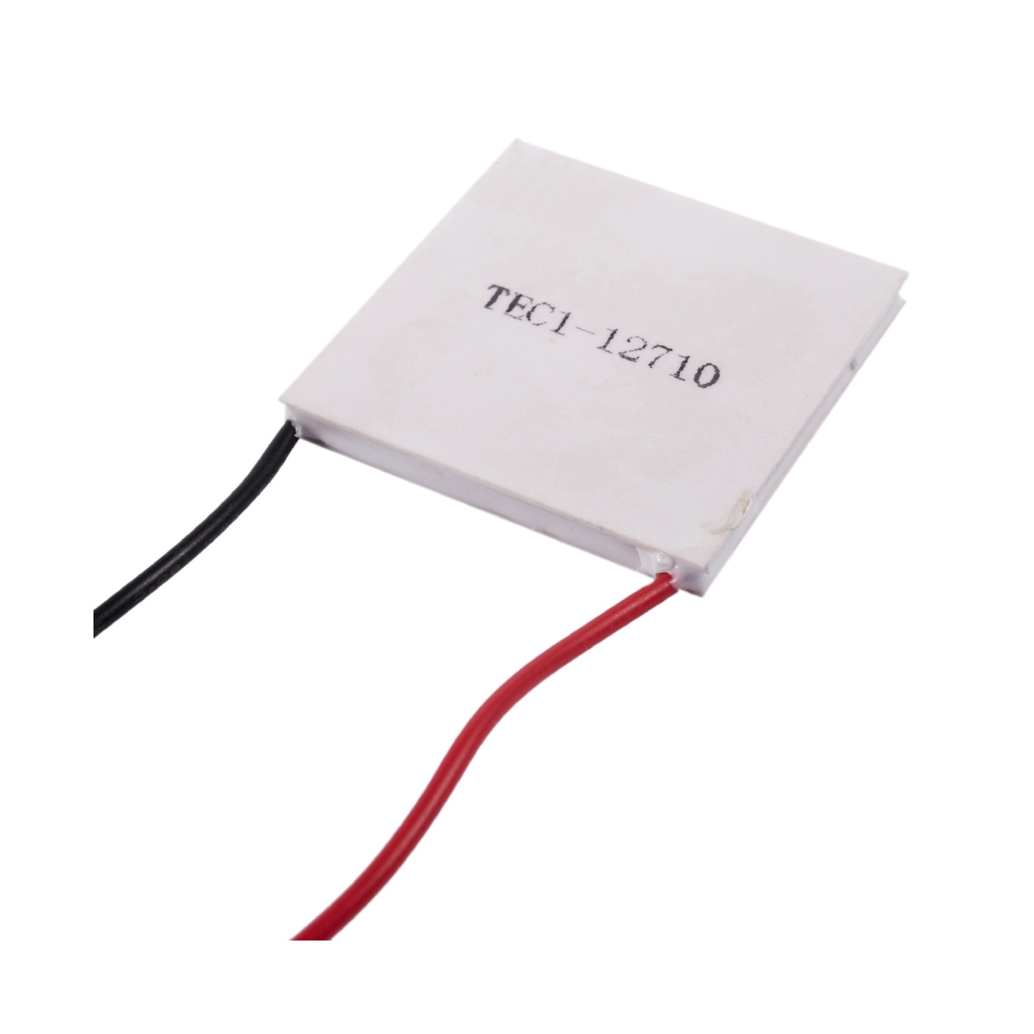

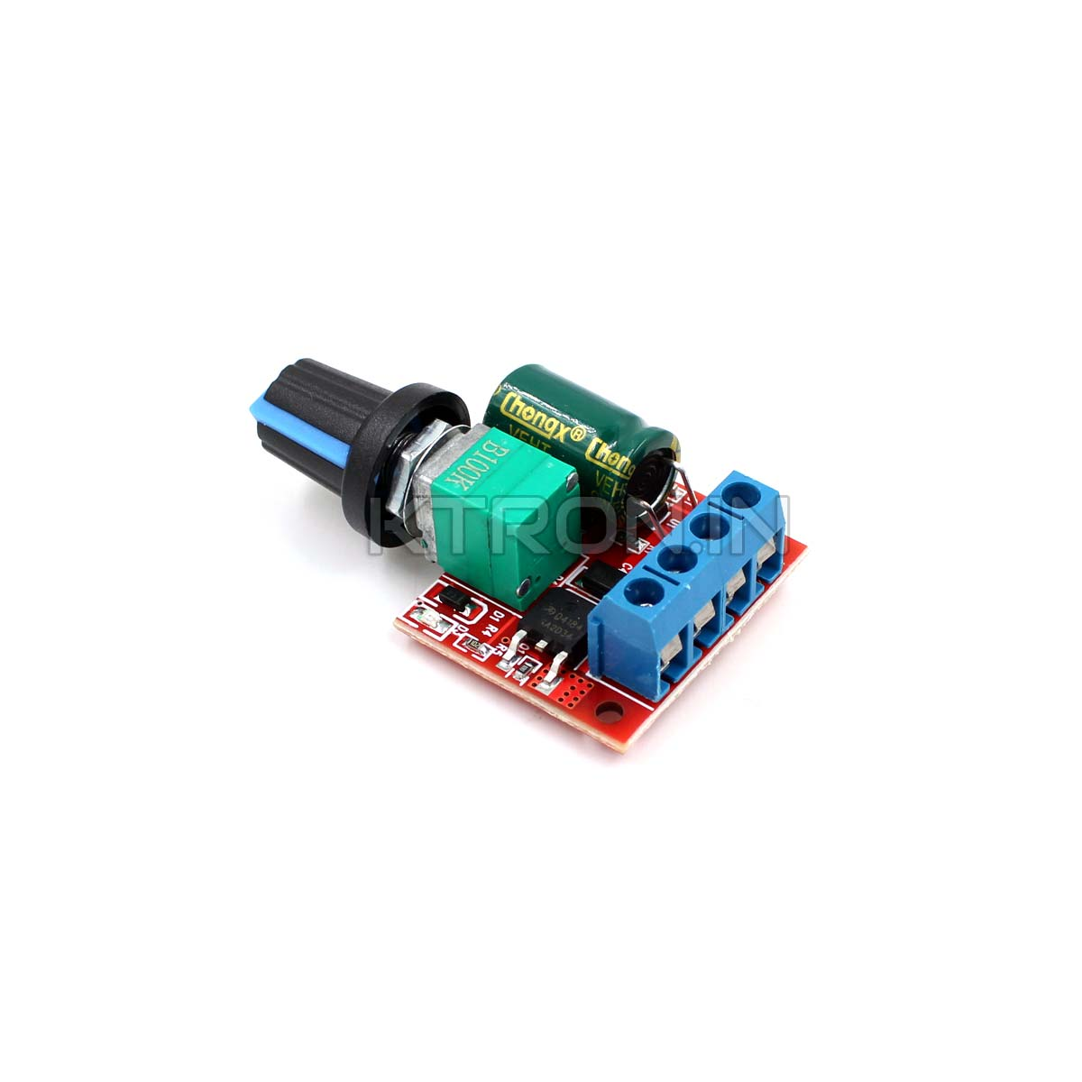

CIRCUIT CONNECTIONS
GND
3.3V
10K Resistor
VCC
DATA
GATE
SOURCE
GND
GPIO 4
GPIO 14
- VE
GND
DRAIN
V +
V +
V-
V-
M -
M +

Slide 4
Objectives :
To design and develop a Peltier-based thermoelectric cooling system controlled by an ESP32.To monitor real-time
temperature using a DHT11 sensor . To automate the cooling process when the temperature exceeds 50°C using a
MOSFET . To regulate the cooling intensity manually using a PWM controller . To ensure continuous operation of the
cooling system until manually stopped using a stop button . To enhance system efficiency by adding a fan for heat
dissipation . To create a stable and efficient temperature regulation system for real-time applications.

Slide 5
METHODOLOGY
Component Selection and Setup:
Selected ESP32-WROOM-32D for its Wi-Fi capability and low power consumption.
Used a DHT11 sensor for its reliability in measuring temperature and humidity.
Chose a TEC1-12706 Peltier module for its high cooling efficiency.
Used an IRLZ44N MOSFET for switching because of its high current handling capacity.
Integrated a PWM controller to adjust the cooling intensity based on real-time needs.
System Configuration:
Configured ESP32 GPIO pins to handle input from the DHT11 sensor.
Defined control logic in Arduino IDE to trigger the MOSFET when the temperature exceeds the threshold.
Tuned the PWM controller’s duty cycle to control the voltage applied to the Peltier module.

Slide 6
Algorithm and Logic Flow:
System starts in monitoring mode.
DHT11 sends real-time temperature and humidity data to the ESP32.
If temperature > 50°C → ESP32 sends a HIGH signal to the MOSFET gate.
MOSFET switches ON → Current flows to the Peltier module via the PWM controller.
Peltier starts cooling → Cooling intensity adjusted manually using the PWM controller.
Peltier continues working even if the temperature drops.
System stops only when the manual stop button is pressed.
Safety measures:
We are using a heat sink on the Peltier module to improve heat dissipation and even a fan to ensure proper heat dissipation.
We are using N-channel MOSFET (IRLZ44N) to ensure that the Peltier module gets correct current from the esp32.

Slide 7
THANK YOU

