Slide 1
Environmental Sound Classification using CNN
Team Members :
V Noothan [CB.SC.U4AIE24156]
M THEJESWARA REDDY [CB.SC.U4AIE24129]

Slide 2
INTRODUCTION 3
Objective 4
Literature review 5
About Our Dataset 6
Advantages and Disadvantages 7
Methodology 8
Result 9
Limitations 12
Future work 13

Slide 3
INTRODUCTION :
Environmental Sound Classification (ESC) is the task of identifying and categorizing sounds from the environment.
It focuses on recognizing common everyday sounds such as dog barks, sirens, and drilling.
The project deals with analyzing and recognizing various non-speech, non-music environmental sounds.
Environmental sound classification has applications in smart cities, security systems, and context-aware devices.
3

Slide 4
Objectives :
To Identify and categorize different environmental sounds like traffic, alarms, and footsteps.
Apply Deep Neural Networks (DNNs) to help the model learn patterns in the audio data.
Use MFCCs to get important features from the sounds for better classification.
Enhance the model’s performance with techniques like MaxPooling and Dropout.
4

Slide 5
LITERATURE REVIEW :
Comparison with previous works
Name | Data set | Model | Accuracy
CNN Model | Urbansound8k | CNN | 86.70
CNN Latent subspaces | Urbansound8k | Latent Subspace | 85.01
CNN Model | Urbansound8k | Conv2D | 91.00
Proposed model | Urbansound8k | Conv1D | 93.13

Slide 6
About Our Dataset :
We are using urbansound8k dataset . Which contains 8732 audio clips in 10 different class
The Classes are Air Conditioner, Car Horn, Children Playing, Dog Bark, Drilling,
Engine Idling, Gun Shot, Jackhammer, Siren, Street Music
Why we are using This Dataset :
The dataset contains real urban environment recordings, making the model practical and realistic.
Audio clips are pre-labeled into 10 sound classes with useful metadata, making training easy.
Widely used in research, allowing easy comparison with other models and studies.
6

Slide 7
Advantages :
Automated Sound Detection: Helps in automatically recognizing sounds without human intervention.
Useful in Real-world Applications: Can be applied in surveillance, healthcare, and smart city monitoring.
High Accuracy with Deep Learning: Using CNN and MFCC improves classification performance.
Disadvantages :
Needs Large Data and Resources: Deep learning models require more data and computational power.
Noise Interference: Background noise can reduce accuracy in real-world settings.
Limited to Predefined Classes: The system only detects sounds it was trained on new sounds won't be recognized.

Slide 8
Methodology :
Data Collection: Used the UrbanSound8K dataset containing 8,732 labeled audio
clips across 10 sound classes.
Audio Preprocessing: Loaded each audio file and extracted features using
MFCC (Mel-Frequency Cepstral Coefficients).
Feature Scaling: Scaled the MFCC features by taking the mean across time
to reduce dimensionality.
Model Building: Designed a 1D Convolutional Neural Network (CNN) to learn
and classify sound patterns.
Train-Test Split: Divided the dataset into training (80%) and testing (20%) sets .
Label Encoding: Converted sound class labels to numerical form using
LabelEncoder and one-hot encoding.
Model Training: Trained the CNN using the training data .
Evaluation: Evaluated the model's performance using accuracy metrics on the test set.

Slide 9
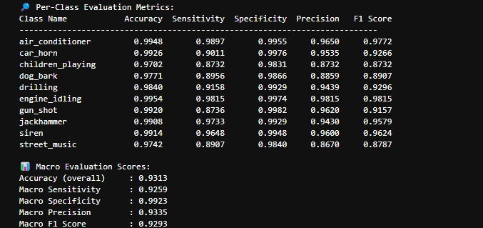
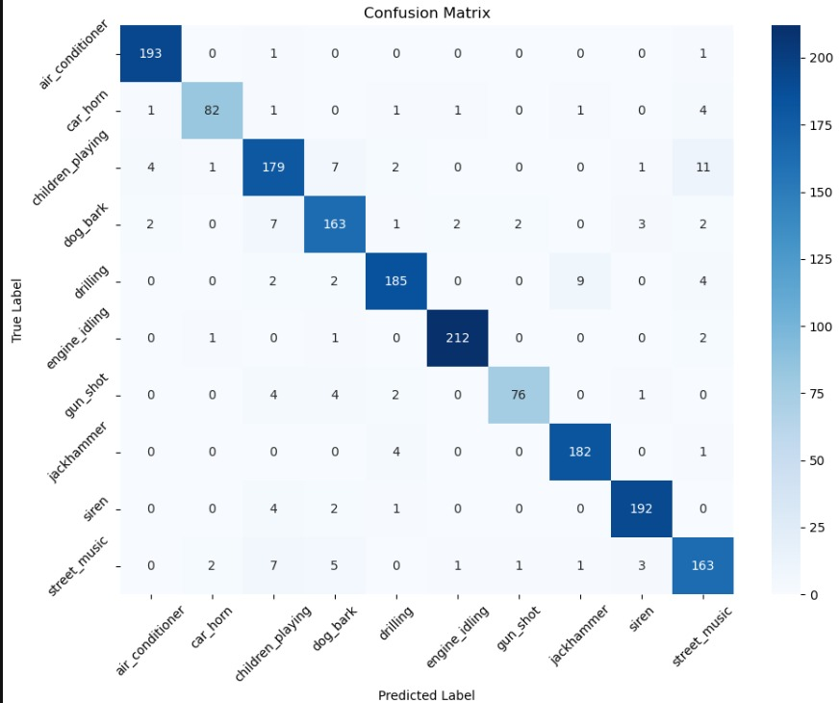
Results :
Achieved an overall accuracy of 93.13% on test data.
High per-class performance, with top F1 Scores for :
engine_idling (98.15%)
air_conditioner(97.72%)
Siren(96.24%)
The confusion matrix shows how well the model predicted each sound class.
Diagonal values (e.g., engine_idling:212 , air_conditioner: 193) show correct predictions.
Off-diagonal values indicate misclassifications, where sounds were confused with others.
The model performed very well in detecting :
Engine_idling(212 correct)
Air_conditioner(193 correct)
Siren(192 correct)
Some confusion observed in :
Dog_bark and drilling being slightly confused
Children_playing being misclassified as street_music

Slide 10
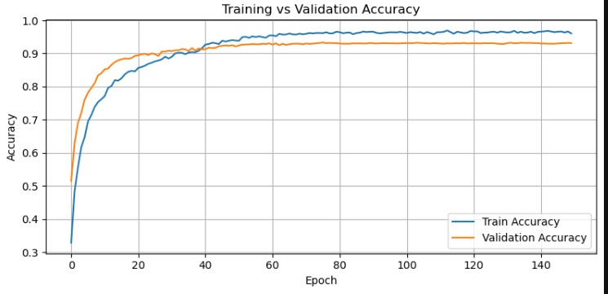
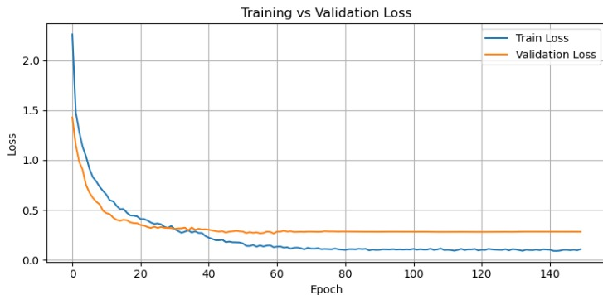
Both training and validation accuracy increased steadily, showing that the model is learning well.
The validation accuracy closely follows the training accuracy, indicating:
No major overfitting.
Model generalizes well to new data.
After around 50 epochs, the accuracy stabilizes, reaching over 93%.
The graph shows how the loss decreases over time (epochs) for both training and validation datasets.
Training Loss steadily decreases, showing that the model is learning well from the training data.
Validation Loss also decreases initially, but flattens out after ~40 epochs, indicating stable performance on unseen data.
The gap between the two lines is small, meaning there is no overfitting.
Lower loss means the model is making fewer prediction errors.

Slide 11
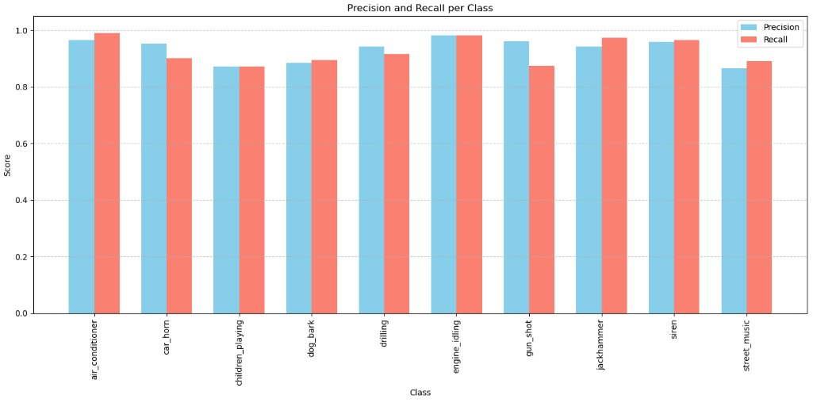
High Performing Classes:
Air_conditioner and engine_idling have both precision and recall close to 1.0, indicating near-perfect classification.
Siren, drilling, and jackhammer also perform very well with high scores.
Moderate Performing Classes:
Children_playing, dog_bark, and street_music have slightly lower precision and recall values (~0.87–0.91), suggesting room for improvement.
3.Lowest Recall:
Gun_shot has noticeably lower recall (~0.87) than precision (~0.96), meaning some actual gunshot instances were missed by the model
4.Balanced vs Imbalanced:
Most classes show balanced precision and recall (bars are close in height), but gun_shot shows a visible gap — a potential area for model tuning.

Slide 12
Limitations :
Limited Dataset Size:UrbanSound8K has only 8732 labeled samples, which may not be sufficient to generalize to real-world noisy environments.
Model Architecture Simplicity: A Conv1D CNN, while efficient, may not capture complex temporal patterns as effectively as models like LSTM, GRU, or Transformer-based networks.
Class imbalance and Misclassification : certain class like gun_shot have lower recall due to fewer samples, leading to biased learning and reduced performance for underrepresented sounds

Slide 13
Future Work :
Explore Advanced Architectures: Implement models like LSTM, GRU, or Transformer-based networks to better capture temporal
dependencies in audio signals.
Real-World and Cross-Dataset Testing: Evaluate the model on other datasets (e.g., ESC-50, AudioSet) and real-world recordings to
improve generalizability and robustness.
Deploy Real-Time System: Integrate the model into an edge device or web interface for live sound detection and classification,
enabling practical IoT applications.

Slide 14
Thank you

